Slide 1


Hazard Questions and Mark Schemes
June 2019 Paper

Slide 2
Hazards – structure of the exam
1 x 4 marks | AO1
1 x 6 marks | AO3
1 x 6 marks | AO1 2 marks AO2 4 marks
2 x 9 marks | AO1 4 marks AO2 5 marks
1 x 20 marks | AO1 10 marks AO2 10 marks

Slide 3
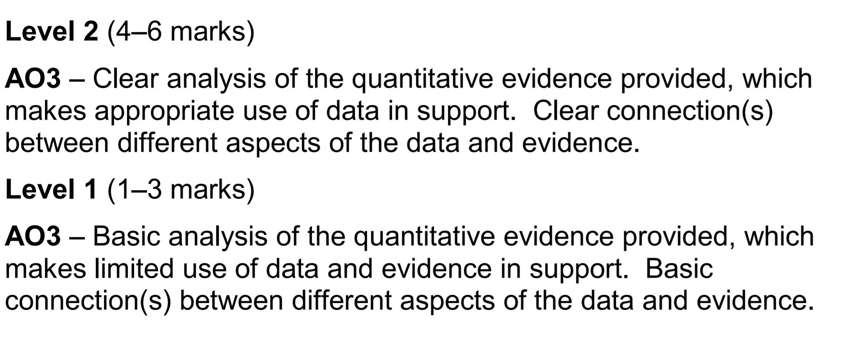
6 Mark Analyse Question (AO3) – Generic mark scheme

Slide 4
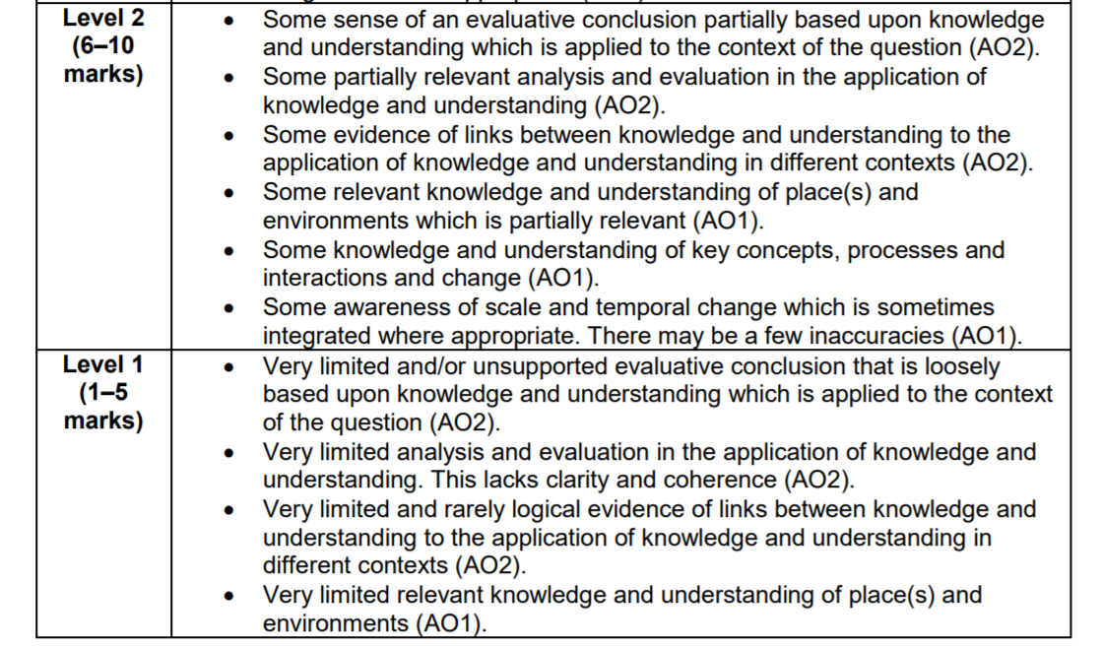
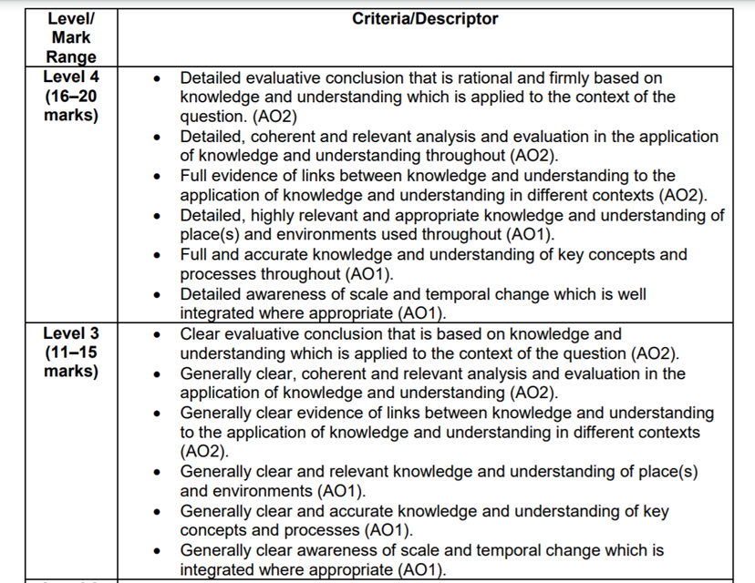
20 mark essay – Generic mark scheme

Slide 5
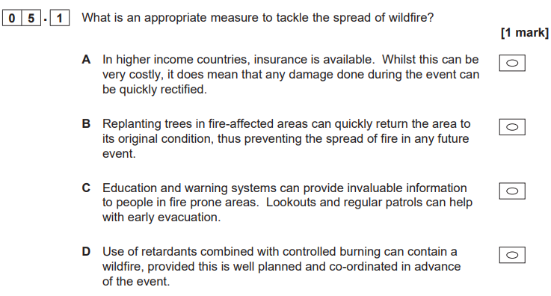
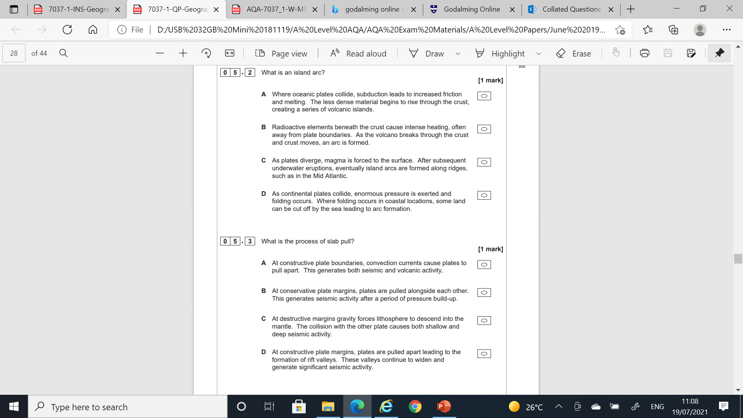

Slide 6
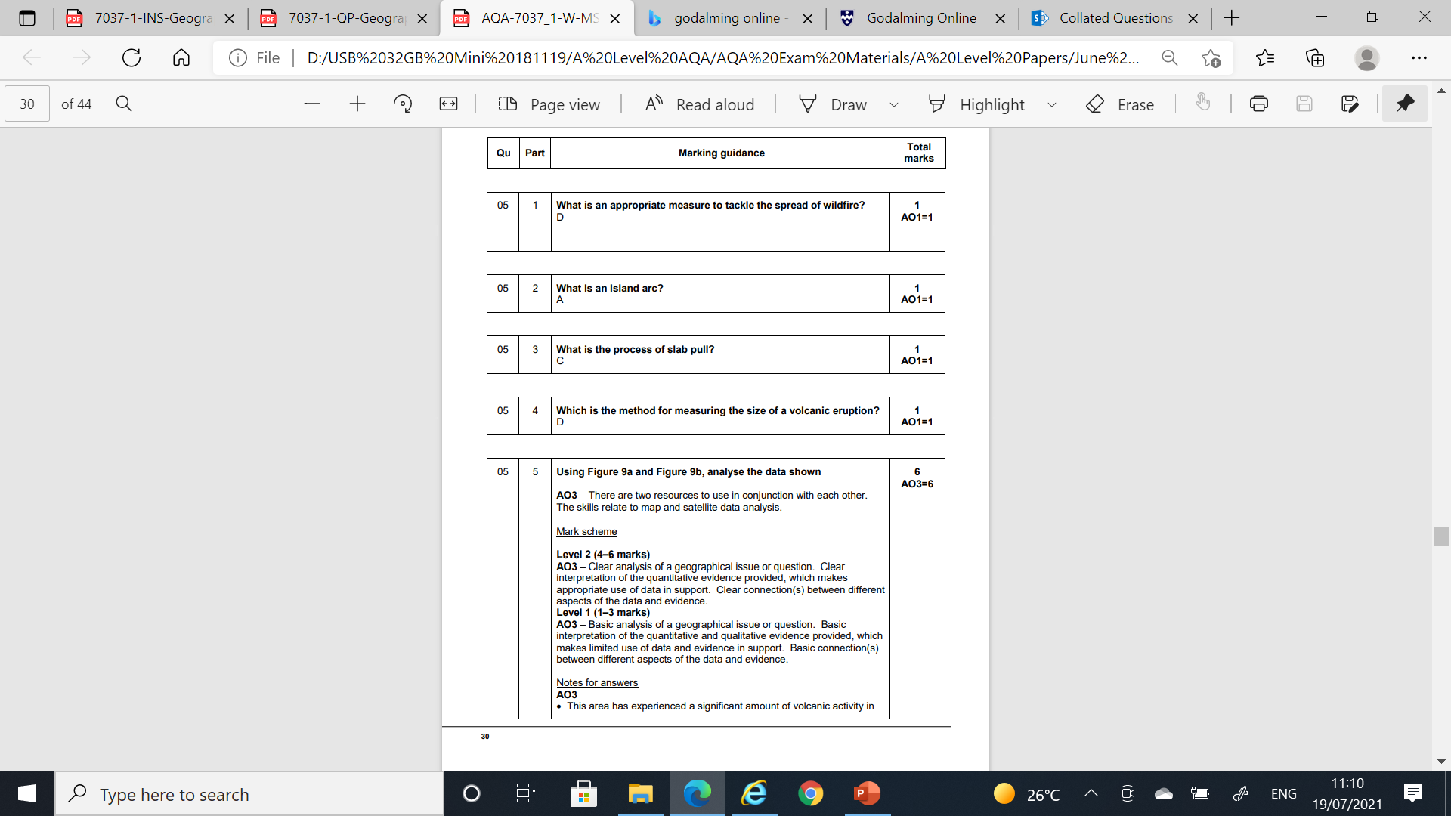

Slide 7


Slide 9
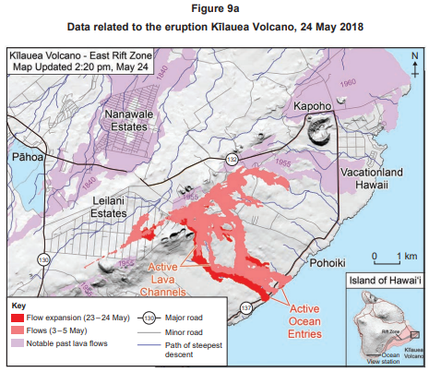
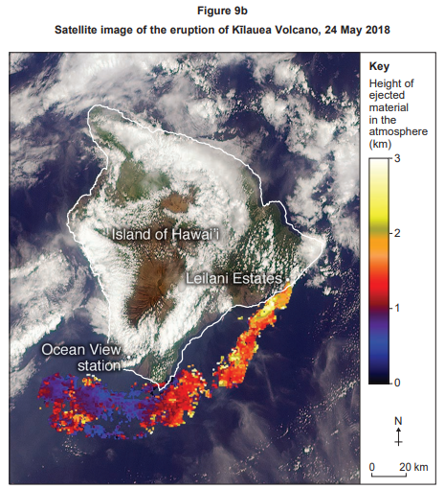

Slide 10
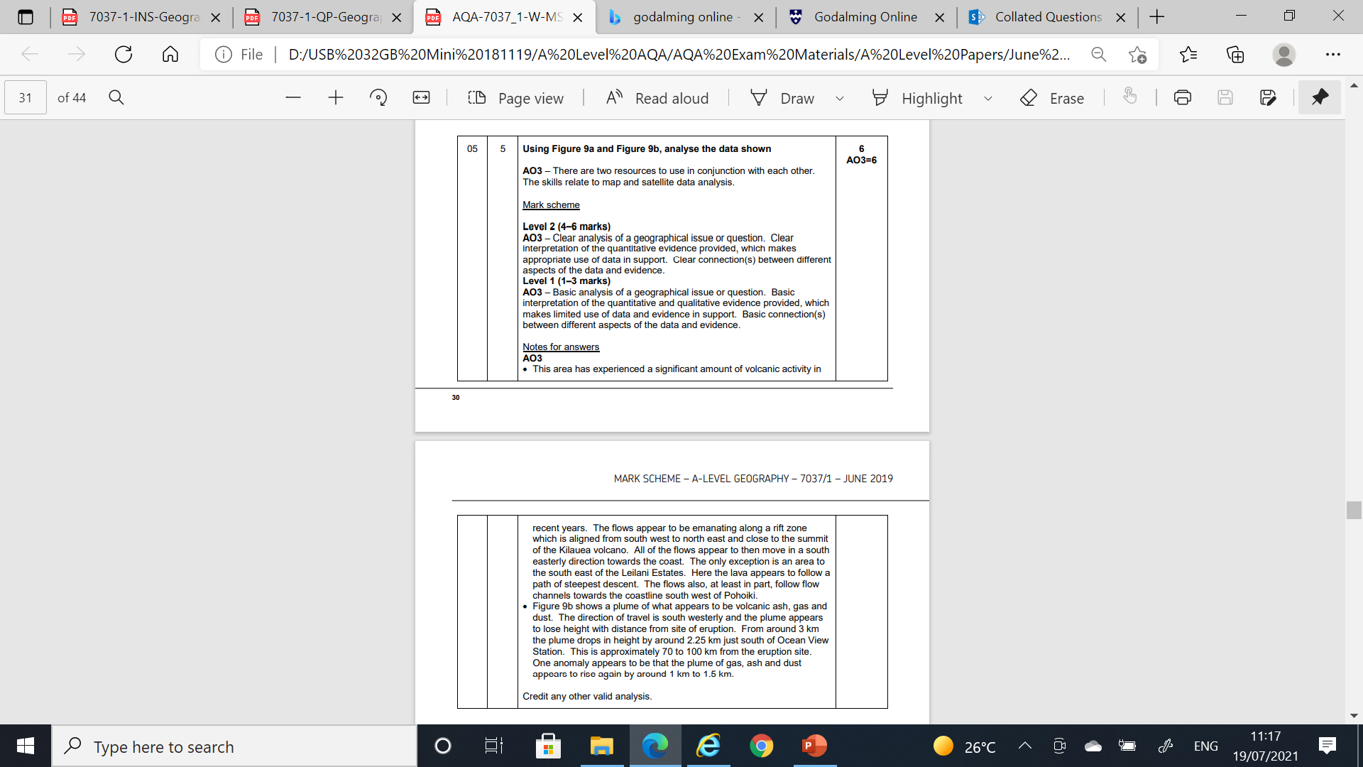

Slide 11
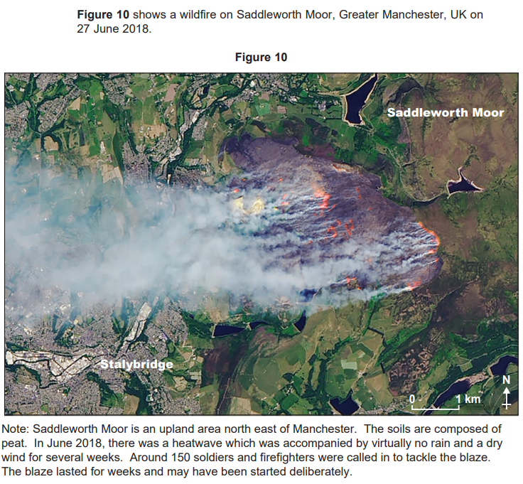
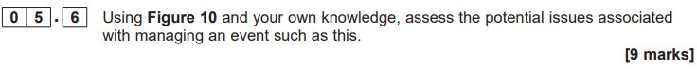

Slide 12
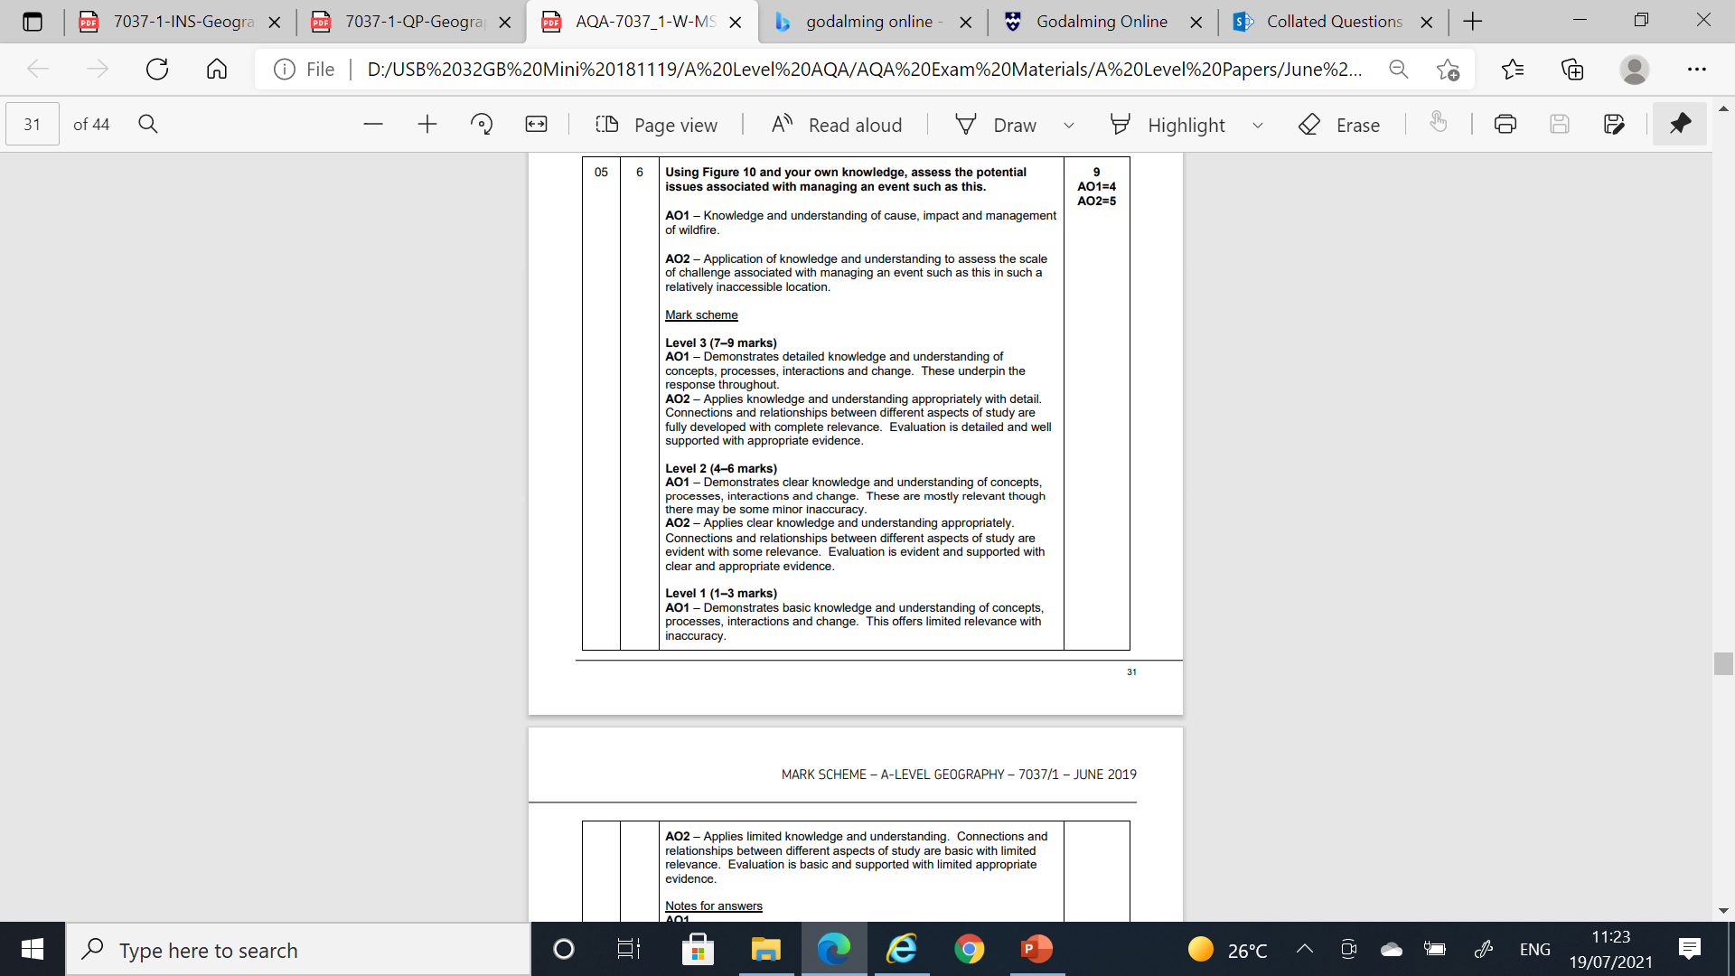
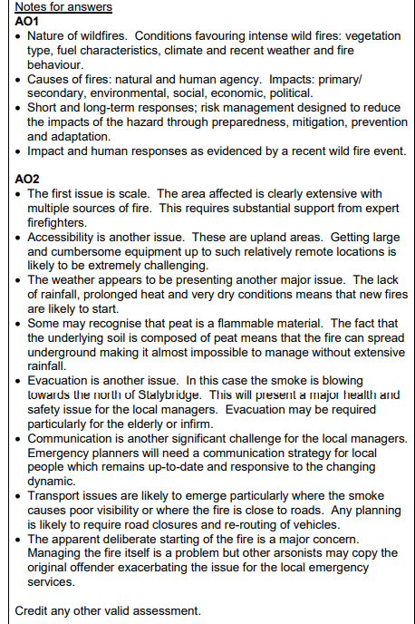

Slide 13
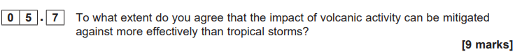

Slide 14
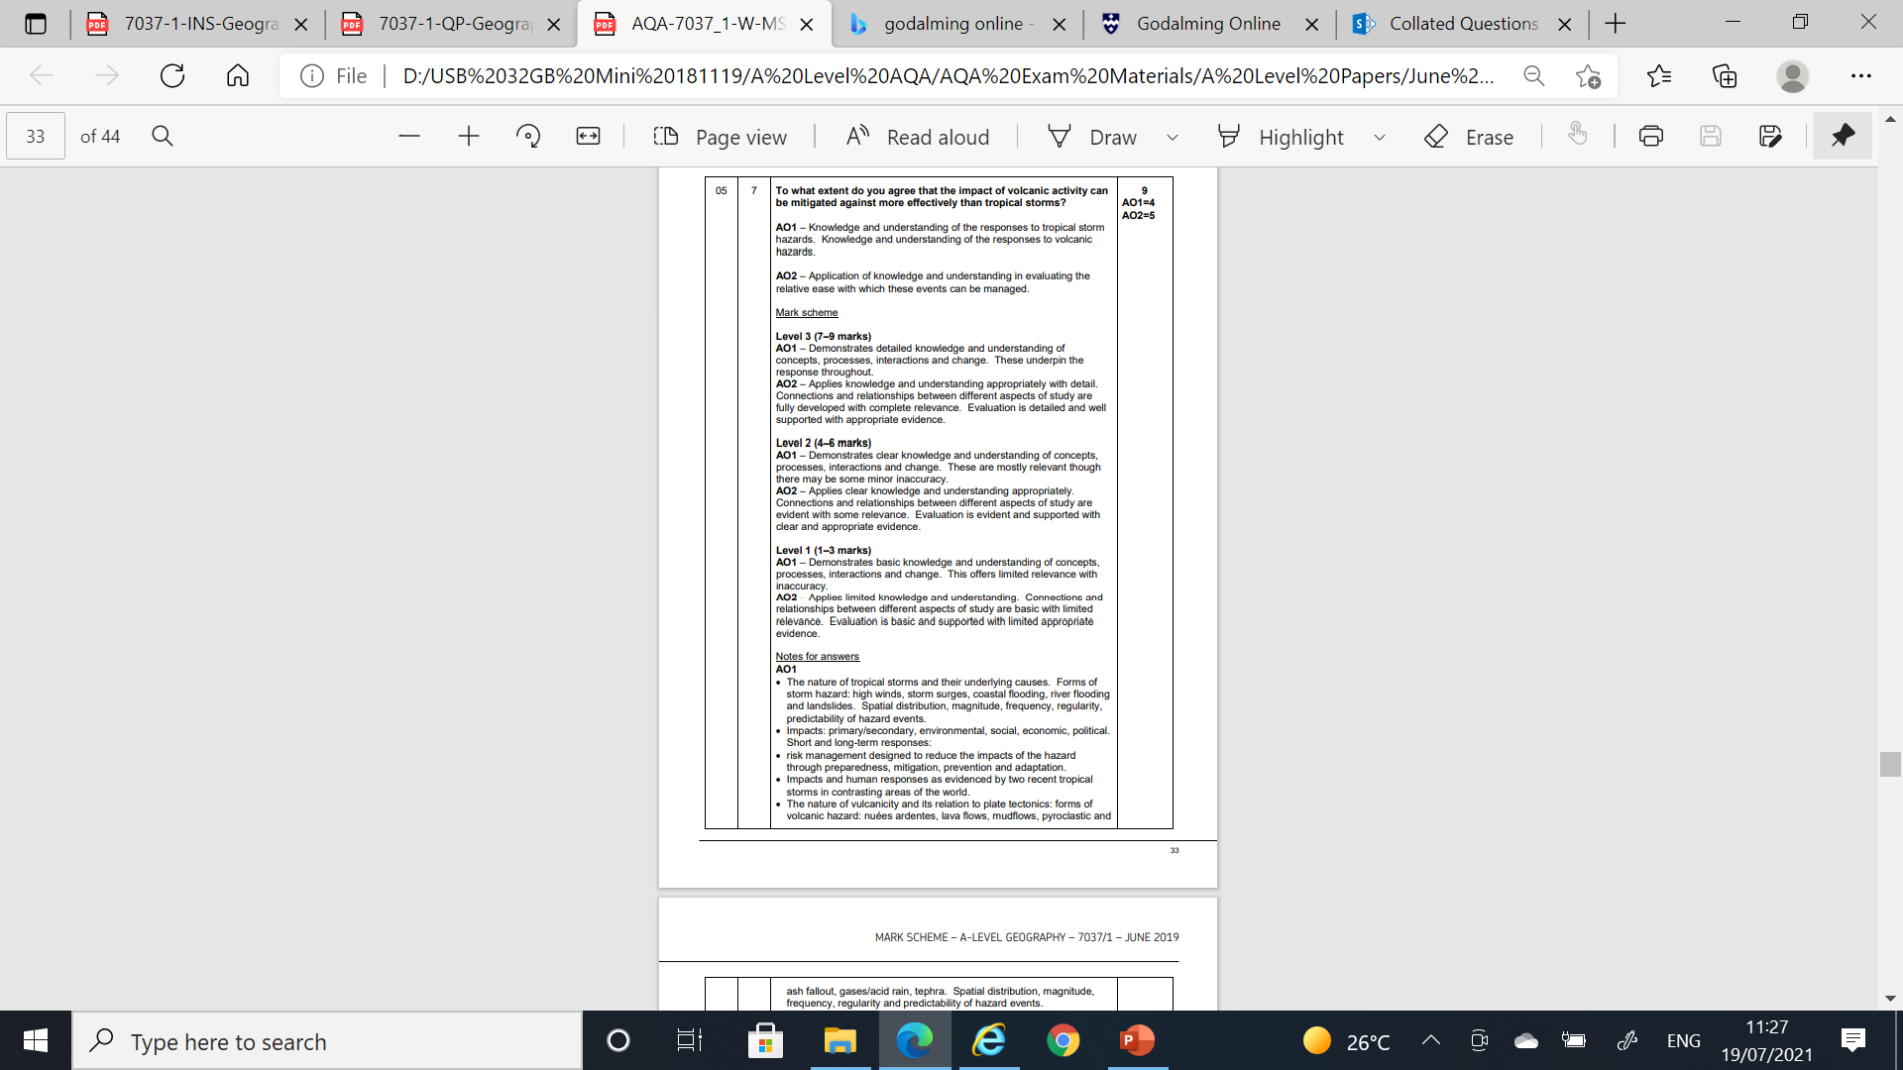
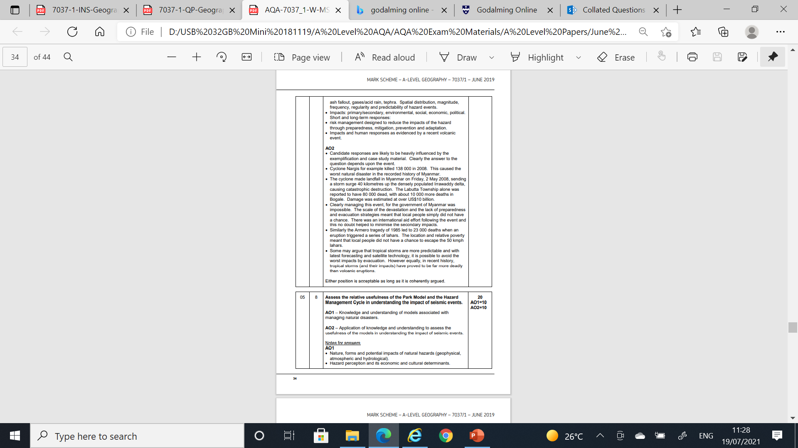

Slide 15


Slide 16
