Slide 1
Hazard Questions and Mark Schemes
June 2022 Paper

Slide 2
Hazards – structure of the exam
1 x 4 marks | AO1
1 x 6 marks | AO3
1 x 6 marks | AO1 2 marks AO2 4 marks
2 x 9 marks | AO1 4 marks AO2 5 marks
1 x 20 marks | AO1 10 marks AO2 10 marks

Slide 3
6 Mark Analyse Question (AO3) – Generic mark scheme

Slide 4
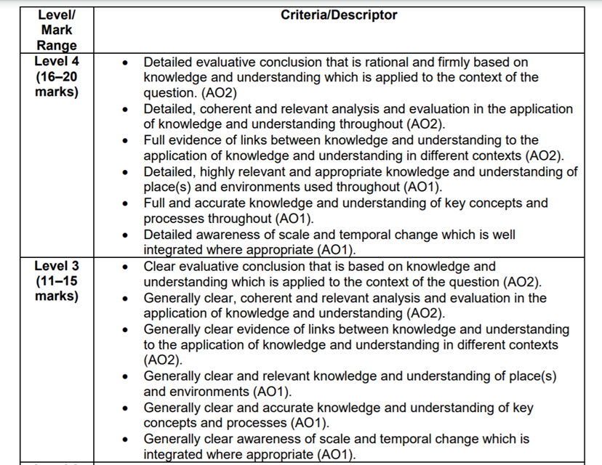
20 mark essay – Generic mark scheme

Slide 9
Figures 10a, 10b and 10c show data related to coastal flooding risk in Louisiana, USA, based upon a 2017 master plan. The information is based upon a 1 in 100 year extreme flood event.
Using Figures 10a, 10b and 10c and your own knowledge assess the challenges in managing flood risk associated with tropical storms in Louisiana. (9 marks)

