Slide 1
Hazard Questions and Mark Schemes
AS June 2022 Paper

Slide 2
6 Mark Analyse Question (AO3) – Generic mark scheme

Slide 3
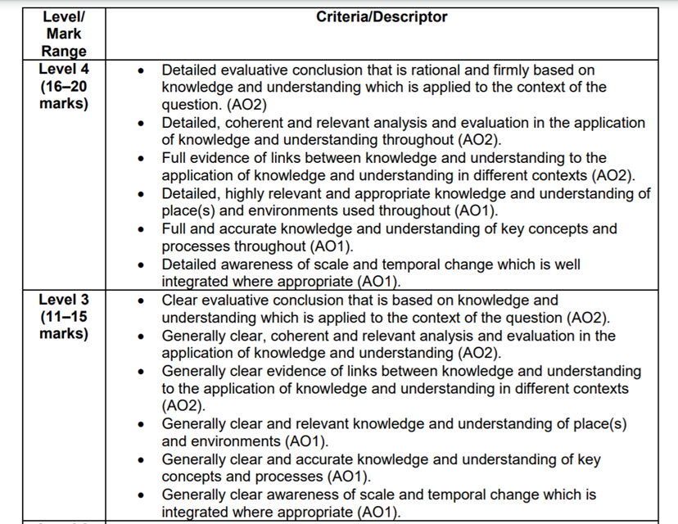
20 mark essay – Generic mark scheme

