Slide 1

Water and Carbon exam question practice
May 22 paper

Slide 2
Water and carbon – structure of the exam
1 x 4 marks | AO1
2 x 6 marks | AO3 AO1 2 marks AO2 4 marks
1 x 20 marks | AO1 10 marks AO2 10 marks

Slide 3
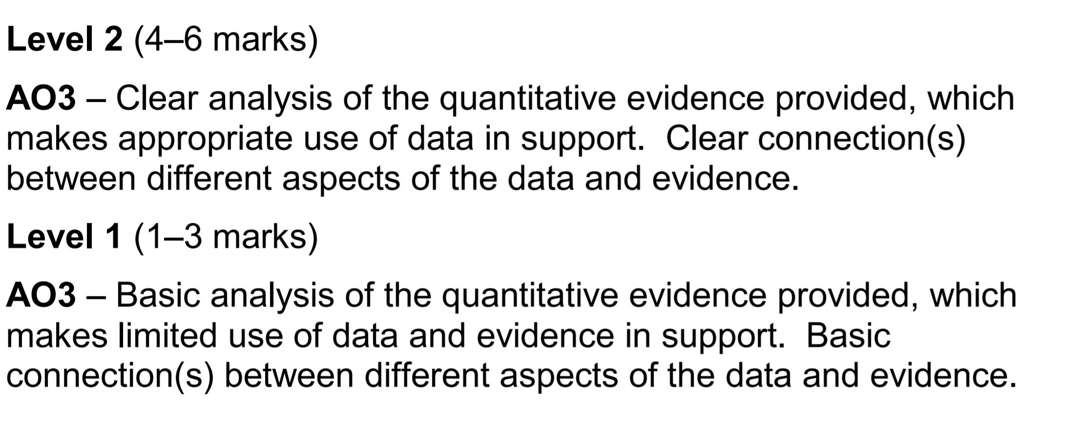
Analyse Question – Generic mark scheme

Slide 4
6 mark assess – generic mark scheme

Slide 5
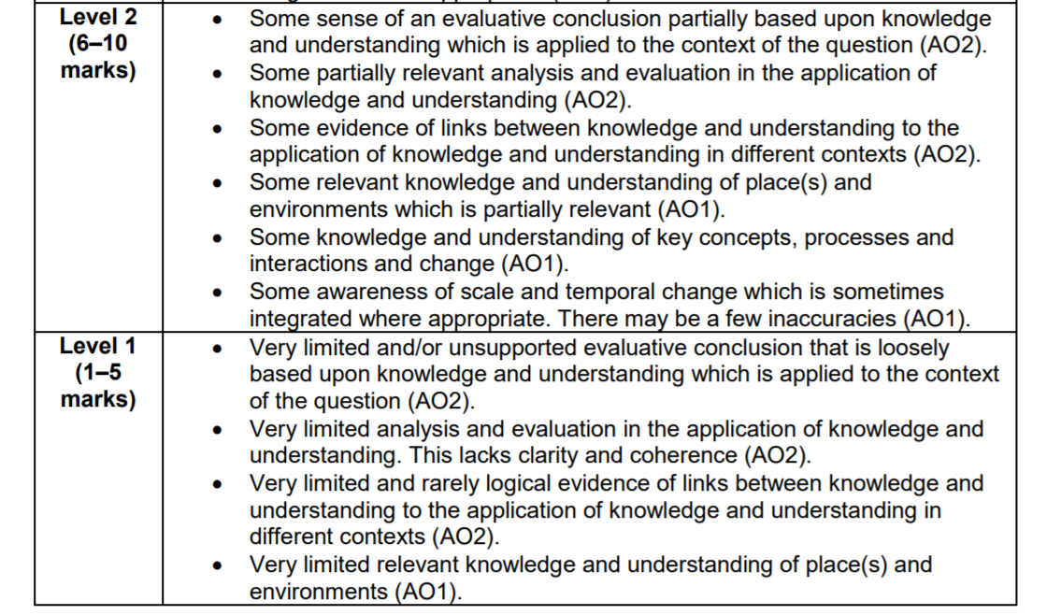
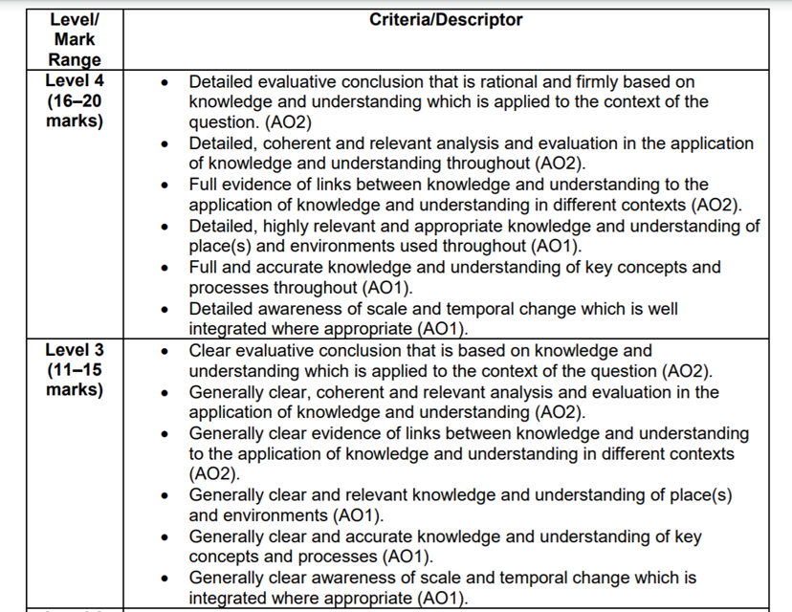
20 mark essay – Generic mark scheme

Slide 6
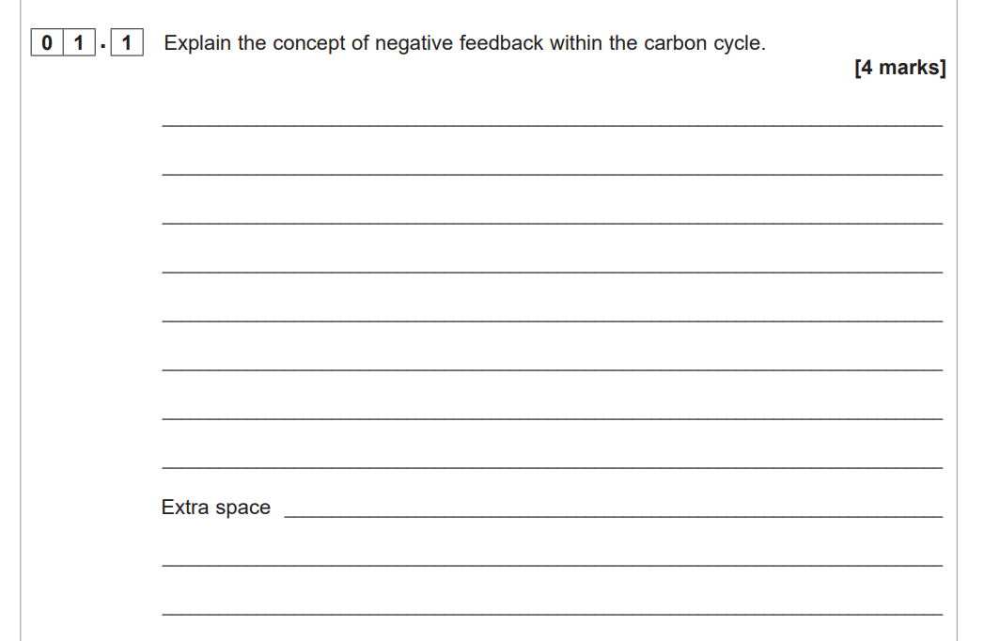

Slide 7
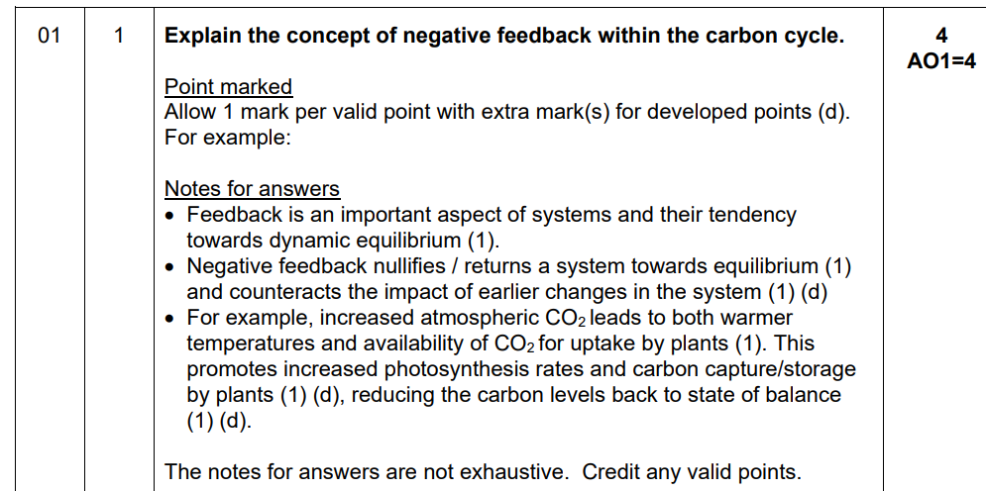
This question was very accessible, scoring an average mark of 2.19. Most understand the concept
of negative feedback with a clear definition. The typical approach was then to offer an example.
Most went with the idea of increased carbon promoting vegetation growth and returning carbon to
the biosphere. Other considered the role of phytoplankton in restoring the dynamic equilibrium of
the carbon cycle. This was also valid.

Slide 8
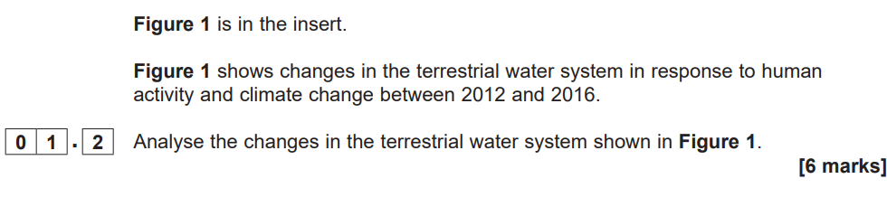
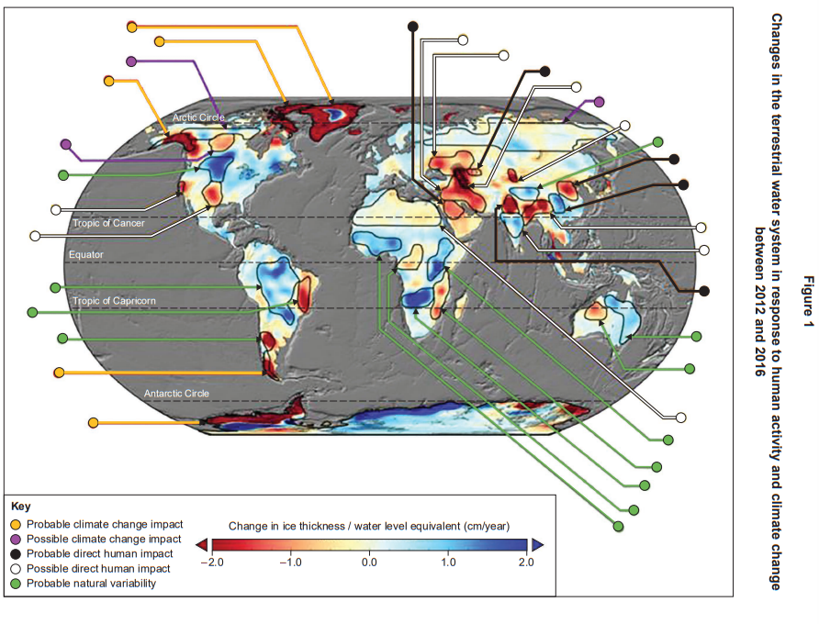

Slide 9
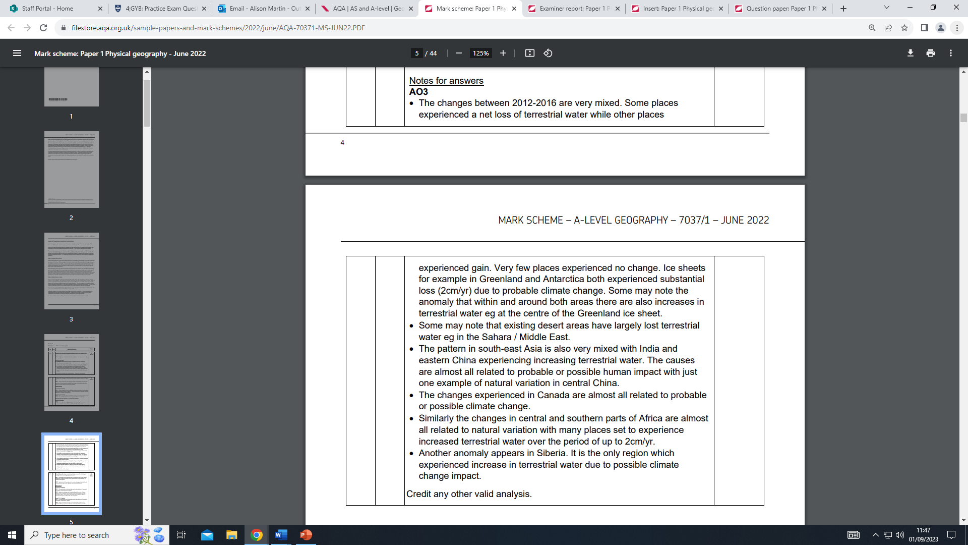
This question differentiated well. Weaker responses magnified small details on the map and wrote
at length without trying to identifying patterns, trends or anomalies. Stronger responses tried to
manipulate data, look for patterns in varying ice thickness / water equivalent and link to cause
where possible. Others noted that it was hard to identify patterns and to some extent that was true,
making this a valid comment.

Slide 10
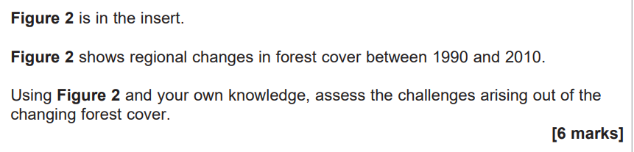
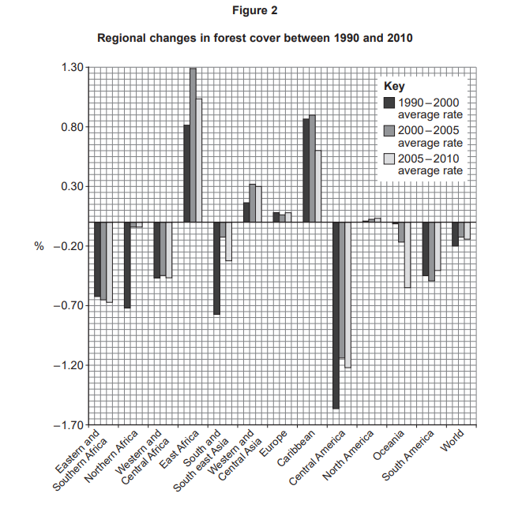

Slide 11
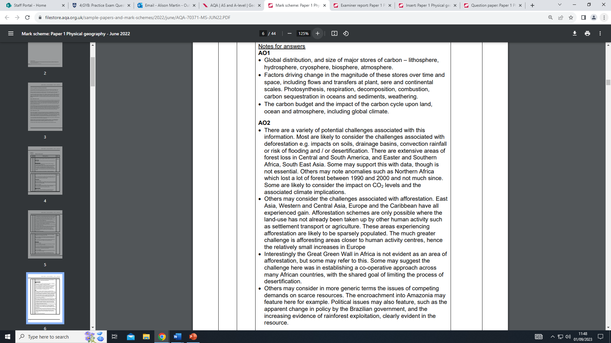
The average mark was 3 for this question. The main issue holding back weaker responses was
that many thought it was a AO3 skills question, rather than an application of knowledge AO1/AO2
question. For those responses, the challenges simply did not feature. Those responses that related
the reduction of forest cover to a whole plethora of challenges around habitat loss, species
diversity issues, soil related issues and climate challenges, readily scored marks and accessed
Level 2.

Slide 12
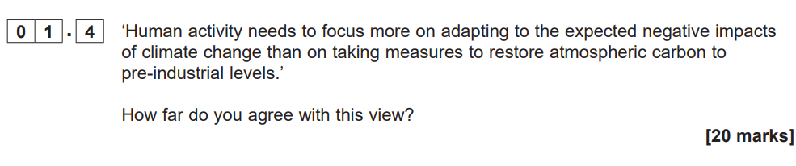

Slide 13
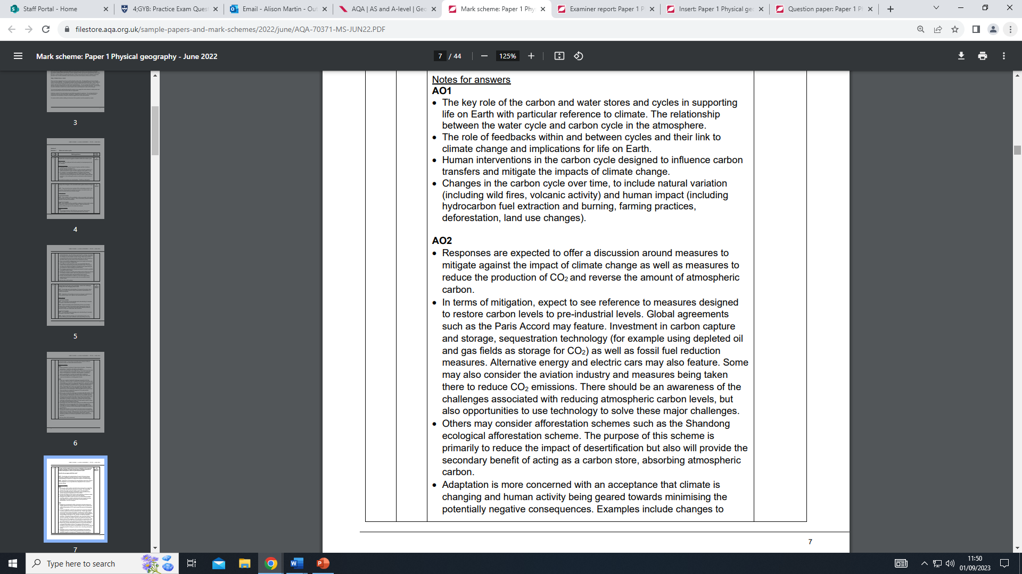
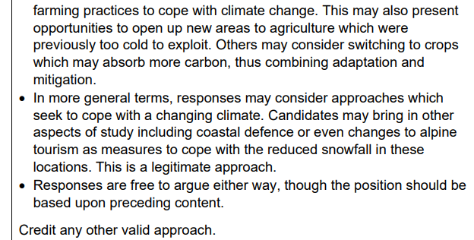
Most understood that this was essentially a question about mitigation versus adaptation in relation
to increased atmospheric carbon. Those arguing for mitigation considered a whole range of
strategies ranging from electric cars, carbon capture and storage as well as global agreements.
Adaptation was probably less well covered. Students mainly considered agricultural changes,
coastal management and changes in settlements to cope with warmer temperature and less
predictable weather patterns.

