Slide 1
Acceleration Time Graphs
3.4.1 Mechanics

Slide 2
Aims
Investigate acceleration-time graphs

Slide 3
Recap
What is a rate of change?
Something which is timed whilst changing
What is negative velocity?
Velocity in the opposite direction or deceleration

Slide 4
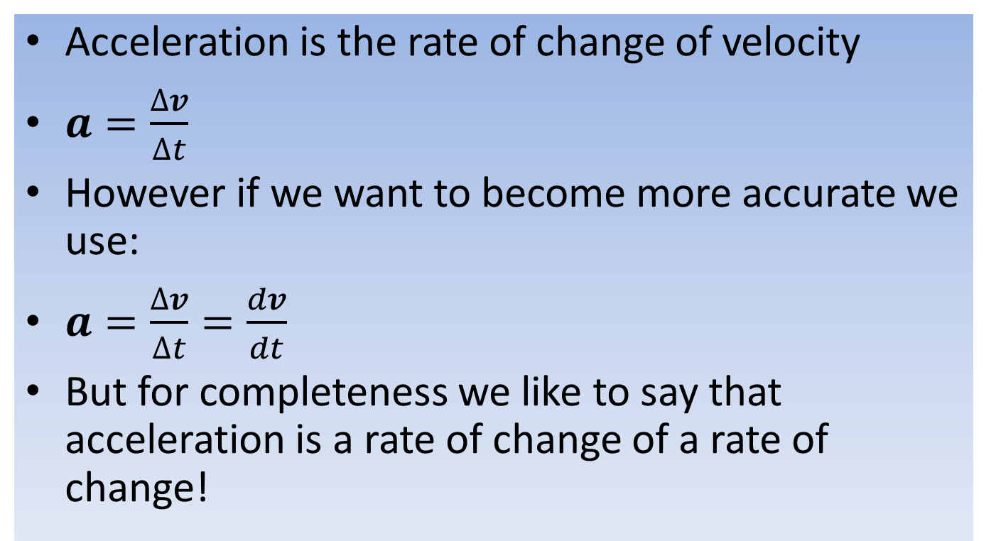
Acceleration
Acceleration is the rate of change of velocity
$a=\frac{∆v}{∆t}$
However if we want to become more accurate we use:
$a=\frac{∆v}{∆t}=\frac{dv}{dt}$
But for completeness we like to say that acceleration is a rate of change of a rate of change!

Slide 5
Acceleration
A simple acceleration of g (acceleration due to gravity) is 9.81 ms⁻²
This means as each second passes whilst in free-fall, your speed will increase by 9.81 metres each second
1s = 9.81 m, 2s = 19.62 m and 3s = 29.43 m and so on

Slide 6
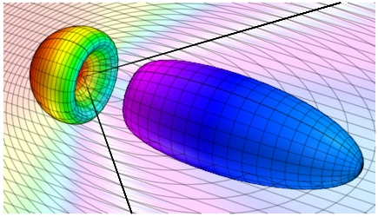
Faster than light?!?!
We all know that nothing travels faster than the speed of light
But Gerald Feinberg working on from O Bilaniuk, V. Deshpande, and E. Sudarshanin 1962, proposed a particle which is believed to travel faster than light – the Tachyon

Slide 7
Faster than light?!?!
Although nothing but energy cannot exceed the cosmic speed limit, acceleration has no problem
Remember that acceleration is the rate of change of velocity
So that your rate of change can be larger in value than 3 x10⁸

Slide 8
Acceleration-Time Graphs
The acceleration-time graph of any object traveling with a constant velocity is the same.
This is true regardless of the velocity of the object.
An aeroplane flying at a constant 600 mph (270 ms⁻¹), a sloth walking with a constant speed 1 mph (0.4 ms⁻¹), and a couch potato lying motionless in front of the TV for hours will all have the same acceleration-time graphs — a horizontal line collinear with the horizontal axis.

Slide 9
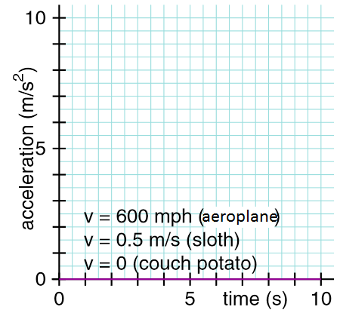
Acceleration-Time Graphs

Slide 10
Acceleration-Time Graphs
From the previous graph we see that:
The velocity of each of these objects is constant.
They're not accelerating.
Their accelerations are zero.

Slide 11
Acceleration-Time Graphs
As with velocity-time graphs, the important thing to remember is that the height above the horizontal axis doesn't correspond to position (or velocity), it corresponds to acceleration.

Slide 12
Acceleration and Velocity
If you trip and fall, your acceleration towards the ground is greater than you'd experience in all but a few high performance cars with the "pedal to the metal".
Going fast does not imply accelerating quickly.
A large acceleration corresponds to a rapid change in velocity, but it tells you nothing about the values of the velocity itself.

Slide 13
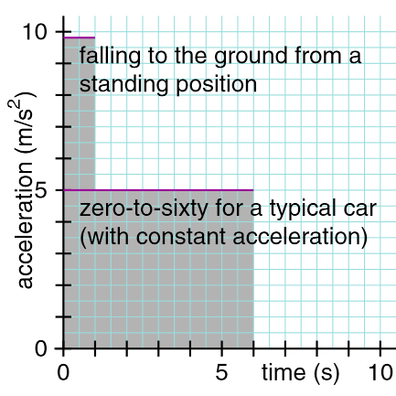
Acceleration and Velocity

Slide 14
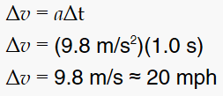
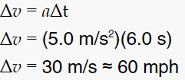
Example
Given an initial velocity of zero (and assuming that down is positive), the final velocity of the person falling in the graph previously is….
And the final velocity of the accelerating car is…

Slide 15
Area under the graph
So basically we should have noted that those calculations show the area under a ‘curve’ for acceleration is change of velocity

Slide 16
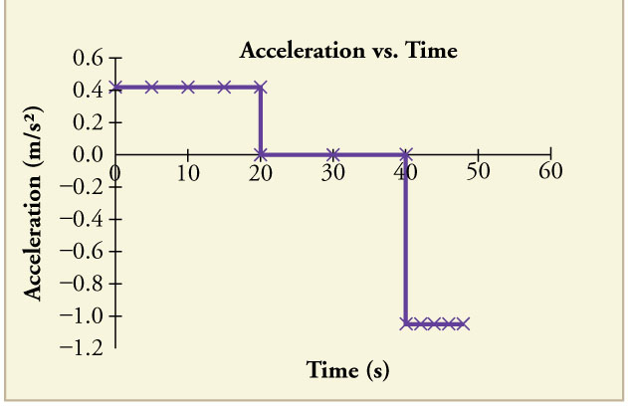
Acceleration Example

Slide 17
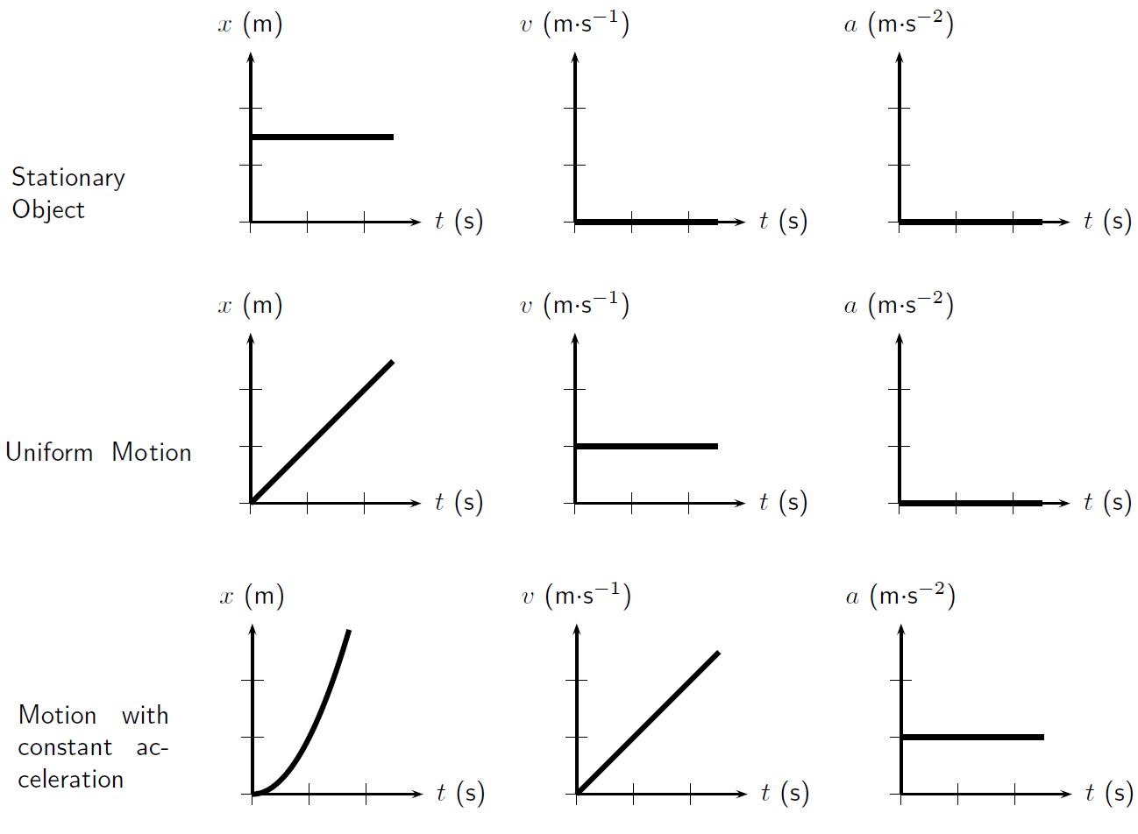
Differences

Slide 18
Question
We have rate of change of displacement gives velocity….
We have rate of change of velocity gives acceleration….
What does the rate of change of acceleration give?

Slide 19
Answer
Jerk, jolt or surge physics
The gradient is a rate of change
If we are looking into the rate of acceleration changing, it results in the physical description of jerky motion

Slide 20
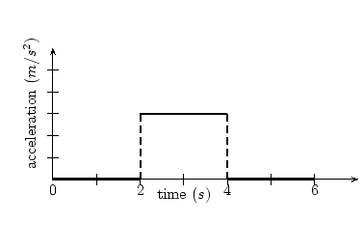
Question
Explain the motion in the graph
Find the change in velocity
Stationary or moving with constant velocity from 0 to 2 s then accelerates up to 3 ms⁻² between 2 and 4 s then constant velocity from 4 to 6 s
Area under the ‘curve’ – 2 x 3 = 6 ms⁻¹ change in velocity between 2 and 4 s

