Slide 1
Applying Newton’s Law

Slide 2
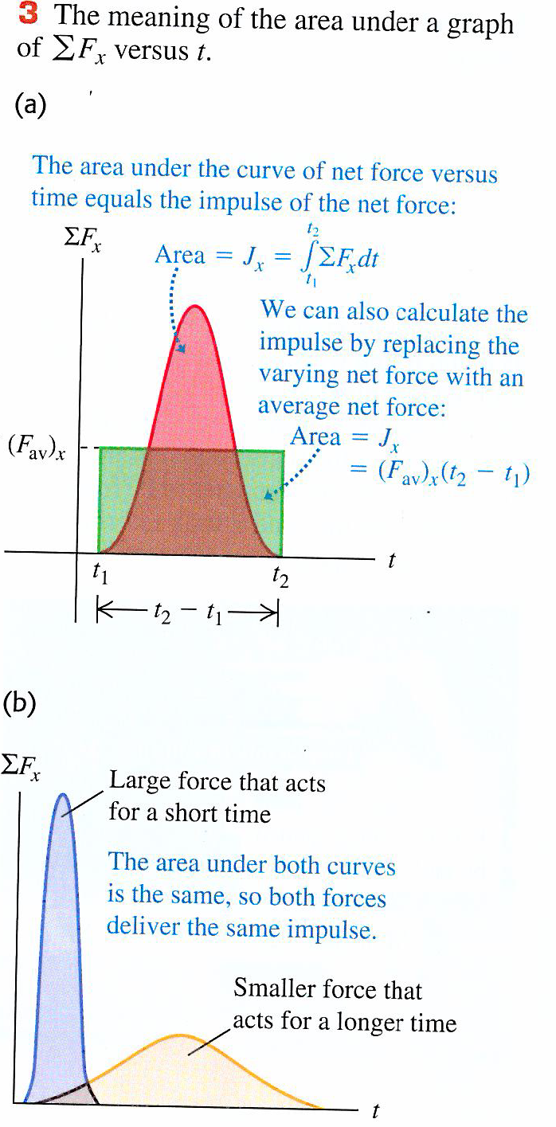
Impulse

Slide 3
Question
A gymnast with mass m=50 kg suspends herself from the lower end of a hanging rope of negligible mass. (a) What is the gymnast’s weight? (b) What force (magnitude and direction) does the rope exert on her? (c) What is the tension at the top of the rope?

Slide 4
Question
Find the tension at each end of the rope in the previous question if the weight of the rope is 120 N

Slide 5
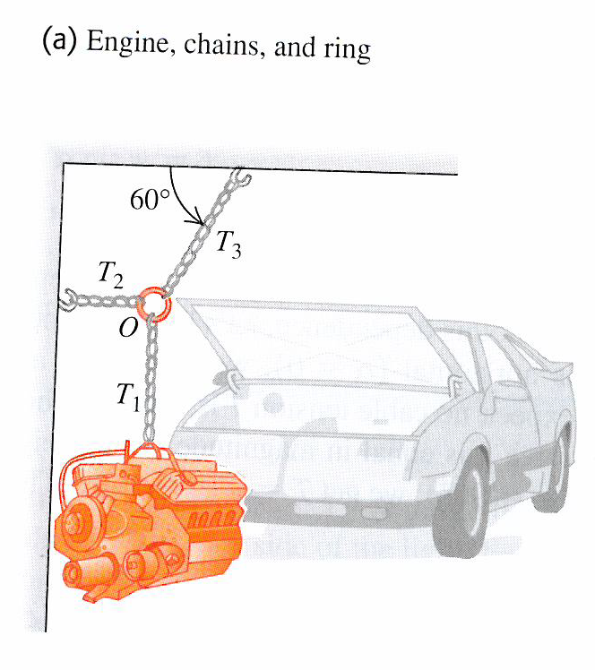
Question
A car engine with weight w hangs from a chain that is linked at ring O to two other chains, one fastened to the ceiling and the other to the wall. Find expressions for the tension in each of the three chains in terms of w. The weights of the ring and chains are negligible.

Slide 6
Question
A car of weight w rests on a slanted ramp attached to a trailer. Only a cable running from the trailer prevents the car from rolling off the ramp. Find the tension in the cable and the force that the ramp exerts on the car’s tyres.

Slide 7
2nd Law Questions

Slide 8
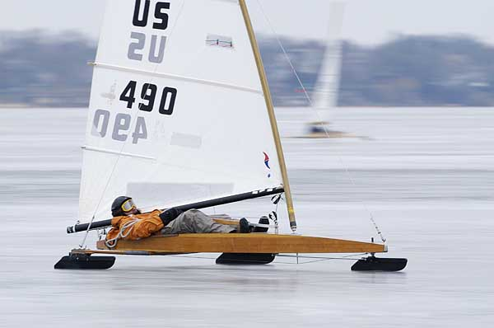
Question
An iceboat is at rest on a frictionless horizontal surface. A wind is blowing along the direction of the runners so that 4.0 s after the iceboat is released, it is moving at 6.0 m/s. What constant horizontal force does the wind exert on the iceboat (iceboat and rider mass is 200 kg)

Slide 9
Question
Suppose a constant horizontal friction force with magnitude 100N opposes the motion of the iceboat (previous question). In this case, what constant force must the wind exert on the iceboat to cause the same constant acceleration of 1.5 ms⁻²?

Slide 10
Question
A shopping centre lift and its load have a combined mass of 800 kg. The lift is initially moving downwards at 10 m/s; it slows to a stop with a constant acceleration in a distance of 25 m. What is the tension in the supporting cable while the lift is being brought to rest?

