Slide 1
Linear Motion Equations
3.4.1. Mechanics

Slide 2
Aims
Deriving and understanding the ‘SUVAT’ equations
Using SUVAT for g

Slide 3
Linear motion equations
These equations only work for constant acceleration
They are easy to learn ‘off-by-heart’ but at this level, that is not enough to truly understand them

Slide 4
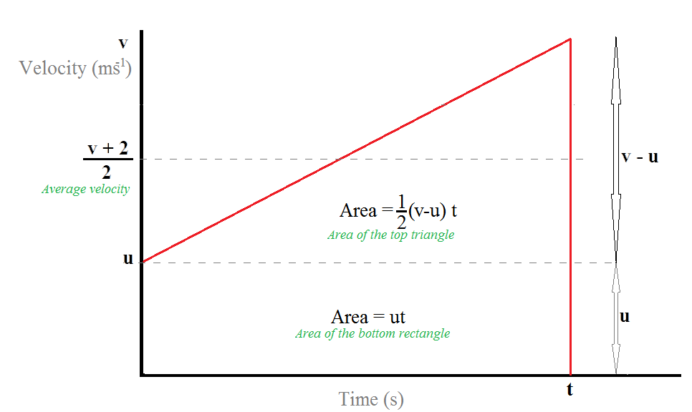

SUVAT Derivations

Slide 5


SUVAT Derivations
1st Equation
$$acceleration= \frac{change in velocity}{time}$$
$$a=\frac{v−u}{t}$$
$$∴v=u+at$$
2nd Equation
$$displacement=ave. velocity×time$$
$$∴s=\frac{\left(u+v\right)}{2}t$$

Slide 6

SUVAT Derivations
3rd Equation
This displacement equation requires us to add the area underneath the line
$$displacement=rectangle area+triangle area$$
$$s=ut+\frac{1}{2}\left(v−u\right)t$$
We know from rearranging 1st equation we get:
$$a=\frac{(v−u)}{t}$$
$$\left(v−u\right)=at$$
Plug this into our equation to tidy things up:
$$s=ut+\frac{1}{2}at^{2}$$

Slide 7

SUVAT Derivations
4th Equation
This equation uses the 1st equation in order to find the missing displacement we derived in the 3rd equation
$$v=u+at$$
$$v^{2}=(u+at)^{2}$$
Expanding the bracket gives:
$$v^{2}=u^{2}+2uat+a^{2}t^{2}$$
Removing 2a from the two last terms:
$$v^{2}=u^{2}+2a(ut+\frac{1}{2}at^{2})$$
$${∴v}^{2}=u^{2}+2as$$

Slide 8

Finally the equations for linear motion at constant acceleration
$v=u+at$
$s=\frac{\left(u+v\right)}{2}t$
$s=ut+\frac{1}{2}at^{2}$
$v^{2}=u^{2}+2as$

Slide 9

Question
You drop a stone off the edge of a high cliff, how far does it fall after 2 seconds?
Using $s=ut+\frac{1}{2}at^{2}$
$s=0×2+\frac{1}{2}×9.81×2^{2}$
s = 19.6 m

Slide 10

Question
What is the displacement after 2 seconds if you throw the stone:
A) with a downward velocity of 5.0 ms⁻¹
B) with an upward velocity of 5.0 ms⁻¹
What do the results show us?
Using $s=ut+\frac{1}{2}at^{2}$ and designating downwards as positive
a) $s=5.0×2+\frac{1}{2}×9.81×2^{2}=29.6 m$
b) $s=5.0×2−\frac{1}{2}×9.81×2^{2}=9.6 m$

Slide 11
Hard Question
A ball is thrown upwards with initial velocity of 15 ms⁻¹ from a height of 1 m above the ground. When does it reach a height of 7 m above the ground?

Slide 12

Hard question
A ball is thrown upwards with initial velocity of 15 ms⁻¹ from a height of 1 m above the ground. When does it reach a height of 7 m above the ground?
Using $s=ut+\frac{1}{2}at^{2}$
First we need to understand that the ball moves up towards 7 m above the ground and then back downwards. We expect two results – up and down.
Making downwards positive:
$−6=−15×t+\frac{1}{2}×9.81×t^{2}$
$0=−15×t+\frac{1}{2}×9.81×t^{2}+6$
$4.9t^{2}−15t+6=0$
Using $\frac{−b±\sqrt{b^{2}−4ac}}{2a}$
$\frac{15±\sqrt{{15}^{2}−4×4.9×6}}{2×4.9}=t_{up}=0.5 s and t_{down}=2.6 s$

Slide 13
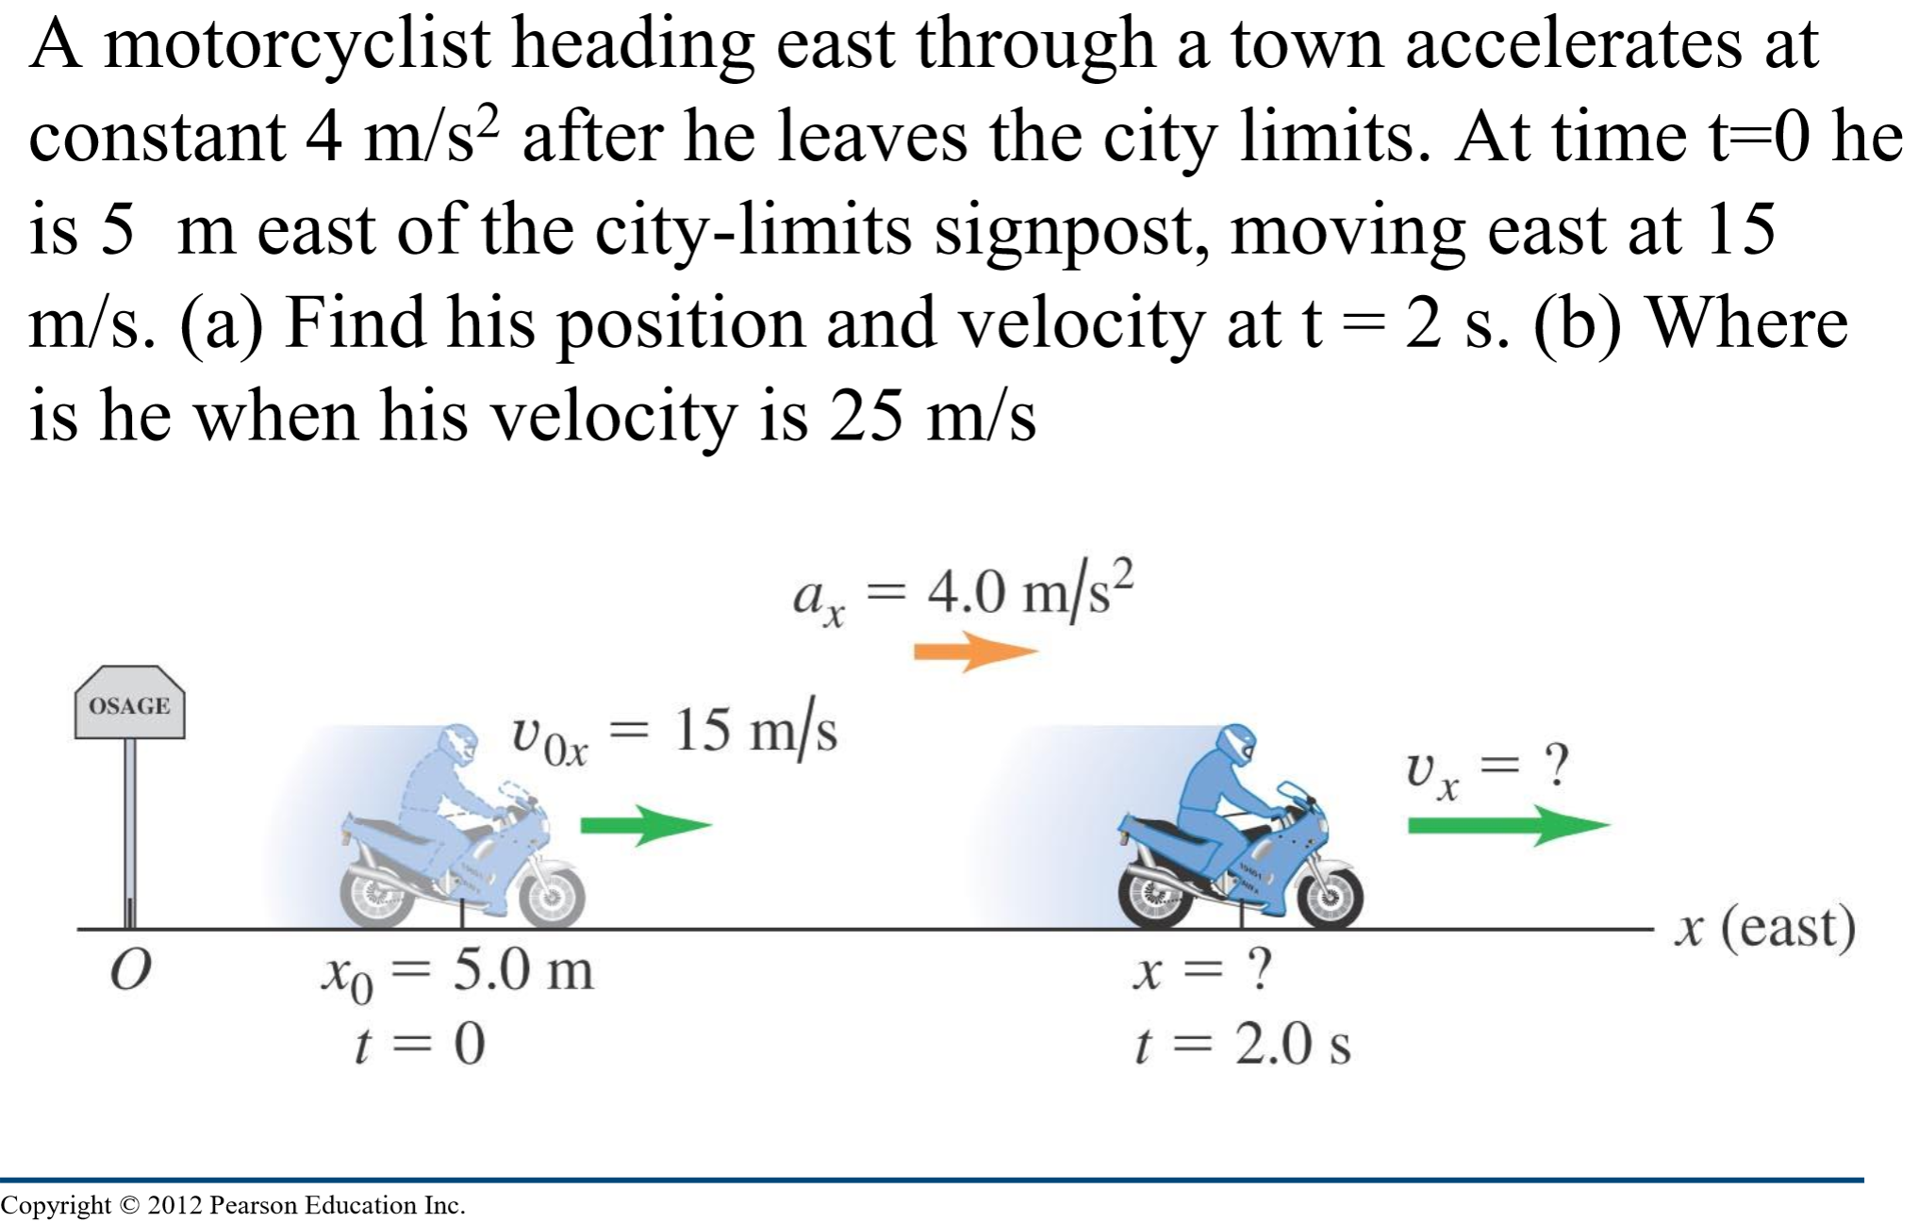


Hard Question

Slide 14

Hard Question
a) Using $s=ut+\frac{1}{2}at^{2}$ + bit past the post
$s=15×2+\frac{1}{2}×4×2^{2}+5=43 m$
$v=u+at$
$v=15+4×2=23 ms^{−1}$
b) Using $v^{2}=u^{2}+2as$
The displacement is $s=s_{2}−s_{1}$and substituting into the above equation:
$v^{2}=u^{2}+2a(s_{2}−s_{1})$
$∴s_{2}=s_{1}+\frac{v^{2}−u^{2}}{2a}=5+\frac{{25}^{2}−{15}^{2}}{2×4}=55 m$

Slide 15
Do summary questions 1 and 3
AS book page 125

Slide 16

Linear Equations and g
The acceleration due to gravity or g is common throughout the SUVAT equations
The displacement equation $s=ut+\frac{1}{2}at^{2}$ is used to find an expression for g:
$s=\frac{1}{2}gt^{2}$
$∴g= \frac{2s}{t^{2}}$

Slide 17

Galileo Revisited
1589 Galileo performed his famous experiment of showing the acceleration of gravity – The Leaning Tower of Pisa experiment (Gedanken or actual depends on who you follow!)
Two balls were dropped from the top of the tower to show that Aristotle’s theory of heavier masses fall faster was incorrect
Using $g= \frac{2s}{t^{2}}$ and the height of the tower being 55 m (timing could be found via pendulum), we find:
$g= \frac{2s}{t^{2}}=\frac{2×55}{{3.25}^{2}}=10.4ms^{−2}$

Slide 18
Galileo Proved 382 years later!
https://www.youtube.com/watch?v=KDp1tiUsZw8

