Slide 1
CW |  | 12/11/2018
From my learning today I will be able to:
Key:
Boost:
Aspire:
Objective

Slide 2
Energy (E)
Energy is needed to move objects, to change their shape or to warm them up.
Work is a measurement of the energy required to do a particular task.
work done = energy change
unit: joule (J)

Slide 3
Work (W)
Work is done when a force moves its point of application.
work = force x distance moved in the direction of the force
W = F s
unit: joule (J)
work is a scalar quantity

Slide 4
If the direction of the force and the distance moved are not in the same direction:
F
θ
object
s
W = F s cos θ
The point of application of force, F moves distance s cos θ when the object moves through the distance s.

Slide 5
Question 1
Calculate the work done when a force of 5 kN moves through a distance of 30 cm
work = force x distance
= 5 kN x 30 cm
= 5000 N x 0.30 m
work = 1500 J

Slide 6
Question 2
Calculate the work done by a child of weight 300N who climbs up a set of stairs consisting of 12 steps each of height 20cm.
work = force x distance
the child must exert an upward force equal to its weight
the distance moved upwards equals (12 x 20cm) = 2.4m
work = 300 N x 2.4 m
work = 720 J

Slide 7
Question 3
Calculate the work done by the wind on the yacht in the situation shown below:
W = F s cos θ
= 800 N x 50 m x cos 30°
= 40 000 x cos 30°
= 40 000 x 0.8660
work = 34 600 J
distance moved by yacht = 50 m
30°
wind force = 800 N

Slide 8
Complete:
Answers
Force | Distance | Angle between F and s | Work
400 N | 5 km | 0° | 2 MJ
200 μN | 300 m | 0° | 60 mJ
50 N | 6 m | 60° | 150 J
400 N | 3 m | 90° | 0 J
400 N
300 m
60°
0 J *
* Note: No work is done when the force and distance are perpendicular to each other.

Slide 9
Force-distance graphs
The area under the curve is equal to the work done.
force
F
area = work
= ½ F s
force
distance
s
F
force
area = work done
area = work
found by counting squares on the graph
F
distance
s
distance
s

Slide 10
Question
Calculate the work done by the brakes of a car if the force exerted by the brakes varies over the car’s braking distance of 100 m as shown in the graph below.
Work = area under graph
= area A + area B
= (½ x 1k x 50)
+ (1k x 100)
= (25k) + (100k)
work = 125 kJ
force / kN
2
area A
1
area B
50 100
distance / m

Slide 11
Define work and give its unit. Explain how work is calculated when force and distance are not in the same direction.
With the aid of a diagram explain how work can be found from a graph.

Slide 12
Conservation of Energy
The principle of the conservation of energy states that energy cannot be created or destroyed.
Energy can change from one form to another.
All forms of energy are scalar quantities

Slide 13
Some examples of forms of energy
Kinetic energy (KE)
Energy due to a body’s motion.
Potential energy (PE)
Energy due to a body’s position
Thermal energy
Energy due to a body’s temperature.
Chemical energy
Energy associated with chemical reactions.
Nuclear energy
Energy associated with nuclear reactions.
Electrical energy
Energy associated with electric charges.
Elastic energy
Energy stored in an object when it is stretched or compressed.
All of the above forms of energy (and others) can ultimately be considered to be variations of kinetic or potential energy.

Slide 14
Kinetic Energy (E_{K})
Kinetic energy is the energy an object has because of its motion and mass.
kinetic energy = ½ x mass x (speed)²
E_{K} = ½ m v²
Note: v = speed NOT velocity.
The direction of motion has no relevance to kinetic energy.

Slide 15
Question 1
Calculate the kinetic energy of a car of mass 800 kg moving at 6 ms⁻¹
E_{K} = ½ m v²
= ½ x 800kg x (6ms⁻¹)²
= ½ x 800 x 36
= 400 x 36
kinetic energy = 14 400 J

Slide 16
Question 2
Calculate the speed of a car of mass 1200kg if its kinetic energy is 15 000J
E_{K} = ½ m v²
15 000J = ½ x 1200kg x v²
15 000 = 600 x v²
15 000 ÷ 600 = v²
25 = v²
v = √25
speed = 5.0 ms⁻¹

Slide 17
Question 3
Calculate the braking distance a car of mass 900 kg travelling at an initial speed of 20 ms⁻¹ if its brakes exert a constant force of 3 kN.
k.e. of car = ½ m v²
= ½ x 900kg x (20ms⁻¹)²
= ½ x 900 x 400
= 450 x 400
k.e. = 180 000 J
The work done by the brakes will be equal to this kinetic energy.
W = F s
180 000 J = 3 kN x s
180 000 = 3000 x s
s = 180 000 / 3000
braking distance = 60 m

Slide 18
Complete:
Answers
Mass | Speed | Kinetic energy
400 g | 4.0 ms⁻¹ | 3.2 J
3000 kg | 10 kms⁻¹ | 60 mJ
8 kg | 300 cms⁻¹ | 36 J
50 mg | 12 ms⁻¹ | 3.6 mJ
3.2 J
1.5 x 10¹¹ J
8 kg
12 ms⁻¹

Slide 19
Gravitational Potential Energy (gpe)
Gravitational potential energy is the energy an object has because of its position in a gravitational field.
change in g.p.e.
= mass x gravitational field strength x change in height
ΔE_{P} = m g Δh

Slide 20
Question
Calculate the change in g.p.e. when a mass of 200 g is lifted upwards by 30 cm.
(g = 9.8 Nkg⁻¹)
ΔE_{P} = m g Δh
= 200 g x 9.8 Nkg⁻¹ x 30 cm
= 0.200 kg x 9.8 Nkg⁻¹ x 0.30 m
change in g.p.e. = 0.59 J

Slide 21
Complete:
Answers
mass | g | Δh | ΔE_{P}
3 kg | 10 Nkg⁻¹ | 400 cm | 120 J
200 g | 1.6 Nkg⁻¹ | 30 m | 9.6 J
7 kg | 10 Nkg⁻¹ | 4000 m | 280 kJ
2000 g | 24 Nkg⁻¹ | 3000 mm | 144 J
3 kg
1.6 Nkg⁻¹
4000 m
144 J

Slide 22
Falling objects
If there is no significant air resistance then the initial GPE of an object is transferred into kinetic energy.
ΔE_{K} = ΔE_{P}
½ m v² = m g Δh
m
gpe = mgΔh
ke = 0
Δh
gpe = ke
gpe = ½ mgΔh
v₁
ke = ½ mv₁²
½ Δh
gpe = 0
ke = ½ mv₂²
v₂
ke = mgΔh

Slide 23
Question
A child of mass 40 kg climbs up a wall of height 2.0 m and then steps off. Assuming no significant air resistance calculate the maximum:
(a) gpe of the child
(b) speed of the child
g = 9.8 Nkg⁻¹
(a) max gpe occurs when the child is on the wall
gpe = mgΔh
= 40 x 9.8 x 2.0
max gpe = 784 J
(b) max speed occurs when the child reaches the ground
½ m v² = m g Δh
½ m v² = 784 J
v² = (2 x 784) / 40
v² = 39.2
v = √39.2
max speed = 6.3 ms⁻¹

Slide 24

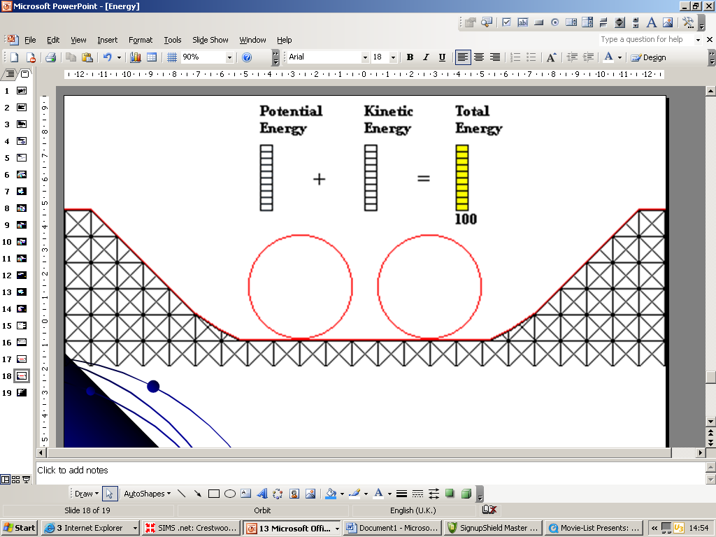
A
F
F
50m
B
D
E
C
Explain what happens to the kinetic and potential energy of the cart at each part of the ride. E.g. At A the cart has high potential energy but zero kinetic…
At which part do you think the velocity of the cart is greatest?
The combined mass of the man and the cart is 200kg. What is the potential energy at A? (assuming g = 10)
As the cart goes down the first slope its acceleration increases – what force is responsible for this?
Put an arrow on the diagram to show where in the loop-the-loop part you think the acceleration is slowest.
At B the cart is moving at 10m/s. How much kinetic energy does the cart and man have?
At F breaks are applied to the cart in order to slow it down gradually before it stops. Why is it important that the breaking takes a long time? (make sure you use the word momentum in your answer)
In theory the cart should have the same amount of energy at each part of the ride, in reality this is not the case. Explain why.

Slide 25
What is the principle of conservation of energy?
Explain what is meant by, and give equations for (a) kinetic energy & (b) gravitational potential energy.
In terms of energy explain what happens as a body falls under gravity.

