Slide 1
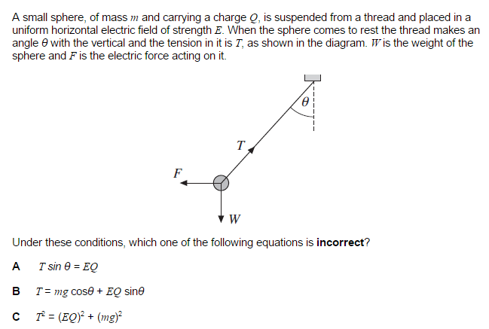
Forces in Equilibrium (Chapter 7 Revision)
From my learning today I will be able to…
C | Define Vectors and represent Vectors
B | Resolve vectors and calculate moments
A/A* | Suggest consequences of calculations such as stability

Slide 2
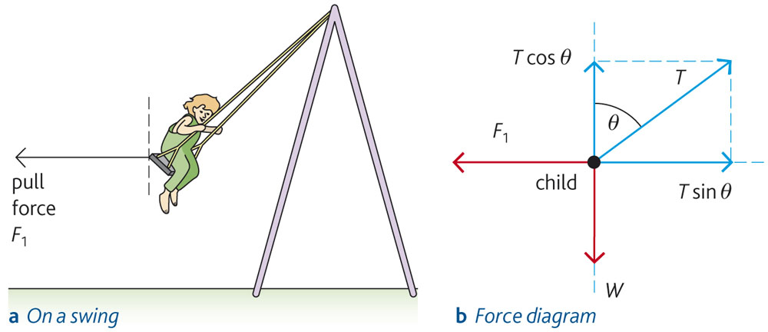
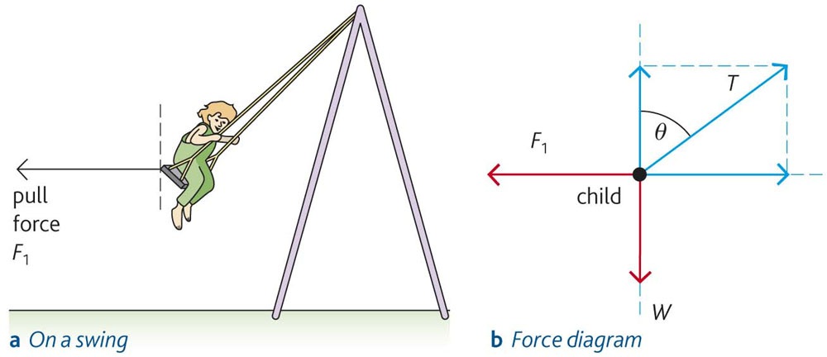
What are all the forces acting on the diagram?

Slide 3
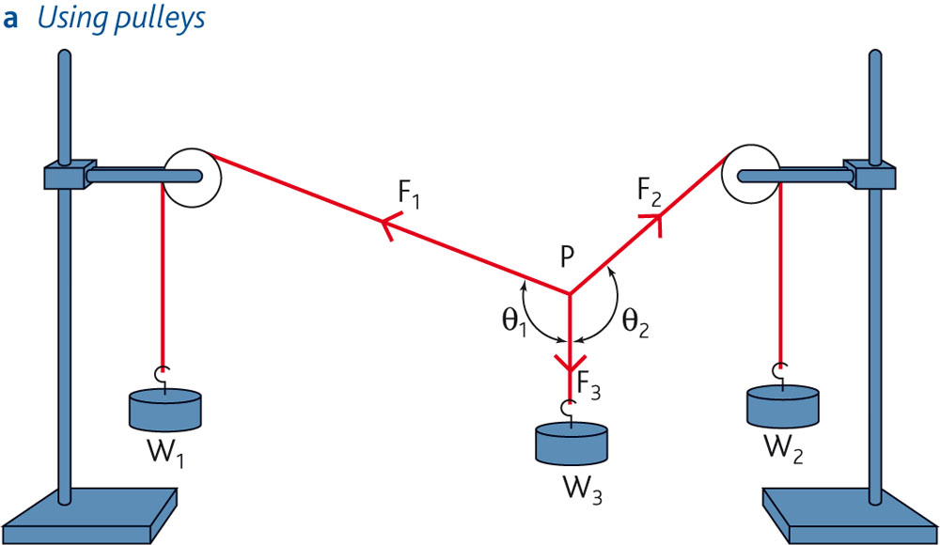
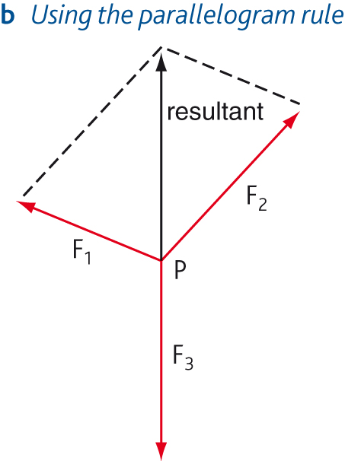
Three force test and diagram

Slide 4
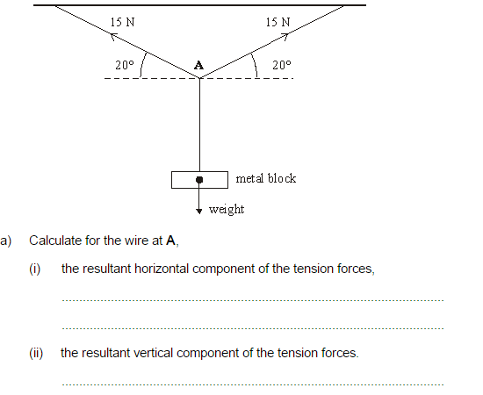
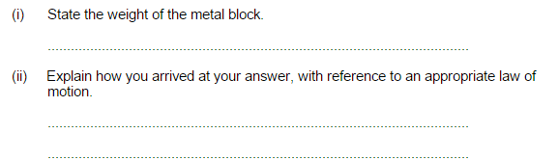

Slide 5
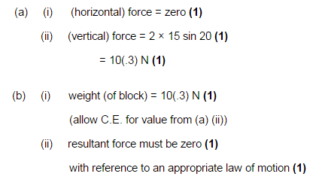

Slide 6
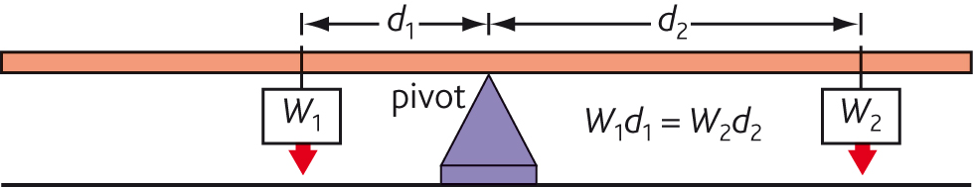
Principle of moments
The moment of a force about any point is defined as the force x the perpendicular distance from the line of action of the force to the point.
the sum of the clockwise moments
=
the sum of the anticlockwise moments

Slide 7
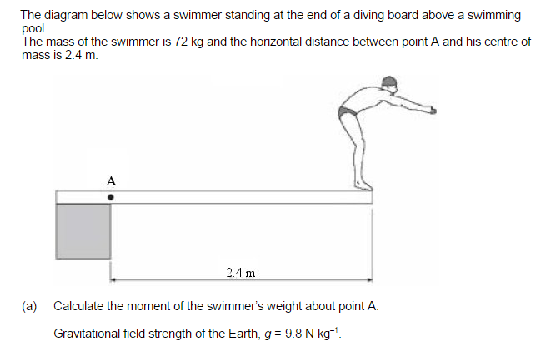

Slide 8
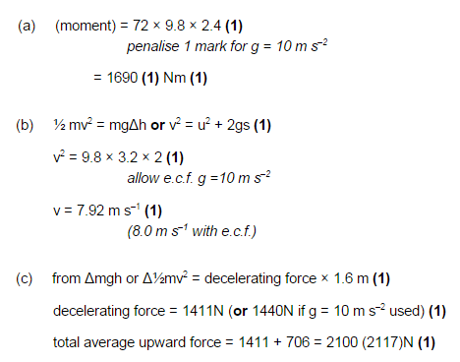

Slide 9
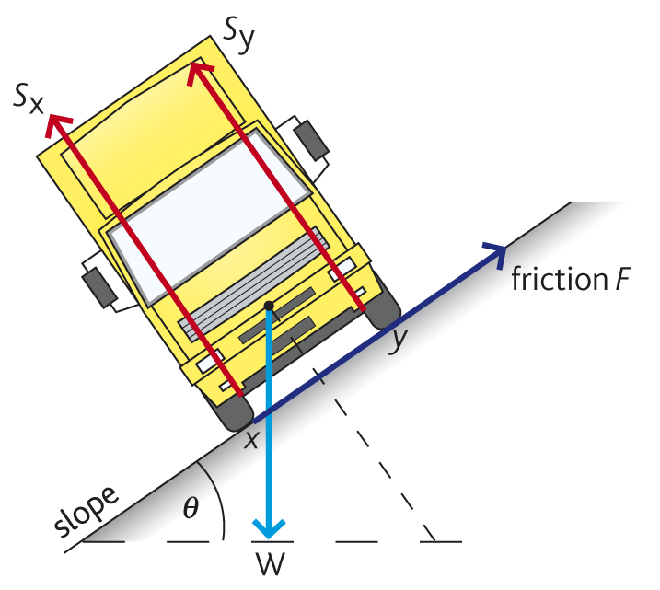
Stability and unstable
If the weight (the force acting due the centre of mass) acts through a line outside of the XY the object will topple.
A wider base and a lower centre of mass increase stability.

Slide 10
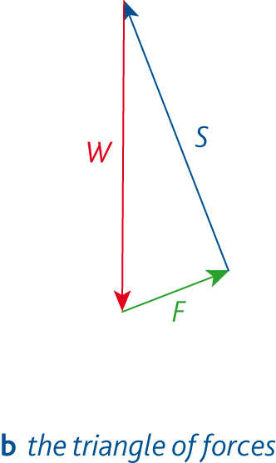
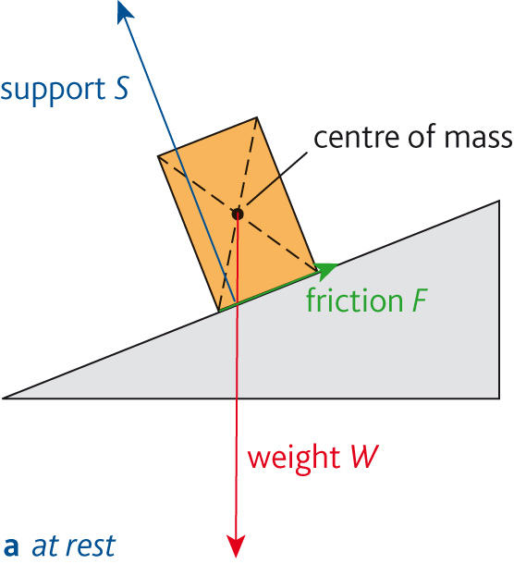
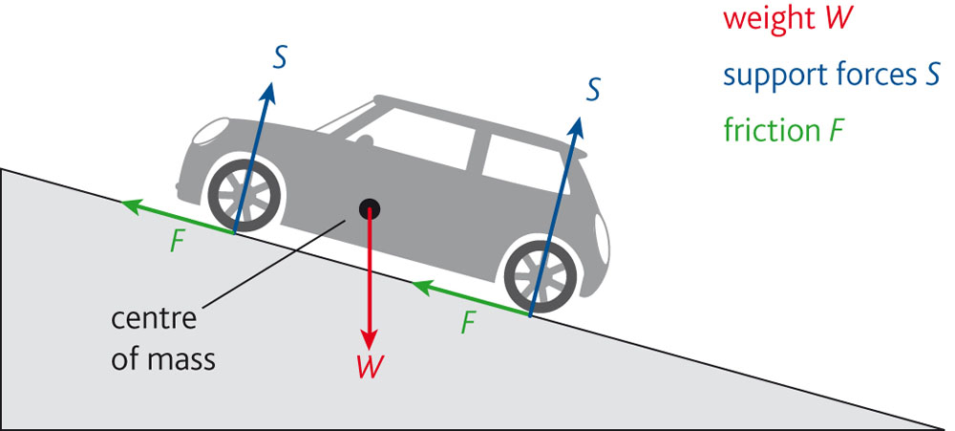
Equilibrium rules

