Slide 1
CW |  | 02/12/2016
distance | time | speed
60 m | 3 s | 20 ms⁻¹
1400 m | 35 s | 40 ms⁻¹
300 m | 0.20 s | 1500 ms⁻¹
80 km | 2 h | 40 km h⁻¹
150 x 10 ⁶ km | 8 min 20 s | 3.0 x 10⁸ ms⁻¹
20
1400
0.20
40
8
From my learning today I will be able to:
Key: | Calculate speed and acceleration
Boost: | Illustrate these on graphs
Aspire: | Interpret and manipulate graphs
Objective

Slide 2
Speed and Velocity Question
Two cars (A and B) travel from Chertsey to Weybridge by the routes shown opposite. If both cars take 30 minutes to complete their journeys calculate their individual average speeds and velocities.
car A: distance = 6km
Chertsey
displacement = 2km EAST
Weybridge
car B: distance = 4km

Slide 3
Car A
speed
= 6km / 0.5h
= 12km h⁻¹
velocity
= 2km EAST / 0.5h
= 4km h⁻¹ EAST
Car B
speed
= 4km / 0.5h
= 8km h⁻¹
velocity
= 2km EAST / 0.5h
= 4km h⁻¹ EAST

Slide 4
Define what is meant by: (a) displacement; (b) speed & (c) velocity.
Explain the difference between speed and velocity.
A ball is thrown vertically upwards and then caught when it falls down again. Sketch distance-time and displacement-time graphs of the ball’s motion and explain why these graphs are different from each other.

Slide 5
Acceleration (a)
average acceleration = velocity change
time taken
a_{av} = Δv / Δt
vector quantity
direction: same as the velocity change
SI unit: ms ⁻²
Instantaneous acceleration (a) is the rate of change of velocity with time: a = dv / dt

Slide 6
Notes:
1. Change in velocity:
= final velocity (v) – initial velocity (u)
so: a_{av} = (v – u) / Δt
2. Uniform acceleration:
This is where the acceleration remains constant over a period of time.
3. Deceleration:
This is where the magnitude of the velocity is decreasing with time.

Slide 7
Question
Calculate the average acceleration of a car that moves from rest (0 ms⁻¹) to 30 ms⁻¹ over a time of 8 seconds.
a_{av} = (v – u) / Δt
= (30 – 0) / 8
average acceleration = 3.75 ms⁻²

Slide 8
Complete
Velocity / ms⁻¹ |  | Time / s | Acceleration / ms⁻²
Initial | Final
0 | 45 | 15 | 3
0 | 24 | 3 | 8
30 | 90 | 10 | 6
20 | 5 | 3 | - 5
0 | - 60 | 20 | - 3
45
3
30
- 5
- 60

Slide 9
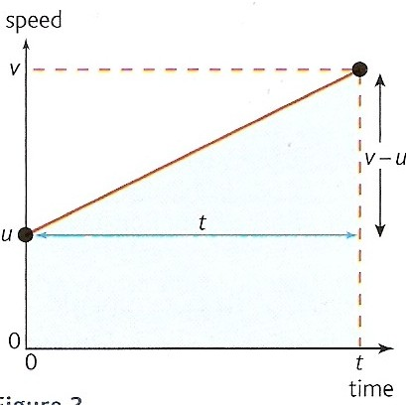
Velocity-time graphs
velocity
With velocity-time graphs:
gradient
= acceleration
a = (v – u) / t
The area under the ‘curve’
= displacement
s = [u x t] + [½ (v – u) x t]

Slide 10
Define what is meant by acceleration.
What is the difference between UNIFORM and NON-UNIFORM acceleration? Illustrate your answer with sketch graphs.
State the equations of constant acceleration. Explain what each of the five symbols used means.

Slide 11
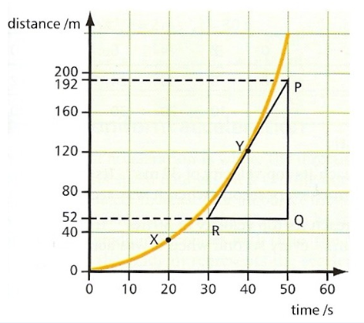



Distance-time graphs
The gradient of a distance-time graph is
equal to the speed

Slide 12
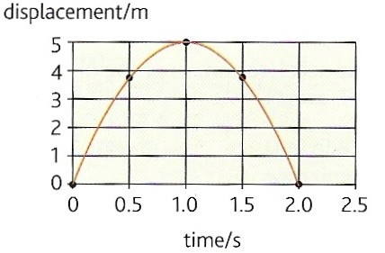
Displacement-time graphs
The gradient of a displacement-time graph is
equal to the velocity
The graph opposite shows how the displacement of an object thrown upwards varies in time.
Note how the gradient falls from a high positive value to zero (at maximum height) to a large negative value.
Estimate the initial velocity of the object.
Initial gradient = (5 – 0)m / (0.5 – 0)s = 10 ms⁻¹
Initial velocity = 10 ms⁻¹

Slide 13
Question 1
Describe the motion shown by the displacement-time graph below:
s / m
C
D
O → A: acceleration from rest
A → B: constant velocity
B → C: deceleration to rest
C → D: rest (no motion)
D → E: acceleration from rest back towards the starting point
B
E
A
t / s

Slide 14
Question 1
Sketch the displacement-time graph for the car of question 2.
displacement-time
co-ordinates:
s / ms⁻¹
64
53
48
t / s | s / m
0 | 0
4 | 24
6 | 48
8.73 | 64.4
11 | 53.0
t / s | s / m
0
4
6
8.73
11
24
4 6 11
T
t / s

Slide 15
Velocity-time graphs
velocity
With velocity-time graphs:
gradient
= acceleration
a = (v – u) / t
The area under the ‘curve’
= displacement
s = [u x t] + [½ (v – u) x t]

Slide 16
Question 2
Describe the motion shown by the velocity-time graph below:
v / ms⁻¹
O → A: UNIFORM POSITIVE acceleration from rest to velocity v₁.
A → B: constant velocity v₁.
B → C → D : UNIFORM NEGATIVE acceleration from v₁ to negative velocity v₂.
At C: The body reverses direction
D → E: constant negative velocity v₂.
E → F: NON-UNIFORM POSITIVE acceleration to rest
A
v₁
B
C
t / s
F
v₂
D
E

Slide 17
Question 3
v / ms⁻¹
The graph shows the velocity-time graph of a car. Calculate or state:
(a) the acceleration of the car during the first 4 seconds.
(b) the displacement of the car after 6 seconds.
(c) time T.
(d) the displacement after 11 seconds.
(e) the average velocity of the car over 11 seconds.
12
T
t / s
4 6 11
-10

Slide 18
Question 3
v / ms⁻¹
a) the acceleration of the car during the first 4 seconds.
acceleration = gradient
= (12 - 0)ms⁻¹ / (4 – 0)s
= 12 / 4
acceleration = 3 ms⁻²
12
T
t / s
4 6 11
-10

Slide 19
Question 3
v / ms⁻¹
(b) the displacement of the car after 6 seconds.
displacement = area
= area A + area B
= ½ (12 x 4) + (12 x 2)
= 24 + 24
displacement = 48 m
12
area
A
area
B
T
t / s
4 6 11
-10

Slide 20
Question 3
v / ms⁻¹
(c) time T.
By similar triangles:
(T - 6):(11 - T) = 12:10
i.e. (T - 6) / (11 - T) = 12 / 10
(T - 6) / (11 - T) = 1.20
(T - 6) = 1.20 (11 – T)
T - 6 = 13.2 – 1.2T
2.2T = 19.2
T = 19.2 / 2.2
T = 8.73 seconds
Note: T can also be found by scale drawing or by using the equations of uniform acceleration (see later).
12
area
A
area
B
T
t / s
4 6 11
-10

Slide 21
Question 3
v / ms⁻¹
(d) the displacement after 11 seconds.
displacement = area
= area A + area B + area C
– area D
= 24 + 24 + ½ (12 x 2.73)
– ½ (10 x 2.27)
= 24 + 24 + 16.38 – 11.35
= 53.03
displacement = 53.0 m
12
area
A
area
B
area
C
T
t / s
4 6 11
area
D
-10

Slide 22
Question 3
v / ms⁻¹
(e) the average velocity of the car over 11 seconds.
average velocity
= displacement / time
= 53.03 / 11
average velocity
= 4.82 ms⁻¹
12
area
A
area
B
area
C
T
t / s
4 6 11
area
D
-10

Slide 23
Question 4
Sketch displacement and velocity time graphs for a bouncing ball.
Take the initial displacement of the ball to be h at time t = 0.
Use the same time axis for both curves and show at least three bounces.
displacement
velocity
h
time
gradients = - 9.8 ms⁻²

