Slide 1
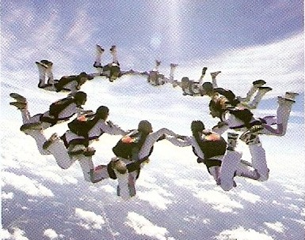
CW | Terminal Speed | 12/10/2018
Describe the motion and speed of a sky diver.
What happens their speed if they were to drop forever
From my learning today I will be able to:
Key: | Describe in terms of forces terminal velocity
Boost: | Explain what happens air resistance as something speeds up
Aspire: | Suggest an experiment to measure this
Objective

Slide 2
Terminal speed
Consider a body falling through a fluid
(e.g. air or water)
When the body is initially released the only significant force acting on the body is due to its weight, the downward force of gravity.
The body will fall with an initial acceleration = g
Note: With dense fluids or with a low density body the upthrust force of the fluid due to it being displaced by the body will also be significant.
weight

Slide 3
As the body accelerates downwards the drag force exerted by the fluid increases.
Therefore the resultant downward force on the body decreases causing the acceleration of the body to decrease.
ΣF = (weight – drag) = ma
Eventually the upward drag force equals the downward gravity force acting on the body.

Slide 4
Therefore there is no longer any resultant force acting on the body.
ΣF = 0 = ma
and so: a = 0
The body now falls with a constant velocity.
This is also known as ‘terminal speed’
Skydivers falling at their terminal speed

Slide 5
resultant force & acceleration
speed
initial acceleration = g
terminal speed
time from release

Slide 6
What does the drag force acting on a body depend upon?
Describe and explain the motion of a body falling because of gravity through a fluid.
What is meant by terminal speed?

