Slide 1
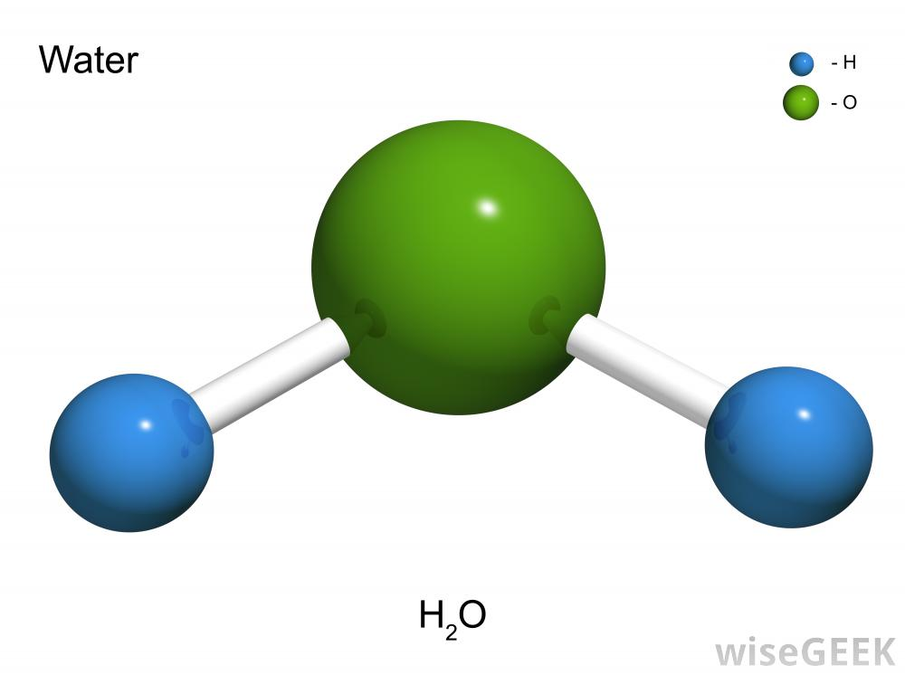
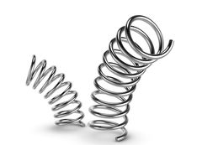
CW | Hookes Law | 18/09/2018
From my learning today I will be able to:
Key: | State Hookes law (C/LO1)
Boost: | Calculate values for Hookes law (B/LO2)
Aspire: | Apply understanding to different areas (A/LO3)
Objective

Slide 2
Hooke’s law
The force (F ) needed to stretch a spring is directly proportional to the extension (ΔL ) of a spring from its natural length.
F α ΔL
Adding a constant of proportionality:
F = k ΔL
k is called the spring constant
The spring constant is the force required to produce an extension of one metre.
unit = Nm⁻¹

Slide 3
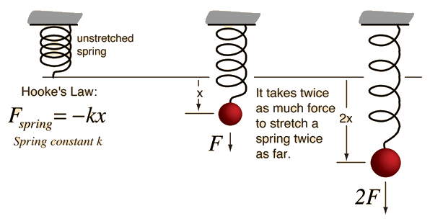

Slide 4
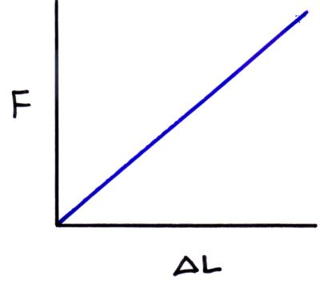

Slide 5
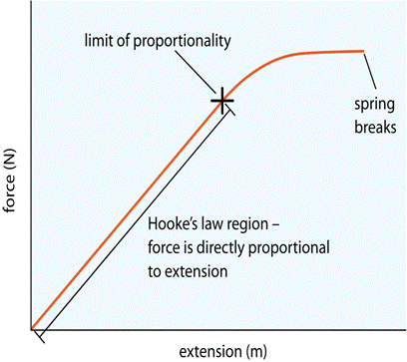

Slide 6
Elastic limit
Up to a certain extension if the force is removed the spring will return to its original length. The spring is said to be behaving elastically.
If this critical extension is exceeded, known as the elastic limit, the spring will be permanently stretched.
Plastic behaviour then occurs and Hooke’s law is no longer obeyed by the spring.

Slide 7
Question
A spring of natural length 15cm is extended by 3cm by a force of 6N. Calculate (a) the spring constant and (b) the length of the spring if a force of 18N is applied.
(a) F = k ΔL
→ k = F / ΔL
= 6N / 0.03m
spring constant, k
= 200 Nm⁻¹
(b) F = k ΔL
→ ΔL = F / k
= 18N / 200 Nm⁻¹
ΔL = 0.09 m
= 9 cm
And so the spring’s length
= 24 cm

Slide 8
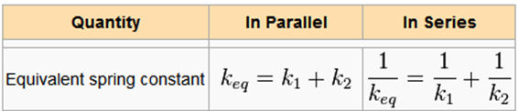
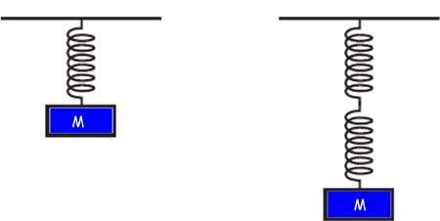
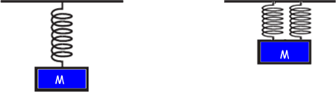

Slide 9
Elastic strain energy
The graph opposite shows how the force varies as the spring extends.
The work done in extending the spring is given by:
work = force x distance
force
0
extension

Slide 10
Elastic strain energy
= average tensile force x extension
= ½ F ΔL
= area under the curve
= energy stored in the spring
and so:
elastic strain energy = ½ F ΔL
force
F
area = ½ F ΔL
0
extension
ΔL

Slide 11
Stretching rubber
The work done in stretching rubber up to extension ΔL is equal to the area under the loading curve.
The unloading curve for rubber is different from its loading curve.
When the rubber is unloaded only the energy equal to the area under the unloading curve is returned.
The area between the two curves is the energy transferred to internal energy, due to which the rubber band becomes warmer.
force
energy lost to heating the rubber
loading
unloading
0
extension
ΔL

Slide 12
Answers
Complete:
tensile force | extension | strain energy
120 N | 2 m
40 N | 15 cm
3 kN | 50 mm | 150 J
2 MN | 6 μm | 12 J
120 J
3 J
100
4

Slide 13
Question
A spring of original length 20cm extends to 25cm when a weight of 4N is hung from it. Calculate:
(a) the elastic strain energy stored in the spring,
(b) the spring constant
(c) the length of the spring when it is storing 0.5 J of energy.
(a) strain energy
= ½ F ΔL
= ½ x 4N x 0.05m
strain energy
= 0.10 J

Slide 14
(b) F = k ΔL
→ k = F / ΔL = 4N / 0.05m
spring constant, k = 80 Nm⁻¹
(c) strain energy = ½ F ΔL and F = k ΔL when combined
give: strain energy = ½ k (ΔL)²
→ ΔL = √(2 x strain energy / k)
= √(2 x 0.5 / 80)
= √(0.0125)
= 0.112m
Therefore spring length = 20cm + 11.2cm
= 31.2 cm

Slide 15
Define Hooke’s law. Quote the equation for Hooke’s law.
What is meant by (a) the spring constant and (b) the elastic limit.
A spring of natural length 40 cm is extended to 50 cm by a force of 2N. Calculate (a) the spring constant in Nm⁻¹ (b) the expected length of the spring if it were to be extended by a force of 5N.
Show that the overall spring constant, k for (a) springs in series is given by k = k₁ + k₂; (b) springs in parallel is given by 1 / k = 1 / k₁ + 1 / k₂ where k₁ and k₂ are the spring constants of the individual springs.

