Slide 1
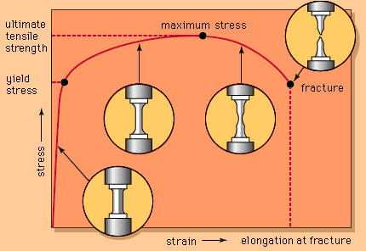
CW |  | 22/02/2017
Objective

Slide 3
Stress – strain curves (a) Metal wire (e.g. steel)
P = Limit of proportionality
Up to this point the stress is proportional to the strain.
stress
P
strain

Slide 4
Stress – strain curves (a) Metal wire (e.g. steel)
E = Elastic limit
This is close to P
Beyond this point the wire will become permanently stretched and suffer plastic deformation.
stress
E
P
strain

Slide 5
Stress – strain curves (a) Metal wire (e.g. steel)
Y₁ = Yield point
This is where the wire weakens temporarily.
Beyond Y₂, a small increase in stress causes a large increase in strain as the wire undergoes plastic flow.
stress
Y₁
E
P
Y₂
strain

Slide 6
Stress – strain curves (a) Metal wire (e.g. steel)
UTS = Ultimate tensile stress
Beyond the maximum stress, (UTS), the wire loses its strength, extends and becomes narrower at its weakest point where it fractures at B
stress
Y₁
UTS
E
breaking point B
P
Y₂
strain

Slide 7
Stress – strain curves (b) Brittle material (e.g. glass)
A brittle material does not undergo plastic
deformation and will fracture at its
elastic limit.
stress
E
breaking point B
P
strain

Slide 8
Stress – strain curves (c) Ductile material (e.g. copper)
A ductile material can be drawn into a wire.
Both steel and copper are both ductile but copper is more ductile because it can withstand a greater strain than steel before breaking although it is not as strong or as stiff as steel.
stress
steel
copper
strain

Slide 10
Stretching rubber
The work done in stretching rubber up to extension ΔL is equal to the area under the loading curve.
The unloading curve for rubber is different from its loading curve.
When the rubber is unloaded only the energy equal to the area under the unloading curve is returned.
The area between the two curves is the energy transferred to internal energy, due to which the rubber band becomes warmer.
force
energy lost to heating the rubber
loading
unloading
0
extension
ΔL

Slide 11
Answers
Complete:
tensile force | extension | strain energy
120 N | 2 m
40 N | 15 cm
3 kN | 50 mm | 150 J
2 MN | 6 μm | 12 J
120 J
3 J
100
4

Slide 12
Question
A spring of original length 20cm extends to 25cm when a weight of 4N is hung from it. Calculate:
(a) the elastic strain energy stored in the spring,
(b) the spring constant
(c) the length of the spring when it is storing 0.5 J of energy.
(a) strain energy
= ½ F ΔL
= ½ x 4N x 0.05m
strain energy
= 0.10 J

Slide 13
(b) F = k ΔL
→ k = F / ΔL = 4N / 0.05m
spring constant, k = 80 Nm⁻¹
(c) strain energy = ½ F ΔL and F = k ΔL when combined
give: strain energy = ½ k (ΔL)²
→ ΔL = √(2 x strain energy / k)
= √(2 x 0.5 / 80)
= √(0.0125)
= 0.112m
Therefore spring length = 20cm + 11.2cm
= 31.2 cm

