Slide 1
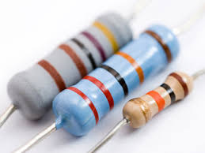
CW | Internal resistance | 11/10/2016
What happens your phone when you charge it?
Why might this happen?
Whats the connection between these questions and the 2 images?
From my learning today I will be able to:
AO1: | Describe what internal resistance is and under what conditions it occurs
AO2: | Carry out a practical on Terminal PD when a load is applied. Calculate EMF using equation. Describe what m and c are.
AO3: | Use graph to suggest what happens when a load is applied to a citrcuit. Suggest why phones heat up when charging. Explain why car batteries need low resistances
Objective

Slide 2
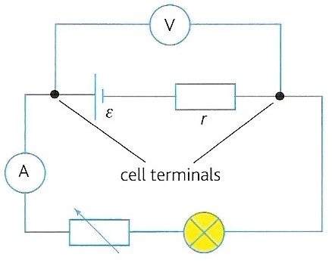
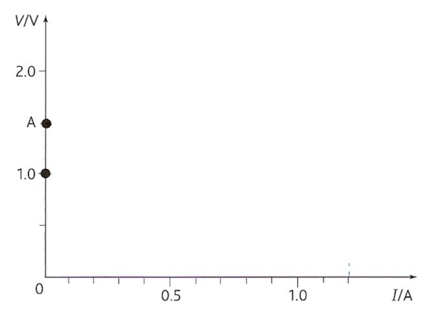
Measure the terminal PD of the Cell. Record this as this is the Terminal PD
Connect up circuit shown opposite.
Measure the terminal pd (V) with the voltmeter
Measure the current drawn (I) with the ammeter
Adjust the variable resistor to attain 5 other results
The bulb, a resistor, limits the maximum current drawn from the cell
a) Draw a graph for V against I – calculate m and c
b) What happens the terminal PD as you increased the resistance?
Explain why this happens using all that you know from electricity so far.
Challenge

Slide 3
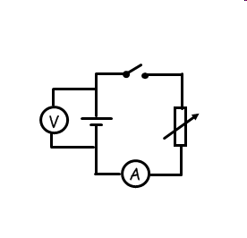
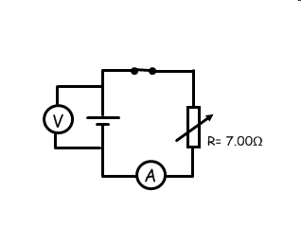
When the cell is supplying no current, voltage across the cell (terminal pd) is equal to the Emf.
I = 0.2A
I = 0.4A
I = 0 A
V = 1.4 V
V = 1.3 V
V = 1.5 V= Emf
lost volts = 1.5-1.4 = 0.1 V
lost volts = 1.5-1.3= 0.2 V
When the cell supplies current, the terminal pd (the pd available for the rest of the circuit) decreases, the larger the current you draw, the smaller the terminal pd.
Why might this be happening?

Slide 4
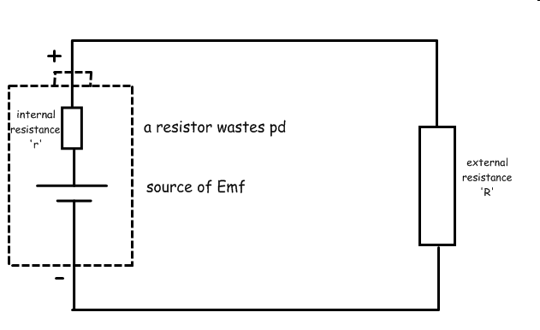
An electrical cell is made from either metal or chemicals, which themselves have some resistance. This resistance is called the internal resistance of the cell (r).
So the pd available to the rest of the circuit = Emf - lost volts

Slide 5
Equation of a complete circuit
The total emf in a complete circuit is equal to the total pds.
emf = sum of all the PDs
For the case opposite:
ε = I R + I r
or
ε = I ( R + r )

Slide 6
Terminal pd (V )
ε = V + I r (as V = I R )
or
V = ε - I r
I r , the lost volts, is the difference between the emf and the terminal pd
ε = V + I r
becomes: ε = V + v
that is:
emf = terminal pd + lost volts

Slide 7
Question 1
Calculate the internal resistance of a battery of emf 12V if its terminal pd falls to 10V when it supplies a current of 6A.
ε = I R + I r
where I R = terminal pd = 10V
so: 12 V = 10 V + (6A x r )
(6 x r ) = 2
r = 2 / 6
internal resistance = 0.333 Ω

Slide 8
Question 2
Calculate the terminal pd across a power supply of emf 2V, internal resistance 0.5Ω when it is connected to a load resistance of 4Ω.
ε = I R + I r
where I R = terminal pd
2 V = (I x 4 Ω) + (I x 0.5 Ω )
2 = (I x 4.5)
I = 2 / 4.5
= 0.444 A
The terminal pd = I R
= 0.444 x 4
terminal pd = 1.78 V

Slide 9
Using V = ε - I r,
What is the gradient?
What is the intercept?

Slide 10
Complete the worksheet
Define what is meant by (a) emf; (b) terminal pd and (c) internal resistance.
Explain the meaning of the terms in the equation, ε=IR+Ir . Explain how this equation illustrates the conservation of energy in a complete circuit.
Calculate the internal resistance of a battery of emf 6V if its terminal pd falls to 5V when it supplies a current of 3A.
Describe an experiment to measure the internal resistance of a cell. Include a circuit diagram and explain how the value of r is found from a graph.
Explain why it is important that a 12V car battery should have a very low internal resistance in order to deliver a current of about 100A to a car’s starter motor.
Collect extra sheet for this

Slide 11
Car battery internal resistance
A car battery has an emf of about 12V.
Its prime purpose is to supply a current of about 100A for a few seconds in order to turn the starter motor of a car.
In order for its terminal pd not to fall significantly from 12V it must have a very low internal resistance (e.g. 0.01Ω)
In this case the lost volts would only be 1V and the terminal pd 11V

Slide 13
Homework
Read through Page 224 and 225, make notes and answer summary questions (Fri)
Answer Isaac Physics questions (Tues)

Slide 14
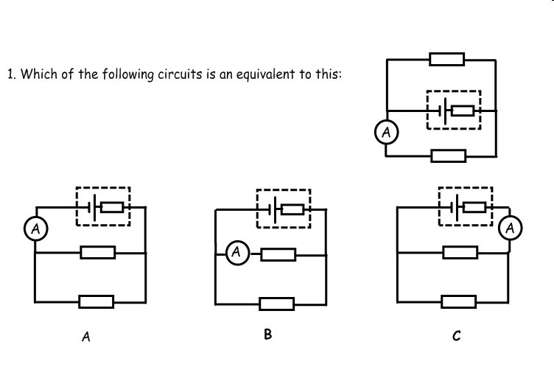

Slide 15
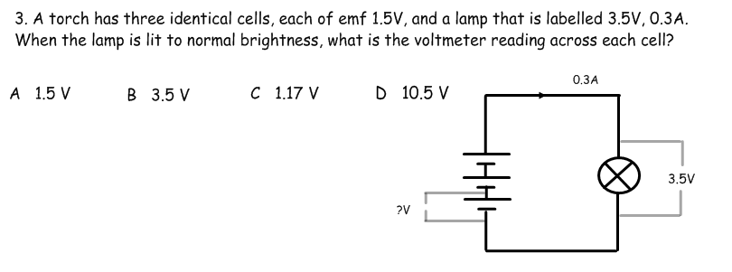
4. The resistance of the lamp in the above question is:
A 11.7 Ω B 1.05 Ω C 1.5 Ω D 1.17Ω
5. The internal resistance of the battery in the above question is:
A 1.1 Ω B 2.2 Ω C 3.3 Ω D 1.17Ω

Slide 16
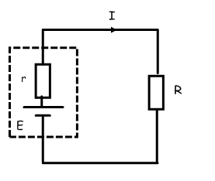
Using the symbols in the circuit here, what is the formula for the power dissipated in the external resistance?
A Iξ² B I²R C Ir D I(r+R)
ξ
What is the formula the power dissipated in the internal resistance?
A Ir² B I²r C I ξ D I(r+R)²

