Slide 1
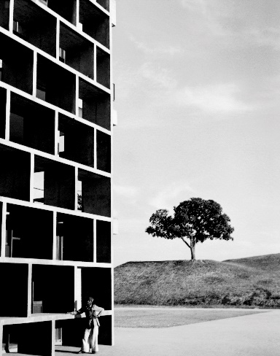
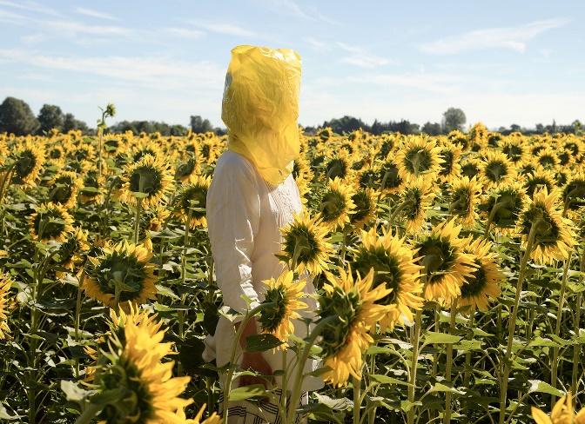
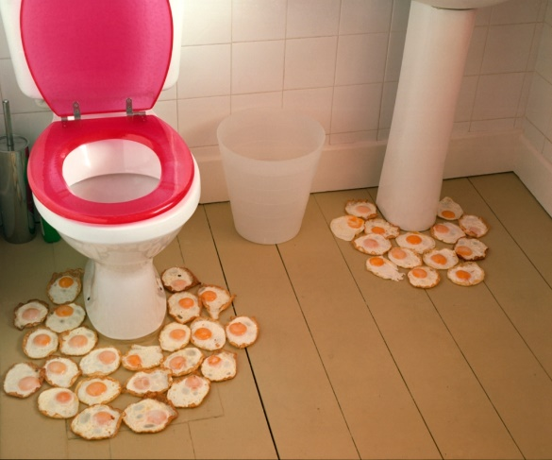
Godalming Photography Induction Work
Select one of the artists below to respond to:
Make at least 10 photographs in response to your chosen artist – you may want to google them to develop a wider understanding of their work
Select your strongest image – feel free to edit and manipulate the image as much as you want
Write a 200 word paragraph analysing your photo. Use the following questions to help you:
What influence have you taken from the artist you chose? (Framing, composition, subject matter, colour, technical, mood)
What have you done differently to your chosen artist?
Why is this your strongest image?
How could you improve the photograph you made?
Please complete these tasks on DIGTALLY on a WORD DOCUMENT– you will need to hand this in via Teams when you start College in September
Lucien Herve
Elina Brotherus
Sian Bonnell

