Slide 1
Btec L2 Business

Slide 2
Hello!
Ellen Bateman (EGB)
EGB@Godalming.ac.uk
Sofia Neves De Abreu
SON@Godalming.ac.uk

Slide 3
Expectations
Good Attendance
If you miss a lesson it is your responsibility to catch up with work missed.
Be on Time
Key information is always given at the start of the lesson.
Always Prepared
You will need notebook, pens and a calculator for lesson and your revision guide.
Good Attitude
All work must be completed to the best of your ability and you actively engage with all lessons.
Seek Help
Struggling with workload or understanding key theory? Seek help by asking/emailing or checking GoL. Workshop – Thursday Lunchtime

Slide 4
Units
Unit 1 – Introducing Business (SON)
Unit 2 – Finance for Business (EGB)
Unit 3 – Enterprise in the Business World (EGB)
Unit 4 – Promoting a Brand (SON)

Slide 5
Unit 2
Finance for Business
Everything you will learn!

Slide 6
Ten areas in Total!
Costs, Revenue and Profit
Break Even
Cash Flow Forecasting
Sources of Finance
Gross & Net Profit
Income Statements (Profit & Loss Accounts)
Statement of Financial Position (Balance Sheets)
Budgeting
Ratios
Building Financial Success
Key Area for Top Marks

Slide 7
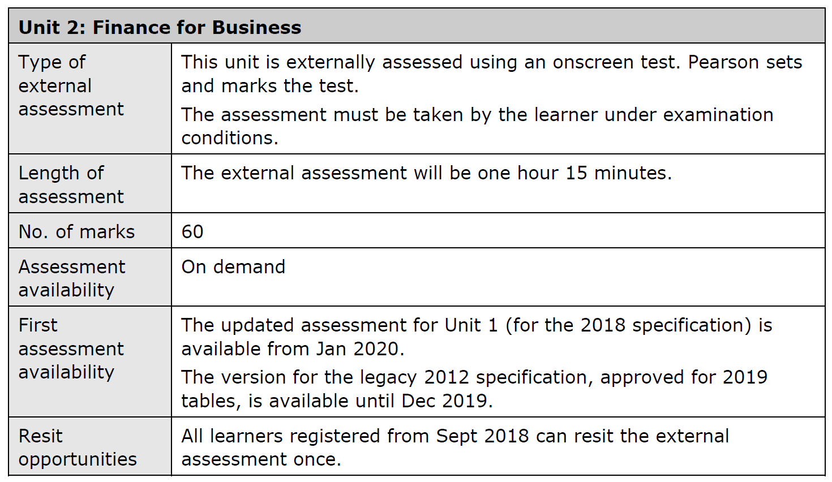

Slide 9
Points mean Prizes
Every unit of work gains you points, those points add up to your final grade!

Slide 10
Unit Grade | Pass | Merit | Distinction
Points | 12 | 18 | 24
Final Course Grade | P | M | D | D*
Points Needed | 48 | 66 | 84 | 90

Slide 11
Distinction Overall
Two Merits and Two Distinctions

