Slide 1
Human error
People felt that the main scientist named Dyatlov was majorly to blame for the incident. It was proclaimed that he had used his powers as a senior to allow the reactor to meltdown. The engineers had not yet done a safety test and had left the reactor on a lower power level for a prolonged period, from midday to 1:15 when the test was scheduled to occur. This was a first issue as the engineers failed to understand as there would be too much Zenon in the reactor leading to an imbalance in the reactor. This was the first error. Next lowering the control rods further caused there to be a very large imbalance. After countless alleged attempts to stop the test by lower ranking officials as they perceived it to be unsafe to proceed with. However dyatlov decided it was not nesserry and would continue. This would prove fatal for many people including himself, 7 years later. People and the soviets felt that the reason why this occurred was souly down to the misjudgment of Dyatlov and his immediate bosses.
MY COMMENT This slide is far too cluttered. It contains all text the speaker wants to say. It is also unattractive. The only part of this that should have appeared is the title. It formed part of a section on possible causes of the Chernobyl explosion.

Slide 2
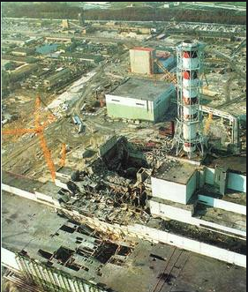
The Explosion: Possible Reasons
Chernobyl
Human Error
Design Flaws
MY COMMENT
This is more like what should have been produced.
Image from https://en.wikipedia.org/wiki/Chernobyl_disaster

Slide 3
Could other Economic Sectors Reduce their Emissions?
Introduction
Electricity Generation
Other Sectors
Carbon Capture
Conclusion
Agriculture
Industry
Transport
MY COMMENT
This slide is good because it flags up what areas are going to be discussed, but does not give away what is going to be said about each

Slide 4
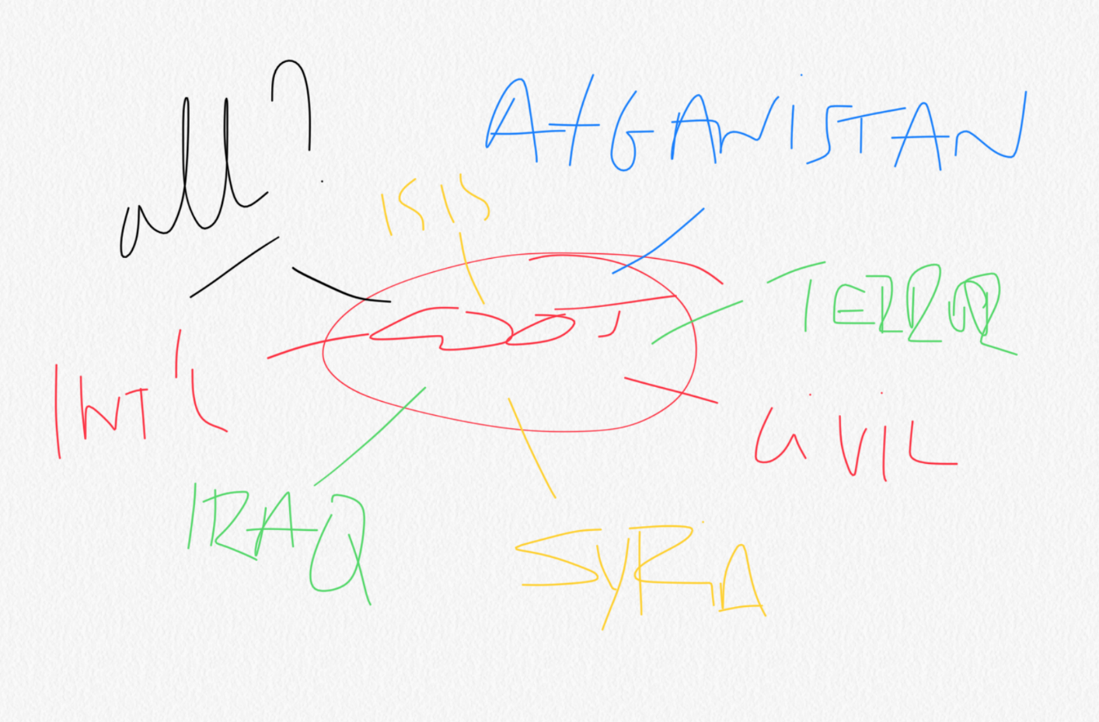
How did I chose my subject area?
FROM MIDDLE EAST to Iraq War?
MY COMMENT
This slide is good because it gives the points to talk about and is not too cluttered

Slide 5
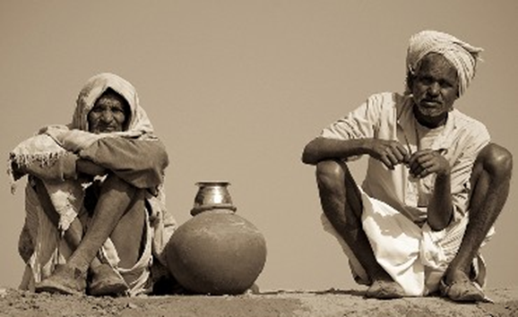
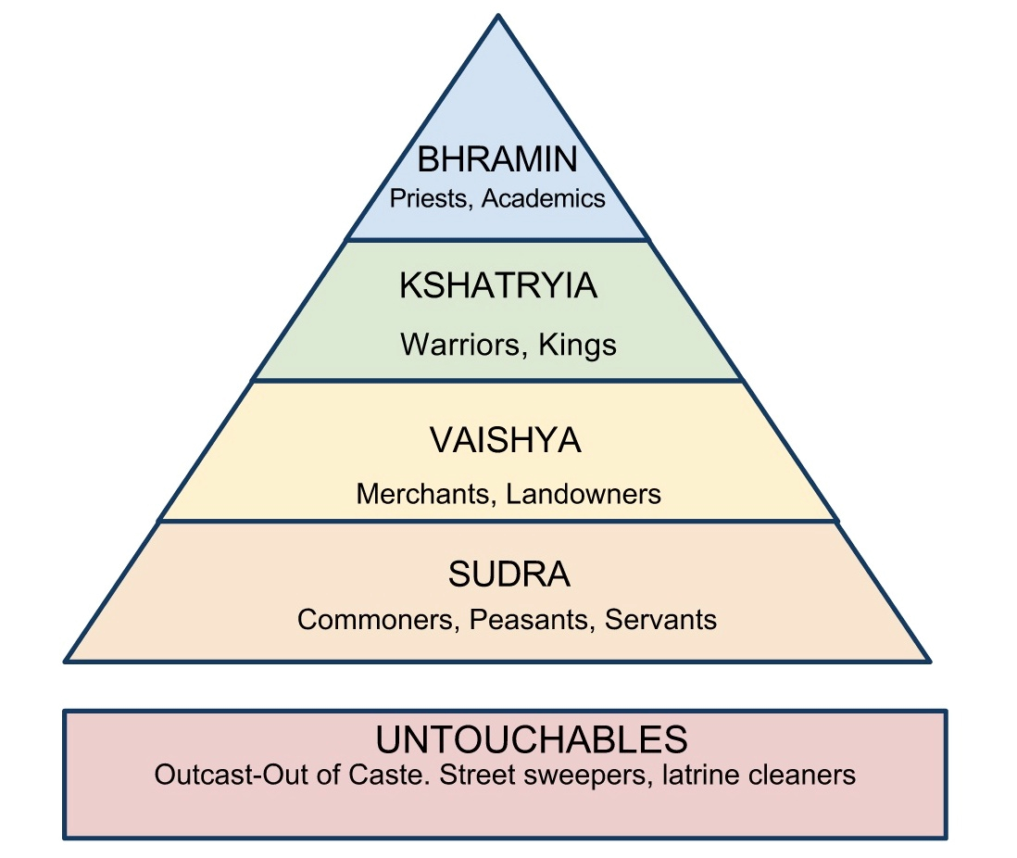
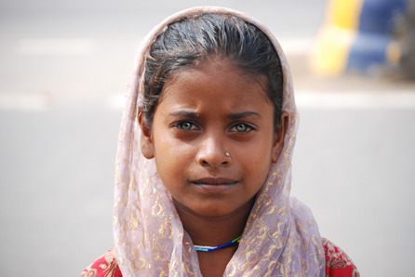
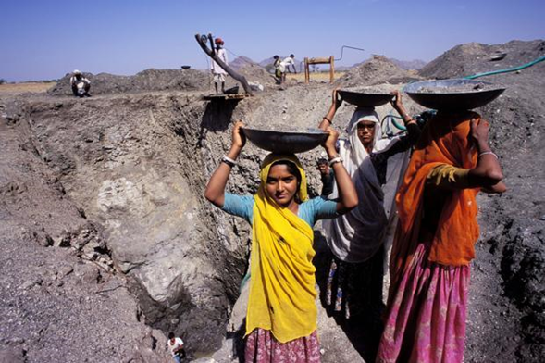
WHAT IS THE CASTE SYSTEM?
Hierarchy rooted in religion and supposedly based on a division of labour.
Unable to progress or move up the hierarchy
E.g. if your ancestors were servants, you would traditionally be prevented from doing anything else
MY COMMENT
This is attractive – which is good - and not too cluttered. However, it would have been better if the bullet points had only been said and not appeared on the slide as here.
Considered ‘outside’ of the system
Traditionally segregated from society
Notes:
Ranked in hierarchical order.
Brahmin: priests, spiritual education
Kshatriya: originally defence (warriors etc)
Vaishya: businessmen and landowners etc.
Shudra: range from semi skilled and unskilled labourers

Slide 6
WHAT IS THE CASTE SYSTEM?
Basis
Movement within it
What does it determine?
Who is not part of this system?
MY COMMENT
This my edit of the previous slide. The other alternative is to have headings only visible at any point and the sub-statements appear in sequence after you say them.
Notes:
Ranked in hierarchical order.
Brahmin: priests, spiritual education
Kshatriya: originally defence (warriors etc)
Vaishya: businessmen and landowners etc.
Shudra: range from semi skilled and unskilled labourers

Slide 7
What would I do differently if I did it again?
Evaluate my sources as I go along
Make sure my essay structure and initial research is more comprehensive
Manage my time better as I could have written more but I did not allow myself enough time to put in these extra ideas
MY COMMENT
Although this is not overcluttered it still gives away too much of what the speaker intends to say. See the next slide for how it could have been improved.

Slide 8
What would I do differently if I did it again?
Source evaluation
Essay structure
Initial Research
Time Management
MY EDIT
This is how the previous slide would have been done better, with just prompts so that none of what you are going to say appears on the slide as you talk.

Slide 9
AREAS OF DIFFICULTY
Time management
Research
Editing
MY COMMENT
This slide is good because it gives points to talk about and is not too cluttered. It is reasonably attractive.
Notes:
TIME MANAGEMENT
Staying on top of all my tasks and doing all my other work was a challenge, sometimes I didn’t quite make it to the target or I let my other work slip a bit
RESEARCH
Doing at various times and not all together made it more difficult than originally planned meaning that I also took much longer than timetabled for
EDITING
After reading through so many times I became less aware of grammatical or even factual mistakes in it

