Slide 1
Mise en Scene
Sometimes written Mise-en-Scène
Notes:
1

Slide 2
Mise en Scene
Mise en Scene
(pronounced meez ahn sen)
‘Mise en Scene’ is a French term that originates from the theatre.
It literally means everything that is ‘put into the scene’, ‘or the staging of a scene’.
Think about all the elements that have been placed in front of the camera.

Slide 3
Mise en Scene
Think about all the planning that has gone
into the arrangement of this still image?

Slide 4
Mise en Scene
Mise en Scene includes:
-Settings/Location/Decor
-Lighting
-Props
-Costume
-Make-up
-Performance/body language/movement

Slide 5
Settings/Location
Settings within a film can evoke many responses.
They can mirror the emotions of a character, establish place and time, and offer information about themes within a film.

Slide 6
Settings/Location ‘The Graduate’ (Mike Nichols, 1967)

Slide 7
Settings/Location

Slide 8
Decor
The way a set/location is decorated can also add meaning to an event, and can mirror a characters psychological state.

Slide 9
Lighting
Lighting is essential in conveying mood and atmosphere.
There are a variety of lighting styles used in cinematography:

Slide 10
Lighting
Key light- Usually brightest light
Back light- Lit behind characters
Filler Light- Helps to soften harsh shadows
Natural lighting- Location shooting using natural sunlight.
Lighting from different angles can produces a range of effects
Underlighting, Toplighting & Backlighting
.

Slide 11
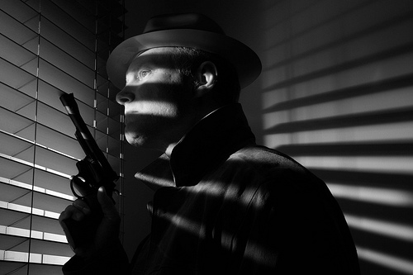
Lighting Film Noir

Slide 12
Props
Objects included in a scene are essential in the generation of meaning, historical period, and character.
If a prop is regularly used or show, it can become a symbolic motif.
One way to identify the genre of a film is through props used.

Slide 13
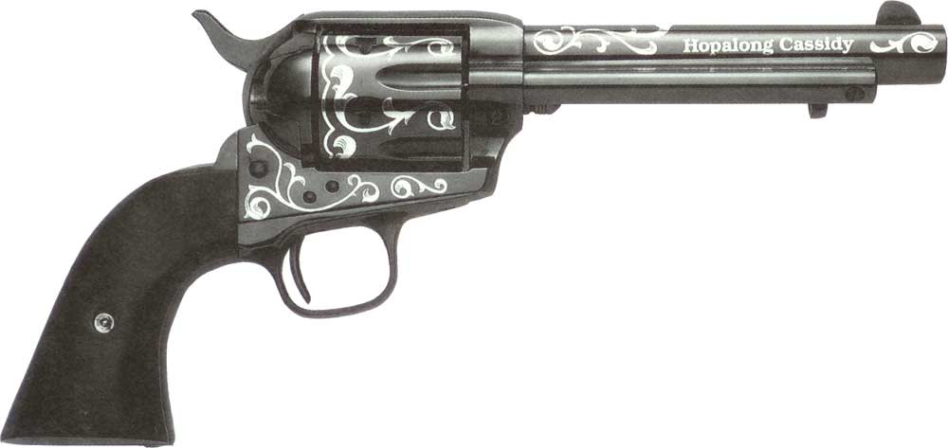
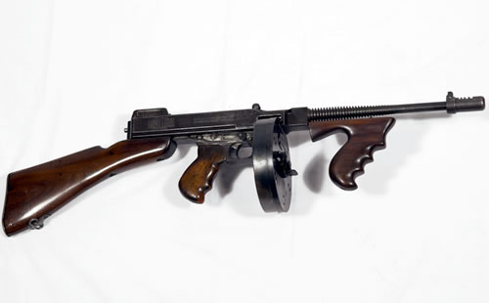
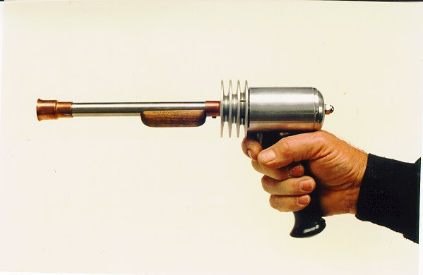
Props
What type of films do these guns belong to?

Slide 14
Costume
Costumes are important in the creation of characters’ status, psyche, and historical time (setting).
A change in costume can signal a change in fortune, a change of heart or perhaps a political stance.

Slide 15
Costume
‘The Royal Tenenbaums’ (Wes Anderson, 2001)

Slide 16
Make-up
Make-up is an essential tool for all actors, but can also be used to generate particular meanings. Prosthetics can vastly change the appearance of an actor.

Slide 17
Performance
Performance (body language and movement) can transmit information about attitudes and feelings.
The way an actor walks, talks, sits, or stands can be symptomatic of his or her state of mind.

Slide 18
As a reminder jot down your key terms in your note books:
Mise en Scene (pronounced meez ahn sen)
Setting/location/Décor
Lighting
Props
Costume
Make-up
Performance (body language, movement)

Slide 19
Now lets look at the opening of Funny People. If we consider the elements of Mise en Scene we can further add to our understanding, interpretation and hopefully our enjoyment of films.
Show Clip:
Funny People (Judd Apatow, 2009)

Slide 20
Analysis Task
Complete an analysis on the opening of ‘Funny People’, making particular reference to the different aspects of Mise en scene.
Word processed
with word count (500 words)

