Slide 1
EDITING
AS Media Studies

Slide 2
What do we mean by the term: Editing?
When someone refers to the editing in a film, what do they mean?
Take 2 minutes to discuss it with the person next to you.

Slide 3
Editing
The unedited footage is known as ‘the rushes’.
Film editing is part of the post-production process of filmmaking.
It involves the selecting and joining together of shots, connecting the resulting scenes, sequences, and ultimately creating a finished film.

Slide 4
What are we looking for when analysing editing in a clip?
Task 1:
Write down as many elements that you can think of that may come under editing (2 mins)

Slide 5
What are we looking for when analysing editing in a clip?
Order of shots/shot choices
Continuity
Transitions
Shot duration
Pace and rhythm
Special effects
You need to be able to discuss how these technical elements help create meaning.

Slide 6
Order of shots
The meaning of a clip can change depending on the order the shots are cut together
Hitchcock Loves Bikinis https://www.youtube.com/watch?v=hCAE0t6KwJY
Putting two shots together can suggest a connection or emphasise contrast (juxtaposition).

Slide 7
Order of shots
The order of shots can reveal who motivates the edit.
Screen time is also part of this – which character do we see most, or which character do we see the perspective of most, i.e. point-of-view shots.
This tells us which characters are most important in a scene or at a particular point in the narrative.

Slide 8
Continuity
Continuity editing:
Cutting shots to tell a story with narrative continuity
Helping the viewer make sense of the action by ensuring smooth flow from shot to shot.
Creates realism – edit is invisible so action appears real rather than constructed

Slide 9
Continuity
Continuity techniques:
Establishing shot (establishes the space in which action is to happen)
The 180̊ rule (ensures that the same space is described in each shot)
Shot/reverse shot
Eye-line match (e.g. character looks off-screen, next shot shows us what they see)
Match on action (character begins to move in one shot, we see continuation of the same movement in the next shot

Slide 10
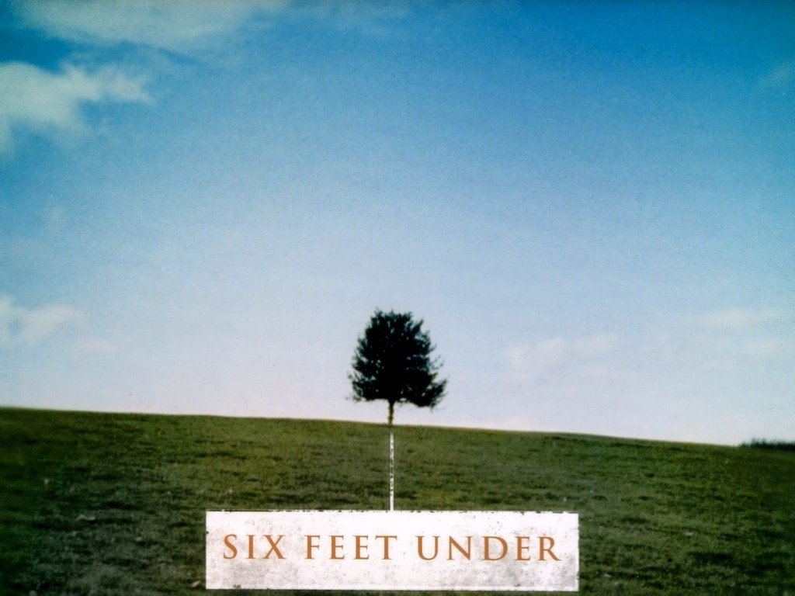
Non-Continuity
Montage – giving information in compressed form – can come under…
Non-continuity editing – continuity is broken and construction is more apparent. Meaning often created through juxtaposition and metaphor shot inserts.
For example the Six Feet Under opening sequence.

Slide 11
Transitions
The process of cutting from one shot to another usually involves a simple straight cut. However, there are other means of transition available to film editors such as:
Fade to black
Dissolve/cross fade
Wipe

Slide 18
Transitions
What meaning could be created by the use of the transitions we have just looked at?

Slide 19
Transitions
As well as simply moving to another shot, transitions can:
Imply a passage of time
Connote a change in location
Emphasise a connection, perhaps what a character is thinking, remembering or dreaming about (dissolve/cross fade).
Click here for more information on transitions

Slide 20
Shot Duration/Pace & Rhythm
The duration of a shot will usually reflect the narrative context.
Generally speaking short shot duration conveys action and urgency (say in a chase sequence) such as this one from Skyfall. See if you can count the number of shots!
Long shot duration creates a slower pace and conveys intensity and intimacy within the narrative, it allows us to focus upon facial expression and other aspects of mise-en-scene which would otherwise be missed.

Slide 21
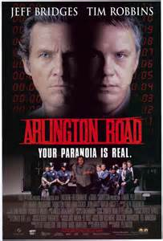
Special Effects
Special effects can be used to further manipulate the mise-en-scene of a sequence.
Look at this example from Arlington Road

Slide 22
Task
Watch three trailers on youtube and take notes on the editing techniques used to create genre and give the audience information about the film.
One romance
One action/adventure
One horror
 | Film Title | Film Title | Film Title
Order of shots
Transitions used
Pace and rhythm
Text
Special effects

