Slide 1
Lesson 1
Introduction to Film

Slide 2
Learning OutComes
Understand why we study film.
2. Look at the key elements of film form.

Slide 3
Do it now
Please find out and write down the following:
Who you are sitting next to
Why they chose Film
What their favourite film (s) is/are
Why is that their favourite film (s)

Slide 4
Why do we study film?
Studying film is not simply
watching a film and saying what
we liked or didn’t like about it.

Slide 5
Analysing film means searching
for meaning, messages or ideas
that are not immediately obvious.
We use a range of tools to consider
what a film may be trying to ‘say’;
what meaning or message it might
want to convey.

Slide 6
GENRE
Film Studies uses many specific
terms which you will need to learn.
Genre.
This is also, of course, used in
English, usually when describing
books. It also relates to music.

Slide 7
Genre
Watch these trailers and identify the different
genres they belong to.
https://www.youtube.com/watch?v=fZ_JOBCLF-I
https://www.youtube.com/watch?v=ZQ6klONCq4s
https://www.youtube.com/watch?v=MR1xo1tLyBk

Slide 8
Watch these two clips and think: what else do we need to consider when studying film?
Spider-Man: Homecoming
Wizard of Oz 1939 trailer

Slide 9
We need to consider
- Who directed the film (and what else they have directed)
Who stars in the film
What studio made the film
What was/is happening at the time the film is made. This is called context.
Film Form – which includes:
Micro Elements (including theory) – you will study this in term 1
Macro Elements – you will study this in term 2

Slide 10
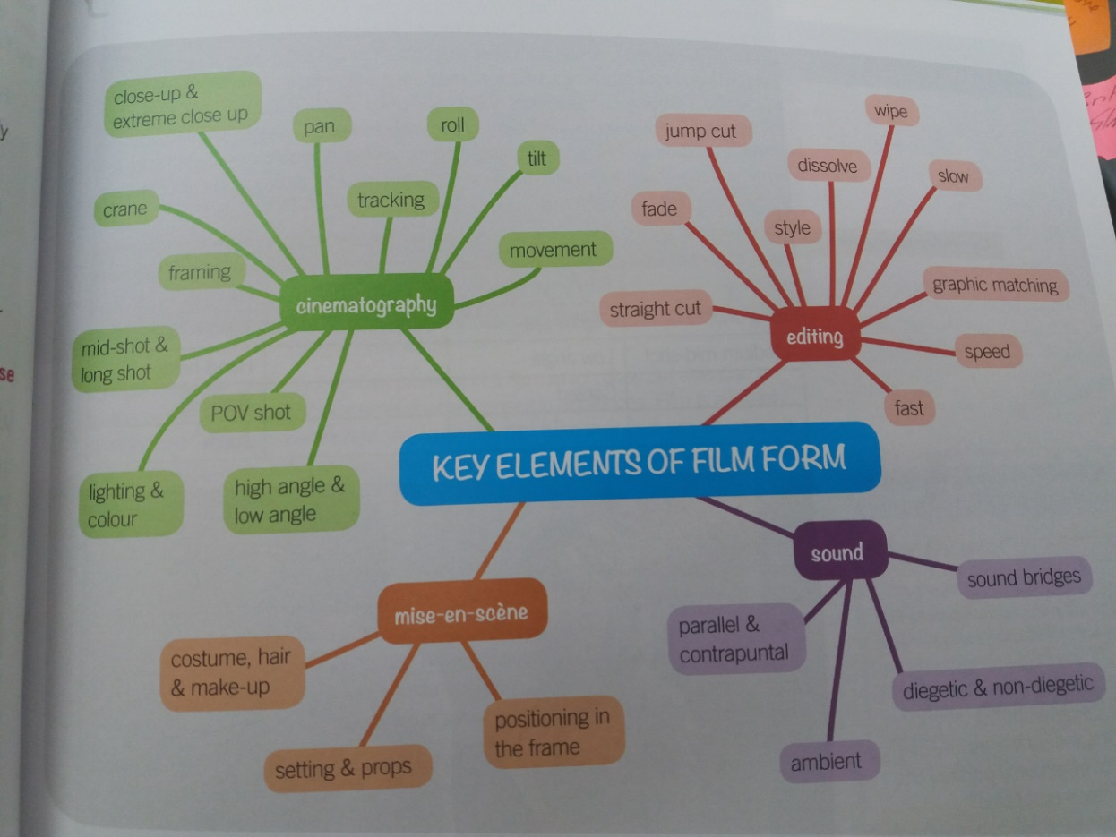
Film form

Slide 11
PLENARY
Film Challenge
Using your iPads, I’d like you to make a short information video explaining what you have just learnt about studying film. You can make and present your film however you want – be as creative as possible! It needs to be between 1-2 minutes long.

