Slide 1
Choosing appropriate Extracts to compare in the WInterson and Novel Analysis.

Slide 2
Remembering focus on “narrative Techniques”
The question for the coursework always asks you to compare the texts (AO4) but also stresses that “narrative techniques” (AO1) are identified in the analysis.
In groups, look at the following pairs of extracts from two texts (Why Be Happy… and one of the recommended novels) and think about: a) how they can be read to reflect a particular question focus; b) which narrative techniques you can identify in making the connection to the question focus?

Slide 3
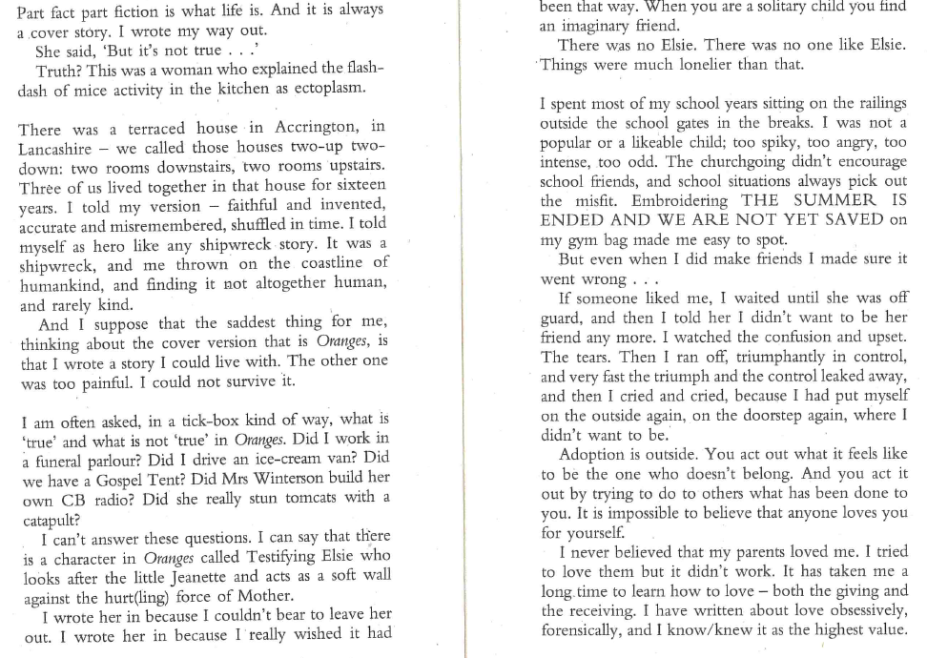
Groups 1&4: Focus on ‘Alienation’

Slide 4
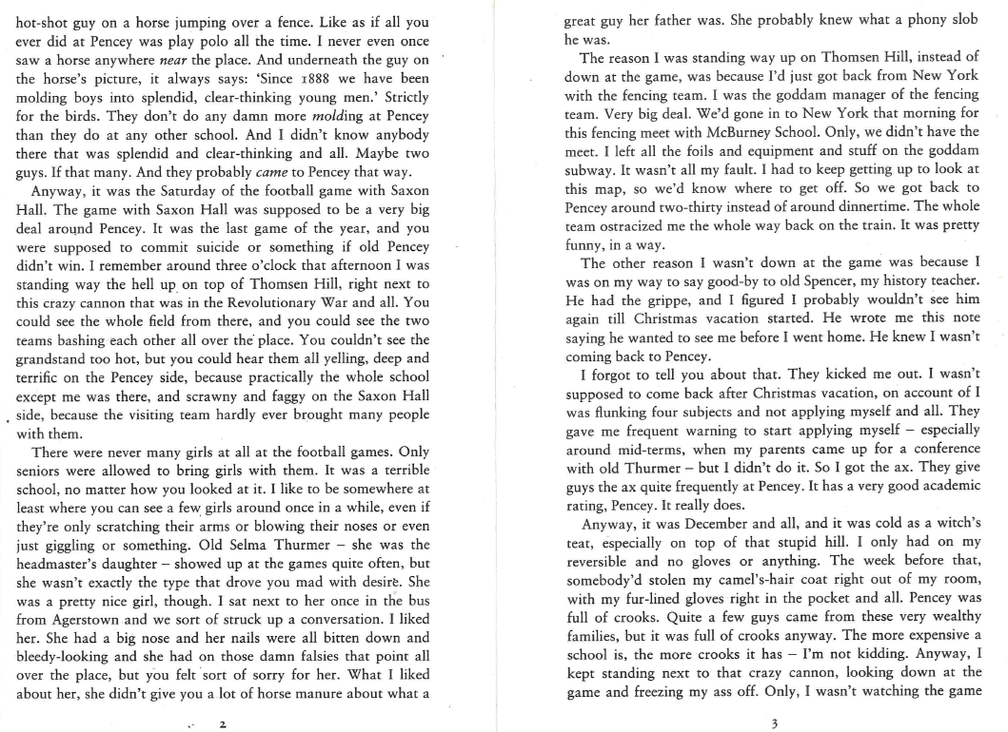
Groups 1&4 : Focus on ‘Alienation’

Slide 5
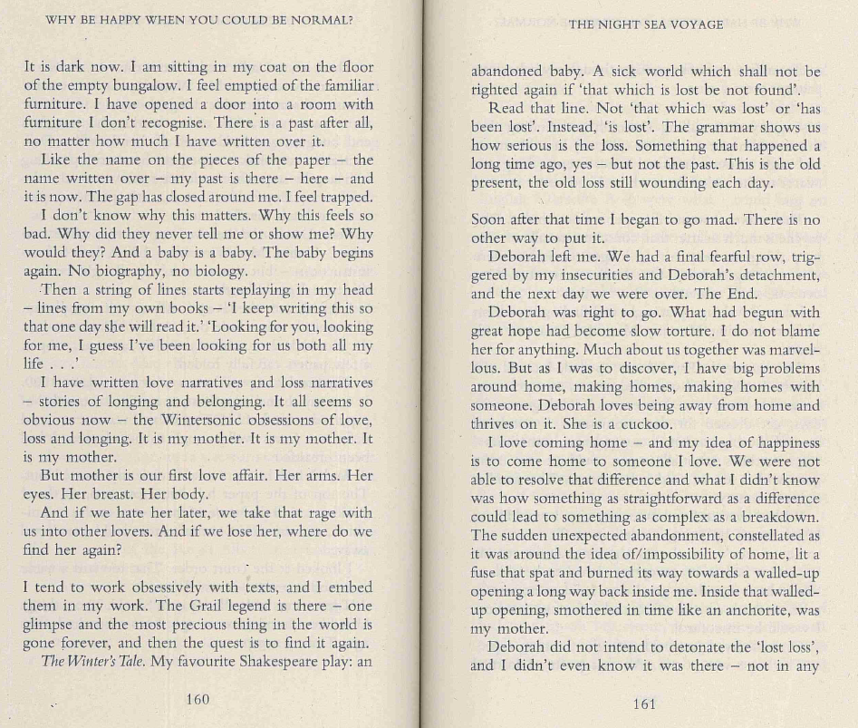
Groups 2&5: Focus on ‘Entrapment

Slide 6
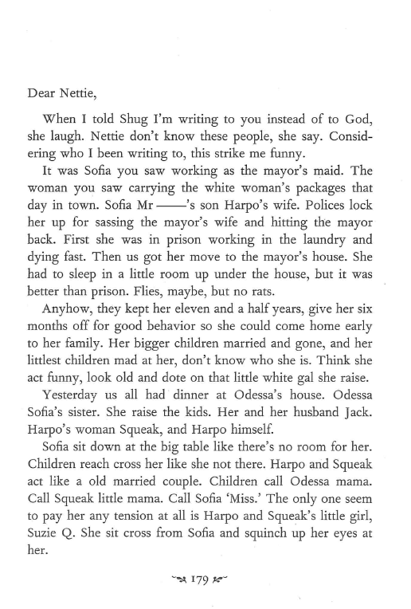
Groups 2&5: Focus on ‘Entrapment’

Slide 7
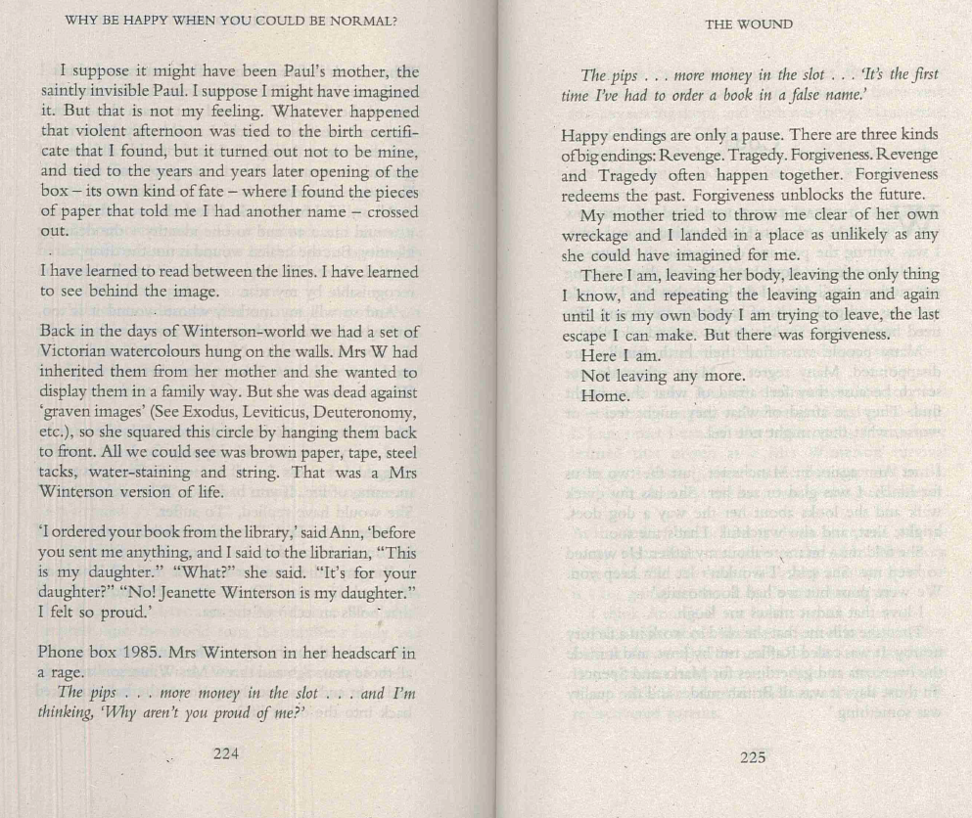
Groups 3&6: Focus on ‘Reconciliation’

Slide 8
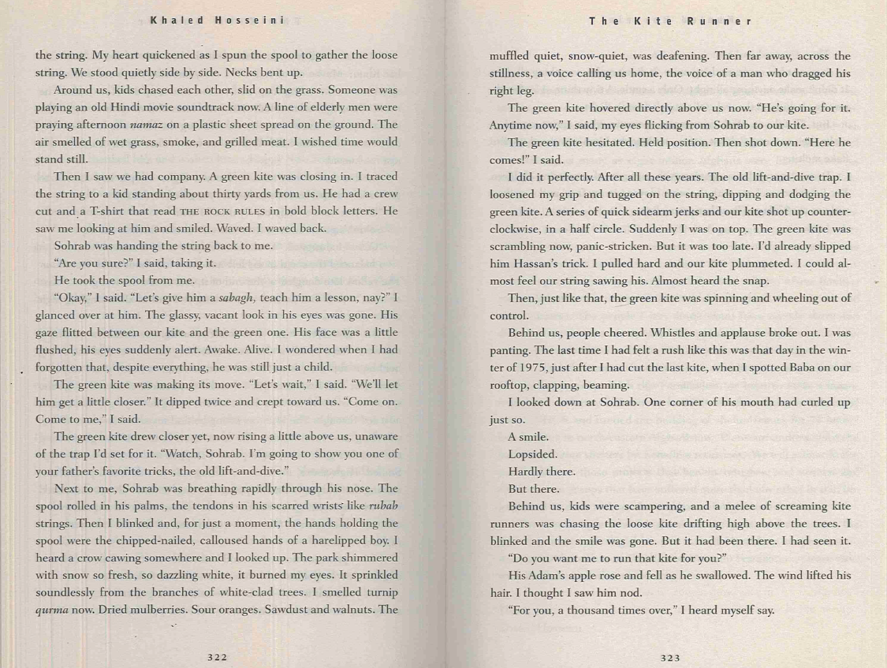
Groups 3&6: Focus on reconciliation

