Slide 1
Creative Writing
Week 1 - Introduction

Slide 2
What do you have to do?
Paper 3, Q3

Slide 4
Paper 3, Q4 (writing a commentary)

Slide 5
On what are you assessed?
Use of English to communicate in different ways (creative writing)
Application of concepts and terminology from linguistic and literary study – written expression
Analysis of the ways in which meanings are created and shaped in texts

Slide 6
What are you doing in your creative writing?
You are making deliberate choices about how you construct your 500 word story.
Before you start, your plan should outline the choices that you have made about:
Perspective and voice
Structure
Time
Character function and role
Setting function and contribution.

Slide 7
Perspectives through language – what’s the difference between these three sentences, and how does it change the perspective?
The men were cycling along the road.
The men were cycling away from me along the road.
Some men cycle along a road.

Slide 8
You might have found that…
The use of the definite article in 1 and 2, suggests that these are specific characters, possibly that the reader has met before, and certainly that have significance.
The inclusion of the first person pronoun shifts the perspective onto the significance of the viewer, and the fact that these characters are leaving them.
The use of the present tense makes it clear that the time of telling is the same as the time of action. It could be seen to create more uncertainty – there is no guarantee that the action will be completed.

Slide 9
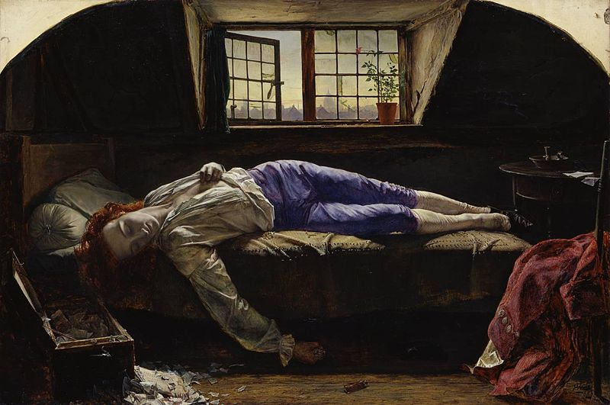
Your turn: one picture, three sentences, three commentaries. (To be handed in, please)
Think, for example:
Tense choice and why?
Definite or indefinite article choice and why?
Pronoun use and why?
Narrative position choice and why?

