Slide 1
Creative Writing
Session 3 – What the examiners have said, Structure and the Opening

Slide 2
Report on June 2022 Series Paper 3 Q 3
Need to go beyond descriptions – merely re-presenting the narrative of the prompts is limiting as it does not demonstrate manipulation of story
Repeated advice to avoid relying too heavily on description as opposed to narrative construction.
Praise offered for "useful" attempts to write from different perspectives
Avoid writing in the horror or gothic genre – it’s difficult to be creative

Slide 3
Remember that in your creative writing, you need to create your story with these in mind:
Perspective and voice
Character function and role
Structure
Time
Setting function and contribution.

Slide 4
Thinking about “manipulation of story” – could be termed “Structure”
Your key question: how will you create a story that really engages your reader, and keeps them interested?
Chekov’s advice to an aspiring writer: “If in the first chapter you say that a gun hung on the wall, in the second, or third chapter it must without fail be discharged.”
What does this mean?
Create a sense of imbalance or tension, and don’t resolve it too quickly.
Your aim is to raise questions at the start (you may hint at events in the past or the future), or leave gaps in the narrative.

Slide 5
What is this writer not telling the reader?
“Hale knew they meant to murder him before he had been in Brighton three hours.”
(The opening sentence of Brighton Rock, by Graham Greene)
How Hale knew this
Who “they” are
Why they “meant to murder him”
What will actually happen

Slide 6
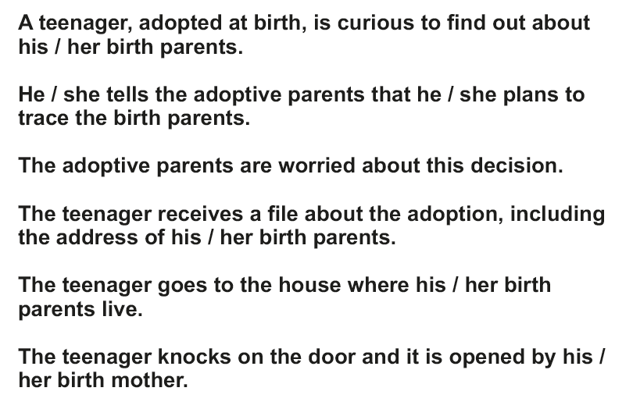
Here is your story line.
Decide where you will start in the story.
Decide whether you will have a linear narrative.
Decide on your perspective and point of view
Decide what you will NOT tell your reader at the start
Decide on what you will imply at the start.
Compare as a class

Slide 7
Now write your opening three sentences
Think:
You need to get your reader interested from the first line.
Will you plunge them into the middle of the story?
Will you include something that is incongruous and inexplicable unless you read on?
Will you use an intriguing narrator who doesn’t know the answers themselves?
Will you hint at the future, or at the past (proleptic or analeptic references)?

