Slide 1
Creative Writing
Session 4 – Time

Slide 2
Time
Two types:
Chronological time: the time in which the events in the novel took place
Narrative time: the order in which plot unfolds, and in which the reader encounters each event.

Slide 3
Manipulating time/pace
What’s the difference in the way the writer uses time in these two extracts?
“The rain cooled about half-past three to a damp mist, through which occasional thin drops swam like dew. [He] looked with vacant eyes through a copy of Clay’s Economics, starting at the Finnish tread that shook the kitchen floor, and peering towards the bleared windows from time to time …”
And
“The arrangement lasted five years, during which the boat went three times around the continent.”

Slide 4
Your thoughts
1) The pace is slowed
2) Time passes quickly, and events are not recalled
The effect:
Slowing the pace: foregrounds a moment in terms of emphasising its importance. It delays the resolution.
Years passing in one sentence, emphasises the unreliable partial nature of story telling, and the subsidiary nature of what is being relayed.

Slide 5
“The Murder”
This is the first line of a story called “The Murder”:
A woman murdered her husband.
This is the last line:
The woman is now a famous doctor.
In no more than five sentences write a skeleton middle for the story.

Slide 6
Your task: create the structure of your story
Think:
What are the subsidiary and the essential elements?
What information should be withheld?
Is the narrative time non linear?
Where will the narrative pace be slow?
Where will the gaps in the narrative be?
Discuss as a class, comparing your chosen structure.

Slide 7
Your task: create the commentary on the structure of your story
Think:
What are the subsidiary and the essential elements, and why?
What information should be withheld, and why?
Is the narrative time non linear; if so, why?
Where will the narrative pace be slow, and why?
Where will the gaps in the narrative be, and why?

Slide 8
Creative Writing
Character Session 5
This Photo by Unknown Author is licensed under CC BY

Slide 9
Worth remembering ….
Character is a linguistic function: we can only learn about them from the text
Therefore: how does a writer create a character?
This Photo by Unknown Author is licensed under CC BY-SA-NC

Slide 10
How is character created here, for example?
The only completely stationary object in the room was an enormous couch on which two women were buoyed up as though upon an anchored balloon. They were both in white, and their dresses were rippling and fluttering as it they had just been blown back in after a short flight around the house.
Through association with specific imagery (of nature)
Through repeated lexical clusters (“rippling” “fluttering” “buoyed up”)
Through symbolism (“white”)

Slide 11
And here?
He paused. “I see you’re looking at my cuff buttons.”
I hadn’t been looking at them, but I did now. They were composed of oddly familiar pieces of ivory.
“Finest specimens of human molars,” he informed me.
“Well!” I inspected them. “that’s a very interesting idea.”
“Yeah.” He flipped his sleeves up under his coat.
Through inanimate objects
Through the verbs (“informed” “inspected”) that indicate the power balance between the two characters. “Flipped” suggests a casual attitude.
Through the actions (“I did now”), again indicating the power balance
Through dialogue (use of hyperbole “finest”, politeness features “interesting idea”)

Slide 12
Choose your character function
Do they function as a protagonist?
Do they function as an antagonist?
Do they function as a major or as a minor character?
Do they function as a foil?
Do they function to illustrate a theme?
Do they function to further the plot?
Does their name have a function?
Do they function as a symbol?

Slide 13
Your task: pick one of these characters. First decide on their function within your imagined story.
Then, write 3 sentences. Create your character through choice of verb, choice of image, choice of name, choice of lexical clusters, association with inanimate object or with setting, by dialogue.
Compare as a class

Slide 14
Creative Writing
Setting Session 6

Slide 15
Setting can play which functions?
SYMBOLIC FUNCTION: representing a particular idea
REFERENTIAL FUNCTION: to help to create a fully convincing world within the novel
ANALOGICAL FUNCTION: to capture the mood of a character
SYMBOLIC FUNCTION: to convey a message
It can also: act as a back drop to events, signal a genre, create expectations

Slide 16
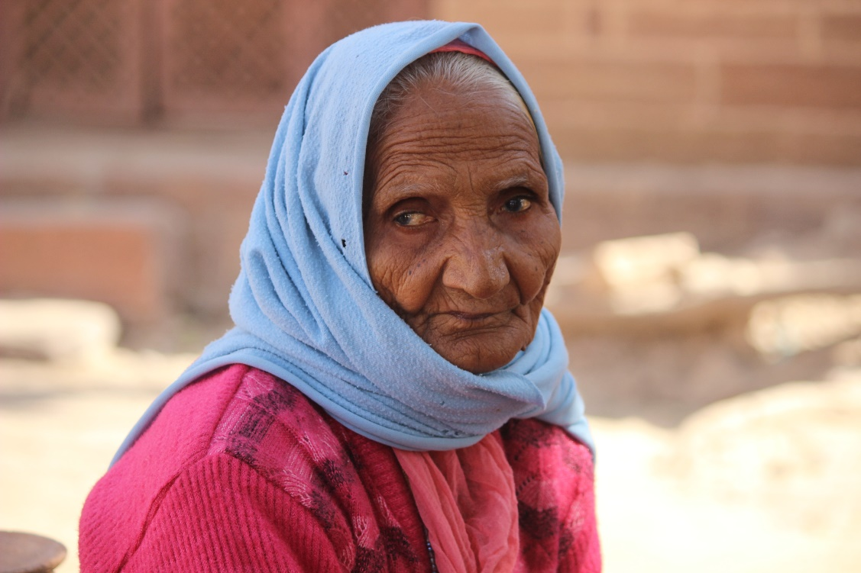
Here is the setting
And the protagonist character
Write the first three sentences, creating the setting.
As a class, decide how the setting is functioning within the story.
This Photo by Unknown Author is licensed under CC BY-NC-ND

Slide 17
Creative Writing
Bringing it all together, and writing the commentary: Session 7

Slide 18
The Commentary
You need to write a commentary of 250 words.
In your commentary you need to explain choices you have made regarding
structure
narrative voice and point of view
lexis and syntax
setting function
characterisation
time manipulation.

Slide 19
What the examiners said:
You should NOT list the features they used in your creative writing
Need for the commentary to follow the narrative rather than drive it
It should NOT be a box-ticking exercise.
Less successful are the those which offer rehearsed claims regarding language features – e.g. pathetic fallacy always creates a moody atmosphere. In other words, don’t decide what you are going to write before you’ve even seen the exam paper!
Both story and commentary are marked separately and a mark is always given to Q3 before the commentary is marked. In other words, do not expect your commentary to explain what’s going on in your creative writing!

Slide 20
Which is the best commentary here and why?
I’ve chosen to write my narrative using a first person narrative voice, from the perspective of the student. Rather than setting the scene, I’ve launched straight into the story, in media res, at a point after the incident with the car driver. I wanted to create suspense, so that the reader wonders why the narrator has all the signs of having been beaten up. I’ve used language features that suggest a spoken discourse, such as minor sentences, rhetorical questions, starting sentences with “And” and colloquial lexis, such as “big fat purple bruise”, “mate” and “pasting” to give an impression of the narrator’s conversational tone. However, the voice is generally conventional, and does not directly address the reader, or comment on the narration of the story.
One of the most important things about how I have written this story is that I have used flashback. I start from the end, and then explain how the event happened, and this keeps the reader interested. I also used similes as this creates a vivid picture in the reader’s head, and makes them want to read on. I wanted to make it rain in my story, as I wanted the pathetic fallacy to create a gloomy mood, to show how the main character was feeling.
I spent a lot of my opening setting the scene, with long descriptive passages, because the place is really important. I used lots of minor sentences, with noun phrases and no verbs, so that I could create an impression quickly. Using the dialogue made it easier for the reader to hear the voices of the characters and to see how they interact with one another. I made the protagonist speak more than the foil because I wanted it to be clear that he was the focalisation.

Slide 21
Which is the best commentary here and why?
I’ve chosen to write my narrative using a first person narrative voice, from the perspective of the student. Rather than setting the scene, I’ve launched straight into the story, in media res, at a point after the incident with the car driver. I wanted to create suspense, so that the reader wonders why the narrator has all the signs of having been beaten up. I’ve used language features that suggest a spoken discourse, such as minor sentences, rhetorical questions, starting sentences with “And” and colloquial lexis, such as “big fat purple bruise”, “mate” and “pasting” to give an impression of the narrator’s conversational tone. However, the voice is generally conventional, and does not directly address the reader, or comment on the narration of the story.
One of the most important things about how I have written this story is that I have used flashback. I start from the end, and then explain how the event happened, and this keeps the reader interested. I also used similes as this creates a vivid picture in the reader’s head, and makes them want to read on. I wanted to make it rain in my story, as I wanted the pathetic fallacy to create a gloomy mood, to show how the main character was feeling.
I spent a lot of my opening setting the scene, with long descriptive passages, because the place is really important. I used lots of minor sentences, with noun phrases and no verbs, so that I could create an impression quickly. Using the dialogue made it easier for the reader to hear the voices of the characters and to see how they interact with one another. I made the protagonist speak more than the foil because I wanted it to be clear that he was the focalisation.
Number 1 is specific to the story that has been written, and there are no generalisations. The points are supported with evidence from the creative writing piece, and the candidate uses terminology accurately and securely. TOP
Number 2 has a tendency to use rehearsed arguments from GCSE (“keeps the reader interested”, “creates a vivid picture), and the commentary could be applied to almost any piece of creative writing. BOTTOM
Number 3 is clear, and does offer specific reasons for the choices made. A couple of the points could be further developed (“an impression” of what, for example? Why is it important that the reader knows how the characters interact?), but generally accurate and fluently expressed. MIDDLE

Slide 22
Your turn to write the commentary for this story

Slide 23
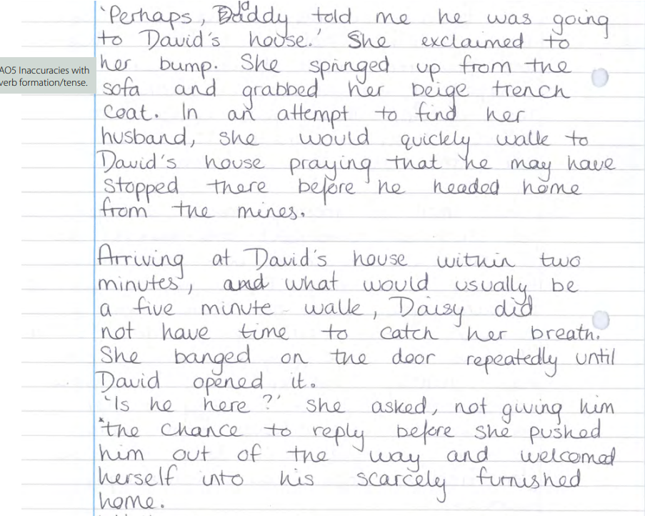

Slide 26
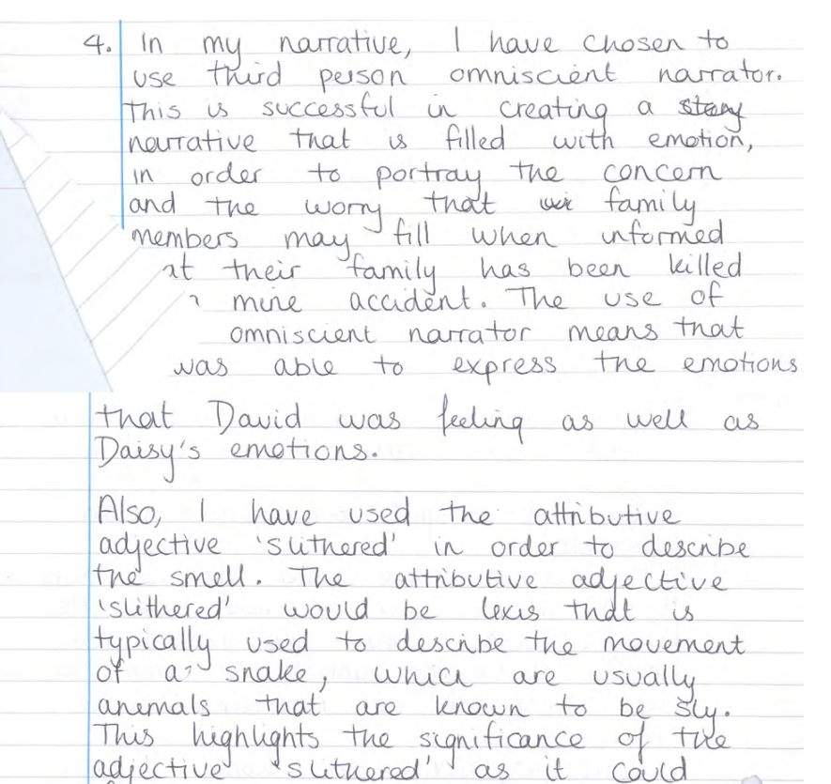
Now compare yours to the original.

Slide 27
In comparison to your own, has this candidate included elements that you would have liked to include, or has this candidate missed out things that you think they should have included?
Discuss with the person next to you.

Slide 28
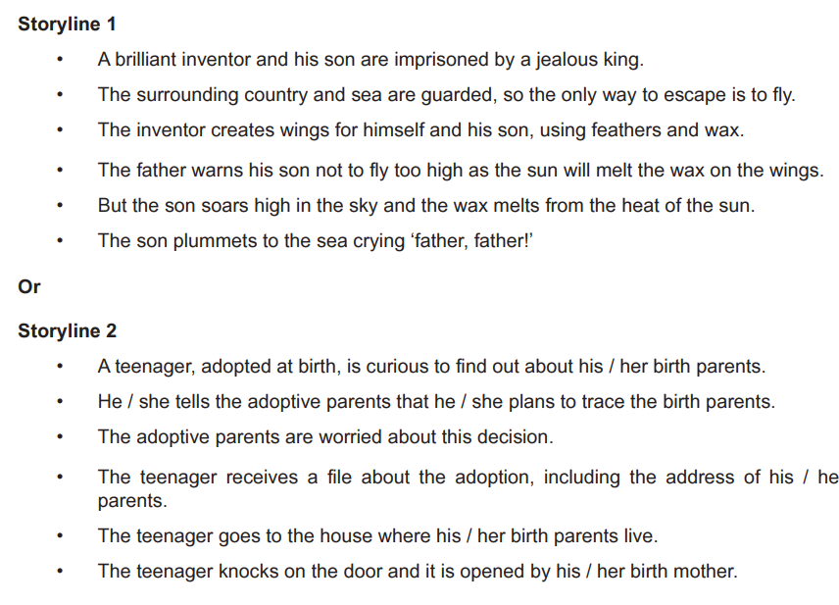
Past Exam Questions – for practice
June 2018

Slide 29
Past Questions
June 2019

Slide 30
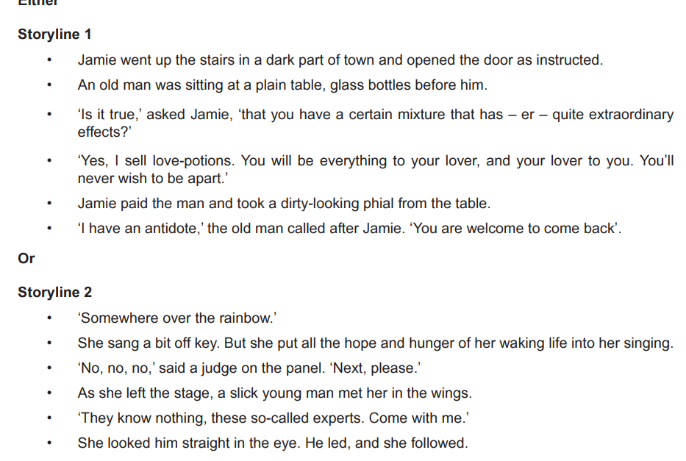
Past Questions
November 2020

Slide 31
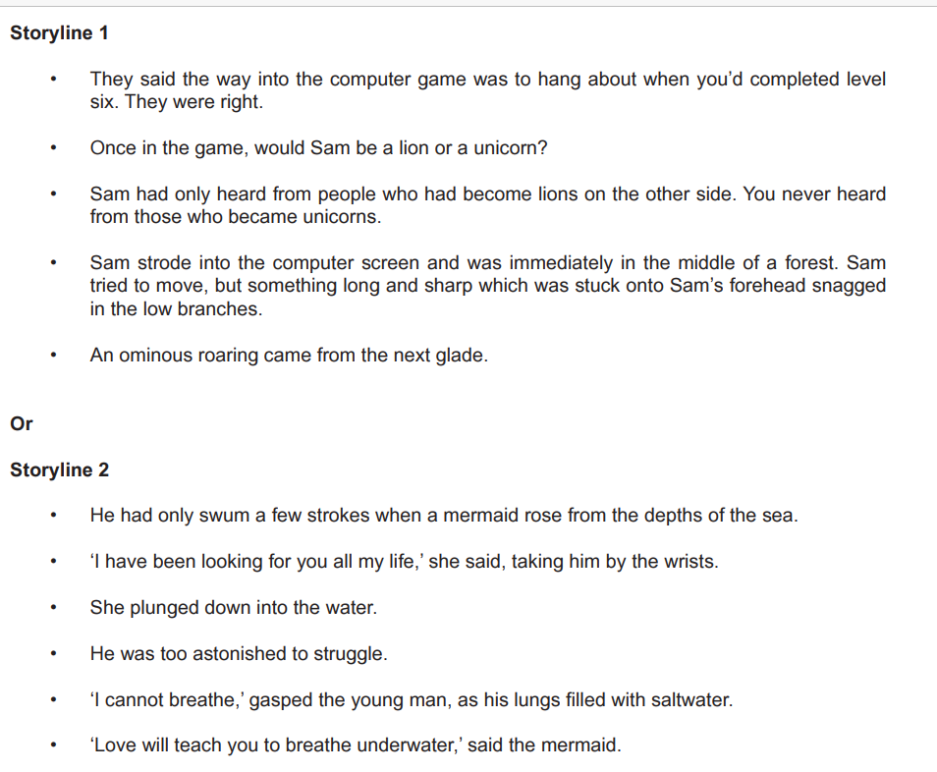
Past Questions
November 2021

Slide 32
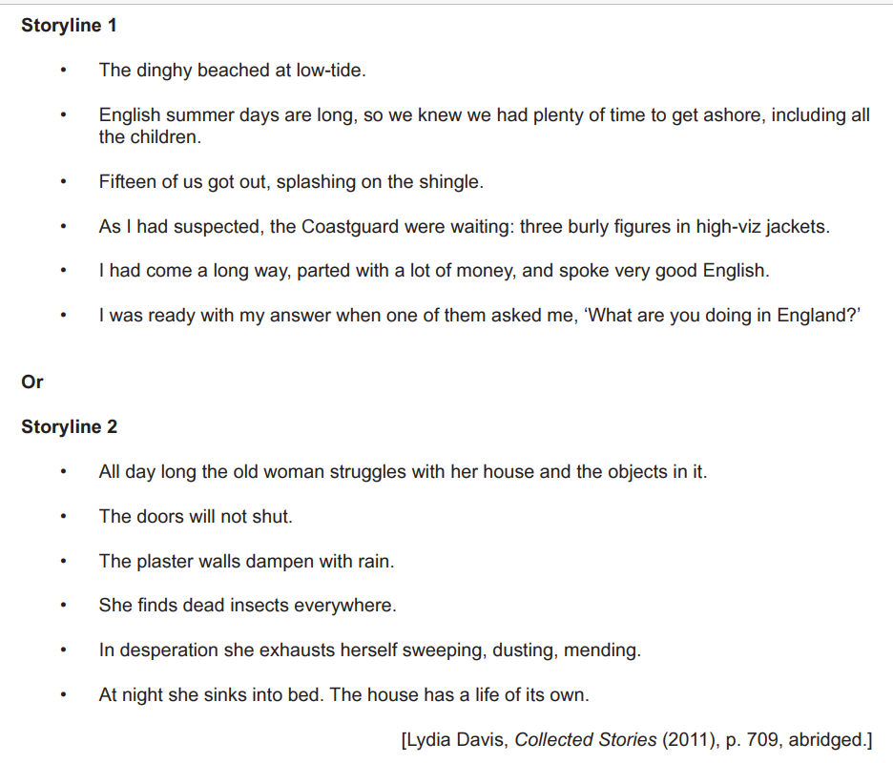
Past Questions
June 2022

