Slide 1
Creative Writing
Bringing it all together, and writing the commentary: Session 7

Slide 2
The Commentary
You need to write a commentary of 250 words.
It is worth 14 marks. The creative writing is worth 18 marks.
It is recommended that you spend 20 minutes on the commentary and 40 minutes on the creative writing.

Slide 3
What could you include?
In your commentary you need to explain choices you have made regarding:
structure
narrative voice and point of view
lexis and syntax
setting function
characterisation
time manipulation.

Slide 4
What the examiners said:
You should NOT list the features used in your creative writing
Need for the commentary to follow the narrative rather than drive it
It should NOT be a box-ticking exercise.
Less successful are the those which offer rehearsed claims regarding language features – e.g. pathetic fallacy always creates a moody atmosphere. In other words, don’t decide what you are going to write before you’ve even seen the exam paper!
Both story and commentary are marked separately and a mark is always given to Q3 before the commentary is marked. In other words, do not expect your commentary to explain what’s going on in your creative writing!

Slide 5
Which is the best commentary here and why?
I’ve chosen to write my narrative using a first person narrative voice, from the perspective of the student. Rather than setting the scene, I’ve launched straight into the story, in media res, at a point after the incident with the car driver. I wanted to create suspense, so that the reader wonders why the narrator has all the signs of having been beaten up. I’ve used language features that suggest a spoken discourse, such as minor sentences, rhetorical questions, starting sentences with “And” and colloquial lexis, such as “big fat purple bruise”, “mate” and “pasting” to give an impression of the narrator’s conversational tone. However, the voice is generally conventional, and does not directly address the reader, or comment on the narration of the story.
One of the most important things about how I have written this story is that I have used flashback. I start from the end, and then explain how the event happened, and this keeps the reader interested. I also used similes as this creates a vivid picture in the reader’s head, and makes them want to read on. I wanted to make it rain in my story, as I wanted the pathetic fallacy to create a gloomy mood, to show how the main character was feeling.
I spent a lot of my opening setting the scene, with long descriptive passages, because the place is really important. I used lots of minor sentences, with noun phrases and no verbs, so that I could create an impression quickly. Using the dialogue made it easier for the reader to hear the voices of the characters and to see how they interact with one another. I made the protagonist speak more than the foil because I wanted it to be clear that he was the focalisation.

Slide 6
Which is the best commentary here and why?
I’ve chosen to write my narrative using a first person narrative voice, from the perspective of the student. Rather than setting the scene, I’ve launched straight into the story, in media res, at a point after the incident with the car driver. I wanted to create suspense, so that the reader wonders why the narrator has all the signs of having been beaten up. I’ve used language features that suggest a spoken discourse, such as minor sentences, rhetorical questions, starting sentences with “And” and colloquial lexis, such as “big fat purple bruise”, “mate” and “pasting” to give an impression of the narrator’s conversational tone. However, the voice is generally conventional, and does not directly address the reader, or comment on the narration of the story.
One of the most important things about how I have written this story is that I have used flashback. I start from the end, and then explain how the event happened, and this keeps the reader interested. I also used similes as this creates a vivid picture in the reader’s head, and makes them want to read on. I wanted to make it rain in my story, as I wanted the pathetic fallacy to create a gloomy mood, to show how the main character was feeling.
I spent a lot of my opening setting the scene, with long descriptive passages, because the place is really important. I used lots of minor sentences, with noun phrases and no verbs, so that I could create an impression quickly. Using the dialogue made it easier for the reader to hear the voices of the characters and to see how they interact with one another. I made the protagonist speak more than the foil because I wanted it to be clear that he was the focalisation.
Number 1 is specific to the story that has been written, and there are no generalisations. The points are supported with evidence from the creative writing piece, and the candidate uses terminology accurately and securely. TOP
Number 2 has a tendency to use rehearsed arguments from GCSE (“keeps the reader interested”, “creates a vivid picture), and the commentary could be applied to almost any piece of creative writing. BOTTOM
Number 3 is clear, and does offer specific reasons for the choices made. A couple of the points could be further developed (“an impression” of what, for example? Why is it important that the reader knows how the characters interact?), but generally accurate and fluently expressed. MIDDLE

Slide 7
Your turn to write the commentary for this story

Slide 8
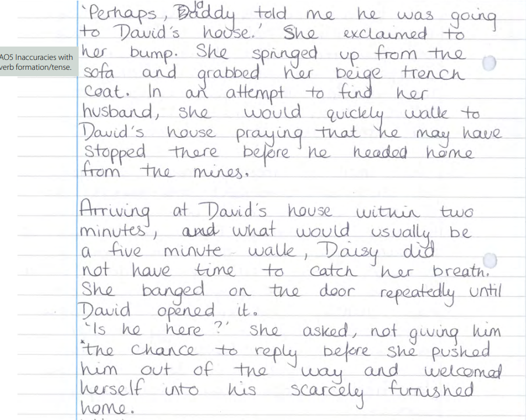

Slide 11
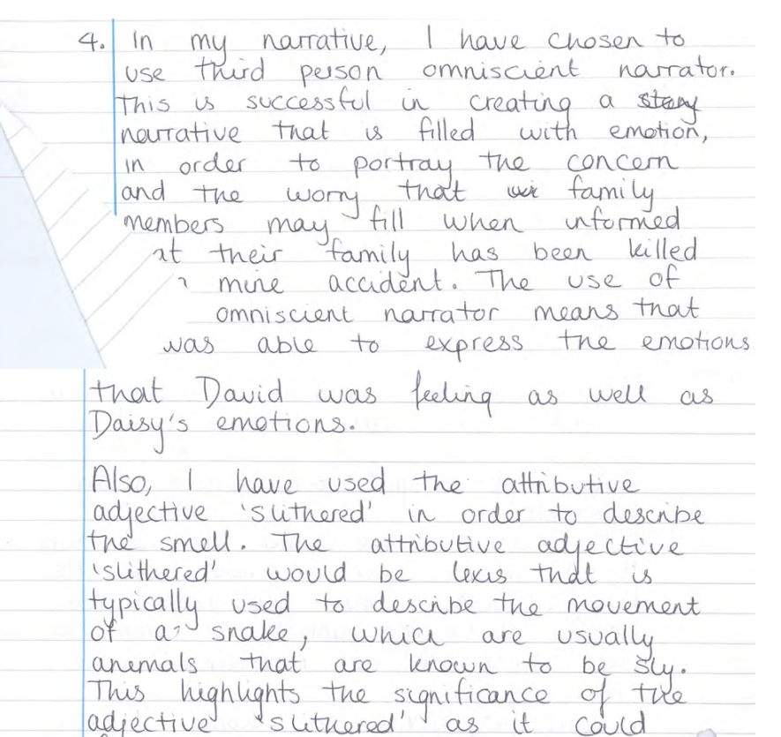
Now compare yours to the original.

Slide 12
In comparison to your own, has this candidate included elements that you would have liked to include, or has this candidate missed out things that you think they should have included?
Discuss with the person next to you.

Slide 13
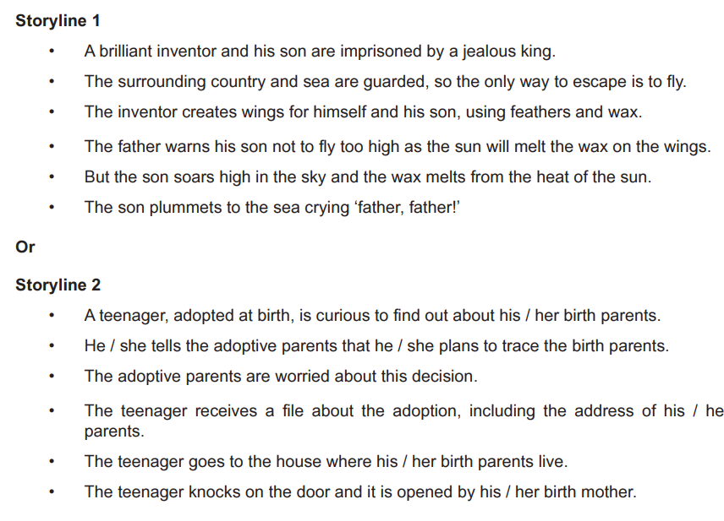
Past Exam Questions – for practice
June 2018

Slide 14
Past Questions
June 2019

Slide 15
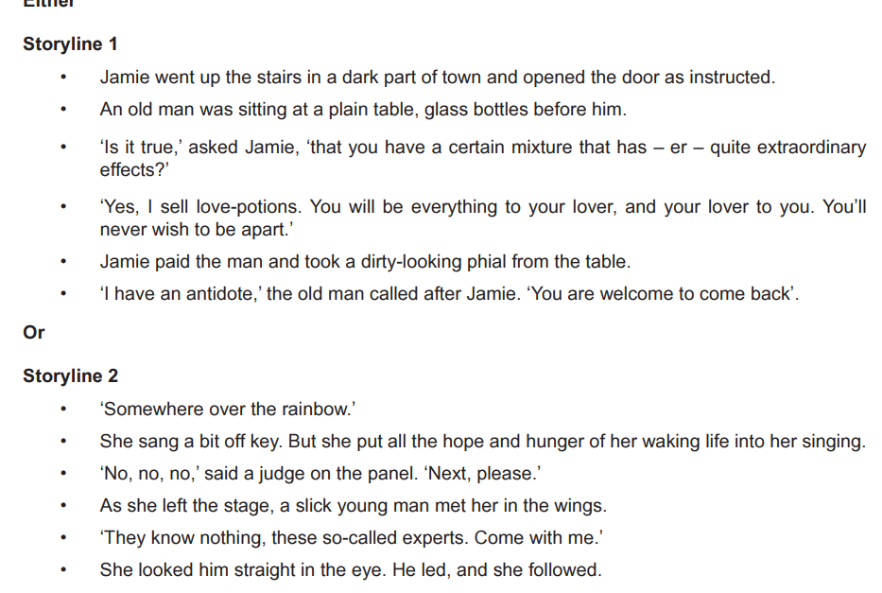
Past Questions
November 2020

Slide 16
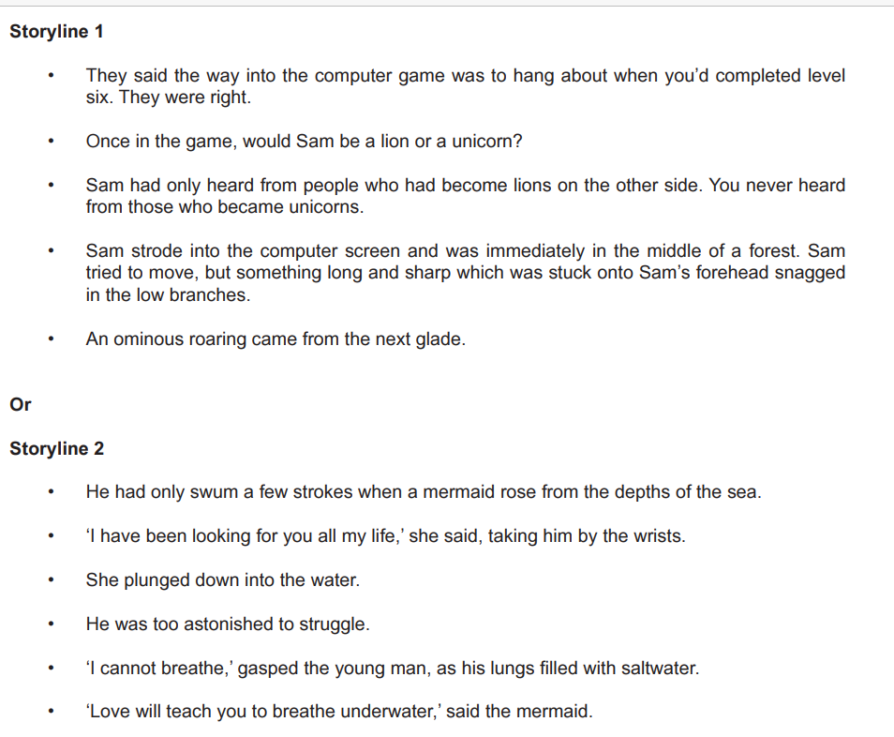
Past Questions
November 2021

Slide 17
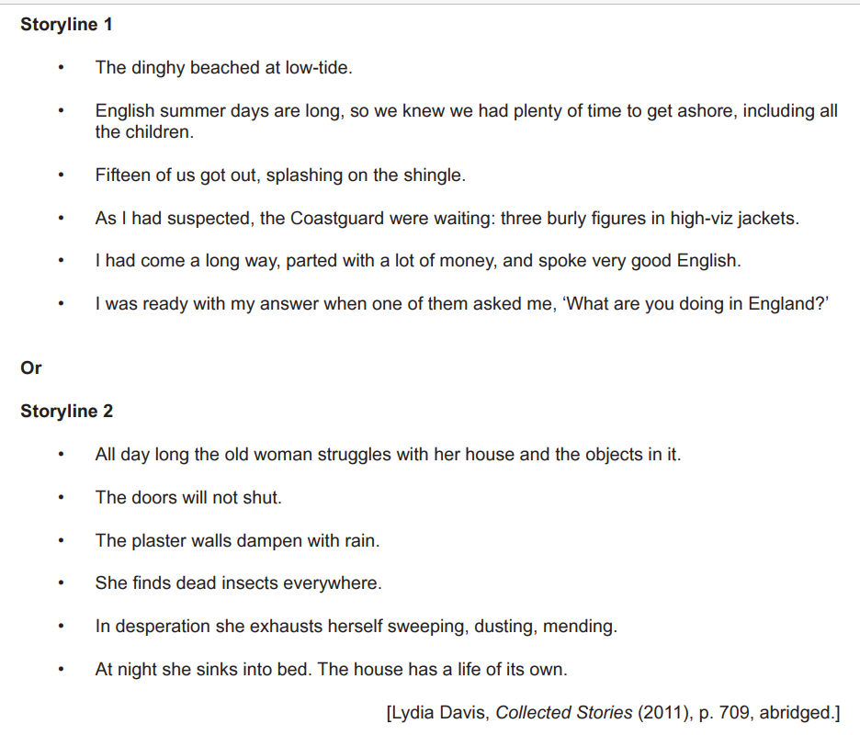
Past Questions
June 2022

