Slide 1
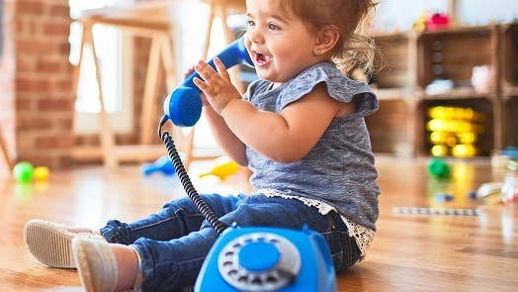
What is Child Development? Why is it important in Early Years?
https://www.highspeedtraining.co.uk/hub/child-development-in-early-years/

Slide 2
What do we mean by child Development?

Slide 3
Child Development can be defined as the process by which all children grow and change over time. It is the sequence of physical growth, as well as intellectual (cognitive), social, emotional and language development. Each of these aspects are often considered separately, however in reality each influences all of the others.

Slide 4
Development 0-5 years
Children develop rapidly in their first five years.
It is important for parents and those who work with children to understand exactly what happens during these early stages of development.
This allows them to meet a child’s needs and ensure that they have the best start in life.

Slide 5
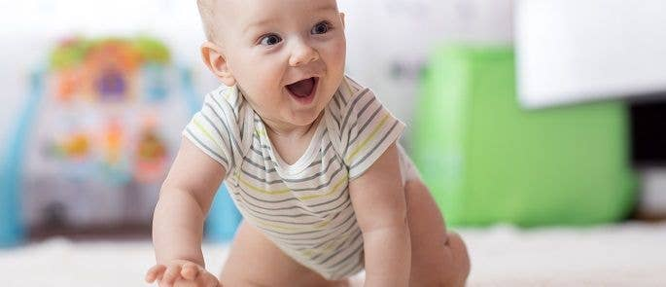
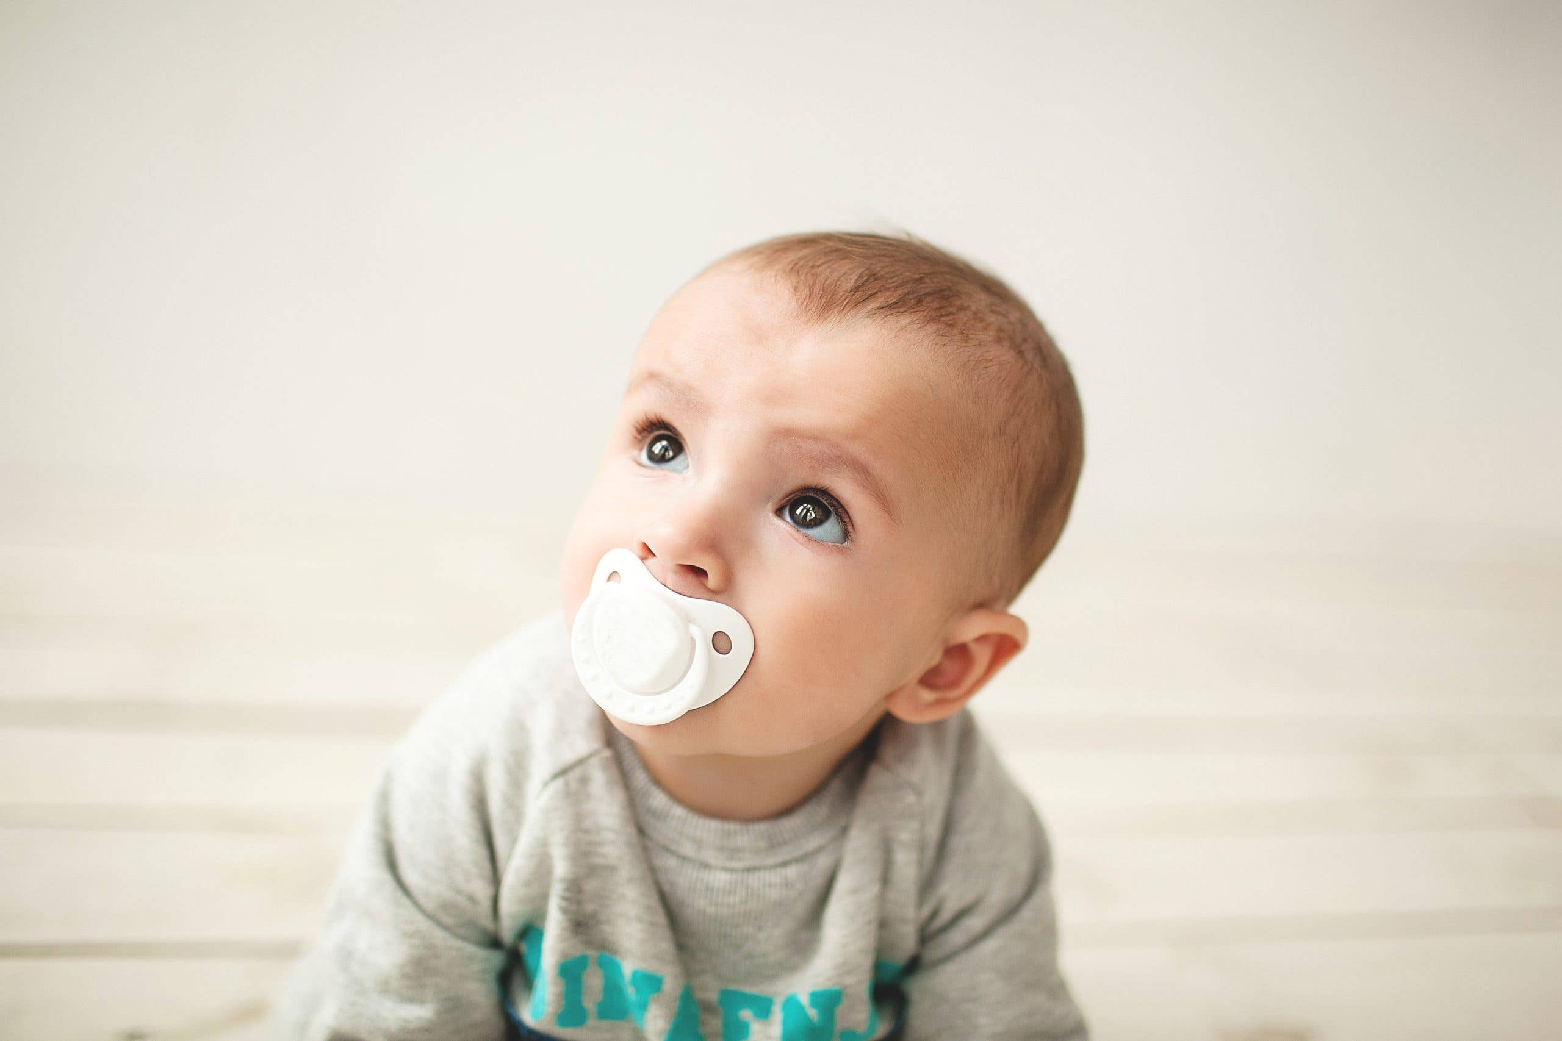
What is holistic development?
Subtitle

Slide 6
Holistic Development is… about supporting the whole development of a child. It is an approach to learning that emphasises on the physical, intellectual, language, social and emotional development of children. | This means
 | It is important to know so that
 | Something else to add would be

Slide 7
Holistic Development Examples: 1. The brain develops physically and this increases intellectual skills and abilities. 2. Language develops and this enhances communication, social and emotional skills. 3. Physical growth and development enables intellectual skills in social and intellectual areas with more opportunities for children to explore and interact with others. Come up with 3 more examples….

Slide 8
Child Development Quiz
Children develop rapidly in their first five years.
https://www.highspeedtraining.co.uk/hub/child-development-quiz/

Slide 9
TedX Talk
https://youtu.be/aISXCw0Pi94
Notes:
This is an interesting talk because ….

Slide 10
Find 2 definitions of Child Development and compare
Definition One:
Definition Two

Slide 11
Write your own definition here
Use books, the internet, other sources.

Slide 12
Topic one
Subtitle

Slide 13
Early Years Matters
https://www.earlyyearsmatters.co.uk/top-tips/your-developing-baby-0-3-months/

Slide 14
The Early Years Foundation Stage (EYFS) is the statutory framework that sets the standards for the development, learning and care of children attending a setting from birth to five until the end of reception year at school (EYFS Profile, 2014). Since being introduced in March 2007, the emergence of this statutory policy initiative has supported the sector to work towards standards across early year’s provision. The EYFS has also enabled the opportunity for settings to continually review practices, and to provide a pedagogical approach that meets children’s interests, experiences and wellbeing, and promote teaching and learning to ensure not only ‘school readiness’ but to give children a broad range of skills that provide the right foundation for future progress (DfE, Statutory Framework, 2017).

Slide 15
There are 5 Stages of Child Development
Development describes the way a child grows, changes, and develops skills – not only physically, but also socially, emotionally, cognitively and communicatively.
Child development can be broken down into five stages:
Newborn (0-3 months)
Infant (3-12 months)
Toddler (1-3 years)
Preschool age (3-4 years)
School age (4-5 years).
At each of these stages, children reach different milestones (also known as ‘characteristics of a stage’ – they develop and progress at a rapid rate.

Slide 16
PILES
Social and Emotional
Physical
The way in which the body increases in skill and becomes more complex
Development of fine and gross motor skills
Movement, balance, co-ordination
Body growth and muscle developed through physical skills and movement in crawling, sitting, walking, running, jumping, climbing etc..
Write 1 more …
The ability to interact with others, develop, manage, and express feelings.
Becoming more independent
Write 2 more …

Slide 17
PILES
Cognitive
Communication and Language
the ability to think, recognise and remember
Write 2 more ….
the ability to make sounds, talk, understand, and interact with others
Write 2 more …

Slide 18
Domains (Areas) of Development
At each stage of their development, children gain skills in four main domains.
1. The communication and speech domain. Children have to learn to communicate with everyone around them. As well as learning the language, they learn about taking turns in conversation, and how to categorise the world around them. This can be extremely difficult, and leads to interesting errors; for example, when a child learns that a round object is a ‘ball’, they have to work out if that means everything round is also called a ball. Is the moon a ball, and why not? It takes time to understand what separates one word from another.
2. The physical domain. The body increases in skill and performance over time, going through gross motor development (learning to use large muscles, such as the arms and legs), and fine motor development (learning to use muscles to make precise movements, such as the hands and fingers).
3. The social and emotional domain. Children’s identities, self-images and perceptions of feelings evolve as they grow. They also develop relationships with others, and learn how to socialise and follow social etiquette.
4. The cognitive domain. ‘Cognitive processes’ are higher-level functions of the brain, including thinking, knowing, remembering, judging, and problem-solving. As they develop, children increase their understanding of the world, improve their memory, gain better concentration, and refine their problem-solving skills.
All of these areas of development interlink at every stage – children can’t progress in one area without progressing in another.

Slide 19
Research Early Years
Research has shown that only 25% of parents recognise the importance of the first five years (see
Also, teacher training does not cover the early years, despite the fact that children are still in their early years (4-5) when they begin school.
This lack of awareness can mean parents and professionals do not provide the best environments for children, and their progress could be limited.

Slide 20
https://royalfoundation.com/the-duchess-of-cambridge-and-the-royal-foundation-to-release-landmark-research-on-the-early-years-this-week/ https://royalfoundation.com/the-royal-foundation-centre-for-early-childhood-unveils-findings-of-new-research-into-public-perceptions-of-early-childhood-development/
Subtitle

Slide 21
What affects children’s development
Relationships
Their Environment
Biological Factors
Daily interactions and love from family, friends etc..
Transitions they experience such as moving house, separation etc..
Play opportunities contribute to cognitive, physical, social and emotional wellbeing
Home and experiences
Poverty and limited resources at home
Poor nutrition affects development and growth
Medical condition
Disabilities
Special Educational needs

Slide 22
Summarise your learning

