Slide 1
Sample program:
# Counter-controlled iterations
# Subroutine to demonstrate loops
def OutputMessage(Message):
for Counter in range(0,10,1):
print(Message)
# Main program
Message = "This is how you get code to repeat"
OutputMessage(Message)
Notes:
Predict what you think this program does.
Type in the code and run it to see if you were right.
If your code does not work, check the following:
Have you typed every line of code exactly as you see it?
Have you used a tab for code inside structures?
Are the commands in lowercase?
Have you missed a colon?

Slide 2
This program outputs a string 10 times.
Understand how the code works:
# Counter-controlled iterations
# Subroutine to demonstrate loops
def OutputMessage(Message):
for Counter in range(0,10,1):
print(Message)
# Main program
Message = "This is how you get code to repeat"
OutputMessage(Message)
Instead of writing lines of source code that need to execute more than once, iterations are used. They are also known as loops.
The keyword “for” is used when it is known how many times the code needs to repeat, and it is not dependent on any other variable except a counter.
A counter variable keeps track of how many iterations have been executed. Counter is a descriptive name, but it can be called anything. I.e. if it were used for counting through indexes in a string, we might choose to call it “index” or “I” instead.
Counter starts at zero in this example, but it can start at any value.
Code to be repeated is tabulated.
The for loop has three parts. The starting value of the counter, the end value of the counter and the amount the counter should increment or decrement in each iteration.
0, 10, 1 means start the count at 0 and keep repeating until the counter is 10, increasing by 1 in each loop.
The command has a colon at the end.
Notes:
Change the program so that it outputs the message 20 times instead.

Slide 3
Sample program:
# Counter-controlled iterations
# Subroutine to demonstrate loops
def DemoLoop():
for Counter in range(1,11,1):
print("This is line {}".format(Counter))
# Main program
DemoLoop()
Notes:
Predict what you think this program does.
Type in the code and run it to see if you were right.
If your code does not work, check the following:
Have you typed every line of code exactly as you see it?
Have you used a tab for code inside structures?
Are the commands in lowercase?
Have you missed a colon?

Slide 4
This program outputs a string 10 times.
Understand how the code works:
# Counter-controlled iterations
# Subroutine to demonstrate loops
def DemoLoop():
for Counter in range(1,11,1):
print("This is line {}".format(Counter))
# Main program
DemoLoop()
Note here how the loop starts at one instead of zero because it better suits what the counter is to be used for within the loop.
The value of the Counter can be used like any other variable in the program.
Notes:
Change the program so that it outputs: 2 is an even number. 4 is an even number. 6 is an even number. 8 is an even number.

Slide 5
Sample program:
# Counter-controlled iterations
# Subroutine to demonstrate loops
def CharLoop(Message):
for Index in range(0,len(Message),1):
Alpha = Message[Index]
print("Character {} of {} is {}".format(Index, Message, Alpha))
# Main program
Message = "Hello World"
CharLoop(Message)
Notes:
Predict what you think this program does.
Type in the code and run it to see if you were right.
If your code does not work, check the following:
Have you typed every line of code exactly as you see it?
Have you used a tab for code inside structures?
Are the commands in lowercase?
Have you missed a colon?

Slide 6
This program outputs all the letters in a string.
Understand how the code works:
# Counter-controlled iterations
# Subroutine to demonstrate loops
def CharLoop(Message):
for Index in range(0,len(Message),1):
Alpha = Message[Index]
print("Character {} of {} is {}".format(Index, Message, Alpha))
# Main program
Message = "Hello World"
CharLoop(Message)
Here the iteration loops over every character in the string “Message”.
Using string manupulation you can examine each letter in turn.
A loop is very useful in a program like this because you don’t necessarily know how many characters will be in the message.
Notes:
Change the message to, “Should indexes start at 0 or 1? The compromise of 0.5 was rejected without proper consideration.” to check the program works with different messages.
Change the program so that it outputs all the vowels in a word by using an “if” command inside the loop. E.g. “Hello has the following vowels: e o” The vowels are a e i o u.

Slide 7
Learning points from this objective:
An iteration is a section of code that is repeated.
Iterations are also known as loops.
Counter-controlled iterations are used when you want to iterate a known number of times.
How much the counter variable is increased or decreased in each iteration is known as the step. This is often one, but can be any number, both positive and negative.
Counter-controlled iterations use a variable which can be used within the code to know the iteration number.
Code in an iteration is tabulated.
It is good practice to comment code before an iteration to explain what is happening.
One iteration can be put inside another iteration. This is known as nesting.
Notes:
Read the summary of the key learning points for this objective.

Slide 8
Program comprehension:
def Countdown(T):
print("T minus {} to liftoff".format(T))
for Cd in range(T-1,-1,-1):
print(Cd)
# Main program
Countdown(10)
ITEM | Identify the decrement.
 | Identify the condition.
PURPOSE | What does line 3 achieve?
 | Why are there three minus ones in line 3?
Notes:
Answer the questions in the tables using the sample code on this slide.
Enter your answer in the row under the question.

Slide 9
Program comprehension:
def Countdown(T):
print("T minus {} to liftoff".format(T))
for Cd in range(T-1,-1,-1):
print(Cd)
# Main program
Countdown(10)
RELATION | What would happen if line 2 was put before line 4 instead?
 | If the following line of code was to be inserted into the program, which line number should it be placed before, 3, 4, 5 or 6? print("We have liftoff on project Iteration.")
APPROACH | This program could also be written like this: print("T minus 10 to liftoff“); print("9"); print(“8"); print(“7"); etc. Why is this a bad idea?
Notes:
Answer the questions in the tables using the sample code on this slide.
Enter your answer in the row under the question.

Slide 10
Keywords introduced in this objective:
for X in range (Y, Z, W): commands… | Repeats code that is tabulated until the condition is met. The for command has four parts: The counter variable (X). The starting value (Y). The ending value (Z). The counter increment step (W).
for X in Y: commands… | Iterates over a data structure. X becomes each character in string Y. A useful alternative to using [X] if every character in the string needs to be examined. Can also be used with lists.
Notes:
Use these keywords you learned as a handy reference when you make your own programs.

Slide 11
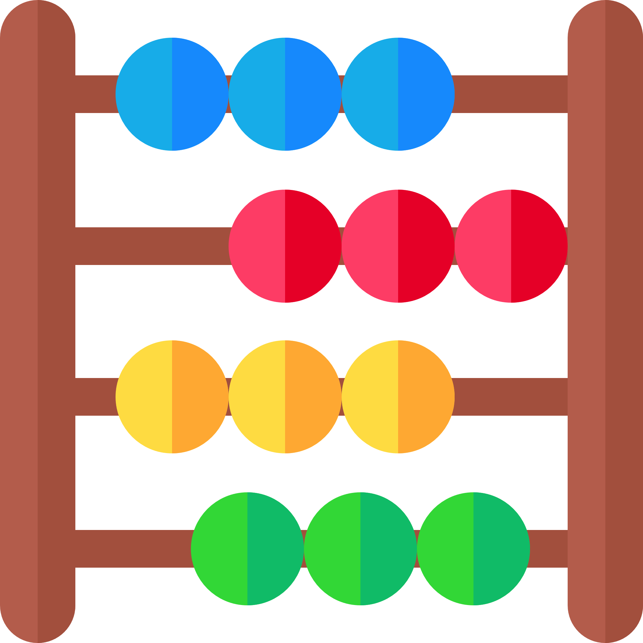
# Times table problem
Times table problem:
1 point.
Write a subroutine that outputs the X times table between 1 and 12.
E.g. for the 6 times table: 1 x 6 = 6
2 x 6 = 12
3 x 6 = 18
4 x 6 = 24
5 x 6 = 30
6 x 6 = 36
7 x 6 = 42
8 x 6 = 48
9 x 6 = 54
10 x 6 = 60
11 x 6 = 66
12 x 6 = 72
# Subroutine to output the X times table.
def TimesTable(X):
TimesTable(6)
# Main program
for Counter in range(1, 13):
print("{} x {} = {}".format(Counter, X, Counter * X))
To help you get started, here is all the code you need with the statements jumbled up.
Notes:
Have a go at some of the problems using what you have learned in this objective.
Only use the commands that you have been shown in the example programs.
Avoid using commands that you have not been taught because you may not be able to use these when answering exam questions.
If your teacher does not direct you, aim to achieve 6 points in total in this objective.

Slide 12
Factorial problem:
1 point.
Write a function called “Fact” that returns the factorial of a number. The factorial of 4 is calculated as 4*3*2*1 = 24. The factorial of 7 is calculated as 7*6*5*4*3*2*1 = 5040.
Notes:
Have a go at some of the problems using what you have learned in this objective.
Only use the commands that you have been shown in the example programs.
Avoid using commands that you have not been taught because you may not be able to use these when answering exam questions.
If your teacher does not direct you, aim to achieve 6 points in total in this objective.

Slide 13
Ten green bottles problem:
1 point.
Write a subroutine that outputs the children’s song below:
10 green bottles hanging on the wall,
10 green bottles hanging on the wall,
And if one green bottle should accidentally fall,
There'll be 9 green bottles hanging on the wall.
9 green bottles hanging on the wall,
9 green bottles hanging on the wall,
And if one green bottle should accidentally fall,
There'll be 8 green bottles hanging on the wall.
.................
1 green bottle hanging on the wall,
1 green bottle hanging on the wall,
And if 1 green bottle should accidentally fall,
There'll be 0 green bottles hanging on the wall.
Note the use of plurals! You can make the problem easier by ignoring plurals for one green bottle if you need to.
Notes:
Have a go at some of the problems using what you have learned in this objective.
Only use the commands that you have been shown in the example programs.
Avoid using commands that you have not been taught because you may not be able to use these when answering exam questions.
If your teacher does not direct you, aim to achieve 6 points in total in this objective.

Slide 14
ASCII art problem:
2 points.
ASCII (pronounced: as-key) art is a graphic design technique of making pictures using only the 95 printable characters on a keyboard.
Write a subroutine that outputs a name in ASCII using the format below, E.g. “Craig’n’Dave” becomes: +-+-+-+-+-+-+-+-+-+-+-+-+
|C|R|A|I|G|'|N|'|D|A|V|E|
+-+-+-+-+-+-+-+-+-+-+-+-+
Here is some cool ASCII art: https://www.youtube.com/watch?v=DEqXNfs_HhY also illustrating why structured code and comments are useful!
FizzBuzz problem:
2 points.
Write a subroutine that outputs the numbers from 1 to X. For the multiples of three output “Fizz” instead of the number and for the multiples of five output “Buzz”. For numbers which are multiples of both three and five output “FizzBuzz”.
Notes:
Have a go at some of the problems using what you have learned in this objective.
Only use the commands that you have been shown in the example programs.
Avoid using commands that you have not been taught because you may not be able to use these when answering exam questions.
If your teacher does not direct you, aim to achieve 6 points in total in this objective.

Slide 15
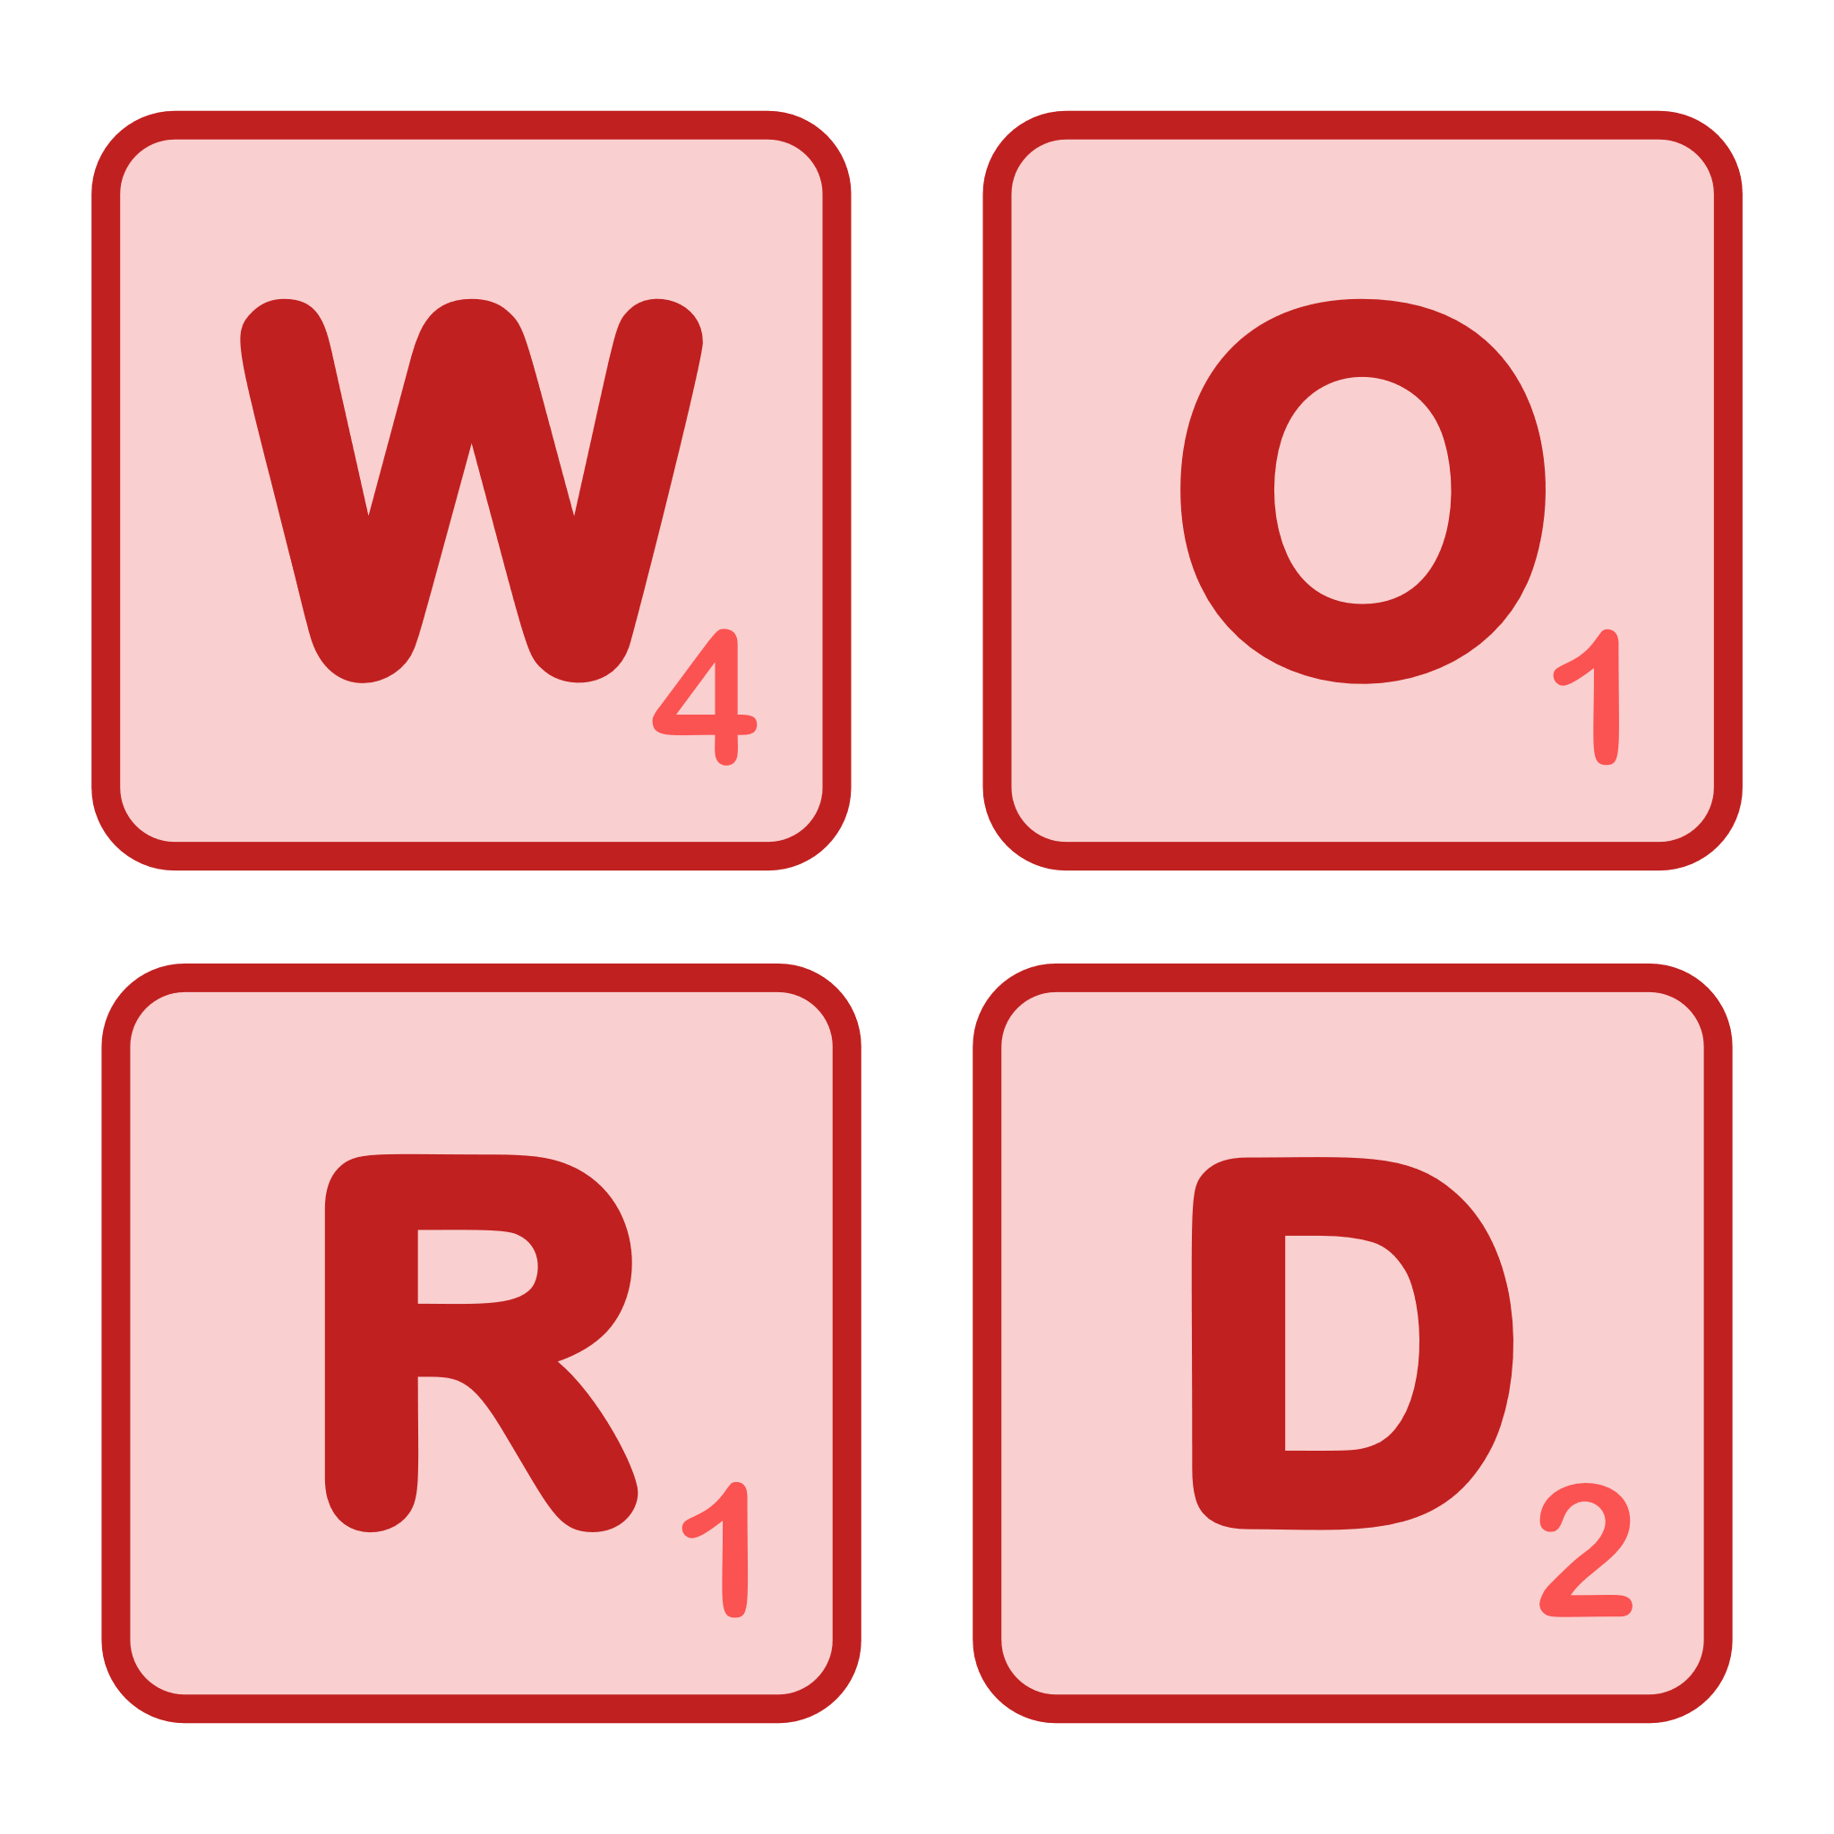
Scrabble problem:
2 points.
Write a function that returns the basic points value of a word in the game scrabble.
1 point: E, A, I, O, N, R, T, L, S, U.
2 points: D, G.
3 points: B, C, M, P.
4 points: F, H, V, W, Y.
5 points: K.
8 points: J, X.
10 points: Q, Z.
Notes:
Have a go at some of the problems using what you have learned in this objective.
Only use the commands that you have been shown in the example programs.
Avoid using commands that you have not been taught because you may not be able to use these when answering exam questions.
If your teacher does not direct you, aim to achieve 6 points in total in this objective.

Slide 16
Passcode problem:
3 points.
Many tablet devices have the option of a passcode. A sequence of digits to enter before the device can be used. It is recommended not to use something that is easy to guess such as 123456 or your date of birth. The problem with random sequences is they are much more difficult to remember. One solution is to take two words you can remember. The passcode is the index of the vowels in those words.
The vowels are A, E, I, O and U.
In this example, the words are Computer Science. The passcode is 1 4 6 2 3 6
Write a function that takes a word as a parameter, e.g. “Computer” and returns the passcode for that word. The complete passcode is the concatenation of the passcode for the two words.
C | O | M | P | U | T | E | R
0 | 1 | 2 | 3 | 4 | 5 | 6 | 7
S | C | I | E | N | C | E
0 | 1 | 2 | 3 | 4 | 5 | 6
Notes:
Have a go at some of the problems using what you have learned in this objective.
Only use the commands that you have been shown in the example programs.
Avoid using commands that you have not been taught because you may not be able to use these when answering exam questions.
If your teacher does not direct you, aim to achieve 6 points in total in this objective.

Slide 17
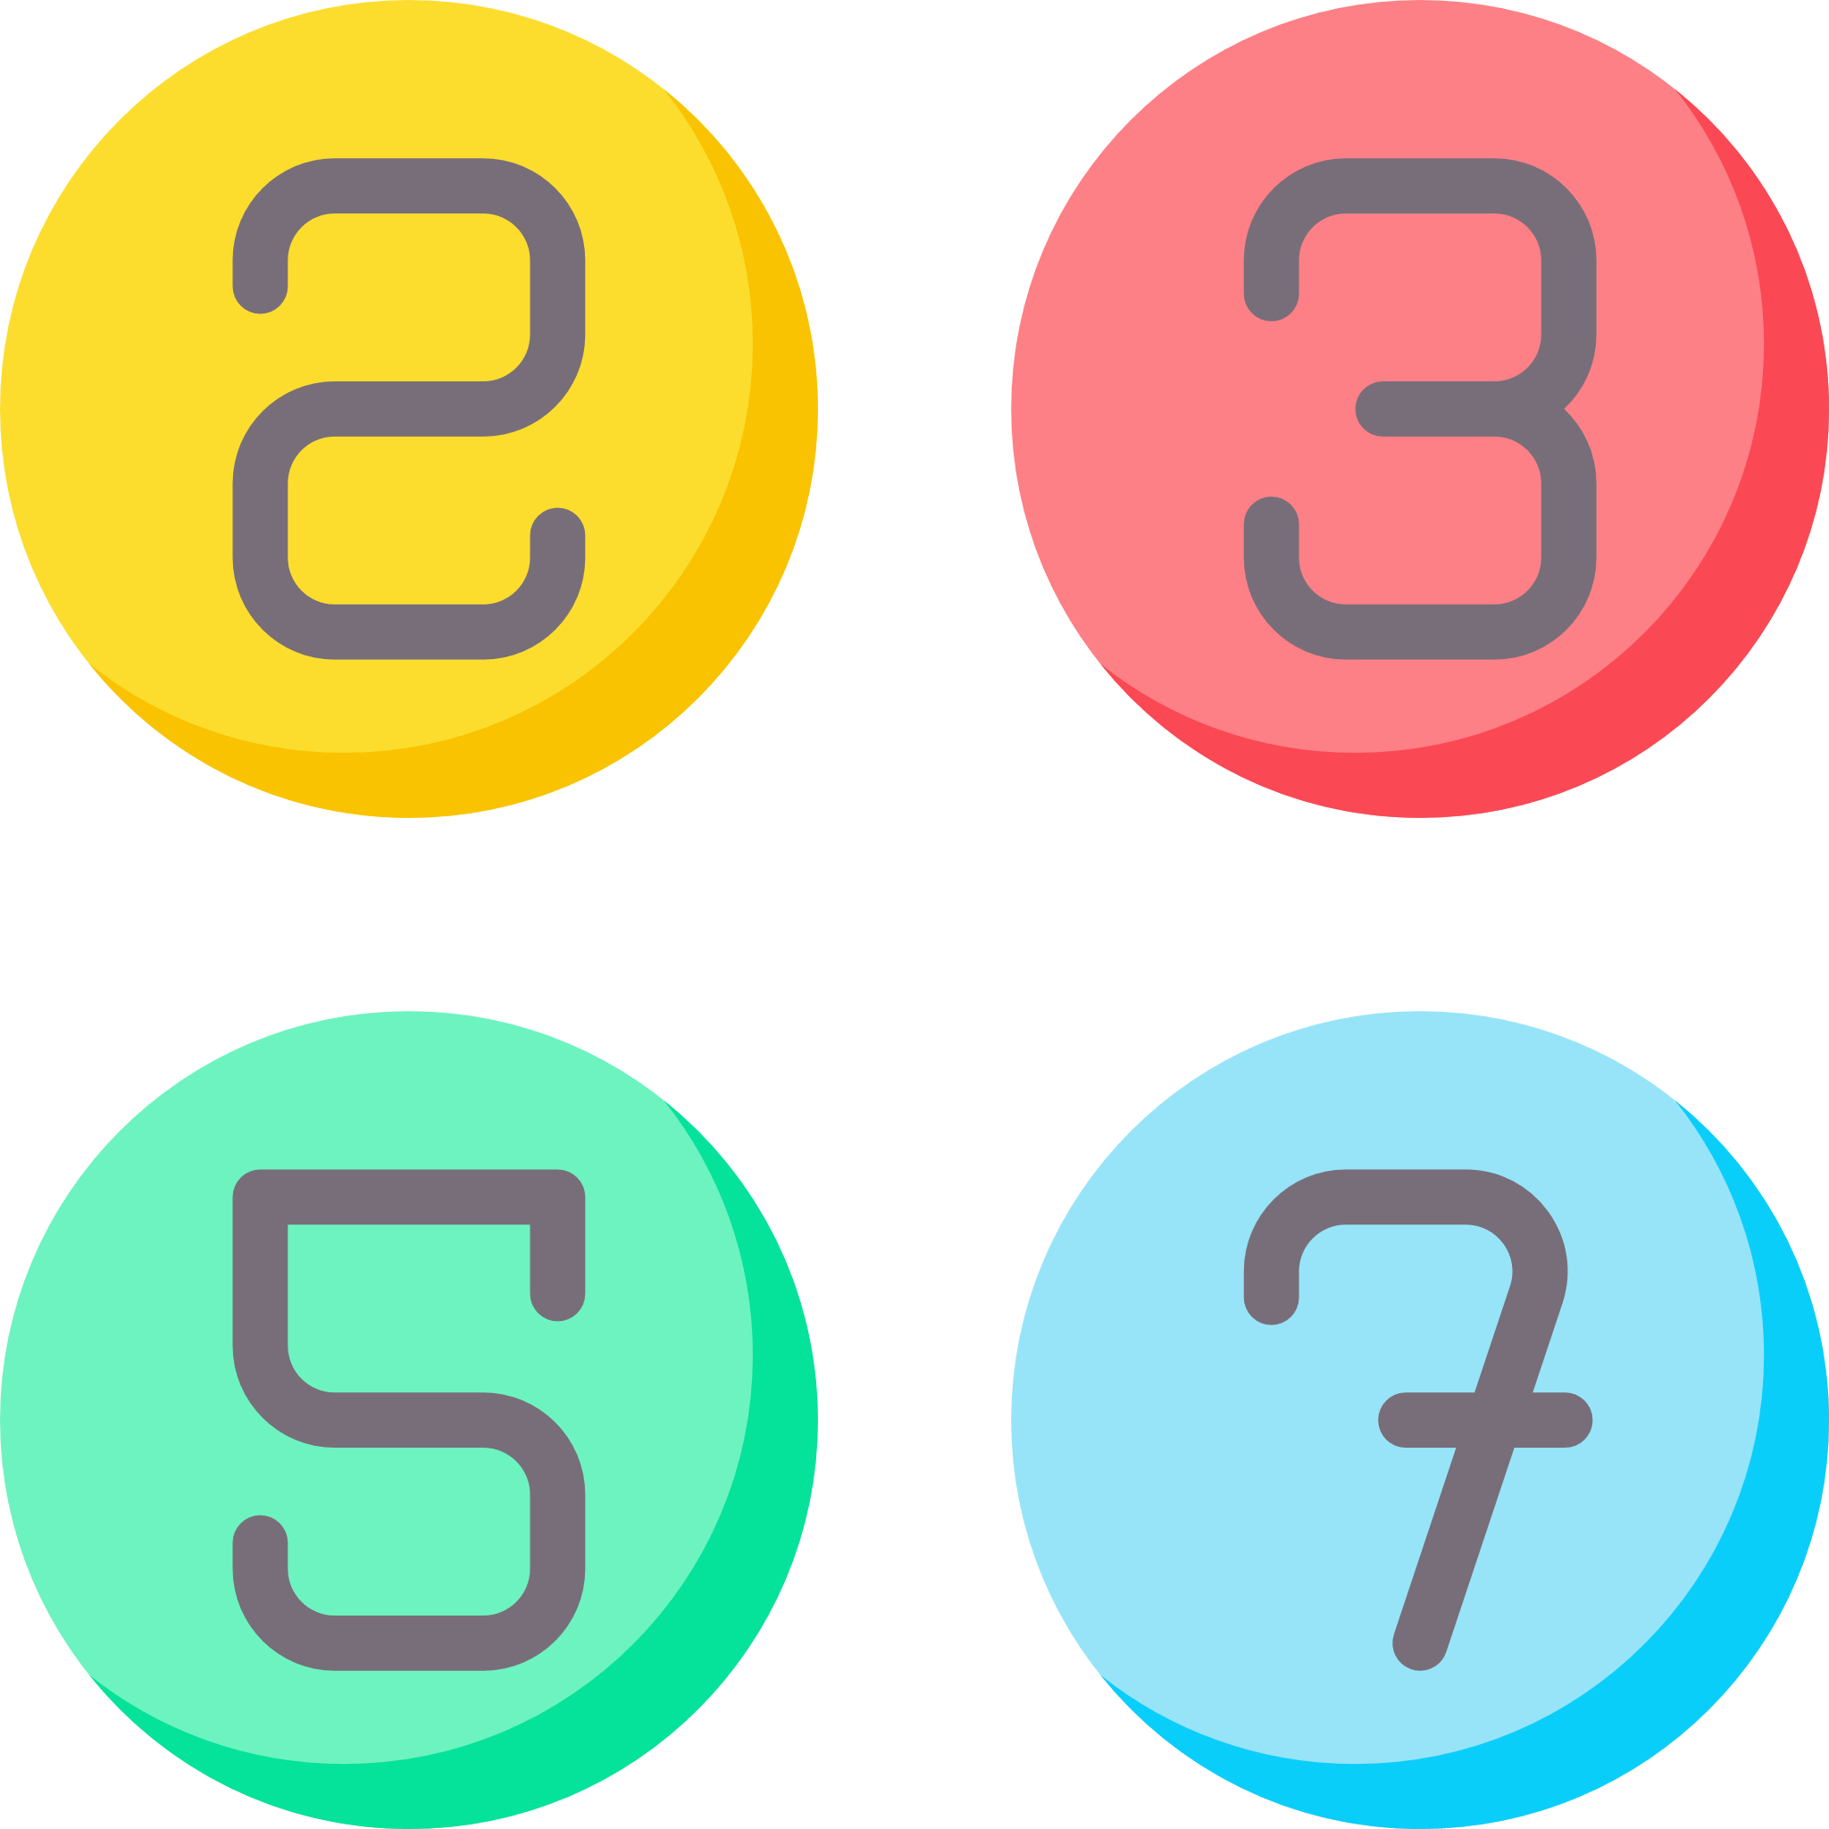
Cassini problem:
3 points.
The Cassini-Huygens spacecraft that visited the planet Saturn had 2.5Gb of memory. Due to solar particles hitting the spacecraft, the memory frequently became corrupted. In its first 2 years alone it suffered 280 single-bit errors on average every day. Without a method of detecting and correcting bits flipping between the zero and one state the spacecraft would be useless. One such method of detecting errors is odd parity. A sequence of bits must contain an odd number of ones and an additional bit is included in the data to ensure this. E.g.
0110001 0 contains three ones (including the parity bit which is set to 0). This sequence is correct.
0110011 0 contains four ones (including the parity bit which is set to 0). This sequence is incorrect and must be corrected.
Write a function called, “OddParity” that takes a binary sequence as a parameter and returns True if the number of ones is odd and False if the number of ones is even.
Prime number problem:
3 points.
Prime numbers are the positive integers greater than 1 that are only divisible by 1 and itself. For example: 2, 3, 5, 7, 11 etc... Write a function called, “IsPrime” that takes a number as a parameter and returns True if the number is a prime number and False if it is not a prime number.
Starting from two and counting up until the number halved is reached, if the number divided by the counter at any point has no remainder the number is not prime.
This is not a very efficient algorithm, but it works!
Notes:
Have a go at some of the problems using what you have learned in this objective.
Only use the commands that you have been shown in the example programs.
Avoid using commands that you have not been taught because you may not be able to use these when answering exam questions.
If your teacher does not direct you, aim to achieve 6 points in total in this objective.

Slide 18
Test tables:
Problem:
Parameter 1 | Parameter 2 | Expected output | Pass/Fail Test
Problem:
Parameter 1 | Parameter 2 | Expected output | Pass/Fail Test
Notes:
You should always “white box” test your programs against a range of valid inputs to check all paths of a selection statement work. Complete the test tables above for at least two of your programs. You can add and delete columns and rows as necessary.

Slide 19
Review your solutions:
Did you: | Self-assess: Yes/No
Complete all the requirements for the problems you solved?
Start your programs with a comment to describe what they do?
Use a subroutine for the main algorithm in your code?
Use a comment to describe what the subroutine does?
Use a comment after each program branch to explain the purpose of the section?
Use a comment before each iteration to explain the purpose of the loop?
Use variable names that describe the data they hold?
Test your programs against different types of data to check they work?
Notes:
Self assess your work by evaluating your solutions against these criteria. Enter yes or no in the “Self-assess” column.
Once you have completed the objective, show your programs to your teacher so you can review them together.

