Slide 1
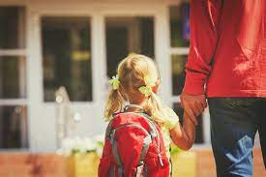
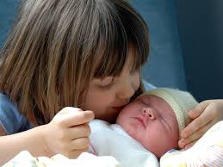
Level 2 Award in
Child Development &Care
Transitions in Early Years

Slide 2
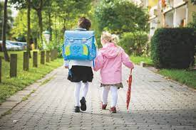
Unit 2 Task 5.1
5. Understand how to support children through transitions in their lives.
5.1 Describe different transitions that children may experience
5.2 Identify the effects of these transitions on the development of children.
Aim of today:
Notes:
Ask if students know what definitions are

Slide 3
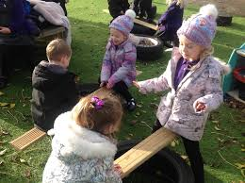
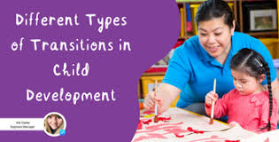
Unit 2 Task 5.1
Assignment D7: Identify different transitions that children may experience
Assignment C1: Identify the possible effects of transitions on the development of children.
Notes:
Ask if students know what definitions are

Slide 4
What do we mean by Transitions?
When you think about transitions during the early years, you usually think of joining the setting, moving rooms for example from baby room to toddler room or starting school.
It can be easy to forget that small changes throughout the day at home and in the setting are also transitions - such as from doing a painting activity to eating lunch, sleeping to having a nappy change, going from the indoors to the

Slide 5
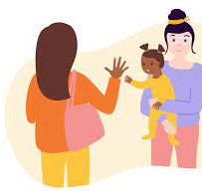
Transitions where children leave Parent/Carer
Going to childminder, nursery or pre-school
Starting school
Being cared for by family member
Going to a club or class
Changing classes at school or nursery

Slide 6
Changes to children’s family circumstances
Family breakdown e.g. Divorce
Arrival of new step-parent and/or step-brother or sister.
Arrival of a new baby
Moving home
Death or illness of a family member

Slide 7
Impact of transitions depends on
Age of the child
How well the child is prepared
How well the child is supported
The type of transition
How well adults work together

Slide 8
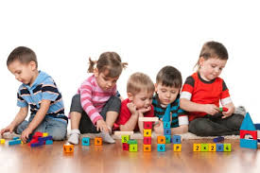
Physical Development & Health
Possible physical effects of transitions
Lack of energy
Sleep
Illness
Feeding

Slide 9
Effects on Language Development
Communication
Wanting to talk – may not want to communicate with a new adult
Listening
Finding it hard to listen – they may become distracted because they are worried
With-
drawing
They may want to be alone & not talk so not practicing communication & language skills.

Slide 10
Effects on Intellectual Development
Concentration
Children who are unhappy or anxious find it hard to pay attention
Memory
If children are not sleeping well they might not be able to learn so well
Interest
Children who are anxious may find it harder to be interested in new toys, resources or activities.

Slide 11
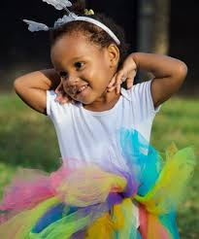
Effects on Social & Emotional Development
Effects on Social and Emotional Development
Clinginess
Attention-seeking behaviour
Defiance & lack of co-operation
Anger towards others e.g. hitting, splitting, shouting
Withdrawn & lack of interest in others

Slide 12
Complete the Transitions Workbook
Read the articles and answer the questions.
Watch the videos
Follow the links to learn more
Complete the table
PACEY Article and Questions
Link to PACEY Handout pdf: https://www.pacey.org.uk/Pacey/media/Website-files/PACEY%20member%20practice%20guides%20(PDFs)/PG10-transitions-and-settling-in.pdf
Answer the 8 questions relating to this handout in your email on the word document.
Print and Send
Send your completed workbook and PACEY questions and answers to ynm@godalming.ac.uk

Slide 13
This work will support you to complete Assignments D7 and C1
D7 Identify different transitions that children may experience
C1 Identify the possible effects of transitions on the development of children.
For these assignments you will produce an information booklet using Power Point

