Slide 1
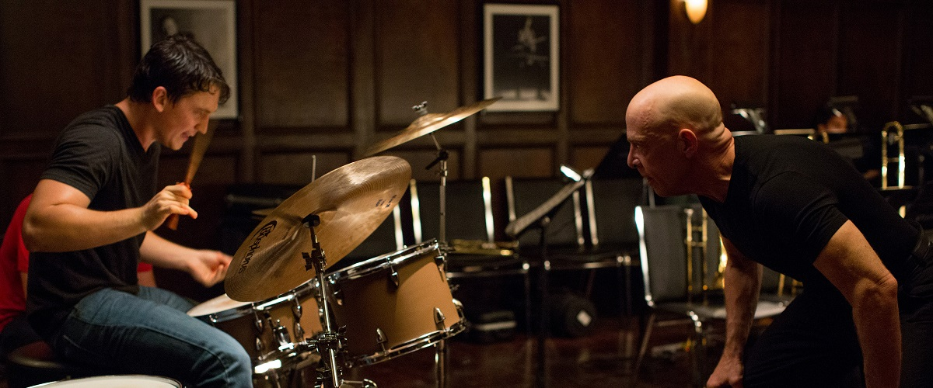
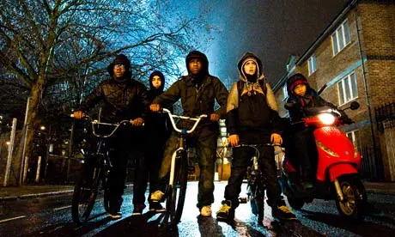
GCSE FILM STUDIES
COURSE OVERVIEW

Slide 2
Wjec eduqas gcse film studies
COMPONENT | AREA OF STUDY
Component 1: YEAR 2 Key Developments in US Film Written examination: 1 hour 30 minutes 35%of qualification | Section A – US Film Comparison E.T. the Extra-Terrestial (1982) & Invasion of the Body Snatchers (1956) Section B – Developments in technology Section C – Independent film – Whiplash (2014)
Component 2: YEAR 1 Global Film: Narrative, Representation and Film Style Written examination: 1 hour 30 minutes 35%of qualification | Section A – English lang film - Slumdog Millionaire (2008) Section B – Non-English lang film – Tsotsi (2006) Section C – UK Film – Attack the Block (2011)
Component 3: YEAR 1 Production Non-exam assessment 30%of qualification | Production, 20%, evaluative analysis, 10% •either a filmed extract from a genre film (2 minutes to 2½ minutes) •or an extract from a screenplay for a genre film(800 to 1000 words)

