Slide 1
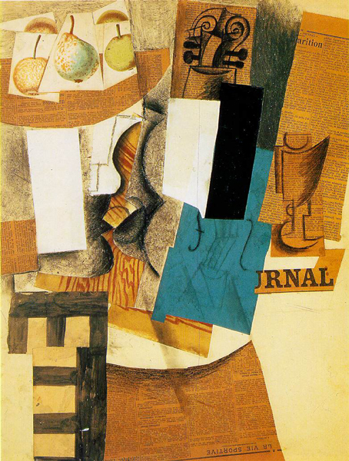
Styles of Collage
The term collage was coined by both Georges Braque and Pablo Picasso in the beginning of the 20th century when collage became a distinctive part of modern art.
www.anothermag.com/art-photography/3318/top-10-collage-artists-hannah-hoch-to-man-ray

Slide 2
Collage unit Three Task:
To begin this unit we want you to research three different subject matters that are all of personal interest to you. Collect images, text and information on your chosen subjects. Try not to just use the internet. Use a variety of sources and list these sources. Do not worry about thinking and planning your own photo shoots at this stage.
Produce three collages each occupying double page spreads.
Each one should have a single theme.
Each one should have a different collage style.
Produce one page of writing for each subject and include on this page what it is you like about your chosen subject.

Slide 3
The Layout
Pages 1-3 leave blank
Pages 4-5 Collage 1
Page 6 Written Ideas page for Collage 1
Page 7 Written Ideas page for Collage 2
Pages 8-9 Collage 2
Page 10-11 Collage 3
Page 12 Written Ideas page for Collage 3

Slide 4
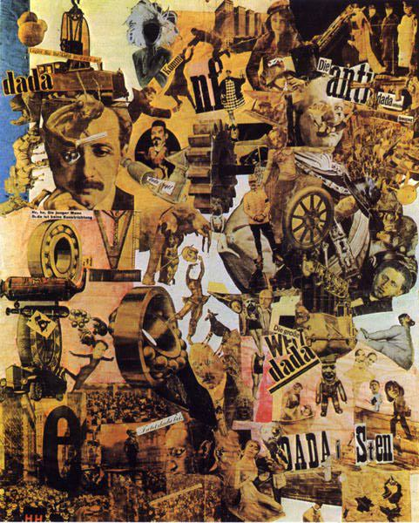
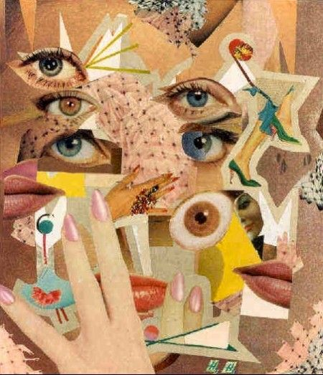
Hannah Hoch www.whitechapelgallery.org/about/press/hannah-hoch/

Slide 5
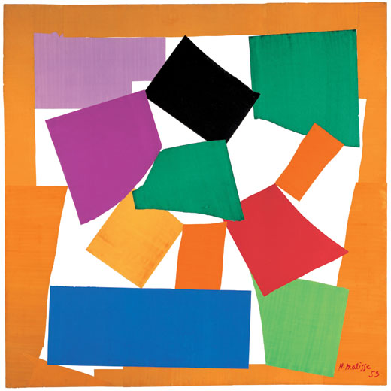
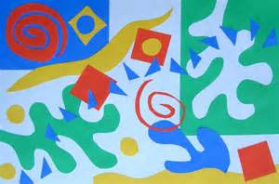
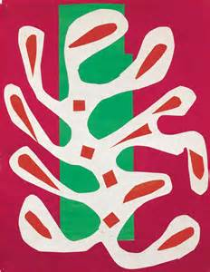
Henri Matisse: The Snail

Slide 6
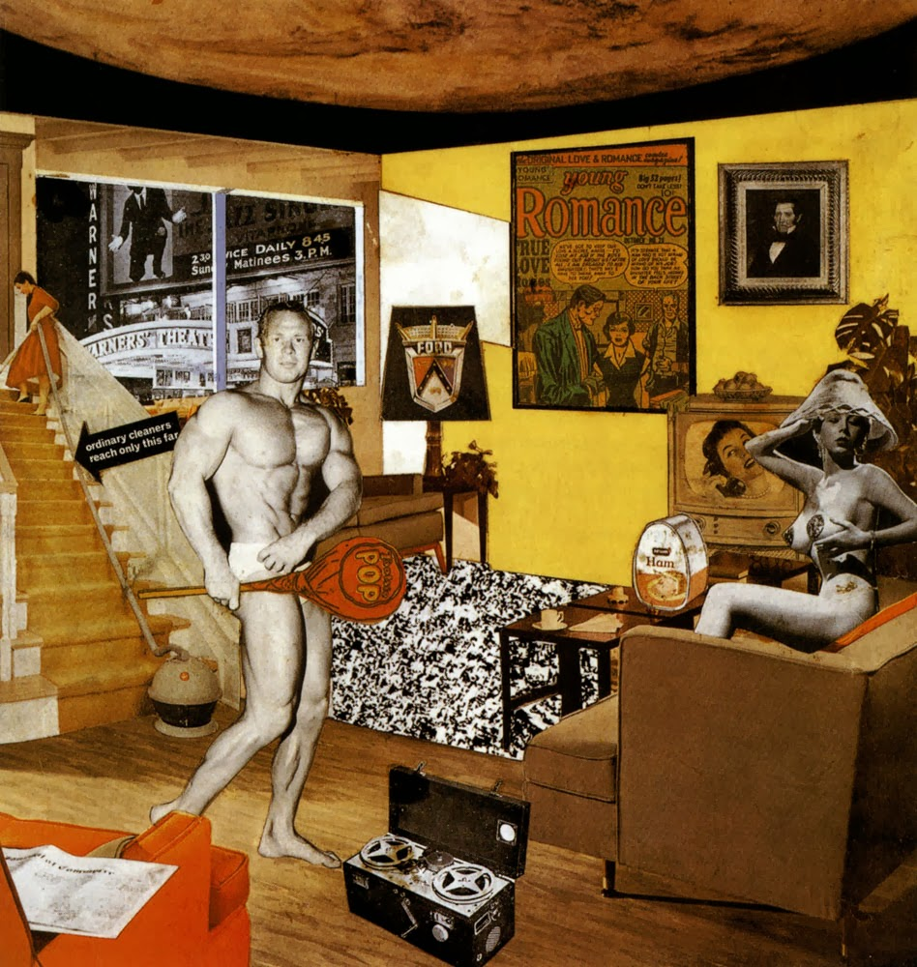
Richard Hamilton
Richard Hamilton "Just what is it that makes today's homes so different, so appealing?"

Slide 7
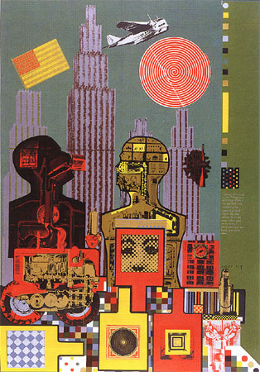
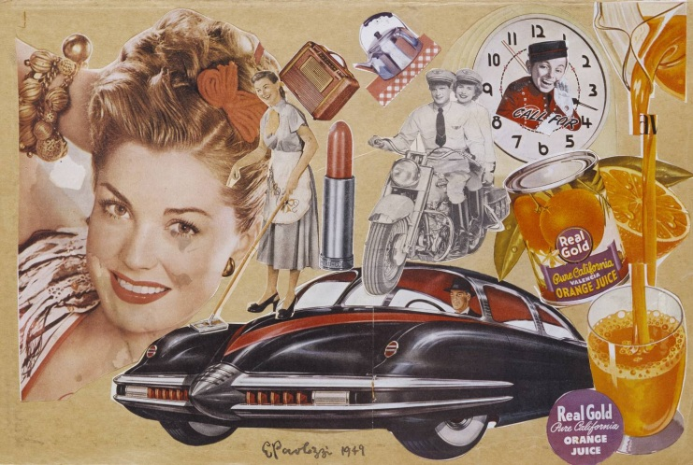
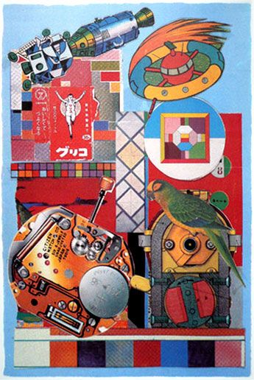
Eduardo Paolozzi

Slide 8
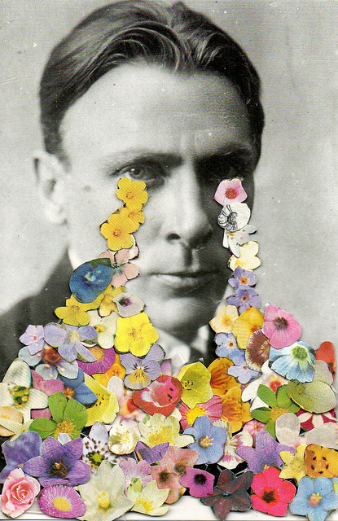
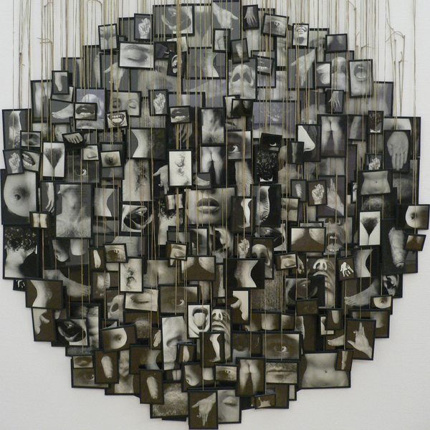
Contemporary examples
Ben Lewis Giles
Annette Messager

Slide 9
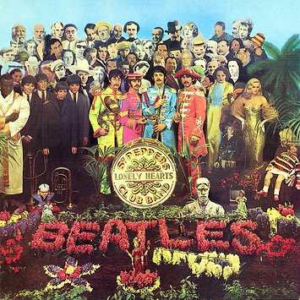
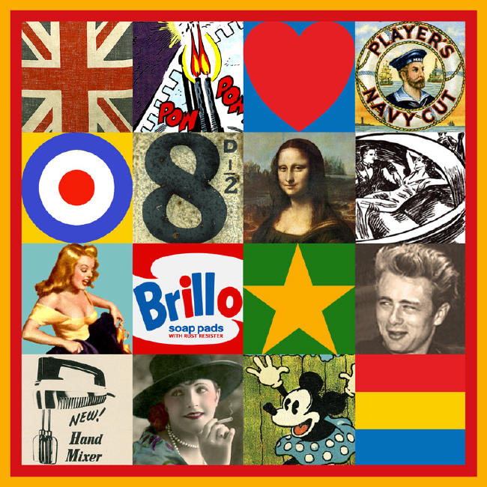
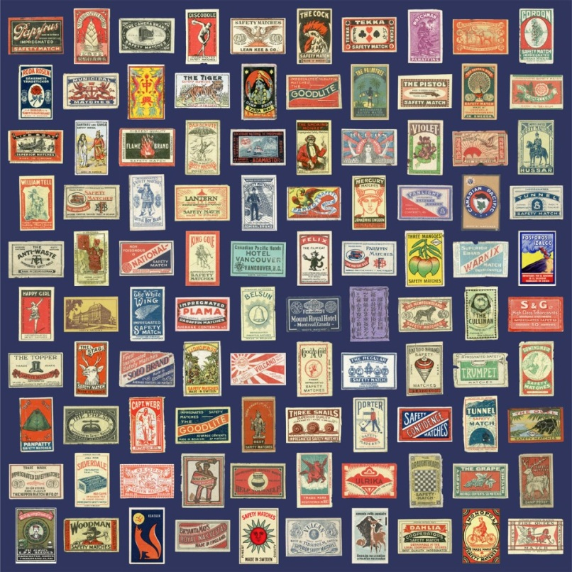
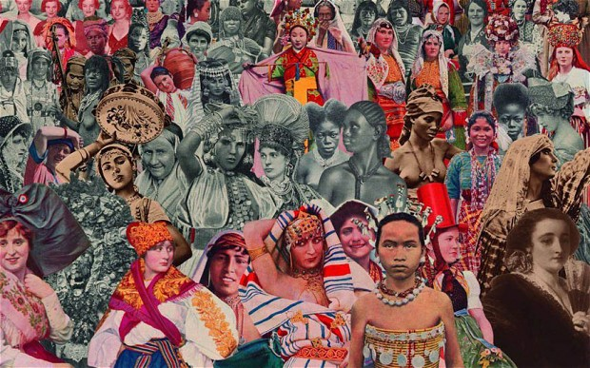
Peter Blake

Slide 10
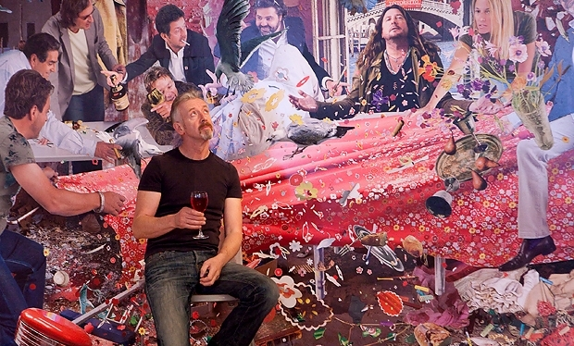
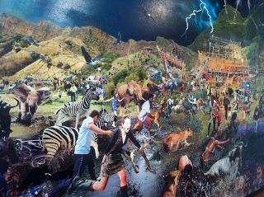
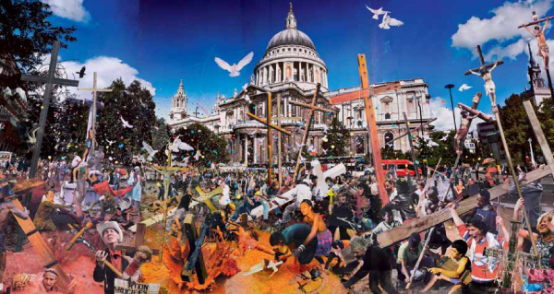
David Mach

Slide 11
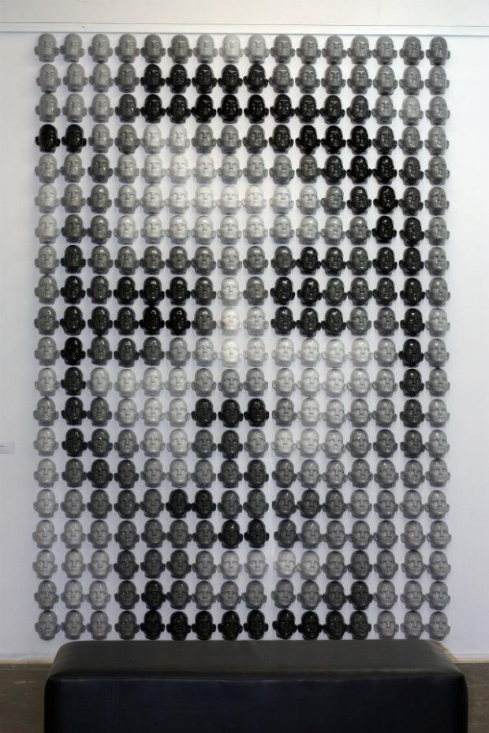
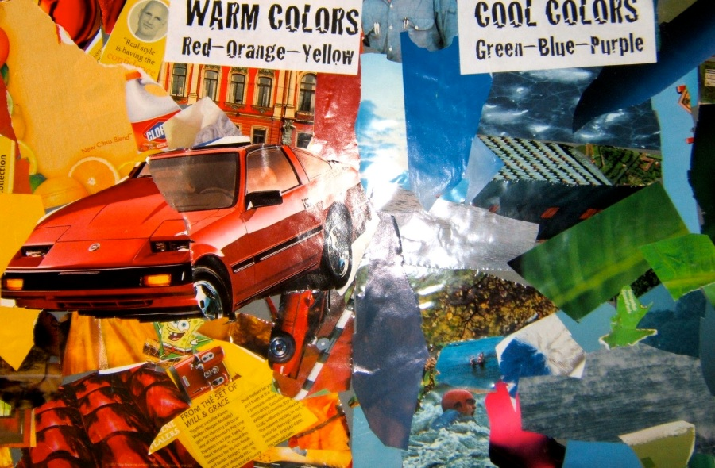
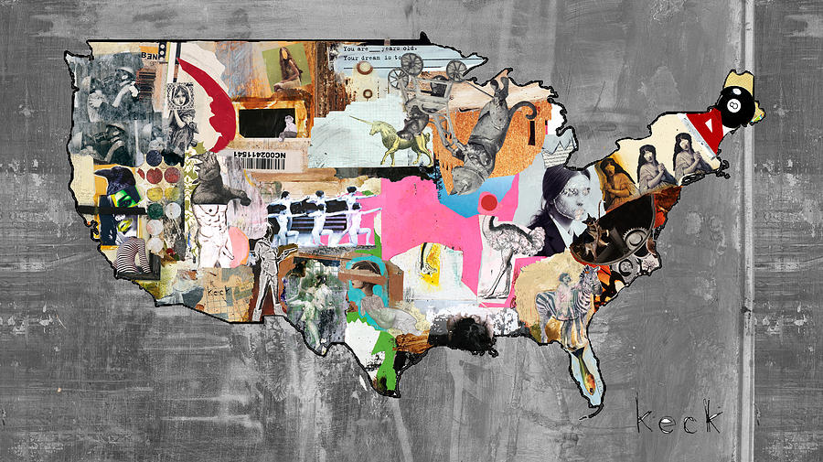

Slide 12
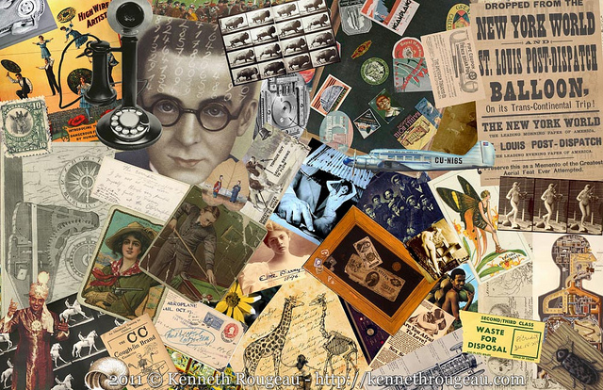
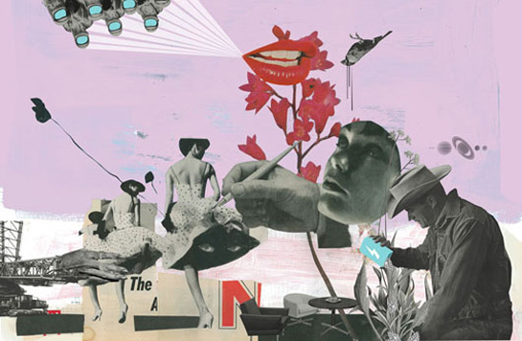
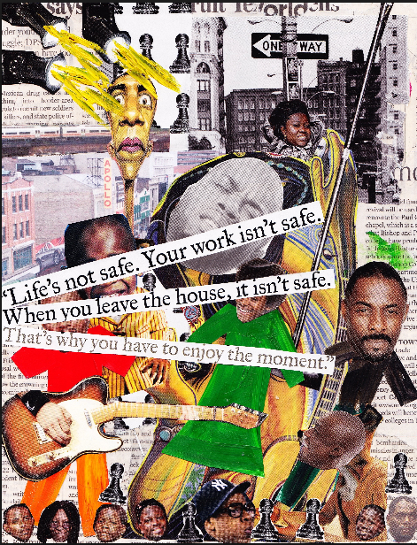
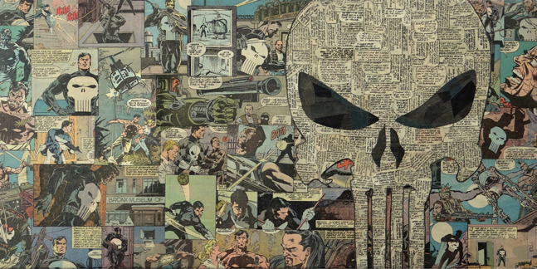
www.mario-wagner.com/

