Slide 1
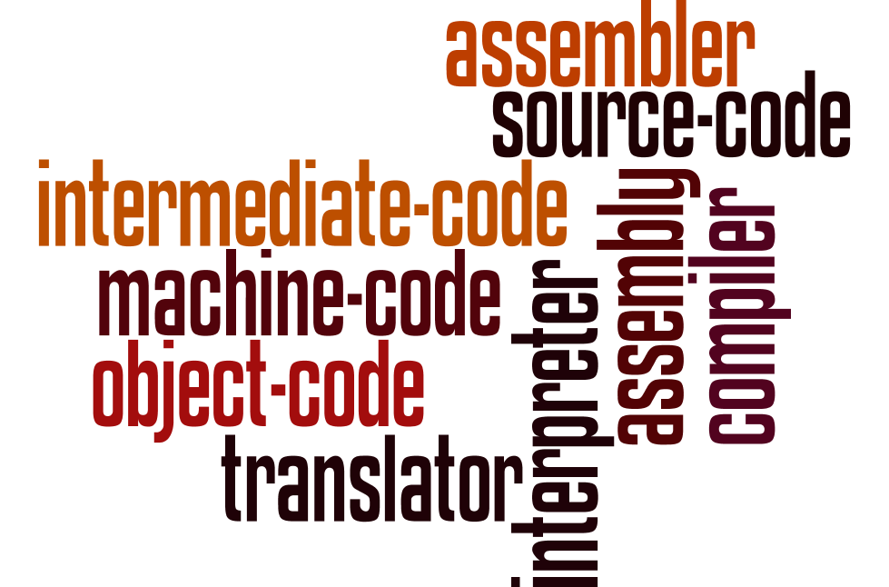
Programming languages and translators
Understand the role of each of the following: • assembler • compiler • interpreter
Explain the differences between compilation and interpretation Describe situations in which each would be appropriate
Using all the words in this word wall, create a diagram to show how all the concepts link together.

