Slide 1
Political Influence on Business

Slide 2
Learning Objectives
Explain how political factors affect business activity
Explain the role of the government in providing a stable framework in which businesses operate
Explain how businesses are affected by taxation and subsides

Slide 3
The Role of the Government in the economy
Provides a legal and regulatory framework e.g. the right to own property and the right to enter into contracts
Provides Public Goods and Merit Goods
Uses tax and public spending to influence the way businesses and individuals behave – e.g. tax on smoking or subsidies on training of workers
Uses tax and public spending to influence demand in the economy – i.e. to help prevent recessions or to control inflation
Has a role in the setting of interest rates that will do the same as the above

Slide 4
Government provides goods and services
The UK government accounts for approx. 40% of all goods and services produced.
It also redistributes income through the welfare benefit system
The main areas of government spending are:
  Social protection and welfare state
  Education
  Healthcare
  Transport, including road and rail subsidies
  Defence
The private sector uses these services e.g. a healthy, educated workforce
Often, the private sector is used to produce goods and service which are then consumed by the public sector to provide these services

Slide 5
Where does the government spend its money?
This article explores this topic. https://ifs.org.uk/taxlab/taxlab-key-questions/what-does-government-spend-money
Notes:
Social protection encompasses the financial assistance and services provided to those in need or at risk of hardship. It provides a safety net to protect the vulnerable in society: those who are unable to make provision for a minimum decent standard of
living. Social protection policies aim to reduce poverty and wealth gaps through the national minimum wage, means-tested benefits, payments such as working tax credits to low earners and assistance with child care. Assistance is provided through direct measures such as benefits payments, tax credits or pensions, payments in kind such as free prescriptions, and the provision of services such as local authority (LA) home-care help

Slide 6
Where does the government get its money?
Use this link to help you research this topic. https://ifs.org.uk/taxlab/taxlab-key-questions/where-does-government-get-its-money

Slide 7
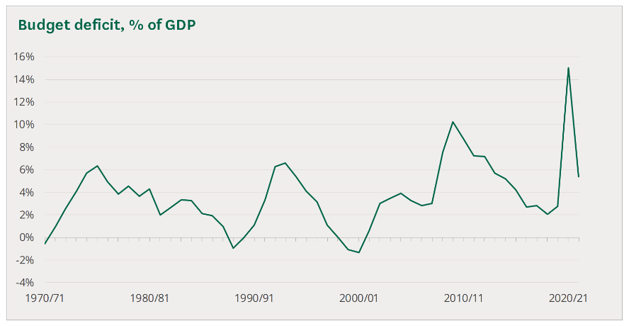
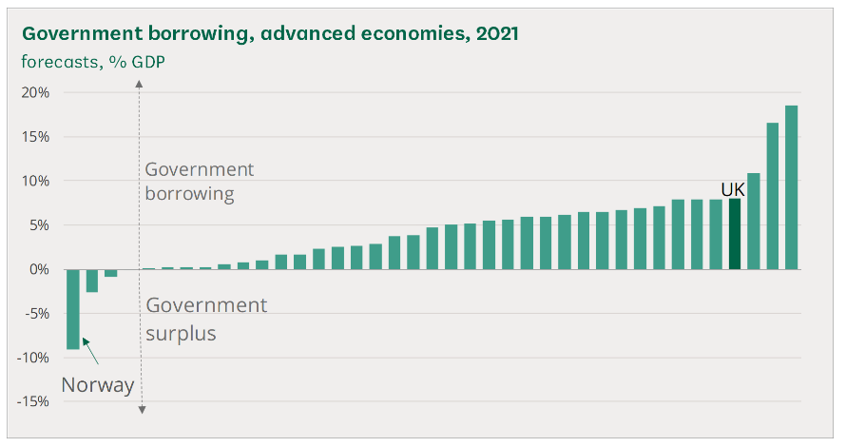
Shortfall? Government Borrowings
Notes:
https://commonslibrary.parliament.uk/research-briefings/sn06167/

Slide 8
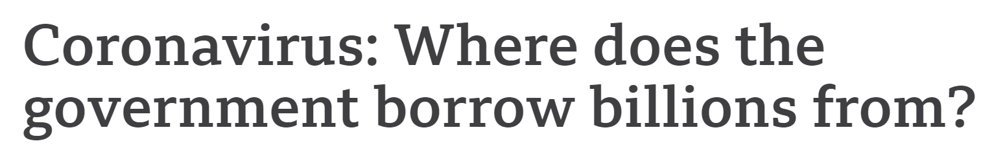
Read and Watch
Read the linked article and watch the video (what does a billion pounds look like)
https://www.bbc.co.uk/news/business-50504151

Slide 9
Question
Reflecting on what you have just researched, plan 1 balanced main paragraph for this 20 marker.
We will discuss your conclusions as a class afterwards.
“The UK needs to raise taxes. It is the only way to rebalance the books. Discuss.”

Slide 10
More on Tax
Use this link to find out more about different forms of taxation and what they are used for.
https://ifs.org.uk/taxlab/taxes-explained

Slide 11
Fiscal Policy
Tax, government spending and borrowings can also be used to govern the economy as a whole.
Fiscal policy can be used to target political, economic or social objectives so expenditure or increased taxation is sometimes targeted at specific industry sectors or alternatively subsidies can be paid to industries

Slide 12
Monetary Policy
Remember, the government has a role in the Monetary Policy Committee, who sets the interest rates. They can also control the economy in this way.

Slide 13
Subsidies
The government can offer financial support to certain industries to alter behaviour.
It is a grant given by government to lower the price of a good.
Example: training subsidies might be given to encourage businesses to train their workers.
A business might be given a subsidy to encourage them to set up in a deprived area of the UK

Slide 14
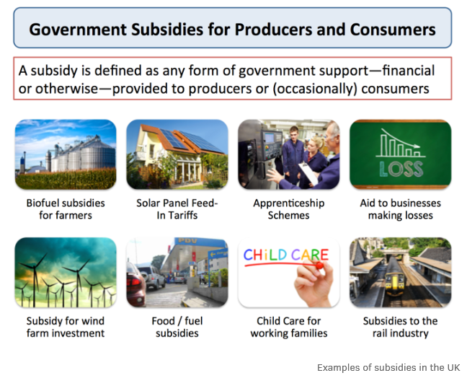

Slide 15
Subsidies
In December 2020, central government paid £11.9 billion more in subsidies to businesses and households than in December 2019.
These additional payments included the cost of the job furlough schemes; £4.7 billion as a part of the Coronavirus Job Retention Scheme (CJRS) and £5.3 billion Self Employment Income Support Scheme (SEISS).

Slide 16
Questions
Political factors
Describe the following political factors
  Instability
  National security
  Major trading partners
  Changes in government
  Pressure groups
How do these factors affect firms and the wider economy?

Slide 17
Questions
Fiscal policy (see page 696 of text book and PEST notes)
If there is a proportionately greater increase in government spending than tax, what will happen to the economy as a whole? Will it be restricted or will it expand?
If there is a proportionately greater increase in tax than government spending (direct tax like income tax, in particular) will the economy be restricted or will it expand?

Slide 18
Questions
Taxes (see page 670 onwards in text book)
  Explain the following taxes, whether they are direct or indirect and how changes in each will influence businesses and individuals
    Income tax
    VAT
    Corporation tax
    National Insurance
    Capital gains tax
    Customs Duties
    Business rates

Slide 19
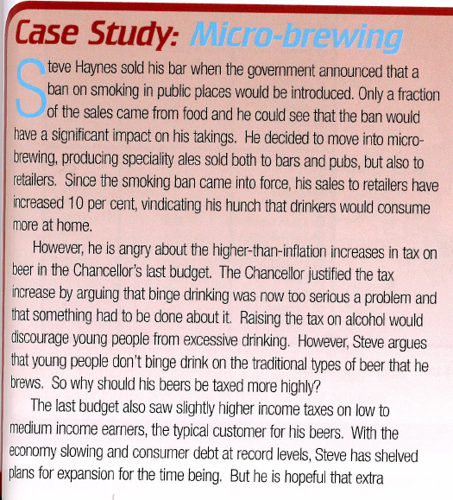
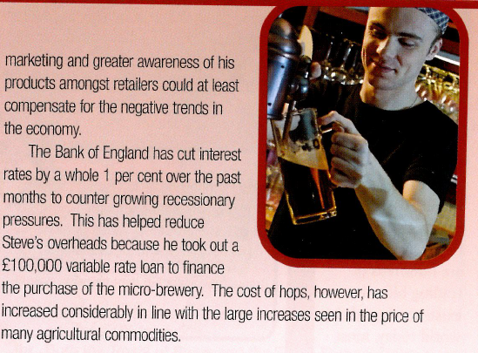
Case Study question
Evaluate the impact of changes in government policy described in the passage on Steve Hayne’s micro brewery
Explain whether Steve Hayne’s micro brewery would have higher sales and higher profits if the government cut every tax and every type of government spending by 20%

