Slide 1
What is a market?
Place where buyers and sellers come together.
A business’ market is it’s customers.
How can ‘markets’ be classified?
Niche / Mass
Local / National / International

Slide 2
Market orientation
This is where a business continually identifies, reviews and analyses consumers’ needs
Flexible to changes in taste and fashion
Decisions based on market research
New products designed to meet customer needs
High cost to research the market
Unpredictability of the future

Slide 3
Product orientation
This is where a business focuses on the production process and the product itself
Focus on product development
Focus on good quality products
Changes in market structure will not be responded to
Fashion and taste are not accounted for

Slide 4
Asset-led marketing
A business that is asset-led is responsive to the needs of the market.
However, it takes into account it own strengths and weaknesses when producing a product or service.
The business makes good quality products based on market needs
Maximises return from assets
Can be difficult, time consuming and expensive for businesses to establish its ‘core competencies’
Notes:
Sony Walkman video

Slide 5
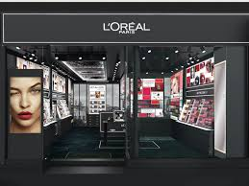
Which marketing approach is used by these companies?

Slide 6
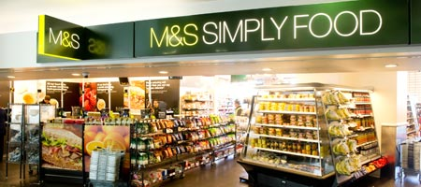
Market orientation
This is where a business continually identifies, reviews and analyses consumers’ needs
e.g. M&S, Costa, Proctor & Gamble, Coca-Cola

Slide 7
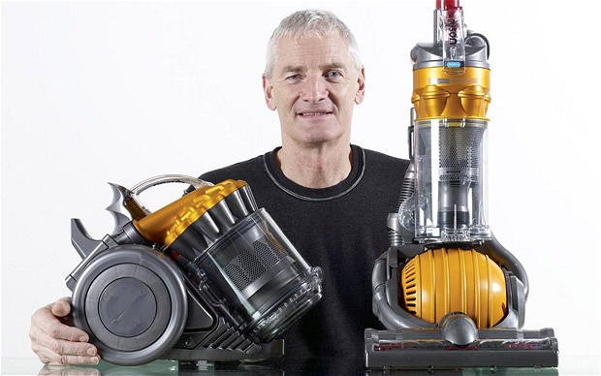
Product orientation
This is where a business focuses on the production process and the product itself
e.g. Dyson, Sony, McDonalds

Slide 8
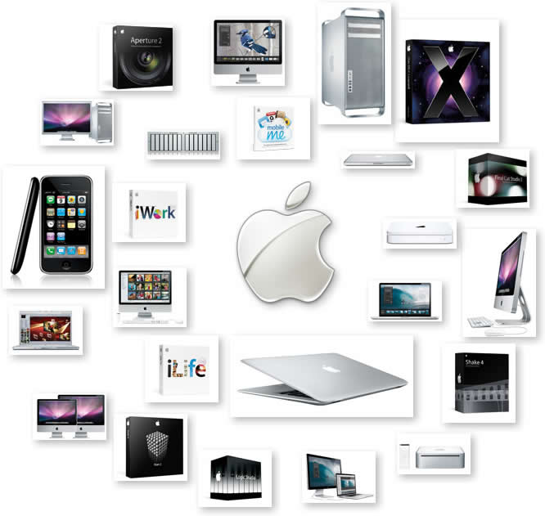
Asset led marketing
A business that is asset-led is responsive to the needs of the market.
However, it takes into account it own strengths and weaknesses when producing a product or service.
E.g. Apple, Tesco
Notes:
NEW Coke video

Slide 9
The marketing mix; the 4 Ps
Product
Price
Place
Promotion

Slide 10
Based on what you have learned today, define marketing using 5 words…

