Slide 1
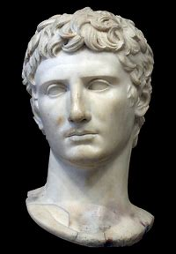
Ancient History Revision Session
Question Technique
Aims of this Session:
Recap the structure and technique needed for each question-type on the exam
Consider do’s and don’ts for each
Focus on how best to use sources
Answer any questions you have
 |  |  | AO1 | AO2 | AO3 | AO4
Section A | 30 Mark Essay | 45 minutes | 5 | 10 | 15 | -
 | 20 Mark Interpretation | 30 minutes | 5 | - | - | 15
Section B | 12 Mark Source Utility | 18 minutes | 6 | - | 6 | -
 | 36 Mark Essay | 54 minutes | 6 | 12 | 18 | -

Slide 2
The Essay Question
30 marks
Use and evaluation of the ancient sources | 15/30
Analysis and Evaluation | 10/30
Own Knowledge | 5/30
Read the question carefully and highlight any key information you are given:
  what date range does the question give you? If this isn’t stated then write it on the question
  What is the issue in the question? Highlight and if necessary explain this
  Spot any judgement words in the question that you could support/challenge (e.g. ‘completely’, ‘always’)
  Is the question asking about a change over the period or within a more specific time-frame?
Spend a minimum of 5 minutes planning your answer – record the key sources you will use in the answer along with the arguments supporting and challenging the question that you will make – aim for 2 brief bullet-point lists
Introduction
  Start by re-wording the question to show your understanding of it
  Outline the arguments you will make for and against the issue in the question
  Provide an overall judgement that you can then come back to in your conclusion – OCR are very keen on this

Slide 3
The Essay Question
30 marks
Use and evaluation of the ancient sources | 15/30
Analysis and Evaluation | 10/30
Own Knowledge | 5/30
Main Paragraphs (3-5)
  Start with a clear signpost sentence introducing the point you are going to make and linking it to the question
  Develop this point using a range of evidence from the ancient sources and your own knowledge
  Argue the significance of the point you are making fully – why is it important/significant but why might it also be limited?
  Link the paragraph back to the question
Using the source
  Focus on including a range and variety of ancient sources (where possible more than just written ones)
  When you include a source reference the author clearly – don’t assume the marker will know this
  You will get marks for using the sources as supporting evidence but also need to evaluate why sources have certain views and how reliable these are
  You can do this by: (1) challenging/supporting sources with your own knowledge (2) challenging/supporting sources with other sources (3) reaching judgements about how the provenance or context of a source makes what it is saying more or less reliable

Slide 4
The Essay Question
30 marks
Use and evaluation of the ancient sources | 15/30
Analysis and Evaluation | 10/30
Own Knowledge | 5/30
Conclusion
  Re-read the question carefully before you write this – its easy to lose focus or subtly change the question
  Ensure your conclusion is balanced but also reaches a clear and direct answer to the question
  Try to make this judgement sophisticated – does the answer change over time (i.e., something becoming more or less important)? Are there any differences between different states (Athens, Corinth Sparta, Persia etc.)?
Do | Don’t
Use a range of sources and, where possible, use them in combination Include source evaluation which is connected to your point, and which supports the argument you are making Cover the timespan if the question is relatively broad Explain the significance of evidence fully – “This demonstrates that…”, “This illustrates that…” are useful phrases to use to do this Aim to put forward a clear argument and sustain this in your essay | Try to write a pre-pared answer – answer the specific question on its merits Include generic off-the-shelf source evaluation (OCR call this ‘pre-fabricated) which does not connect to the point you are making, or worse, contradicts your argument Describe long periods of history to start to tell the story – this is what happens when you don’t have evaluation of evidence and/or don’t have a clear argument to each paragraph Lose focus on the timeframe or forget about Persia Write in the first-person

Slide 5
The Essay Question
30 & 36 marks
Use and evaluation of the ancient sources | 15/18 /30
Analysis and Evaluation | 10/12 /30
Own Knowledge | 5/6 /30
30 vs 36 Mark essay
  The technique for these questions is the same – don't over-complicate!
  Differences:
    You have approx. 9 more minutes for the 36 mark essay
    It should contain greater depth of evidence (OK and source) and evaluation (OK and the sources)
    The 36 mark essay is likely to cover one of the 5 depth study topics, whereas the 30 mark essay will cover several or all of the period study topics (depth vs range)
    Depth study sources tend to be more flexible (particularly on the Greek course) meaning you can use them in lots of different questions
    The 36 mark essay has a L6 available on the mark scheme – one of the clearest signs of this top level is a clear and sustained argument

Slide 6
The Interpretation Question
20 marks
Supported evaluation of the interpretation | 15/20
Own Knowledge | 5/20
Read the question carefully – identify which key debate the interpretation is from. for 2022 you know it will be:
  Greek – Key Debate 3: Why did Athens lose the Peloponnesian War
  Roman – Key Debate 3: The benefits of imperial rule
Read the passage – spend a minimum of 5 minutes doing this. Don’t expect it to be easy or obvious but don’t panic either if you find it difficult to understand the first-time round
  Once you have read the passage once, write above it what its overall argument is in relation to the issue in the question
  Read it again and highlight/number the individual points (sub-arguments) it makes within this
Introduction– Summarise the overall argument the historian is making and provide a brief judgement on how convincing this is. Keep the introduction short

Slide 7
The Interpretation Question
20 marks
Supported evaluation of the interpretation | 15/20
Own Knowledge | 5/20
Main Section – This is not an essay!
your answer needs to consider the strengths and limitations of what is being argued so you could have one section on each
Focus on: (1) introducing an argument from the passage (2) providing a clear judgement on this using critical vocabulary (3) supporting and explaining this judgement using own and source knowledge (4) linking your point back to the question
Don’t feel you have to look for the historian getting something wrong. Instead, do they place too much emphasis on something? Do they neglect or ignore something more important? Is their argument too narrow? To short or long-term. You do not need a 50/50 split of strengths and limitations
Conclusion – This needs to be developed and carefully thought-out. Try to do more than just say that it is or isn’t convincing. Is it largely convincing but still makes a weaker argument? What is the most convincing point that it makes? Etc.

Slide 8
The Interpretation Question
20 marks
Supported evaluation of the interpretation | 15/20
Own Knowledge | 5/20
Read the question carefully – identify which key debate the interpretation is from. This will help you to understand what the passage is arguing if you can narrow it down to a particular debate
Read the passage – spend a minimum of 5 minutes doing this. Don’t expect it to be easy or obvious but don’t panic either if you find it difficult to understand the first time round
  Once you have read the passage once, write above it what its overall argument is in relation to the issue in the question
  Read it again and highlight/number the individual points (sub-arguments) it makes within this
Introduction– Summarise the overall argument the historian is making and provide a brief judgement on how convincing this is. Keep the introduction short

Slide 9
The Interpretation Question
20 marks
Supported evaluation of the interpretation | 15/20
Own Knowledge | 5/20
Main Section – This is not an essay but your answer needs to consider he strengths and limitations of what is being argued so you could have one section on each
Focus on: (1) introducing an argument from the passage (2) providing a clear judgement on this using critical vocabulary (3) supporting and explaining this judgement using own and source knowledge (4) linking your point back to the question (See next slide)
Don’t feel you have to look for the historian getting something wrong. Instead, do they place too much emphasis on something? Do they neglect or ignore something more important? Is their argument too narrow?
Conclusion – This needs to be developed and carefully thought-out. Try to do more than just say that it is or isn’t convincing. Is it largely convincing but still makes a weaker argument? What is the most convincing point that it makes? Etc.

Slide 10
Introduce a point from
the passage including a brief quotation
if not immediately clear explain what the historian is arguing
Provide a clear judgement on this point using critical vocabulary
Support your judgement with own and/or source knowledge
Link your evaluation back to the question
Some useful critical vocabulary:
Convincing, Limited, Valid, Invalid, Insightful, Narrow, Broad, Doubtful, Correct, Persuasive, Appreciates, Fails to Appreciate, over-emphasises, downplays, does not give enough credit to…, long-term, short-term, underlying, catalyst

Slide 11
The Interpretation Question
20 marks
Supported evaluation of the interpretation | 15/20
Own Knowledge | 5/20
Do | Don’t
Expect the passage to be challenging when you first read it and then work to understand it Separate the interpretation into 3-4 (ish) sub-arguments each of which you can then evaluate Use detailed own and source knowledge to test the views in the interpretation Include source evaluation when it links to your judgement about he interpretation Use carefully chosen critical vocabulary to highlight your judgements Focus on developing a persuasive conclusion – try to add more than one ‘yes’ or ‘no’ layer | Lump the views of the interpretation together into one point which you then evaluate – limits the possible range of your answer Lose focus on the specific wording of the question – this will vary and you need to answer it specifically Try to write this as an essay Make assertions about the interpretation i.e. judgements which are not supported by evidence Include source evaluation for the sake of it - there are no AO3 marks available here Try to get a 50/50 split of strengths and limitations Offer an overly simplistic conclusion

Slide 12
The Source Utility Question
12 marks
Use and evaluation of the ancient sources | 6/12
Own Knowledge | 6/12
The nature of the question –
  You will be given between 1 and 4 extracts from the prescribed sources you have studied
  Expect these to be written and or visual sources (buildings, coins, inscriptions, plans etc.)
  You are being asked how useful they are in understanding a particular issue not just in general
  It is not an essay question but will require an overall judgement
How to approach it –
  Focus on the contents of the source or sources – what information do they give to you directly that is useful in understanding the issue in the question.
  OCR say to “mine the passages for information” – this means more than a surface reading but taking specific points or inferences from the passage
  Use other sources to corroborate or challenge the points in the extracts
  Consider the provenance and reliability of the extracts – does this make their views more or less useful?

Slide 13
The Source Utility Question
12 marks
Use and evaluation of the ancient sources | 6/12
Own Knowledge | 6/12
Introduction –
  Not essential and if you are short for time don’t include one
  Otherwise briefly introduce what the extract(s) is
Main Section –
  Introduce a point or view from the source, offer a judgement about how useful it is and then explain fully using you knowledge of the period and, where relevant, other sources to corroborate/challenge
  Think about the ways in which the passage is useful but also how it is limited (normally due to reliability). You do not need a 50/50 split of each and don’t try to manufacture one.
  Concentrate on explaining why a point is useful rather than just stating it is or simply describing what the passage says
Conclusion –
  Very important that you do provide an overall answer to the question – is the extract(s) more or less useful in understanding the issue in the question and why?

Slide 14
The Source Utility Question
12 marks
Use and evaluation of the ancient sources | 6/12
Own Knowledge | 6/12
When analysing an extract think about:
  What does it give you directly to help you understand the stated issue?
  What does it suggest or imply which is useful? Read between the lines
  Does it offer a unique or a limited perspective on the issue?
  Does it leave out something and does this make it more or less useful?
  Do other sources share the same view or information as the extract or offer different ideas?
  Is the source reliable?
  If it is unreliable does this make it any less useful?

Slide 15
The Source Utility Question
12 marks
Use and evaluation of the ancient sources | 6/12
Own Knowledge | 6/12
Do | Don’t
Read or study the passages/sources closely Extract as much information from them as possible Take the ‘surface’ points from the sources and look for the deeper or implied points. Include short references. Explain fully why these points are useful in relation to the specific issue in the question – how do they develop our understanding? What important perspective do they give us Corroborate or challenge the points in the sources with other sources and with your own knowledge Consider the reliability of the views/information in the passage and whether this enhances the utility or not Directly answer the ‘how useful’ part of the question | Lump the views/information of the source(s) into one generalised point as this won’t give you enough range to get the marks Simply describe what the sources say or show – the answer needs to be linked to the issue in the question and to explain why something is useful Try to find a 50/50 split of useful and limited points. This normally means inventing reasons why a source might not be useful and describing what it leaves out. It is better to focus on what is in the passage and only argue limitations if they are included or to do with provenance Include length quotes from the passage or from other sources – no time for this and will mean you are describing

Slide 16
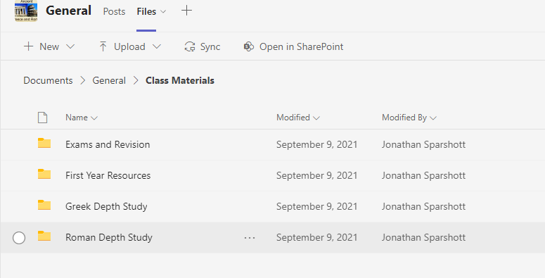
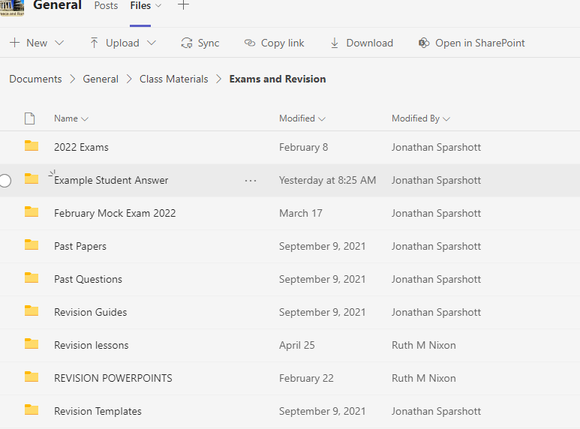
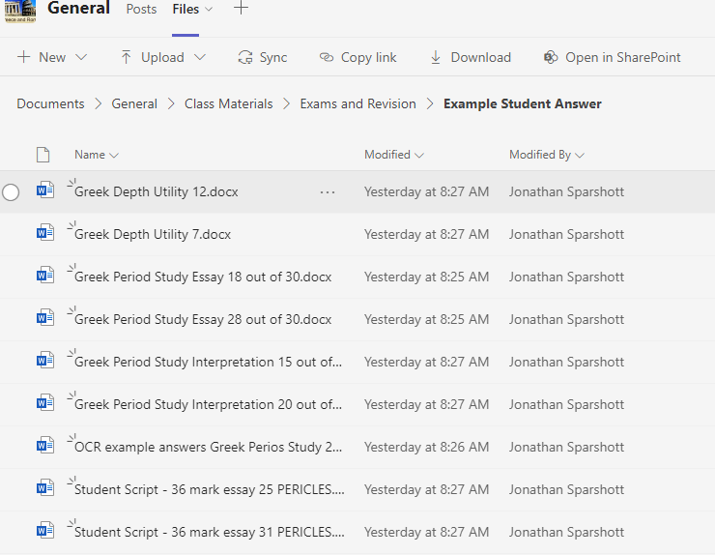
For exam-board example answers, complete with marks and feedback, go to the ‘Exams and Revision’ section of the class materials on Teams

