Slide 1
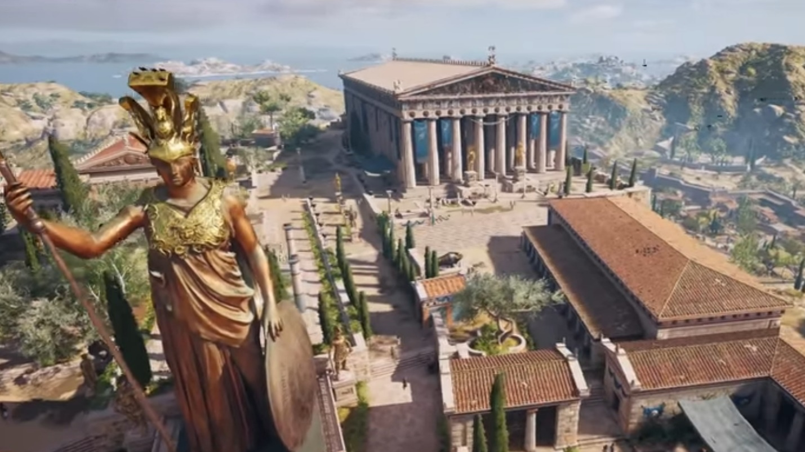
Ancient History Impact Session
Greek Period Study (Section B):
The Politics and Culture of Athens c. 460-399 BC

Slide 2
Structure and Technique – The Basics
Examined in Section B of the exam – should aim to spend approximately 1 hour 15 minutes on this section
One 36 mark essay questions from a choice of two – 54 minutes
One compulsory source utility question (12 marks) – 18 minutes
The focus of this section is on examining the depth of your understanding of the unit rather than the range – questions are likely to focus on one topic at a time

Slide 3
The Essay Question
36 marks
Use and evaluation of the ancient sources | 18/30
Analysis and Evaluation | 12/30
Own Knowledge | 6/30
The structure and technique of this essay question is the same as the period study 30 mark question – see previous impact sessions
The questions will focus on a more specific issue i.e. one of the five topics and it is your depth of understanding of this topic and the sources surrounding it which is being assessed
You have 54 minutes for this question so should be looking to develop 4-5 points per essay
Prioritise including and evaluating a range of ancient sources – for the Greek side of the course this is wider in the depth study than the period study

Slide 4
The Source Utility Question
12 marks
Use and evaluation of the ancient sources | 6/12
Own Knowledge | 6/12
The nature of the question –
You will be given between 1 and 4 extracts from the prescribed sources you have studied
You are being asked how useful they are in understanding a particular issue
It is not an essay question but will require an overall judgement
How to approach it –
Focus in the first place on the contents of the source or sources – what information do they give to you directly that is useful in understanding the issue in the question
Use other sources which show something similar/different to the extracts given
Consider the provenance and reliability of the extracts – does this make their views more or less useful?

Slide 5
The Source Utility Question
12 marks
Use and evaluation of the ancient sources | 6/12
Own Knowledge | 6/12
Introduction –
Not essential and if you are short for time don’t include one
Otherwise briefly introduce what the extract(s) is
Main Section –
Your answer needs to be balanced i.e. consider ways in which the extracts are and are not useful – suggest that you have one paragraph on useful an one on not useful
Introduce a point or view from the source, offer a judgement about how useful it is and then explain fully using you knowledge of the period and, where relevant, other sources
Conclusion –
Very important that you do provide an overall answer to the question – is the extract(s) more or less useful in understanding the issue in the question and why?

Slide 6
The Source Utility Question
12 marks
Use and evaluation of the ancient sources | 6/12
Own Knowledge | 6/12
When analysing an extract think about:
What does it give you directly to help you understand the stated issue?
What does it suggest or imply which is useful?
Does it offer a unique or a limited perspective on the issue?
Does it leave out something and does this make it more or less useful?
Do other sources share the same view or information as the extract or offer different ideas?
Is the source reliable?
If it is unreliable does this make it any less useful?

Slide 7
Key Sources to go over:
Thucydides – Pericles’ Funeral Oration
The Old Oligarch – Constitution of the Athenians
Aristotle – The Athenian Constitution
Aristophanes – Wasps, Knights, Clouds
Plato – Apology
Euripides – Hippolytus
Others

Slide 8
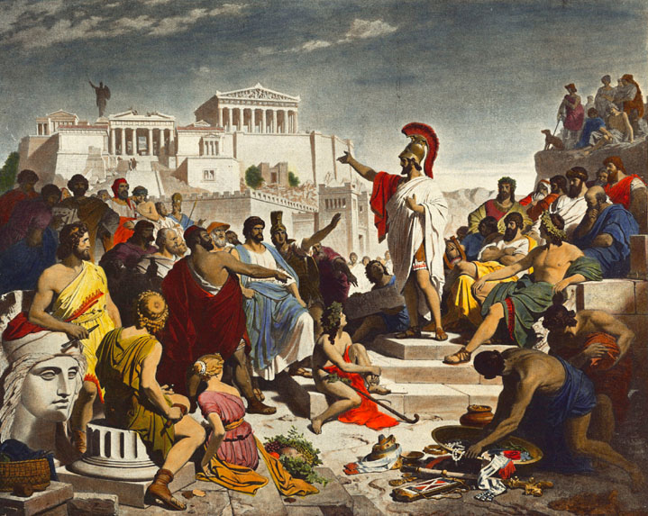
Key Source - Pericles’ Funeral Oration
Delivered at the end of the first-year of the Archidamian War (431) to honour the dead. Traditional that a leading citizen would deliver a funeral oration. Held in the kerameikos district
The oration can be divided into two halves: the first explains what makes Athens great, the second remembers those who had died in the first year
Focuses on why Athens’ democracy and society was superior to Sparta and their enemies
“Our constitution is called a democracy because power is in the hands not of a minority but of the whole people.” – praises democracy as not favouring ability rather than one particular class or wealth. Politics and private lives are tolerant
“In her case, and in her case alone, no invading enemy is ashamed at being defeated, and no subject can complain of being governed by people unfit for their responsibilities. Mighty indeed are the marks and monuments of our empire which we have left.”– Glorifies the Athenian empire and stressed that subjects have no grounds for complaint. Claims that the Athenians make friends by doing good to others

Slide 9
Key Source - Pericles’ Funeral Oration (Thucydides)
“What I would prefer is that you should fix your eyes every day on the greatness of Athens as she really is, and should fall in love with her.”– glorifies the success of Athens e.g. its buildings, intellectual thought, culture etc.
“Perhaps I should say a word or two on the duties of women to those among you who are now widowed. I can say all I have to say in a short word of advice. Your great glory is not to be inferior to what God has made you, and the greatest glory of a woman is to be least talked about by men, whether they are praising you or criticizing you.” Gives very little time to women suggesting they had a limited and very private role in Athens
How reliable is the Funeral Oration? Thucydides would have been present when the speech was delivered or would have spoken to those who were. However he does not claim to record the speech word-for-word but to give a summary of what he thought was said. He also used the speech to characterise Pericles so may have emphasised his leadership.

Slide 10
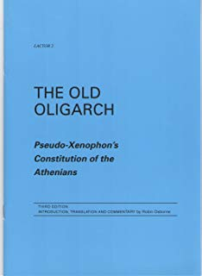
Key Source – The Old Oligarch (Pseudo-Xenophon) Constitution of the Athenians
The author is unknown and was originally thought to be Xenophon. Most historians today reject this and refer to the author as ‘the Old Oligarch’
Probably written in Athens in the 420s
The source is a detailed account of Athenian society and the Athenian political system
It is critical of democracy and the power that it gives to ‘common’ people
The author argues that the old system of oligarchy was a better form of government for Athens
Gives an aristocratic, conservative view of Athens and its democracy and is naturally hostile towards ordinary people. However it was written at the time and gives us evidence of the criticism that would have been made
Essential for any question on Athenian democracy or society

Slide 11
Key Source – The Old Oligarch (Pseudo-Xenophon) Constitution of the Athenians
Some Key Points it Makes:
Ordinary people dominate in Athens because they are the rowers and crews of the ships
The positions which are elected and still controlled by the aristocracy are the best run
Claims that democracy cannot produce the ‘best city’ because it favours the interests of bad people
Slaves lead undisciplined lives and are treated softly
Metics are given freedoms due to their skills
Common Athenians expect the rich to pay for festivals for them and the city provides public sacrifices for the poor
The Athenians exploit their empire and recognise that they are hated by the ruled
Oligarchies abide by their alliances but a democracy like Athens doesn’t
The Old Oligarch disapproves of democracy but thinks that the Athenians do a good job of preserving it
The Council and Assembly are overwhelmed by business and issues can take over a year to get settled
Implies that the Council and Assembly can be bribed to get certain business done quicker
Law courts are overwhelmed by regular cases linked to appointments and festivals and the cases brought by ordinary Athenians - very litigious

Slide 12
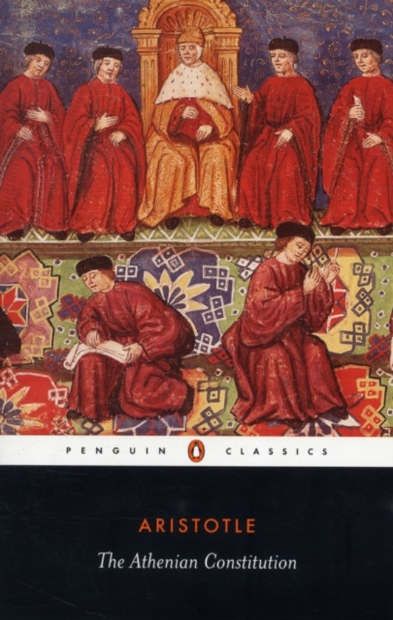
Key Source – Aristotle, The Athenian Constitution
Written by Aristotle or one of his pupils in the 320s BC
A detailed account of the democratic system in Athens
The work is based on records from the 5th Century and was carefully researched (Aristotle was followed by a group of students who would do this)
Gives detail of the reforms and changes made to democracy during out period
Aristotle was not Athenian and was writing about the system as it stood in the 320s so not entirely reliable
Essential for any question on Athenian democracy

Slide 13
Key Source – Aristotle, The Athenian Constitution
Some Key Points it Makes:
The city was well led when the aristocratic Council of Areopagus had control after the Persian Wars
Athens had around 700 archons (magistrates) in the city and sent around 700 to run parts of the empire
Ephialtes became the new champion of the people and reduced the power of the Council of Areopagus (462/1). The Council and law courts became more powerful
Further reforms opened up the nine archonships to lower social classes
Pericles’ citizenship laws (451/0)
Overall Pericles made the city more democratic - reducing the power of the Council of Areopagus, strengthening the city’s naval power, and introduced jury payment (Aristotle says that corruption in the courts began after this)
Control and maintenance of democratic Athens declined after Pericles’ death – singles out Cleon: “more than anyone else he corrupted the people with his wild impulses”
Claims that the best leaders other than Pericles were Nicias and Thucydides (the politician) because they were “gentlemen” and “public-spirited”
Outlines the development of faction in the Athens – one group of the people and one of the aristocracy

Slide 14
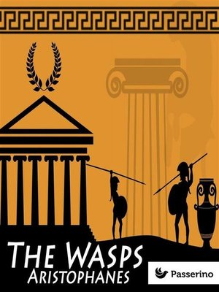
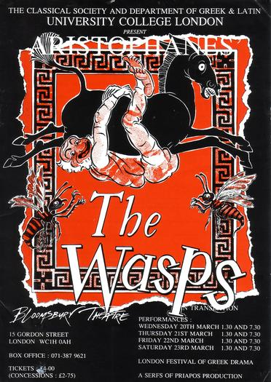
Aristophanes’ Wasps
A source which gives us an important insight into the Athenian legal system is Aristophanes’ play Wasps, first performed in 422 BC.
Aristophanes was critical of the courts and the jurors (dikasts). In Wasps, he portrays the jurors as old conservative men, at times addicted to jury service, and being the only ones in Athenian society with the time to serve on juries.
Philocleon – (Cleon-lover) elderly man addicted to serving on juries and has been locked in his house by his son to cure him
Bdelycleon – (Cleon-hater) Philocleon’s son who locks him in his house. As a compromise he allows his father to hold a mini-trial of the household dog
Labes – (Snatcher) dog standing trial accused of stealing cheese

Slide 15
Aristophanes’ Wasps
How could you use it:
In a question on democracy or participation
The play criticises the legal system for being dominated by old, prejudiced men simply out for payment (or in the case of Bdelycleon, soup)
This is in turn a criticism of the democratic system – the jurors are easily swayed by emotional appeals (also a point made by Socrates in the Apology)
However, it is also evidence of how the legal system actually worked and that it was open to participation by ordinary citizens. As an aristocrat Aristophanes may have been hostile towards the courts for this reason

Slide 16
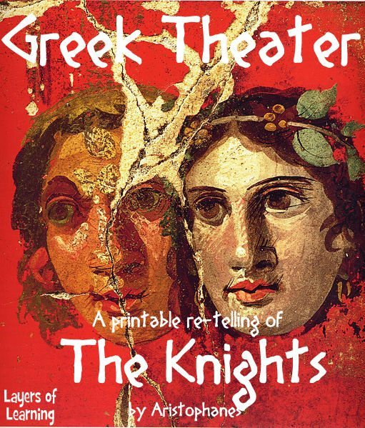
Aristophanes’ Knights
Performed in 424 BC
Unique as the only known play of its time to target and attack one political figure – Cleon
Cleon had previously prosecuted Aristophanes for Slandering Athens in 426 BC
A criticism more generally of how demagogues like Cleon manipulate the people
Knights presents the city of Athens as a household run by a bad-tempered and gullible man called Demos (‘the people’)
A new slave called Paphlagonian (Cleon) tricks Demos and claims credit for the work of other slaves
The other slaves – Demosthenes and Nicias try to find some one to replace the Paphlagonian in the household who is even more ignorant and selfish – the Sausage-Seller

Slide 17
Aristophanes’ Knights
How could you use it:
In a question on democracy or leadership in democratic Athens
The play attacks the character and behaviour of Cleon claiming that he is violent and impulsive, and holds power as a demagogue i.e. he can whip up the mob
Aristophanes is also indirectly criticising the democratic system by suggesting that it rewards people who can shout the loudest not the most able politicians and leaders. This matches Socrates’ views on Democracy (analogies of the ship and lion-tamer) and the those of the Old Oligarch
In a period study question on leadership
A theme in the play is that Cleon takes credit for the work of Demosthenes and Nicias. This is a reference to Pylos and Sphacteria where Aristophanes thought that Cleon arrived to take the glory after the hard work of Demosthenes
This would be useful to suggest that Cleon’s leadership during he Archidamian War was limited

Slide 18
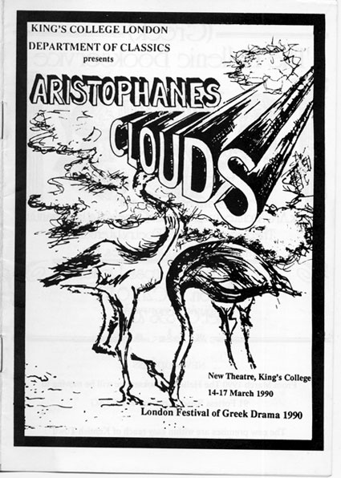
Aristophanes’ Clouds
First performed in 423 BC and then re-written around 419 (the re-write survives)
Pheidippides is sent to the ‘thinker’ by his father Strepsiades to learn the art of rhetoric so that he can talk his way out of his gambling debts.
The thinker is run by Socrates who is used a symbol/character to represent new thinking altogether
Pheidippides initially refuses to go and his father goes in his place. He fails to learn anything properly and his son eventually attends.
He chooses ‘wrong’ to teach him how to make the weaker argument the stronger and talks his way out of his gambling debts. He goes on, however, to argue that children are allowed to beat their parents and the play ends with him doing this to Strepsiades.

Slide 19
Aristophanes’ Clouds
How could you use it:
Evidence of opposition to the sophists and ‘new thinking’. The moral of the play is that Athenians should not be lured or distracted by clever new thinking and should instead stick with traditional values
Evidence of criticism of rhetoric. ‘Wrong’ boasts of the power of his rhetorical skills in making the weaker argument appear the stronger. He claims he can teach Pheidippides to be able to talk his way out of adultery. This criticism of rhetoric matches lots of other sources – Mytilene debate, Plato, Aristotle, Hippolytus
In a question on religion. Part of the new thinking taught in the thinkery is to challenge traditional religion (Strepsiades comes back laughing at his son for believing in Zeus). Aristophanes would only have included this theme if people were genuinely challenging traditional belief at the time. However, Aristophanes remains very critical of new religious thinking suggesting new ideas were limited and controversial.
In a question on Socrates. He would claim in his defence speech that the portrayal of him in Clouds and the association of him with the sophists would start to turn opinion against him

Slide 20
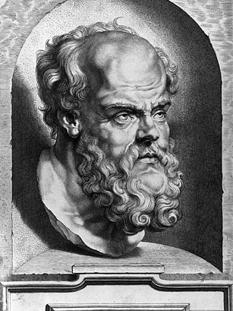
Key Source - Plato’s Apology
The Nature and Reliability of the source:
Plato was a student of Socrates and was present at his trial
However, the Apology was written some time after the trial (possibly 10 years) and is not, therefore, a word-for-word account
Xenophon also left an account of Socrates’ trial which has significant differences to Plato’s Apology
The purpose of the Apology was to present Socrates in the best light possible and to distinguish him from the Sophists

Slide 21
Key Source - Plato’s Apology
Some Key Points it Makes:
Socrates is accused of corrupting the youth and of denying the gods/inventing new ones
He rejects the claim that he is a sophist as he does not receive payment and does not have any expertise – he just asks questions
Understands that his method of questioning has made him unpopular by exposing the ignorance of others
Socrates begins his defence humbly but becomes increasingly defiant as he lectures the jury
He criticises democracy when he explains his refusal to perform public service. The jury would have been strongly democratic
He criticises traditional conventions in law courts by refusing to make emotional pleas and by suggesting a ridiculous punishment
He uses his Socratic method to cross-examine Meletus – this is remarkable when you consider that he is accused of corrupting the youth through this method
Gives an example of how the courts work – he suggests his own punishment after he has been found guilty

Slide 22
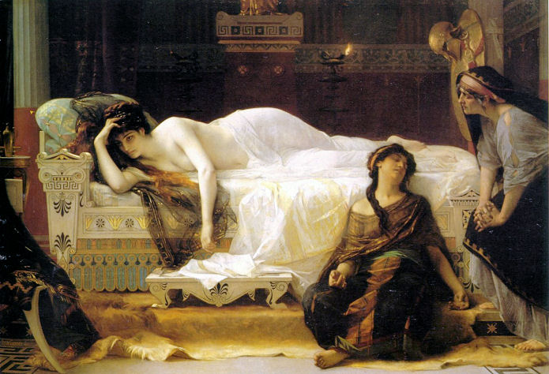
Key Source – Euripides, Hippolytus
The Plot of Hippolytus:
The goddess Aphrodite wants revenge against the young man Hippolytus (son of the Athenian king Theseus) because he has declared that he has no interest in sex and love
Aphrodite makes Theseus’ wife Phaedra fall in love with her step-son Hippolytus
Phaedra hides her love but is tricked into revealing it to her nurse who tells Hippolytus who in turn threatens to tell Theseus
Phaedra commits suicide and leaves a note claiming that she had been raped by Hippolytus
Theseus curses an exiles his son Hippolytus who is killed by a bull sent by Poseidon
At the end of the play the goddess Artemis reveals the truth about what has happened to the dying Hippolytus who forgives his father

Slide 23
Key Source – Euripides, Hippolytus
How could you use it:
As evidence of the impact of rhetoric on tragedy (The influence of the sophists)
Two scenes are full of rhetoric: Hippolytus’ ‘defence speech’ when confronted by Theseus (known as the Agon) & the tricks used by the Nurse to persuade Phaedra to reveal her desire for Hippolytus. This shows that rhetoric was a common part of Athenian society, recognisable to the audience but is also a criticism of its power to persuade/manipulate
In a question on drama or dramatic festivals
Hippolytus reveals a lot about these – it shows how seriously the competition at the City Dionysia was taken as the play that was performed and won 1st place in 428 was a re-write of an earlier version (Hippolytus Veiled), which had not done so well because it was thought too controversial. Euripides, therefore, was not trying to shock or overly-challenge his audience and wanted his play to be popular
Linked to this, Hippolytus is an example of a tragedy being set in a mythological scene. Almost all tragedies did this as it was viewed as ‘safer’. Serious points could still be made but without being too controversial

Slide 24
Key Source – Euripides, Hippolytus
How could you use it cont.:
In a question on religion
On the one hand Hippolytus presents a very traditional image of the gods and religion, suggesting that this wasn’t being challenged in the 5th Century. Hippolytus is punished for showing disrespect towards Aphrodite and gods are shown as having human characteristics e.g. Aphrodite's envy and spite
However, there is some evidence that traditional religion was being challenged or questioned – the punishment of Hippolytus and the treatment of Phaedra are portrayed as disproportionate to their offences and the gods as cruel – this is expressed by the Messenger towards the end of the play
In a question on women
Evidence that women were viewed as second class (link here to a topic 1 question on society and participation). The play contains stereotypical views of women – the Nurse is interfering and manipulative whilst Hippolytus delivers an anti-women rant (“evil pest”)
However, the play is also dominated by a number of strong female characters – Aphrodite, Artemis and Phaedra. Phaedra fights against the curse placed on her by Aphrodite and commits suicide rather than give in to it. She also complains of the treatment of women – “how cruel a curse it is to be born a woman,”

Slide 25
Key Sources - Others
Aristophanes – Women at the Thesmophoria
The parabasis of the play outlines the complaints of women in Athens and their second-class status. Shows that women were not docile victims. Also evidence of the importance of religious festivals for women where they were often given a leading role
Gorgias – The Encomium of Helen
Show speech from the 420s advertising Gorgias’ rhetorical skill – a speech designed to argue that Helen was not to blame for going to Troy. Important link to the law courts and Assembly where this skill would have been needed.
Plato Republic
Analogies of the ‘Ship’ and the ‘Lion Tamer’ – Socrates expresses critical views on democracy
Plutarch
Gives an account of the Periclean building project and how it was justified
Pericles’ citizenship laws
Role of Aspasia – evidence of opportunities for metics
Accounts of Pericles, Cleon, Nicias and Alcibiades’ leadership

Slide 26
Key Sources – Others cont.
Xenophon
Slavery of ‘friends’ is thought wrong but of enemies natural – according to Socrates (Memorabilia)
Argued for giving metics more rights as they were ‘our finest resource’ (Poroi)
Compares sophists as paid teachers to prostitutes (Memorabilia)
Described the type of thought Socrates was interested in – human ethics (Memorabilia)
Defended Socrates saying that he did not introduce new gods or deny old ones (Memorabilia)
Plato Dialogues
Recorded supposed conversations between Socrates and a number of Sophists designed to criticise their behaviour (i.e. payment) and distinguish Socrates from them – Hippias, Gorgias, Protagoras
Aristotle
Claimed that rhetoric made the weaker argument the stronger
Isocrates
Explained the worship of chthonic gods
Pausanias Description of Greece
This was a detailed account of the monuments of Greece, written somewhere between c.110-c.180 AD. Pausanias’ strength is his detail but he was describing buildings as he found them in his day, over 500 years later. He was also particularly interested in religious buildings meaning he gives lots of attention to those he viewed as important and less to others.

Slide 27
To what extent do the sources enable us to understand how the Sophists affected the intellectual climate in Athens?
They do help us to understand how sophists affected the intellectual climate in Athens | They do not help us to understand how sophists affected the intellectual climate in Athens
Evidence that sophist ideas influenced Athenian tragedy – Hippolytus heavily influenced by rhetoric e.g. Hippolytus’ defence speech when accused by Theseus & the Nurses’ persuasion Evidence that the sophists influenced Athenian Comedy – Aristophanes’ Clouds and the portrayal of new thinking e.g. ‘Wrong’ making the weaker argument the stronger Evidence that it affected debate and discussion in the Assembly and law courts – Thucydides’ account of the Mytilene Debate shows the presence of rhetoric (Cleon criticises it and both speakers use it). Aristophanes’ Wasps shows a clear impact on defence speeches as citizens used the techniques developed by Gorgias (Encomium of Helen) Could ague that the sophists were changing the way people viewed religion e.g. Anaxagoras argued that the moon was a rock which reflected sunlight (Plato Apology) whilst Protagoras developed ideas of relativism ‘man is the measure of all things’ which challenged the ideas of set rules from the gods Philosophical thought shows the impact of the sophists – Socrates was not a sophist but from Apology was clearly associated with them and spent a lot of his defence speech talking about them. | Difficult from the sources to understand how much of this change was due to the sophists directly e.g. were changes in debate in the Assembly and the courts due to the sophists or developments in democracy The sources might suggest that the sophists and their ideas were an unpopular minority in the 5th-century and therefore had minimal impact e.g. Aristophanes warns against new ideas in Clouds rather than supporting them Religious ideas remained largely traditional during this period – e.g. the construction of the Erechtheion and the trial of Socrates A number of sources are themselves hostile to the sophists so might exaggerate their impact on Athenian society – Plato and Xenophon give us most of our understanding of the sophists and yet wanted to make them look worse and distinguish them from Socrates.

Slide 28
‘The dramatic festivals in Athens were primarily concerned with religion.’ To what extent do the sources support this view?
YES | NO
Dramatic festivals were forms of religious worship – the City Dionysia and the Lenaea were in honour of Dionysus The festival was full of acts of religious worship e.g. on day 2 a ceremony was held in the Theatre of Dionysus starting with the sacrifice of a piglet followed by poured offerings (libations) from the ten generals The themes and contents of the plays often reinforced traditional religion and worship of the gods – Hippolytus tells the audience to act with respect towards the gods and not neglect their worship as Hippolytus did that of Aphrodite Comedies also reinforced religious worship – Aristophanes’ Women at the Thesmophoria is set against the backdrop of a religious festival whilst in Clouds Aristophanes satirises those who were challenging traditional religion - Strepsiades | Religious festivals concerned a variety of other issues/motives: They were concerned with political issues – festivals were opportunities to emphasise the power of Athens and the strength of its empire. For example day 2 of the City Dionysia included the ‘Parades’: the Parade of Tribute demonstrated Athens’ control of its empire Dramatic festivals also provided opportunities for ambitious individuals to gain a reputation and influence. Each playwright was funded by a chorēgos who would have their name engraved on a victory monument if they won (Pericles did this in 472) Dramatic festivals were concerned with social issues – they helped to create a strong sense of community and Athenian identity. The seating in the theatre was divided into tribes whilst the Parade of Orphans reinforced the common care Athenians took for one another It could be questioned, however, whether the Athenians would have seen any distinction between religion, politics and society. For them this would have all been the same thing

Slide 29
How far do the sources help us to understand the impact of religious festivals on the lives of the people of Attica?
YES | NO
The Panathenaia festival and its importance is reflected in the Parthenon Frieze which most historians think depicts the preparation and events of the festival. This was the largest celebration in the Athenian calendar and the Great Panathenaia held every four years included 8 days of contest and worship. This was also relatively inclusive – women were involved in production of the peplos and metics were allowed to take part in the procession to the Acropolis Aristophanes’ Women at the Thesmophoria demonstrates the impact of festivals on women in particular, for whom a religious festival was a rare opportunity to have a public role and to be free of male supervision The Old Oligarch details the impact to religious festivals saying that the Athenians celebrate more than any other city and that slows down the rate at which government and legal business can be done Euripides’ and Aristophanes’ works show the significance of the dramatic festivals (City Dionysia and Lenaea) – must have had a considerable impact as attendance (male citizens) was widespread and eventually paid for through the theoric fund The worship of the Eleusinian Mysteries was also clearly very significant – Sanctuary at Eleusis was built and Alicibiades announced his return to Athens in 407 by restoring the pilgrimage to Eleusis (Plutarch) | The sources, such as the Parthenon frieze, show us what took place in the Panathenaia but don’t help us to understand what impact they had on ordinary people. For example, did the annual festival have as much impact as the Great Panathenaia? Sources also do not reveal whether all groups participated in the festivals to the same degree – religious festivals clearly had a considerable impact on citizens but this was much more limited for women, metics and slaves

