Slide 1
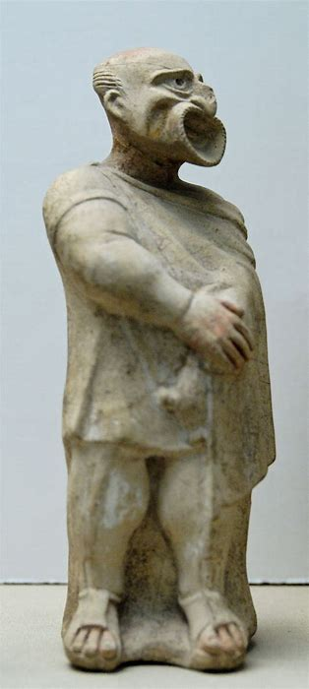
Greek Depth Study Aristophanes Revision
Knights (424 BC)
Clouds (423 BC)
Wasps (422 BC)
Thesmophoriazusae (411)

Slide 2
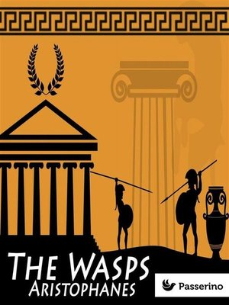
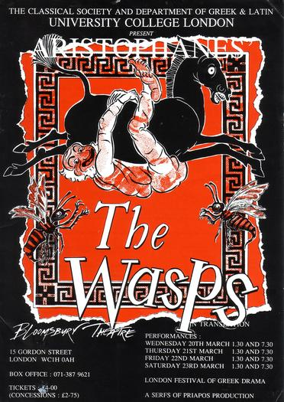
Aristophanes’ Wasps
How could you use it:
In a question on democracy or participation
The play criticises the legal system for being dominated by old, prejudiced men simply out for payment (or in the case of Bdelycleon, soup)
This is in turn a criticism of the democratic system – the jurors are easily swayed by emotional appeals (also a point made by Socrates in the Apology)
However, it is also evidence of how the legal system actually worked and that it was open to participation by ordinary citizens. As an aristocrat Aristophanes may have been hostile towards the courts for this reason

Slide 3
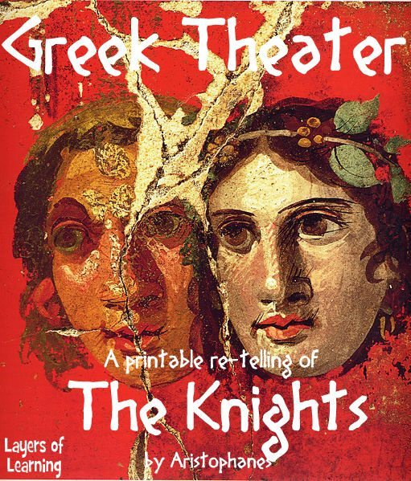
Aristophanes’ Knights
Performed in 424 BC
Unique as the only known play of its time to target and attack one political figure – Cleon
Cleon had previously prosecuted Aristophanes for Slandering Athens in 426 BC
A criticism more generally of how demagogues like Cleon manipulate the people
Knights presents the city of Athens as a household run by a bad-tempered and gullible man called Demos (‘the people’)
A new slave called Paphlagonian (Cleon) tricks Demos and claims credit for the work of other slaves
The other slaves – Demosthenes and Nicias try to find some one to replace the Paphlagonian in the household who is even more ignorant and selfish – the Sausage-Seller

Slide 4
Aristophanes’ Knights
How could you use it:
In a question on democracy or leadership in democratic Athens
The play attacks the character and behaviour of Cleon claiming that he is violent and impulsive, and holds power as a demagogue i.e. he can whip up the mob
Aristophanes is also indirectly criticising the democratic system by suggesting that it rewards people who can shout the loudest not the most able politicians and leaders. This matches Socrates’ views on Democracy (analogies of the ship and lion-tamer) and the those of the Old Oligarch
In a period study question on leadership
A theme in the play is that Cleon takes credit for the work of Demosthenes and Nicias. This is a reference to Pylos and Sphacteria where Aristophanes thought that Cleon arrived to take the glory after the hard work of Demosthenes
This would be useful to suggest that Cleon’s leadership during the Archidamian War was limited

Slide 5
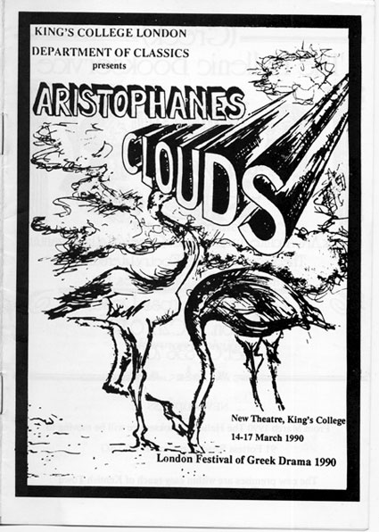
Aristophanes’ Clouds
First performed in 423 BC and then re-written around 419 (the re-write survives)
Pheidippides is sent to the ‘thinkery’ by his father Strepsiades to learn the art of rhetoric so that he can talk his way out of his gambling debts.
The thinkery is run by Socrates who is used a symbol/character to represent new thinking altogether
Pheidippides initially refuses to go and his father goes in his place. He fails to learn anything properly and his son eventually attends.
He chooses ‘Wrong’ to teach him how to make the weaker argument the stronger and talks his way out of his gambling debts. He goes on, however, to argue that children are allowed to beat their parents and the play ends with him doing this to Strepsiades.

Slide 6
Aristophanes’ Clouds
How could you use it:
Evidence of opposition to the sophists and ‘new thinking’. The moral of the play is that Athenians should not be lured or distracted by clever new thinking and should instead stick with traditional values
Evidence of criticism of rhetoric. ‘Wrong’ boasts of the power of his rhetorical skills in making the weaker argument appear the stronger. He claims he can teach Pheidippides to be able to talk his way out of adultery. This criticism of rhetoric matches lots of other sources – Mytilene debate, Plato, Aristotle, Hippolytus
In a question on religion. Part of the new thinking taught in the Thinkery is to challenge traditional religion (Strepsiades comes back laughing at his son for believing in Zeus). Aristophanes would only have included this theme if people were genuinely challenging traditional belief at the time. However, Aristophanes remains very critical of new religious thinking suggesting new ideas were limited and controversial.
In a question on Socrates. He would claim in his defence speech that the portrayal of him in Clouds and the association of him with the sophists would start to turn opinion against him

Slide 7
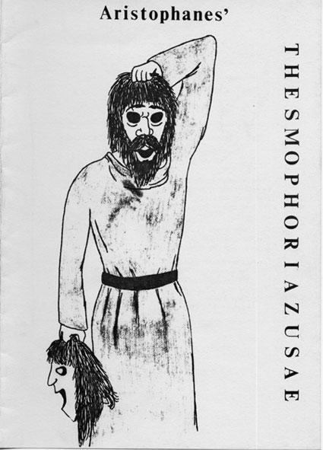
Aristophanes’ Thesmophoriazusae
Performed in 411 BC
The women of Athens have become frustrated with Euripides’ negative portrayal of them in his plays, which is making their husbands mistrust them
The women decide to kill Euripides, who learning of this asks his old friend Mnesilochus to infiltrate the Thesmopohria Festival (dressed as a woman) to speak up for Euripides in his defence
Mnesilochus is discovered and after several failed rescue attempts, the women agree to spare him and Euripides in return for fairer treatment in his tragedies
The prescribed section we study is the parabasis where the women of the Thesmophoria address the audience directly

Slide 8
Aristophanes’ Thesmophoriazusae
How could you use it:
Evidence of the position of women: The complaints of the women confirm that they were treated as second class citizens also that they were not passive victims, and instead criticised their position. However, the amount you can learn about the position of women through the play is limited by the fact it is a male perspective – male writer, actors, (probably) audience
Evidence of the importance of religious festivals . The comedy revolves around the Thesmophoria Festival – a female-only festival in honour of Demeter and Persephone which took place in the Autumn. Worshipping these gods was essential to bring fertility to the city and it also provided a unique opportunity to women. Married women camped out near to the Pynx (seat of the Assembly) for three days and two nights. It was a rare occasion of female independence and empowerment
In a question on Athena and Poseidon: the Thesmophoria shows that that the Athenians had a more diverse custom of religious worship than simply honouring Athena and Poseidon. Other gods were important and at times dominated the religious calendar

Slide 9
To what extent was Comedy influenced by contemporary events?

