Slide 1
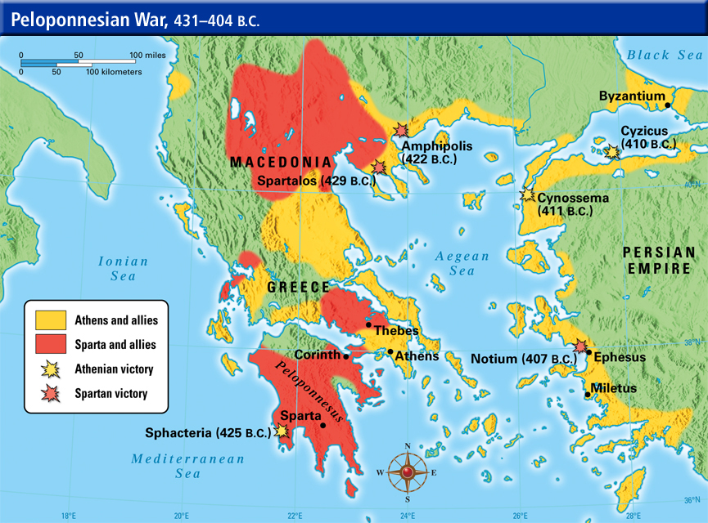
Ancient History Impact Session
Greek Period Study (Section A):
Relations between Greek States and Greek and non-Greek states, 492-404 BC

Slide 2
Structure and Technique – The Basics
Examined in Section A of the exam – should aim to spend approximately 1 hour 15 minutes on this section
One 30 mark essay questions from a choice of two – 45 minutes
One compulsory interpretation question – 30 minutes
The focus of this section is on examining your understanding of a broad range of history
Don’t forget Persia!

Slide 3
The Essay Question
30 marks
Use and evaluation of the ancient sources | 15/30
Analysis and Evaluation | 10/30
Own Knowledge | 5/30
Read the question carefully and highlight any key information you are given:
what date range does the question give you? If this isn’t stated then write it on the question
What is the issue in the question? Highlight and if necessary explain this
Spot any judgement words in the question that you could support/challenge (e.g. ‘completely’, ‘always’)
Is the question asking about a change over the period or within a more specific time-frame?
Spend a minimum of 5 minutes planning your answer – record the key sources you will use in the answer along with the arguments supporting and challenging the question that you will make
Introduction
Start by re-wording the question to show your understanding of it
Outline the arguments you will make for and against the issue in the question
Provide an overall judgement that you can then come back to in your conclusion

Slide 4
The Essay Question
30 marks
Use and evaluation of the ancient sources | 15/30
Analysis and Evaluation | 10/30
Own Knowledge | 5/30
Main Paragraphs
Start with a clear signpost sentence introducing the point you are going to make and linking it to the question
Develop this point using a range of evidence from the ancient sources and your own knowledge
Argue the significance of the point you are making fully – why is it important/significant but why might it also be limited?
Link the paragraph back to the question
Using the source
Focus on including a range and variety of ancient sources (where possible more than just written ones)
When you include a source reference the author clearly – don’t assume the marker will know this
You will get marks for using the sources as supporting evidence but also need to evaluate why sources have certain views and how reliable these are
You can do this by: (1) challenging/supporting sources with your own knowledge (2) challenging/supporting sources with other sources (3) reaching judgements about how the provenance or context of a source makes what it is saying more or less reliable

Slide 5
The Essay Question
30 marks
Use and evaluation of the ancient sources | 15/30
Analysis and Evaluation | 10/30
Own Knowledge | 5/30
Conclusion
Re-read the question carefully before you write this – its easy to lose focus or subtly change the question
Ensure your conclusion is balanced but also reaches a clear and direct answer to the question
Try to make this judgement sophisticated – does the answer change over time (i.e. something becoming more or less important)? Are there any differences between different states (Athens, Corinth Sparta, Persia etc.)?

Slide 6
The Interpretation Question
20 marks
Supported evaluation of the interpretation | 15/20
Own Knowledge | 5/20
Read the question carefully – identify which key debate the interpretation is from. This will help you to understand what the passage is arguing if you can narrow it down to a particular debate
Read the passage – spend a minimum of 5 minutes doing this. Don’t expect it to be easy or obvious but don’t panic either if you find it difficult to understand the first time round
Once you have read the passage once, write above it what its overall argument is in relation to the issue in the question
Read it again and highlight/number the individual points (sub-arguments) it makes within this
Introduction– Summarise the overall argument the historian is making and provide a brief judgement on how convincing this is. Keep the introduction short

Slide 7
The Interpretation Question
20 marks
Supported evaluation of the interpretation | 15/20
Own Knowledge | 5/20
Main Section – This is not an essay but your answer needs to consider he strengths and limitations of what is being argued so you could have one section on each
Focus on: (1) introducing an argument from the passage (2) providing a clear judgement on this using critical vocabulary (3) supporting and explaining this judgement using own and source knowledge (4) linking your point back to the question
Don’t feel you have to look for the historian getting something wrong. Instead, do they place too much emphasis on something? Do they neglect or ignore something more important? Is their argument too narrow?
Conclusion – This needs to be developed and carefully thought-out. Try to do more than just say that it is or isn’t convincing. Is it largely convincing but still makes a weaker argument? What is the most convicning point that it makes? Etc.

Slide 8
Sources - Herodotus
There are though a number of features of Herodotus’ writing that you need to be aware of and be ready to analyse in an essay:
SPEECHES – Herodotus includes lengthy speeches that he had no way of hearing or getting an account of. These are made up by him often to portray someone in a particular way. E.g.:
Xerxes receiving advice from Artabanus and Mardonius - Herodotus uses this to portray the king as indecisive weak; Artabanus is shown as the wise uncle who is ignored
Xerxes receiving advice from Artemisa – she is portrayed as wise an decisive to again make the king look worse
MYTHS/GODS – Herodotus mixes factual accounts of events with myths and gods (this in sharp contrast to Thucydides who deliberately left this out)E.g.:
Mardonius fleet in 492 was lost near Thasos and the men eaten by sea monsters
The Athenian runner Pheidippides was confronted by the god Pan whilst running to Sparta to get help in 490

Slide 9
Sources - Herodotus
PRO-ATHENIAN – Herodotus was not Athenian but lived there for a period and was clearly sympathetic. Throughout his work he puts forward a pro-Athenian interpretation of events. E.g.:
He credits victory at Mycale exclusively to Athens despite the Greek forces being mixed and having Spartan leadership
Herodotus was also critical of other Greek states who at the time he was writing were hostile to Athens (Sparta and Corinth in particular). E.g.:
In the arguments for and against fighting at Salamis he portrays the Corinthian commander Adeimantus as a coward
Sparta are shown as reluctant to fight at Mycale and wanted instead to retreat behind the wall across the Isthmus
LEADERS – Herodotus glorifies the role of Athenian leaders E.g.
Miltiades in persuading the Athenians to fight at Marathon
Themistocles for persuading the Greeks to fight at Salamis

Slide 10
Sources - Others
Persian Inscriptions
Naqs-e Rustam – shows Darius’ desire to expand the Persian empire but also his concern for law and justice
Xerxes’ Inscriptions – found at the ‘Gate of All Lands’; challenges Herodotus’ portrayal by showing the king as humble to the highest god of the Persian religion and also a builder rather than just a fighter
Serpent Column
Built in 478 BC at Delphi to thank the god Apollo for Greek victory. The names of 31 Greek states are inscribed on the column giving a sense of the cooperation of the Hellenic League. However, Athens and Sparta are still at the top and 5 members of the League are not included showing disagreement and division

Slide 11
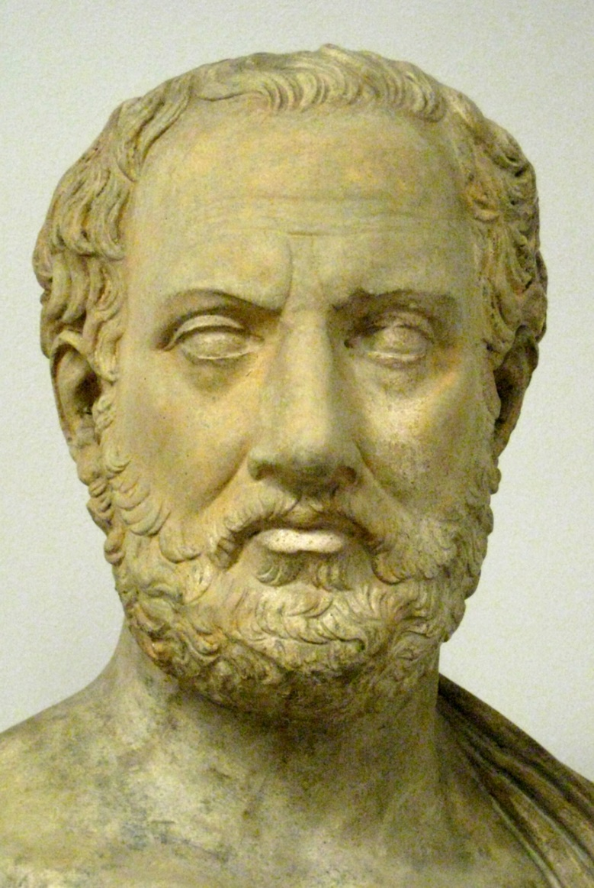
Sources - Thucydides
Wrote History of the Peloponnesian War
Focused on relations between Athens and Sparta in the build-up to conflict in 431 and then the conflict itself
Was a general during the Archidamian War – failed to stop Brasidas from capturing Amphipolis in 424
Claim to write a dispassionate account and certainly less pro-Athenian than Herodotus
Writing during a movement in Athens known as rationalism that sought ‘scientific’ explanations for things rather than myths and the gods
The Pentecontaetia covers the period 479-431 but lacks detail on in places on this wide period
Thucydides also neglected the importance of Persia in his work
Work ends in 411

Slide 12
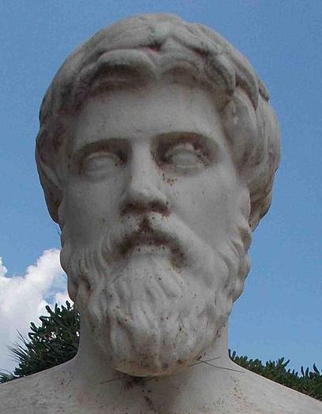
Sources – Plutarch
Wrote Parallel Lives which compared famous Greeks and Romans. This included the Lives of Aristeides, Cimon and Pericles
Born in Greece, writing during the Roman empire approx. AD 50-120
Style of his work was biographical – he states that it is not his aim to critically weigh up and analyse evidence
Very distant from the events he was describing but based his work a wide range of sources some of which were very early and have been lost
At times he compares earlier sources to reach judgements about which is most reliable. At others his is accepting of what they say

Slide 13
Plutarch – some key sources
Aristeides 23
Praises Aristeides and Cimon as ‘fair’ and ‘noble’, whilst criticising the Spartan commander Pausanias as ‘harsh
Cimon 11-12
Praises Cimon’s leadership of the Delian League as he pushed back Persia: “No one did more to humble the great King and abase his pride than Kimon”
Pericles 23.1-2
Suggests that Pericles paid off the Spartans in 446 BC (invaded Attica under King Pleistoanax) by paying 10 talents year and “in this way deferred the war”
Shows that Greeks used other means than conflict to resolve differences but also suggests conflict was inevitable as Pericles was “not purchasing peace but time during which he could make preparations quietly and ensure that the Athenians fought better.”
Pericles 30-31
Outlines the possible reasons for the Megarian Decree

Slide 14
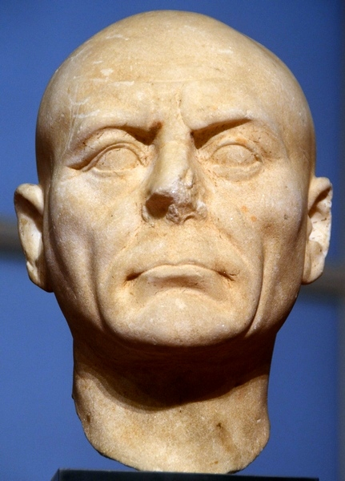
Sources – Diodorus
Wrote Universal History which was an attempt to write a history of the known world up to 60 BC
Writing in the first-century BC. From Sicily, known as the ‘Sicilian’
Based his work on the Greek writer Ephorus (405-330) who was much closer to the events of the Peloponnesian Wars but was trained in the school of rhetoric which tried to make events as dramatic and exciting as possible
Very few of his other sources survive meaning that historians debate the reliability of Diodorus’ account

Slide 15
Diodorus – some key sources
11.46-47 :
Praises Aristeides for setting the tribute fairly for members of the Delian League
Says that the Greek states in the Aegean “enthusiastically submitted” to Aristeides and Athens (important when assessing whether Athens built an empire or not)
12.2.1-2 :
Praises the growth of Athenian power after 479 saying that they had “so humbled the famous Persian hegemony as to compel them to make an agreement to free all the cities of Asia.”
This is evidence for the Peace of Callias in 449 (Diodorus gives the terms of the peace on p.22-3
Not prescribed sources but…
Diodorus claims that the Spartans offered Athens a peace treaty after the battle of Arginusae in 406 – suggests that Athens could have avoided defeat as late as 406 and that the refusal of the offer was a result of poor Athenian leadership (Cleophon)

Slide 16
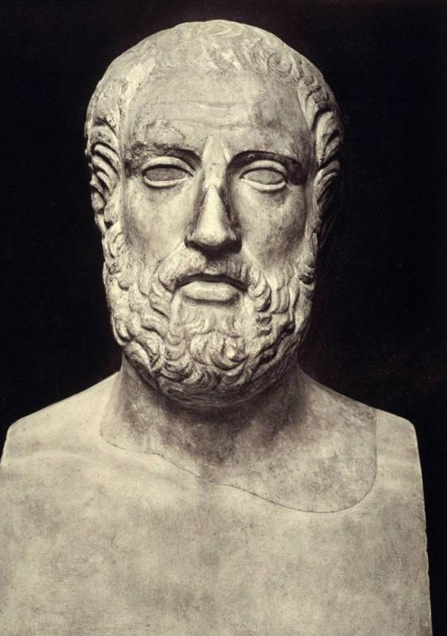
Sources – Aristophanes
Comic playwright producing plays from the 420s onwards. His style of comedy included satire – making fun of contemporary society and politics
Aristocratic Athenian
Hostile towards Cleon due to his social status and also because Cleon had previously tried to prosecute him
Two prescribed plays for the period study – Archarnians (425) and Peace (421)

Slide 17
Aristophanes – some key sources
Archarnians:
Claims the Megarian Decree was the theft of a number of Aspasia’s prostitutes
Significant as suggest that the Decree was not an attempt to create war and that Sparta may have exaggerated its importance to justify attacking Athens
Peace:
Shows that many Greek states under Athenian control were ripe for revolt
The play was performed in 421 BC and demonstrates that many in Athens wanted peace – shows division at home over continuing the war
Peace :
Highlight critical of Cleon claiming that he attacked opponents by calling them “Brasidean sympathisers” whilst ignoring that “Greece was on its way to desolation”
Like Thucydides, Aristophanes disliked Cleon’s humble roots: “And the man who did all of this was the tanner.” His portrayal of Cleon will therefore potentially be exaggerated

Slide 18
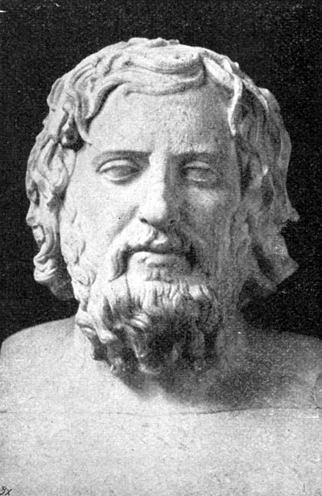
Xenophon – some key sources
Wrote ‘A History of My Times’ (also known as ‘Hellenica’)
Athenian citizen born 430 BC
Picked up the period 411 BC onwards as Thucydides’ account stops
Lacks the same depth as Thucydides
Covers the Spartan –Persian alliance from 411 onwards along with the final battels of the war

Slide 19
Xenophon – some key sources
Xenophon (1.5)
Details the positive first meeting between Lysander and Cyrus. Also shows the financial support Persia provided
Xenophon (1.6)
Details the negative meeting between Callicratidas and Cyrus
Xenophon (2.1)
“On the fifth day as the Athenians sailed up, Lysander gave special instructions to the ships that they were to follow them.”
Xenophon gives particular praise to Lysander for the Spartan victory at Aegospotami

Slide 20
Sources - Others
Harpokration, s.v. Attikois grammasin
Harpokration wrote about the work of an earlier historian Theopompus. Harpokration argued that the supposed Peace of Callias between the Delian League and Persia in 449 was a forgery from Theopompus, who was writing when Athenian power in the 4th century BC was considerable reduced and wanted to exaggerate the height of its power in the 5th century
Aristotle Politics
A 4th century philosopher in Athens. Commented that the Athens’ treatment of its allies was very harsh and in particular of Chios, Samos and Lesbos who by 450 were the only members of the league still providing ships - Very good evidence to show that by 446 Athens was running the Delian League as an empire
Chalkis Decree
446/5 – a decree passed by the Athenian assembly imposing terms on the city of Chalkis on the island of Euboea. The Chalkidians had to swear not revolt against Athens and important legal cases were transferred from Chalkis to Athens. Very good evidence to show that by 446 Athens was running the Delian League as an empire

Slide 21
To what extent did the outcome of conflicts during this period depend on the strengths and weaknesses of the leaders of each side?
The outcome of conflicts did depend on the strengths and weaknesses of leaders | The outcome of conflicts did not depend on the strengths and weaknesses of leaders
Persian Wars – effective leadership from Miltiades (Marathon, 490), Themistocles (Salamis, 480) and in general from Spartan commanders of the Hellenic League (Leonidas, Eurybiades, Pausanias, Leotychides) Persian Wars – Xerxes portrayed as a weak indecisive leader whose mistakes (continuing the invasion after Plataea) caused Persia’s defeat. However much of this portrayal is an exaggeration from Herodotus Archidamian War - Cleon and Brasidas shaped the final years of the Archidamian War. Thucydides states that the death of both created the conditions for peace in 421 Sicily - weaknesses and division of Athenian leadership caused defeat e.g. Nicias opposed the invasion altogether Ionian War – effective leadership of Lysander led to Spartan victory at Aegospotami. He also managed to build an effective alliance with Persia. (Xenophon) Ionian War – Poor Athenian leadership caused defeat e.g. rejection of Alcibiades’ advice at Aegospotami | A range of other factors shaped the outcome of conflicts: Athenian Naval strength – decisive at Salamis and also at the start of the Archidamian War (Naupactus) ensuring a stalemate

Slide 22
‘Relations between the Persians and the Greeks changed completely during this period.’ How far do you agree with his view?

Slide 23
‘Both Sparta and Athens were led by their allies into conflicts which they did not want.’ To what extent do the sources support this view?

