Slide 1
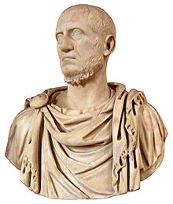
Roman Period Study Key Source Summary

Slide 2
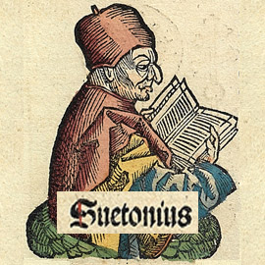
Prescribed Source - Suetonius
Suetonius Lives of the Caesars (AD 70-c.140)
Came from the equestrian rank
Worked in the imperial court under Emperors Trajan and Hadrian
Writing in the early second-century AD
Most famous work – Lives of the Caesars which covered 12 emperors from Julius Caesar onwards
His works were biographies designed to satisfy general curiosity about the emperors
Included gossip, rumour and trivial details to make his subjects appear more human
Wanted to readers to make judgements about the moral character of the emperors and also for his accounts to be dramatic
Had access to the imperial archives as ‘director of the imperial libraries’
Along with Tacitus, the main source for our period

Slide 3
Prescribed Source - Suetonius
Suetonius Lives of the Caesars (SOME KEY SOURCES)
Says that the gates to the temple of Janus Quirnus were closed three times during Augustus; rule – Pax Augusta
Gives detail on Augustus’ administrative reforms in Rome and reforms to the Senate
Recognised that Tiberius made a good start to his rule and gradually showed that he was princeps
Tiberius vetoed all bills for the dedication of temples to himself
Romans shouted ‘To the Tiber with Tiberius’ on news of his death
Enthusiastic reception for Gaius – Chick, star, baby – also set aside Tiberius’ will
The people demanded Claudius be made emperor after the death of Gaius
Claudius’ relationship with the plebs – calls everyone ‘My lords’
Gives detail on Nero’s golden five years and his love of music and Greek culture
Describes the assassination attempts of Agrippina the Younger
Account of the Great Fire and the building of the Domus Aureus

Slide 4
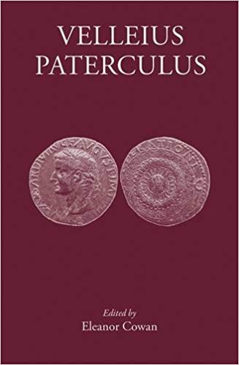
Velleius Paterculus, History of Rome
Written c. AD 30
A history of Rome from the Trojan war to AD 29
Paterculus was a military officer and then politician during the reigns of Augustus and Tiberius
He offers a first-hand account and perspective on events
He had particular insight into the emperors’ political decision as he was a senator
HOWEVER – Paterculus owed his position to Augustus and Tiberius so is very supportive
He was writing during the reign of Tiberius whom he singles out for praise (Tiberius restored ‘treason trials’ meaning that it was dangerous to criticise him)

Slide 5
Velleius Paterculus, History of Rome
Claimed that Augustus restored the traditional forms of government of the republic
Detail on Augustus' successors and the rise of Tiberius
Highlights of Tiberius' reign e.g. building programme
Positive accounts of Tiberius' handling of the German mutinies and of Sejanus' role

Slide 6
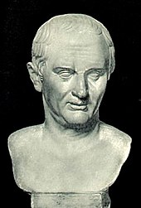
Ancient Source: Tacitus, Annals
AD 56/7-c.117
Held political office and was in the Senate. Would achieve the rank of Consul
Two main works are The Histories and The Annals
The Annals is a year-by-year narrative written Early 2nd Century AD and covering the period AD 14-68
Not a contemporary account
Very little detail on Augustus and his principate
Critical of absolute power i.e. one person holding all the power of the state
He admired traditional values of the Roman Republic (although he had never experienced this)
A supporter of the Senate and its position in society but critical of how passive and obedient it had become under the emperors

Slide 7
Ancient Source: Tacitus, Annals
Augustus seduced the soldiery with gifts and arrogated (collected) all the powers of the state
No one was left alive who remembered the true republic
Detailed accounts of the German mutinies and the Tacfarinas revolt under Tiberius
Claims Tiberius pretended to rule through the Senate but assumed full control whilst the Senate ‘rushed to servitude’.
Criticises Agrippina’s role under Claudius and Nero claiming that she engineered the succession of her son.
Claudius’ senatorial reforms – Gauls
Describes Nero’s love of Greek culture – his competitions in Greece ad then Rome, involvement of equestrians and senators. Argues that Nero was infecting Roman morals
Account of the Fire of Rome – Doesn’t claim explicitly that Nero started it but that he profited from the fire.
Account of Nero’s reign ends in AD 66

Slide 8
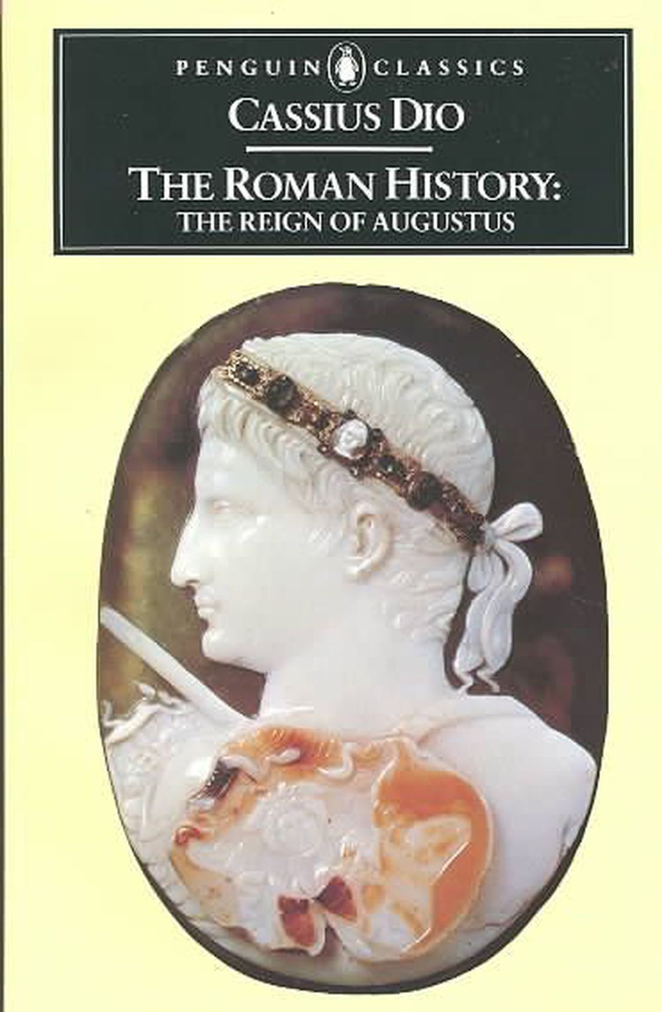
Ancient Source: Cassius Dio The Roman History
c. AD 155 to c. 235 AD
A senator from a Greek/Roman background
His work attempted to tell the full history of Rome from its mythological founding onwards
Lived during a period of instability in the Roman empire and his views comments on the Julio-Claudians were often designed to make comments on his time
Only part of his work survives

Slide 9
Ancient Source: Cassius Dio The Roman History
Argued that Augustus became a king in all but name – gives lots of detail on the First Constitutional Settlement in 27 BC
Detailed account of Sejanus’ downfall
Gaius’ attitude towards the Senate – Gaius acting as Tiberius reintroducing the treason trials
Criticism of Gaius’ behaviour and attitude towards the imperial cult
Criticism of Messalina’s sexual behaviour under Claudius and of the role of his freedmen
One of two detailed accounts of Nero’s downfall

Slide 10
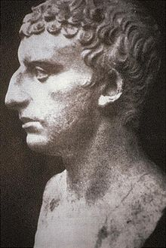
Ancient Source: Josephus, Jewish Antiquities
AD 37- c.100 (written 93-94)
Worked as a translator for the Flavian emperors having previously been made a Roman citizen
One way to make the Flavians look good was to criticise the previous dynasty – the Julio-Claudians.

Slide 11
Ancient Source: Josephus, Jewish Antiquities
Described Gaius’ attitude towards the imperial cult – he claimed honours ‘no longer appropriate for mortal men’
Gave an account of the assassination of Gaius and gave a damning account of his reign
Account of Claudius’ rise to power e.g. attempts of the Senate to persuade him against becoming emperor
Claimed that the people wanted emperors as they feared the ‘rapacity of the Senate’ – e.g. emperors protected them from the greed of the Senate.

Slide 12
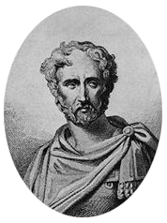
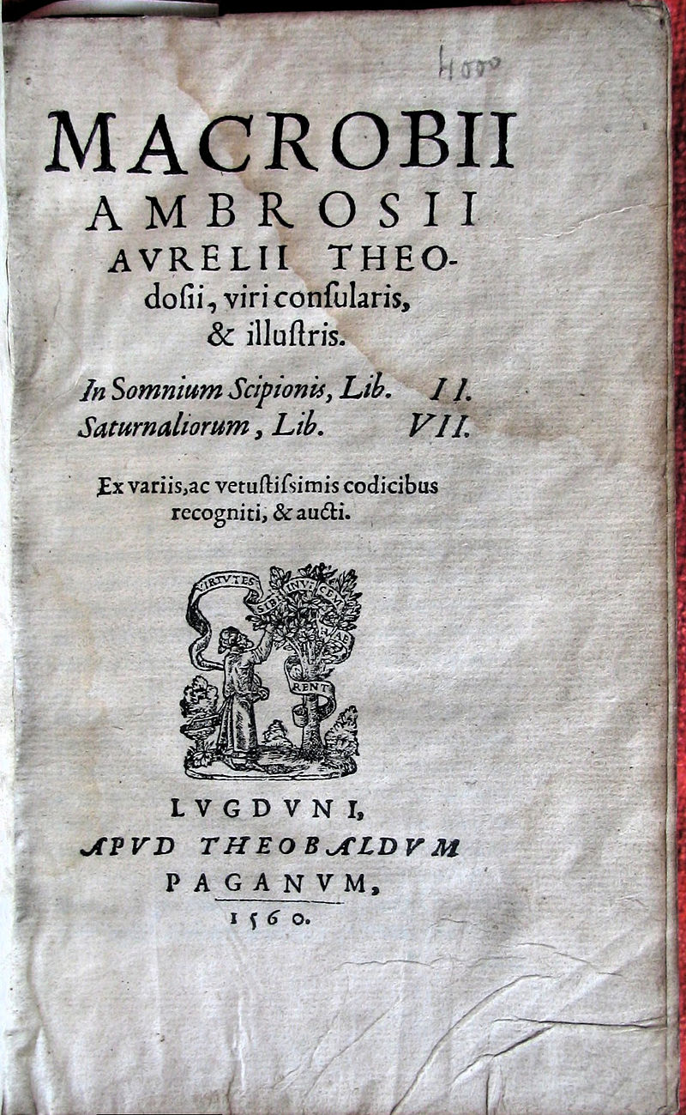
Augustus
Ancient Source: Pliny, Natural History
Written AD 77-79
Encyclopaedia
Natural History claimed to cover the entire field of ancient knowledge
Writing after the Julio-Claudian dynasty
Ancient Source: Macrobius, Saturnalia
Written 5th Century AD
Dialogue – a collection of supposed conversations at a fictional banquet
Based on ideas and facts from earlier writers

Slide 13
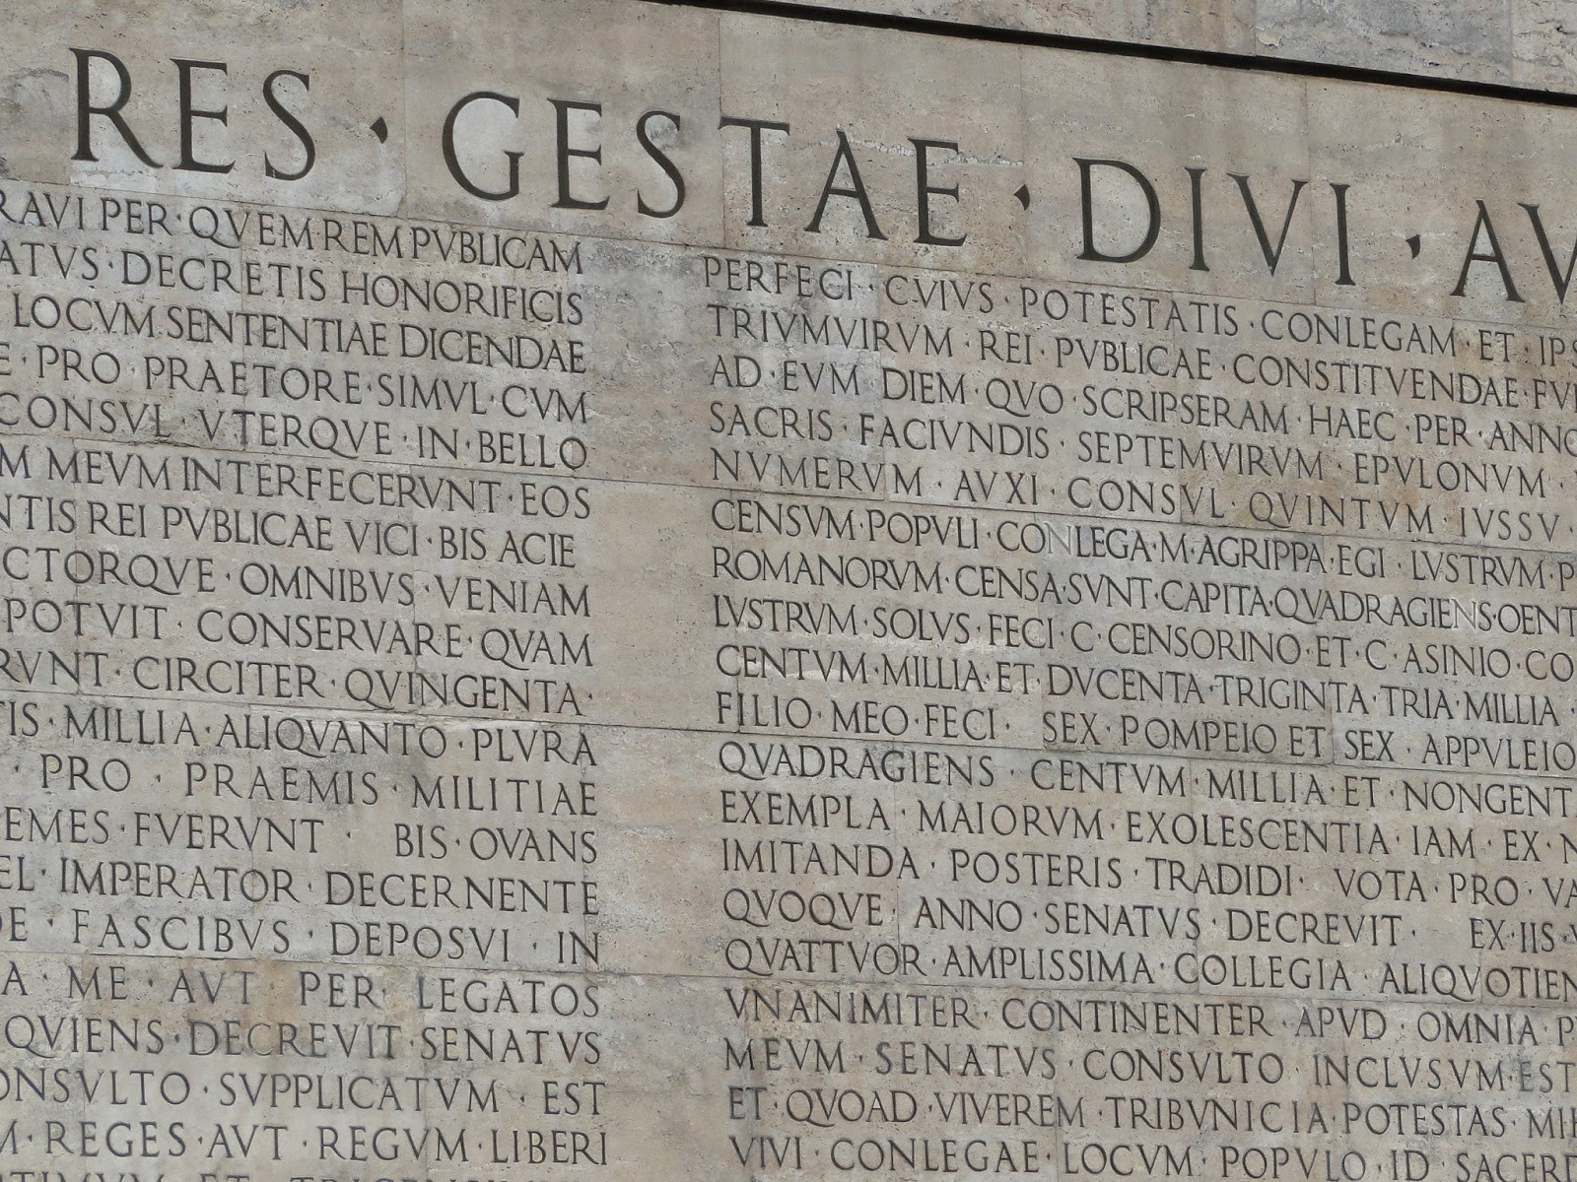
Ancient Source: Res Gestae Divi Augusti
AD 13/14
Augustus’ official account of his rule
Very useful to understand what image Augustus wanted to project of himself and of the principate
The source is, however, official propaganda, presenting Augustus’ actions in the best possible light and excluding unfavourable events altogether
Augustus emphasises his restoration of the republic, his creation of the Pax Augusta, expansion of the empire, temple building, general building etc.
Restoring Roman Values
“By means of new laws brought in under my sponsorship I revived many exemplary ancestral practices which were by then dying out in our generation, and I myself handed down to later generations exemplary practices for them to imitate.”
Restoring the Republic
“After I had put an end to civil wars, although by everyone’s agreement I had power over everything, I transferred the state from my power into the control of the Roman senate and people.”

Slide 14
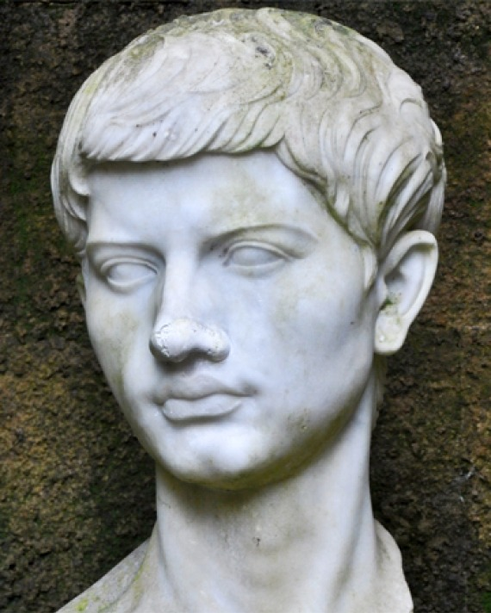
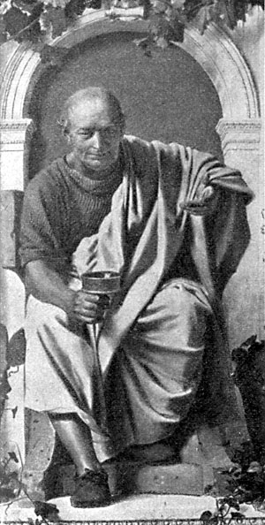
Ancient Source: Virgil Aneid
Written c. 29-19 BC
Official poet under Augustus
Maecenas was his patron who was in turn a close adviser of Augustus
His work projects an official image of Augustus’ rule (in particular when referring to victory at Actium)
Ancient Source: Horace Odes
Written 23 BC
Official poet under Augustus
Maecenas was his patron who was in turn a close adviser of Augustus
His work projects an official image of Augustus’ rule (in particular when referring to victory at Actium)
Very supportive of Augustus’ moral reforms – Horace liked the idea of traditional Roman values and a return to traditional ways of life

Slide 15
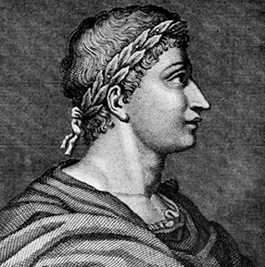
Ancient Source: Ovid, Fasti
Written c. AD 17
Poetry written during the rule of Augustus about the Roman religious calendar
Ovid was banished by Augustus in AD 8 for an unknown offence. Fasti was patriotic and flattering to Augustus possibly to encourage him to let in return to Rome
Other Sources:
Seneca the Younger
Tiberius’ Letter to the people of Gytheion, AD 15
Claudius’ Letter to the people of Alexandria, AD 41
Strabo – the division of the empire under Augustus and creation of a fire service
Edicts of Cyrene 7-6BC
Altar to the Numen of Augustus in Narbonne (Gaul) AD 12-13

