Slide 1
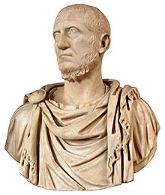
Roman Period Study Impact Session

Slide 2
General Points
All of the exam technique which we went through in the Greek impact sessions applies to the Roman topics too
Range and variety of sources for the two essay questions is key for the Roman exam
Aim to combine written sources with poems, coinage, archaeological sources etc.
This needs to be planned into your answer at the start

Slide 3
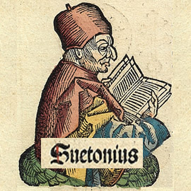
Suetonius Lives of the Caesars (AD 70-c.140)
Came from the equestrian rank
Worked in the imperial court under Emperors Trajan and Hadrian
Writing in the early second-century AD
Most famous work – Lives of the Caesars which covered 12 emperors from Julius Caesar onwards
His works were biographies designed to satisfy general curiosity about the emperors
Included gossip, rumour and trivial details to make his subjects appear more human
Wanted to readers to make judgements about the moral character of the emperors and also for his accounts to be dramatic
Had access to the imperial archives as ‘director of the imperial libraries’
Along with Tacitus, the main source for our period

Slide 4
Suetonius Lives of the Caesars (SOME KEY SOURCES)
Says that the gates to the temple of Janus Quirnus were closed three times during Augustus; rule – Pax Augusta
Gives detail on Augustus’ administrative reforms in Rome and reforms to the Senate
Recognised that Tiberius made a good start to his rule and gradually showed that he was princeps
Tiberius vetoed all bills for the dedication of temples to himself
Romans shouted ‘To the Tiber with Tiberius’ on news of his death
Enthusiastic reception for Gaius – Chick, star, baby – also set aside Tiberius’ will
The people demanded Claudius be made emperor after the death of Gaius
Claudius’ relationship with the plebs – calls everyone ‘My lords’
Gives detail on Nero’s golden five years and his love of music and Greek culture
Describes the assassination attempts of Agrippina the Younger
Account of the Great Fire and the building of the Domus Aureus

Slide 5
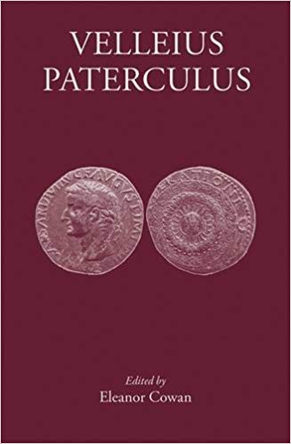
Velleius Paterculus, History of Rome
Written c. AD 30
A history of Rome from the Trojan war to AD 29
Paterculus was a military officer and then politician during the reigns of Augustus and Tiberius
He offers a first-hand account and perspective on events
He had particular insight into the emperors’ political decision as he was a senator
HOWEVER – Paterculus owed his position to Augustus and Tiberius so is very supportive
He was writing during the reign of Tiberius whom he singles out for praise (Tiberius restored ‘treason trials’ meaning that it was dangerous to criticise him)

Slide 6
Velleius Paterculus, History of Rome
Claimed that Augustus restored the traditional forms of government of the republic
Detail on Augustus' successors and the rise of Tiberius
Highlights of Tiberius' reign e.g. building programme
Positive accounts of Tiberius' handling of the German mutinies and of Sejanus' role

Slide 7
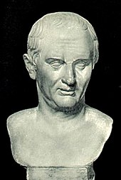
Ancient Source: Tacitus, Annals
AD 56/7-c.117
Held political office and was in the Senate. Would achieve the rank of Consul
Two main works are The Histories and The Annals
The Annals is a year-by-year narrative written Early 2nd Century AD and covering the period AD 14-68
Not a contemporary account
Very little detail on Augustus and his Principate
Critical of absolute power i.e. one person holding all the power of the state
He admired traditional values of the Roman Republic (although he had never experienced this)
A supporter of the Senate and its position in society but critical of how passive and obedient it had become under the emperors

Slide 8
Ancient Source: Tacitus, Annals
Augustus seduced the soldiery with gifts and arrogated (collected) all the powers of the state
No one was left alive who remembered the true republic
Detailed accounts of the German mutinies and the Tacfarinas revolt under Tiberius
Claims Tiberius pretended to rule through the Senate but assumed full control whilst the Senate ‘rushed to servitude’.
Criticises Agrippina’s role under Claudius and Nero claiming that she engineered the succession of her son.
Claudius’ senatorial reforms – Gauls
Describes Nero’s love of Greek culture – his competitions in Greece and then Rome, involvement of equestrians and senators. Argues that Nero was infecting Roman morals
Account of the Fire of Rome – Doesn’t claim explicitly that Nero started it but that he profited from the fire.
Account of Nero’s reign ends in AD 66

Slide 9
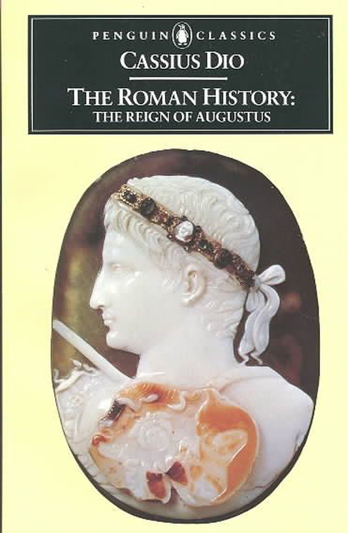
Ancient Source: Cassius Dio The Roman History
c. AD 155 to c. 235 AD
A senator from a Greek/Roman background
His work attempted to tell the full history of Rome from its mythological founding onwards
Lived during a period of instability in the Roman empire and his views comments on the Julio-Claudians were often designed to make comments on his time
Only part of his work survives

Slide 10
Ancient Source: Cassius Dio The Roman History
Argued that Augustus became a king in all but name – gives lots of detail on the First Constitutional Settlement in 27 BC
Detailed account of Sejanus’ downfall
Gaius’ attitude towards the Senate – Gaius acting as Tiberius reintroducing the treason trials
Criticism of Gaius’ behaviour and attitude towards the imperial cult
Criticism of Messalina’s sexual behaviour under Claudius and of the role of his freedmen
One of two detailed accounts of Nero’s downfall

Slide 11
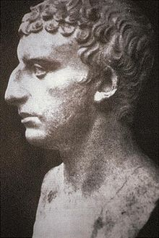
Ancient Source: Josephus, Jewish Antiquities
AD 37- c.100 (written 93-94)
Worked as a translator for the Flavian emperors having previously been made a Roman citizen
One way to make the Flavians look good was to criticise the previous dynasty – the Julio-Claudians.

Slide 12
Ancient Source: Josephus, Jewish Antiquities
Described Gaius’ attitude towards the imperial cult – he claimed honours ‘no longer appropriate for mortal men’
Gave an account of the assassination of Gaius and gave a damning account of his reign
Account of Claudius’ rise to power e.g. attempts of the Senate to persuade him against becoming emperor
Claimed that the people wanted emperors as they feared the ‘rapacity of the Senate’ – e.g. emperors protected them from the greed of the Senate.

Slide 13
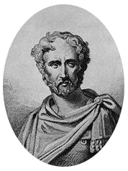
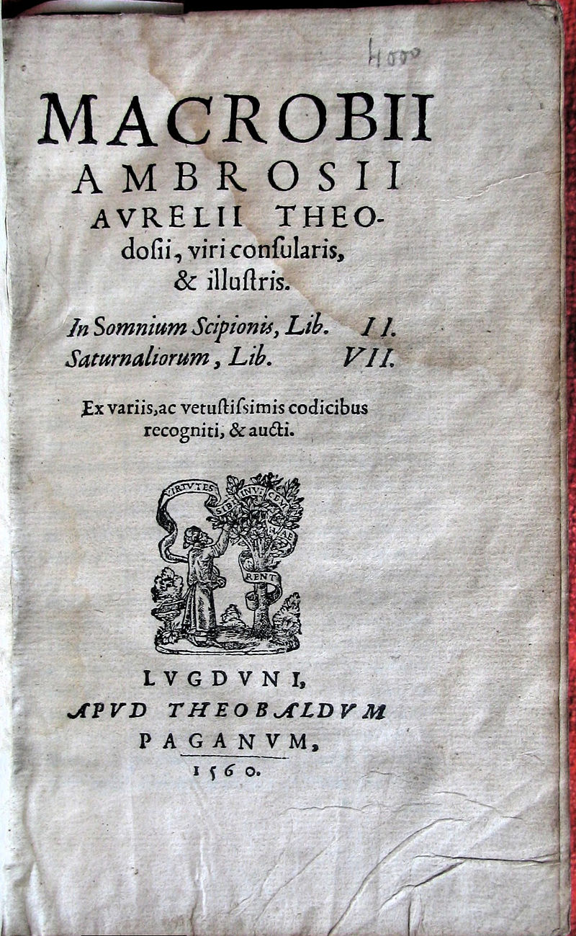
Augustus
Ancient Source: Pliny, Natural History
Written AD 77-79
Encyclopaedia
Natural History claimed to cover the entire field of ancient knowledge
Writing after the Julio-Claudian dynasty
Ancient Source: Macrobius, Saturnalia
Written 5th Century AD
Dialogue – a collection of supposed conversations at a fictional banquet
Based on ideas and facts from earlier writers

Slide 14
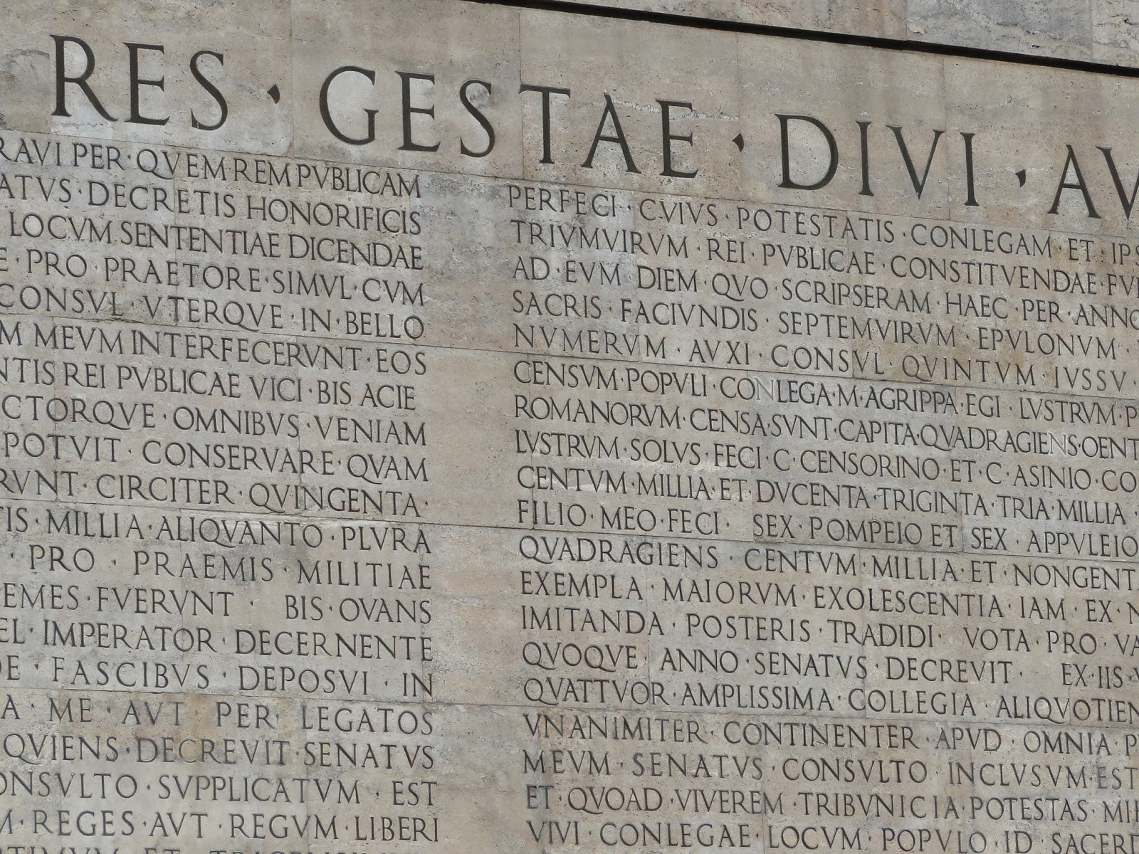
Ancient Source: Res Gestae Divi Augusti
AD 13/14
Augustus’ official account of his rule
Very useful to understand what image Augustus wanted to project of himself and of the principate
The source is, however, official propaganda, presenting Augustus’ actions in the best possible light and excluding unfavourable events altogether
Augustus emphasises his restoration of the republic, his creation of the Pax Augusta, expansion of the empire, temple building, general building etc.
Restoring Roman Values
“By means of new laws brought in under my sponsorship I revived many exemplary ancestral practices which were by then dying out in our generation, and I myself handed down to later generations exemplary practices for them to imitate.”
Restoring the Republic
“After I had put an end to civil wars, although by everyone’s agreement I had power over everything, I transferred the state from my power into the control of the Roman senate and people.”

Slide 15
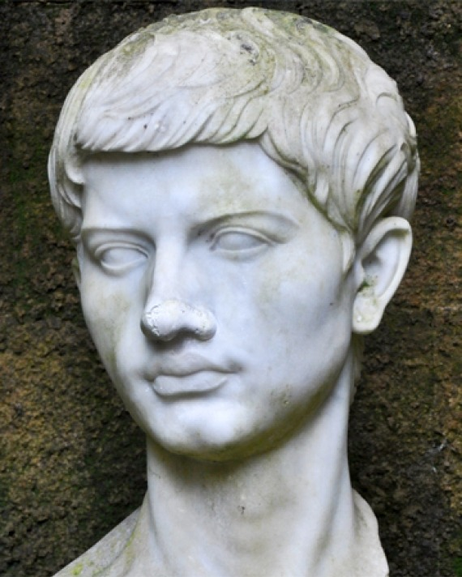
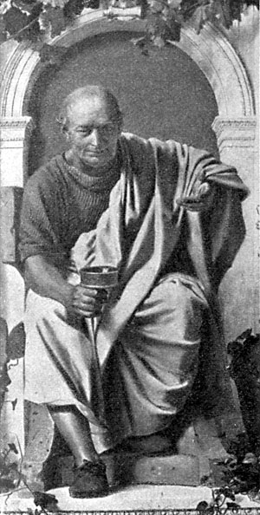
Ancient Source: Virgil Aeneid
Written c. 29-19 BC
Official poet under Augustus
Maecenas was his patron who was in turn a close adviser of Augustus
His work projects an official image of Augustus’ rule (in particular when referring to victory at Actium)
Ancient Source: Horace Odes
Written 23 BC
Official poet under Augustus
Maecenas was his patron who was in turn a close adviser of Augustus
His work projects an official image of Augustus’ rule (in particular when referring to victory at Actium)
Very supportive of Augustus’ moral reforms – Horace liked the idea of traditional Roman values and a return to traditional ways of life

Slide 16
Ancient Source: Virgil Aeneid
The Shield of Aeneas – Victory of the civilised Romans and their gods over the ‘east’. Claims that Octavian led the “Senate and the People”
Jupiter’s Prophecy – Octavian’s rise to power was decided and planned by the gods. He would extend the empire and bring peace (Pax Augusta)
Pageant of Roman Heroes– Octavian would restore a golden age to Rome and extend the empire. Makes Octavian’s rise to power look natural and legitimate
Ancient Source: Horace Odes
Suicide of Cleopatra – presents the victory at Actium as the triumph of the civilised Romans over the ‘east’
3.6 – Criticises contemporary morale standards suggesting they had declined from when Rome was great

Slide 17
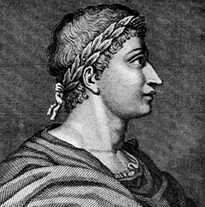
Ancient Source: Ovid, Fasti
Written c. AD 17
Poetry written during the rule of Augustus about the Roman religious calendar
Ovid was banished by Augustus in AD 8 for an unknown offence. Fasti was patriotic and flattering to Augustus possibly to encourage him to let in return to Rome
Other Sources:
Seneca the Younger
Tiberius’ Letter to the people of Gytheion, AD 15
Claudius’ Letter to the people of Alexandria, AD 41
Strabo – the division of the empire under Augustus and creation of a fire service
Edicts of Cyrene 7-6BC
Altar to the Numen of Augustus in Narbonne (Gaul) AD 12-13

Slide 18
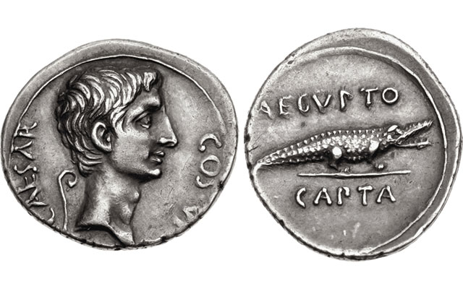
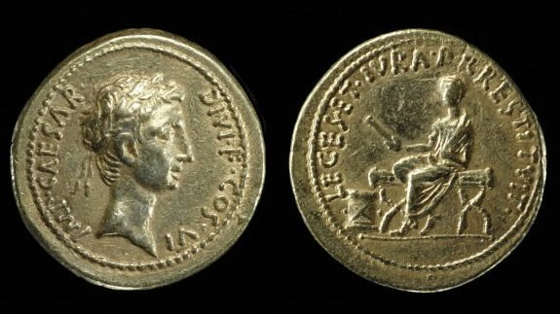
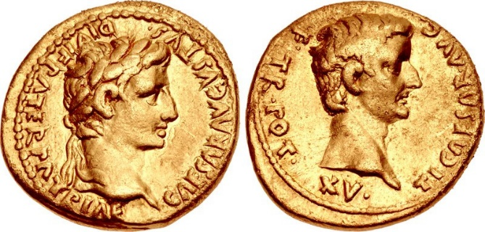
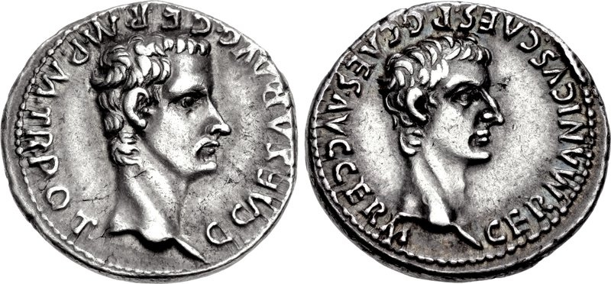
Coins
Prescribed Source – Capture of Egypt, denarius, 27 BC
Obv.: Bare head of Augustus, “Caesar, Son of the Deified, Consul for the seventh time”
Rev.: crocodile, “Egypt captured”
Prescribed Source – New aureus 28 BC
Obv.: Head of Octavian, wearing laurel wreath “Commander Caesar, Son of the Deified, consul for the sixth time”
Rev.: Octavian seated on magistrate’s chair wearing toga, holding out scroll in right hand “He has restored to the Roman People their laws and rights”
Prescribed Source – Aureus of Tiberius, 13-14 AD
Obv.: Augustus, “Caesar Augustus, Son of the Deified, Father of the Fatherland
Rev.: Tiberius; “Tiberius Caesar, Son of Augustus, Tribunician power for the fifteenth time
Prescribed Source – Denarius of Gaius, AD 37
Obv.: Head of Gaius; “Gaius Caesar, Augustus, Germanicus, pontifex maximus, with tribunician power”
Rev.: Head of Germanicus; “Germanicus Caesar, father of Gaius Caesar Augustus Germanicus”

Slide 19
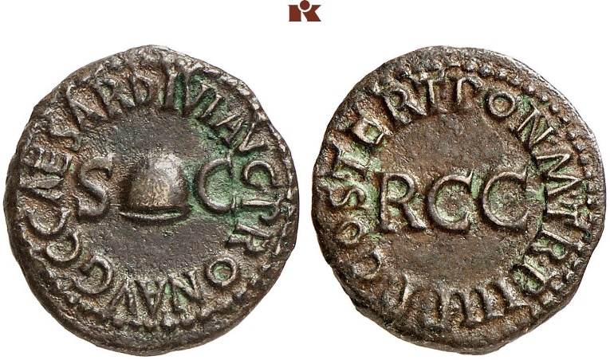
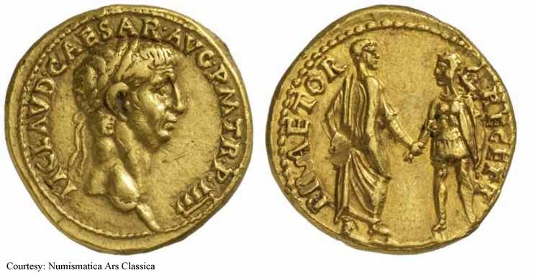
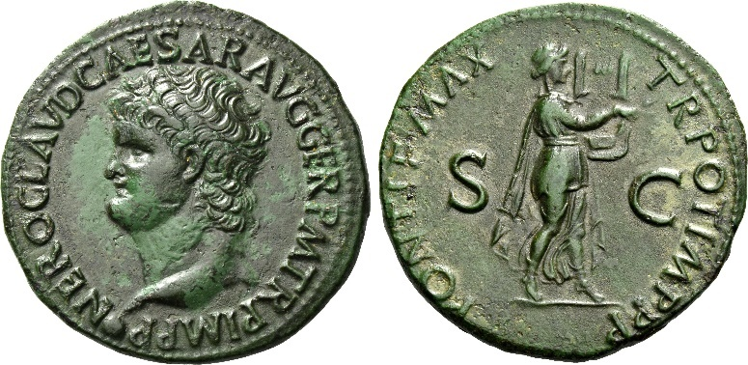
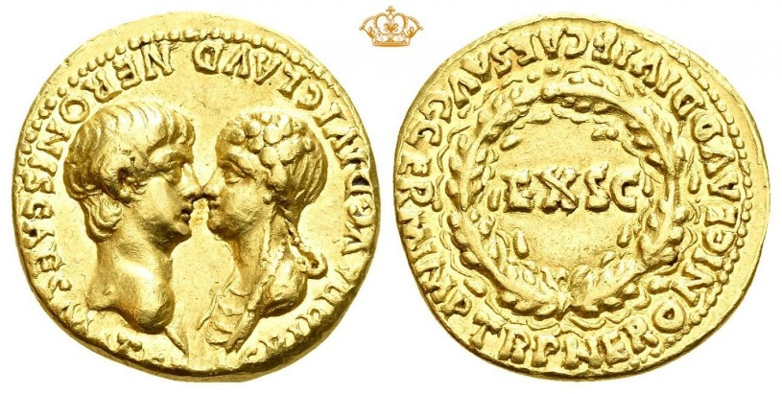
Coins
Prescribed Source – As of Gaius, AD 39
Obv.: Pileus between SC; “Gaius Caesar, Augustus, grandson of Augustus, by decree of the senate”
Rev.: RCC (Remission of the 1/200 tax); “pontifex maximus, in his 3rd year of tribunician power, father of the fatherland, designated consul for the 3rd time”
Prescribed Source Aureus of Claudius, AD 41-5
Obverse: Head of Claudius; ‘Tiberius Claudius Caesar Augustus, pontifex maximus, with tribunician power’
Reverse: Claudius wearing a toga, clasping the hand of a long-haired soldier with shield and legionary eagle; ‘With praetorians having been received’
Prescribed Source – As of Nero as a lyre-player, AD 62
Obv.: Head of Nero, ‘Nero Claudius Caesar, Augustus Germanicus’
Rev.: Nero, as Apollo Citharodeus, playing lyre; ‘Pontifex maximus, with tribunician power, victorious commander, father of the fatherland’
Prescribed Source – Aureus of Nero, AD 54
Obv.: Heads of Nero and Agrippina, ‘Agrippina Augusta, wife of the divine Claudius, mother of Nero Caesar’
Rev.: ‘By decree of the senate to Nero Caesar Augustus Germanicus, son of the divine Claudius hailed victorious commander, with tribunician power’

Slide 20
Key Debate 1 – Did Augustus actually restore the republic?
Yes | No
Augustus claimed in the Res Gestae to have transferred power back to the Senate and to have held no more power than any other magistrate (public figure) Paterculus claims that he restored traditional laws, respect to the Senate and the Republic Coinage and official poems (Virgil and Horace) all present Augustus as traditional rather than revolutionary The First Constitutional Settlement gave Octavian/Augustus a collection of existing and honorific titles supporting his claims in the Res Gestae Augustus retained the Senate even after his position was secure and carried out reforms to improve its standards | Dio states that Augustus took on the power of a monarch in all but name Tacitus claims that he arrogated (collected) all powers to himself and suggest that he used the appearance of the Republic, which by then no one was left alive who actually remembered it In the First settlement of 27 BC Augustus held all real power and this was formalised in the Second settlement of 23 BC, in particular with the creation of the title of imperium proconslare maius The Senate quickly became a rubber-stamp – Augustus removed potential opposition and then bribed/rewarded others to ensure total loyalty Augustus was pre-occupied with succession for much of his reign which was totally at odds with the idea of a republic

Slide 21
Key Debate 1 – Did Augustus actually restore the republic?
Other Arguments
Augustus did not originally intend to end the republic and replace it with the Principate but this evolved during his reign as his power adapted to different situations. For example, he formalised his power in 23 BC not because of a master plan to destroy the republic but because his health had suddenly declined and he needed clearer powers to be able to pass on to a successor Augustus created a hybrid form of government that kept some elements of the Republic and combined these with new powers under the Principate Augustus did end the Republic but because it was no longer possible for this form of government to control Rome after the civil wars (Tacitus and Suetonius both suggest this) The sources most certain that he did end the Republic (Tacitus and Dio) were written at least a century later when the power of emperors had grown and become clear. Hindsight possibly leads them to exaggerate the extent to which Augustus caused this change. Writers at the time were much less aware of a significant change

Slide 22
Key Debate 2 – The Characters of Tiberius, Gaius, Claudius and Nero
Emperor | Character | Support | Challenge
Tiberius | Introvert and distant Cold and paranoid Brutal | Role in the treason trials Leaving Rome for Capri Possible murder of relatives/rivals Poor relationship with the plebs | Treason trials may have been led by others Acted decisively when necessary – German mutinies, removal of Sejanus
Gaius | Extrovert Excessive Impulsive and brutal Sinister | Imperial cult Lavish public games Enjoyment of execution/torture Alleged incest with sisters | Strong relationship with the plebs Sensible administrative reforms at the start of his rule Evidence of brutality and incest largely anecdotal

Slide 23
Key Debate 2 – The Characters of Tiberius, Gaius, Claudius and Nero
Emperor | Character | Support | Challenge
Claudius | Old bumbling man Not up to the job Gullible and easily manipulated | Portrayal in the take-over of power i.e. hiding behind a curtain Control of wives and freedmen His alleged murder by Agrippina | Very successful building projects Invasion of Britain Maintained obedience of the Senate and support of the plebs Role of freedmen was traditional
Nero | Philhellenism Artistic Impulsive and violent Immature and gullible | Participation in musical and theatrical performances Domination by his mother Manipulated by Poppaea and advisers Portrayal during the Great Fire in AD 64 Portrayal in AD 68 – weak and indecisive | Quinquennium Aureum Modelled the start of his reign on a restoration of Augustus Acted decisively against his mother to rule more independently after 59 Reforms after the Fire of Rome Accounts of him fleeing Rome and committing suicide heavily fictionalised

Slide 24
Key Debate 3 – Did imperial rule benefit the inhabitants of Rome?
Yes | No
Emperors brought peace and stability after the chaos of the civil wars. Suetonius and Josephus both make clear that the people wanted Claudius as emperor in AD 41 rather than the Senate Administrative reforms – emperors improved the running of the city e.g. Augustus creating districts and wards and Gaius improving the legal system Building projects – lots of these and several are credited by Pliny e.g. aqueducts of Augustus and Claudius Bread and Circuses provided entertainment for the inhabitants of Rome Equestrians and Senators did well under certain emperors e.g. Augustus made more use of the Equestrians to rule and enhanced their status | Bread and circuses was delivered to varying degrees of success by different emperors – Gaius was meant to have left Rome with only 7 days of corn upon his death (Seneca) Emperors could be violent and abusive towards the inhabitants of Rome – the use of treason trials, violence towards the mob under Gaius, humiliation of the equestrians and senators by Nero Some emperors neglected the running of the city of Rome and/or focused on personal vanity projects – Nero was away competing in Greece; Tiberius left for Capri in AD 26 Emperors could place heavy taxes on the people of Rome e.g. Nero following the Great Fire

