Slide 1
AQA
    A Level
      Computer Science
      Paper 2
Floating point form
  Appendix A

Slide 2
Objectives
Know how numbers with a fractional part can be represented in floating point form
Be able to normalise un-normalised floating point numbers with positive or negative mantissas
Calculate the absolute and relative errors of numerical data stored and processed in computer systems
Compare fixed- and floating-point form
Explain underflow and overflow and describe the circumstances in which they occur

Slide 3
Fixed point and floating point
Fixed point binary numbers have a pre-determined number of bits before and after the point
This makes fixed point numbers easier to process but they cannot represent the range or accuracy of numbers that may be required

Slide 4
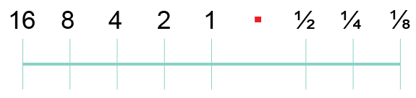
Fixed point binary numbers
We could hold an 8-bit number in fixed point format like this:
If the first bit is a sign bit representing -16, what is the largest positive number that can be held?
If we want to hold larger numbers, the point must be set further to the right
  What effect does this have on accuracy?

Slide 5
Fixed point binary numbers
Suppose you want to convert the decimal number 4.6 to binary using this representation
The closest you can get is 00100.100, i.e. 4.5
There is a rounding error of 0.1.
  If you need more accuracy, the binary point would need to be moved left

Slide 6
Floating point numbers
When decimal numbers become very large, they are held in the format m x 10^{n} where m is known as the mantissa, and n is the exponent
The number 75,000 can be represented as 0.75 x 10⁵
  How would you represent 458.675?
  How could you represent 0.005 in this format?

Slide 7
Floating point numbers
Binary numbers are typically held in 32 or 64 bits
In our examples we will use just 12 bits, with the first bit being a sign bit
The number above represents the number 0.1011010 x 2³ since the exponent is 3 in decimal
This is 101.1010 or 4 + 1 +0.5 + 0.125 = 5.625
Sign bit |  | Mantissa |  |  |  |  |  |  |  | Exponent
0 | · | 1 | 0 | 1 | 1 | 0 | 1 | 0 |  | 0 | 0 | 1 | 1

Slide 8
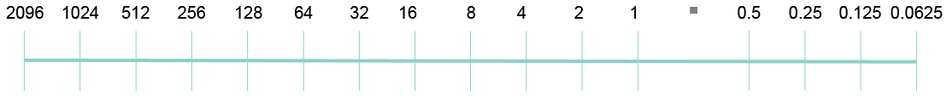
Floating point binary to decimal
Convert 0.1101100 0100 to decimal, assuming an
8-bit mantissa and 4 bit exponent
  Write down the mantissa, 0.1101100
  Translate the exponent from binary to decimal; 0100 = 4
  The binary point of the mantissa has to be moved 4 places right to multiply it by 2⁴
  Binary number is 01101.100
  Translate using the table below:

Slide 9
Negative binary to decimal
A negative floating point number will start with a 1 (the sign bit)
The number 1.0010100 0011 has a negative mantissa and a positive exponent
  Find the twos complement of the mantissa
  Translate the exponent to decimal, giving 3
  The binary point of the mantissa has to be moved 3 places right to multiply it by 2³
  What is the binary number and its decimal equivalent?

Slide 10
Negative binary to decimal
Here’s the answer:
The number 1.0010100 0011 has a negative mantissa and a positive exponent
  The mantissa is 1.0010100
  The twos complement of 1.0010100 is 0.1101100
  The exponent is 3
  The mantissa, with the binary point moved 3 places right, is 0110.1100
  The number is -6.75

Slide 11
Negative mantissa
Try this one:
1 . 0101011 0101
  Find the twos complement of the mantissa (0.1010101)
  Translate the exponent to decimal giving 5
  Move the binary point 5 places right
  Do you get an answer of -21.25?

Slide 12
Negative exponent
The leftmost bit of the exponent is a sign bit, just as it is in the mantissa
An exponent of 1000 in a 4-bit exponent is -8
You can calculate the denary value of a negative exponent, for example 1011, as -8 + 3 = -5
Or, you can use the twos complement method which will give you the same result
What is the denary value of negative exponent 1111?

Slide 13
Negative exponent
If the exponent is negative, the binary point must be moved left instead of right
e.g. convert 0.1100000 1110 to decimal, assuming an 8-bit mantissa and 4 bit exponent
  Write down the mantissa, 0.1100000
  Translate the exponent from binary to decimal;
  1110 = -8 + 6 = -2
  The mantissa has to be moved 2 places left to divide it by 2²
  Binary number is 0.0011000 = 0.125 + 0.0625 = 0.1875

Slide 14
Worksheet 1
Now try the questions in Task 1 of the worksheet

Slide 15
Normalisation
Normalisation is the process of moving the binary point of a floating point number to provide the maximum level of precision for a given number of bits
This is achieved by ensuring that the first digit after the binary point is a significant digit

Slide 16
Normalisation
Here are some examples in decimal:
  0.1234567 x 10⁷ = 1,234,567
  0.0123456 x 10⁸ = 1,234,560
  0.0012345 x 10⁹ = 1,234,500
The first representation with a significant (non-zero) digit after the decimal point has the maximum precision using the same number of digits

Slide 17
Normalisation
In normalised floating point form:
A positive number has a sign bit of 0
and the next digit is always 1
This means that the mantissa of a positive number in normalised form always lies between ½ and 1

Slide 18
Example
Normalise the binary number 0.0011010 0100
  The binary point needs to move 2 places to the right so that there is a 1 following the binary point
  Pad with 0s at the righthand end, giving 0.1101000
  To compensate for making the mantissa larger, we must make the exponent smaller
  Subtract 2 from the exponent making it 0010
  The normalised number is 0.1101000 0010
Try this one:
Normalise the binary number 0.0000111 0111

Slide 19
Normalisation Answer
Normalising the number 0.0000111 0111
means moving the binary point 4 places right, and subtracting 4 from the exponent
This gives 0.1110000 0011

Slide 20
Normalised negative numbers
An unnormalised negative number will have a sign bit of 1 and one or more 1s after the binary point
  e.g. 1.1100011 0011
A normalised negative number has a sign bit of
1 followed by a zero after the binary point

Slide 21
Normalising a negative number
Example: normalise the number 1.1100011 0011
Move the binary point 2 places right and subtract 2 from the exponent
111.00011 0001
This is the same as 1.0001100 0001
  Note that leading 1s in a negative number do not change its value (like leading 0s in a positive number)

Slide 22
From decimal to normalised binary floating point
Eg: Convert 88 to normalised floating point binary
First convert the number to fixed point binary
  In fixed point binary, the number is 01011000
  Move the binary point 7 places left
  Set the exponent equal to 7
  The number is 0.1011000 0111
Now try converting 17.25 to normalised floating point binary

Slide 23
Answer
Convert 17.25 to normalised floating point binary
  Convert to fixed point binary 10001.010
  Move binary point 5 places left
  Set exponent to 5
Binary number is 01000101 0101
Carry out the opposite conversion to check the result

Slide 24
Converting a negative decimal number
If the number is negative, first calculate the two’s complement
e.g. calculate the binary equivalent of -17.75
  The number is (-) 010001.11
  Ones complement 101110.00
  Twos complement 101110.01
  Move the point 5 places left
  Set the exponent equal to 5
The number is 1.0111001 0101

Slide 25
Worksheet 1
Now try Task 2 on the worksheet

Slide 26
Rounding errors
In the decimal system, 1/3 can never be represented completely accurately as a decimal number
Similarly, in the binary system some numbers can never be represented completely accurately
An example is the decimal number 0.1
  To be represented accurately, a number must be capable of being represented in a given number of bits
  How accurately can 0.7 be held in binary if 4 bits are allowed for the fractional part of the binary number?
  (.5 + .125 + .0625 = 0.6825)

Slide 27
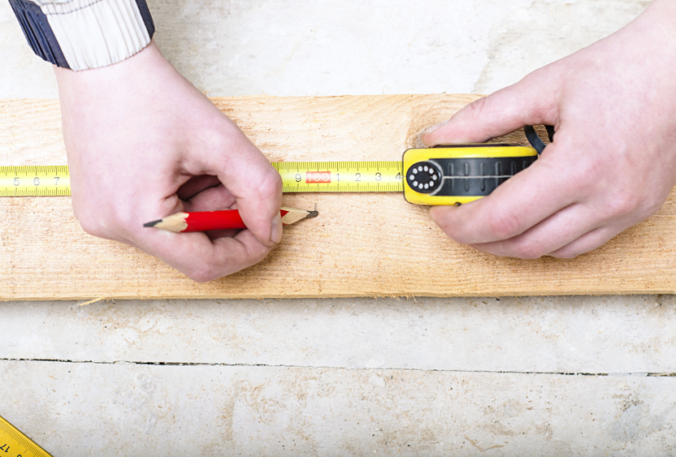
Absolute and relative errors
If you are measuring a window frame 50cm wide so that you can replace a rotten window, and you are off by 2cm, that’s pretty significant

Slide 28

The effect of number magnitude
If you’re measuring a 400m race track and you are off by 2cm, that is negligible
It’s all relative!

Slide 29
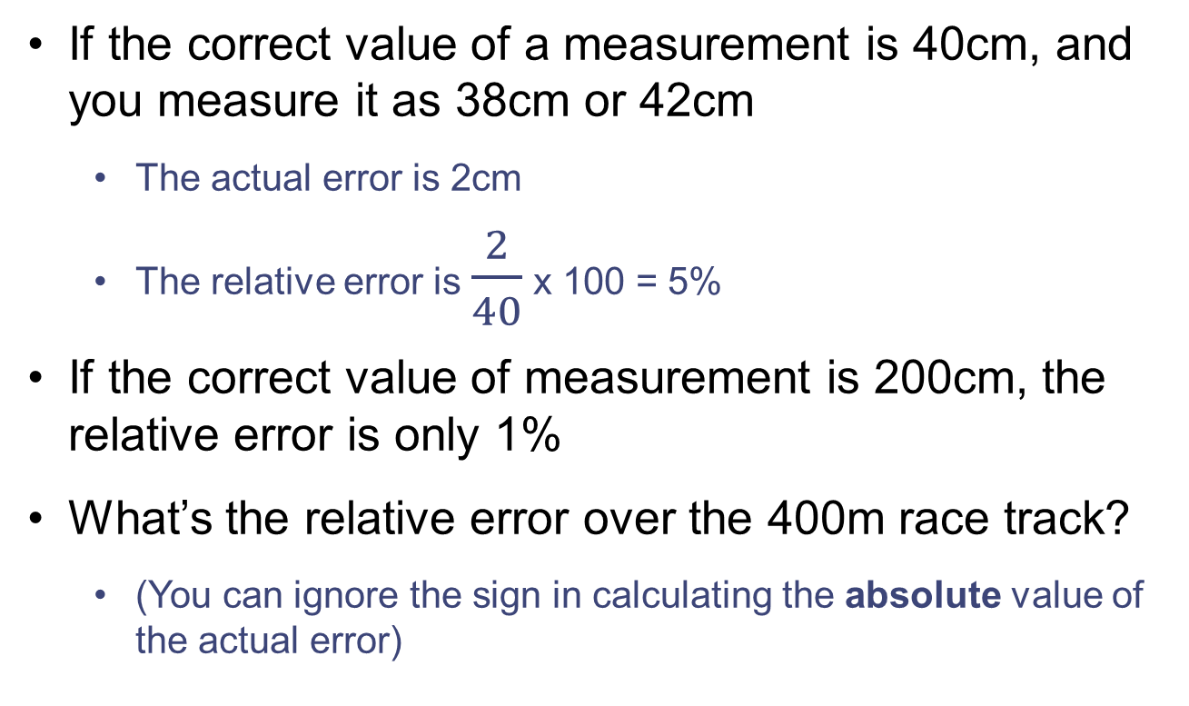
Calculating relative error
If the correct value of a measurement is 40cm, and you measure it as 38cm or 42cm
  The actual error is 2cm
  The relative error is $\frac{2}{40}$ x 100 = 5%
If the correct value of measurement is 200cm, the relative error is only 1%
What’s the relative error over the 400m race track?
  (You can ignore the sign in calculating the absolute value of the actual error)

Slide 30
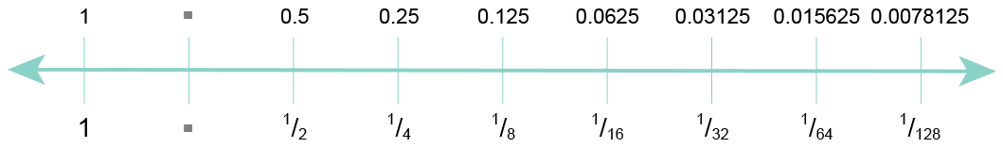
Relative errors in binary
Look again at how a fractional number is held
in binary
In this representation there are 7 bits after the
binary point
  A rounding error in a very small number, or a number close to 1, is a much larger relative error than in a large number

Slide 31
Fixed point vs floating point
Floating point numbers allow a far greater range of numbers using the same number of bits
Very large numbers and very small fractional numbers can be represented
Fixed point binary is a simpler system and is faster to process

Slide 32
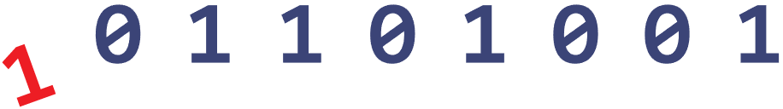
Overflow
Overflow occurs when the result of a calculation is too large to be held in the number of bits allocated
For example, adding two integers in an 8-bit byte (ignore the sign bit)
1110 1001
+ 1000 0000

Slide 33

Underflow
Underflow occurs when a number is too small to be represented in the number of bits allocated
It may occur if a very small number is divided by a number greater than 1:
  Divide the binary number 0000 0001 by 2

Slide 34
Worksheet 1
Try Task 3 on the worksheet

Slide 35
Plenary
Be sure you can:
  convert floating binary numbers to decimal and vice versa
  normalise floating-point numbers with positive and negative mantissas
  explain the effect of increasing the size of the mantissa and exponent
  give advantages of fixed and floating point form
  calculate absolute and relative errors
  explain overflow and underflow and how they may occur

