Slide 1
Introduction to Crime Dramas: Part 1
Lesson 1

Slide 2
Learning Outcomes
Understand the differences between the various crime drama titles
Become familiar with the different crime dramas that fall into different subgenres and hybrid genres
Understand the key differences between the sci-fi and supernatural genres as they relate to crime dramas

Slide 3
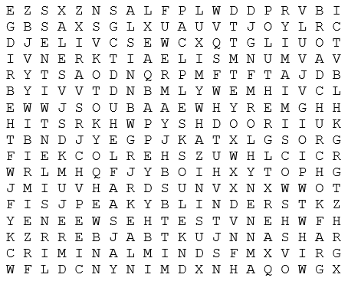
Starter: Find the Crime Drama titles

Slide 4
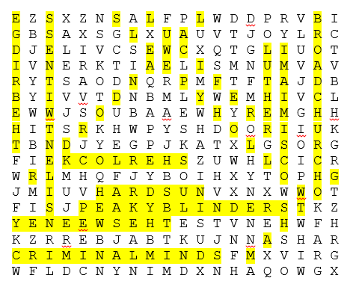
Starter: Find the Crime Drama titles
Broadchurch
Criminal Minds
CSI: Miami
Gotham
Hard Sun
Law and Order
Lucifer
Luther
Peaky Blinders
Sherlock
Silent Witness
Sleepy Hollow
The Bridge
The Sweeney

Slide 5
Intro: Crime Drama Discussion
Which of these crime dramas have you seen?
What other crime dramas have you seen that aren’t listed in the word search?
Why are these series called crime dramas?
How would you identify them?
How do the titles you’ve mentioned fall into a subgenre, if at all?

Slide 6
Task 2: Merging Genres
A television crime drama may not only draw conventions typically associated with the crime genre, it may also adopt conventions usually associated with another genre altogether.
In this case, the crime drama would be considered part of a hybrid genre.

Slide 7
Task 2: Merging Genres
You are going to be provided with clues that illustrate hybrid crime dramas.
Can you guess the hybrid?
Can you provide an example of such a series?

Slide 8
Task 2: Merging Genres
For example:
BBC’s The Moorside
Social crime drama
The main character/s are often civilians afflicted with a crime which seeks a resolution from their perspective instead of law enforcement.

Slide 9
Task 2: Merging Genres
For example:
NBC’s The Brave
Action crime drama
The main character or team solves crimes in a setting deeply rooted within a fast-paced environment, typically associated with the action genre.

Slide 10
Task 2: Merging Genres
For example:
ABC’s Quantico
For example:
BBC America’s
Killing Eve
Spy/espionage crime drama
The main character or team is faced with the task of solving crimes. However, they are typically involved in the intelligence sector (MI6, CIA, FBI, etc.).

Slide 11
Task 2: Merging Genres
For example:
Fox’s Lucifer
For example:
Fox’s Sleepy Hollow
Supernatural crime drama
The main character or team solves crimes in a world where supernatural or fantastical elements are possible (or the norm).

Slide 12
Task 2: Merging Genres
For example:
The CW’s The Flash
For example:
BBC America’s
Life on Mars
Sci-fi crime drama
For example:
BBC/Hulu’s
Hard Sun
The main character or team solves crimes in a world where science fiction – as perceived by us – is a normal occurrence.

Slide 13
Plenary: Sci-fi VS Supernatural
Whichever way you slice it, Life on Mars is a crime drama. However, there is much debate about whether or not it is a sci-fi crime drama or a supernatural crime drama.
Discuss why you think this is so, and why the genres of science fiction and supernatural are heavily debatable…
Talking points / Answers are provided on the next slide.
The following is a link to the trailer for Life on Mars (UK), in case some students are not familiar with the series: https://www.youtube.com/watch?v=jZOzsIhCPgs

Slide 14
Plenary: Sci-fi VS Supernatural
Sci-fi
Supernatural
General: Use of science in a way that is impossible, implausible or not yet a reality.
General: The use of elements that are unnatural – not just to us (the audience), but also the setting which they occupy.
In Life on Mars: Time travel is alluded to as the way Sam Tyler makes his way to the 1970s. Time travel is often regarded as a sci-fi concept.
However, in the finale of Ashes to Ashes (the spinoff sequel to Life on Mars) it is revealed that characters are in a form of purgatory (an afterlife version of ‘limbo’ considered to be a fantastical element).
Examples: Life on Mars, Ashes to Ashes, Arrowverse, Marvel’s Agents of S.H.I.E.L.D., Gotham

