Slide 1
Representation, PARt 1 Reality and the world
Lesson 8

Slide 2
Learning Outcomes
Understand the importance of representation of the world and reality in crime dramas
Understand how episodic crime dramas differ from serialised crime dramas and how they portray reality
Understand the importance of the representation of the world in certain crime dramas and how the setting can play an integral role

Slide 3
Intro: The Episodic Vs the Serial
Traditionally, crime dramas can be either episodic or serialised; the format of which has a differing effect on the final product.
An episodic (procedural) crime drama typically has a one-off storyline in each episode, each of which is linked to common characters, settings and themes.
Serialised crime drama episodes often feed from the previous and into the next. Storylines are progressive and the crime takes a number of episodes (usually a season) to solve.

Slide 4
Intro: The Episodic Vs the Serial
Here are 12 crime dramas. Can you categorise them based on their format: episodic or serialised? You may wish to confer with each other and discuss, if you have not individually seen each of these shows.
Broadchurch
The Mentalist
Hard Sun
The Bridge
Criminal Minds
CSI: Miami
Lucifer
Peaky Blinders
The Sweeney
Sherlock
Luther
Gotham
Some of these dramas are delegated to being serialised while others are episodic. Some share features of both formats. Can you identify these crime dramas?
Hint: three of the dramas above classify as having both features

Slide 5
Intro: The Episodic Vs the Serial
How many did you get? Use the sheet provided to place your answers in the correct category.
Serialised | Episodic
Broadchurch | Criminal Minds
Gotham | CSI: Miami
Hard Sun | The Mentalist
Luther | Lucifer
Peaky Blinders | Sherlock
The Bridge | The Sweeney
An explanation as to how and why these three crime dramas have features of both formats can be found on Answer Sheet 8.2.

Slide 6
Task 1: Inner-city Crime
You will be shown two extracts: one from Luther, and one from The Sweeney. In each extract, London is heavily featured, as is criminal (or antisocial) activity.
Compare and contrast by debating in class how inner-city crime is represented in the two clips.
Luther S01E01: Netflix timings (23:00–27:50)
The Sweeney S01E01: Vimeo timings (18:00–20:25)

Slide 7
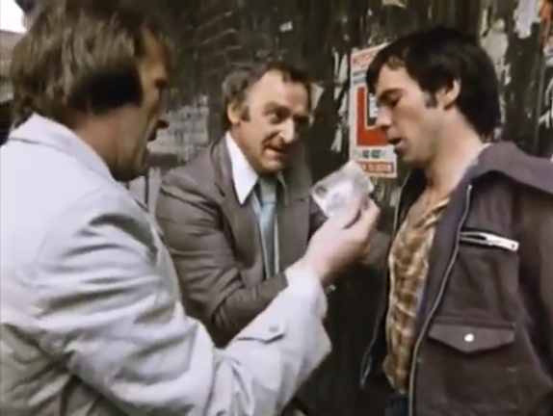
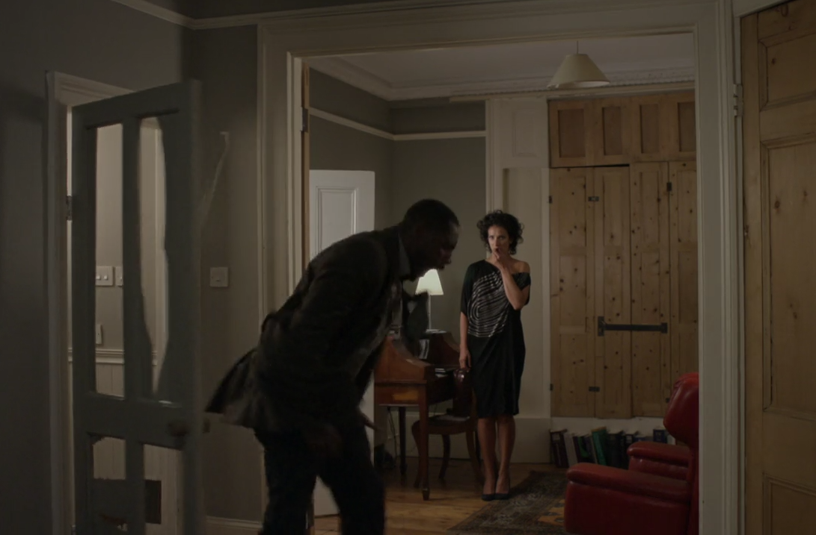
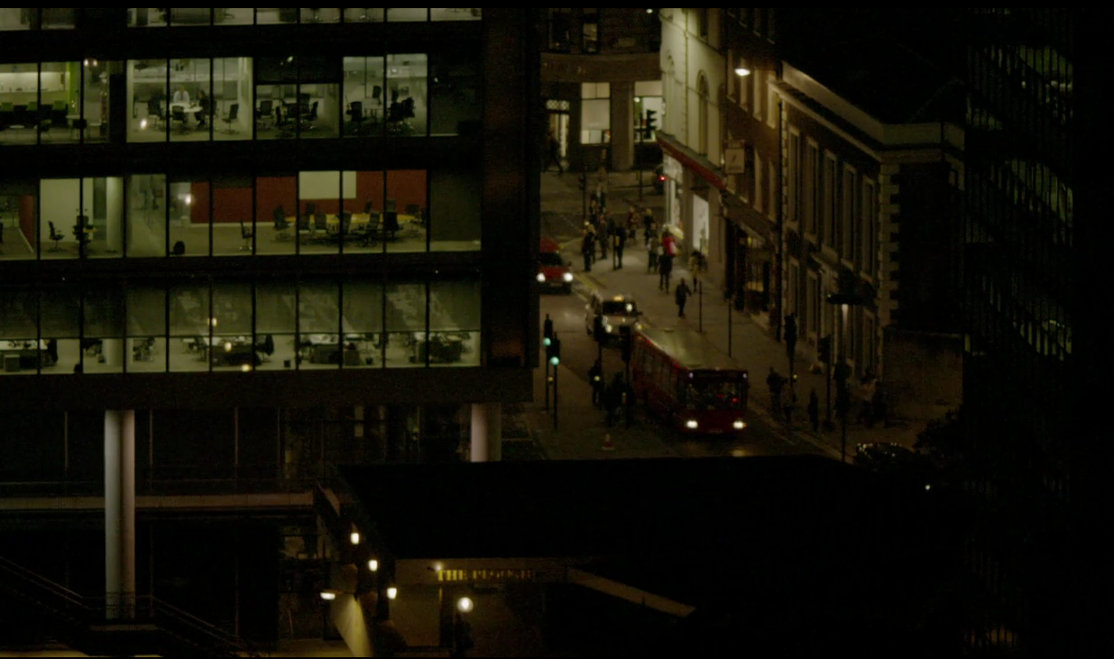
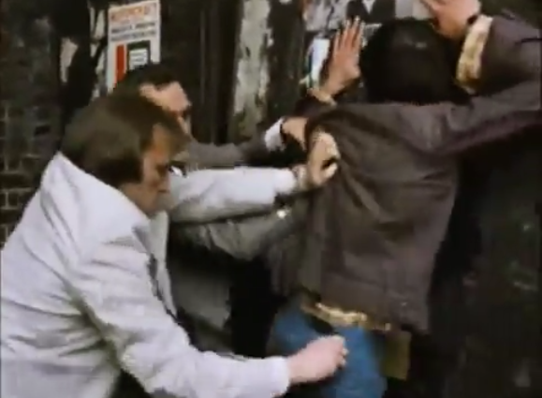
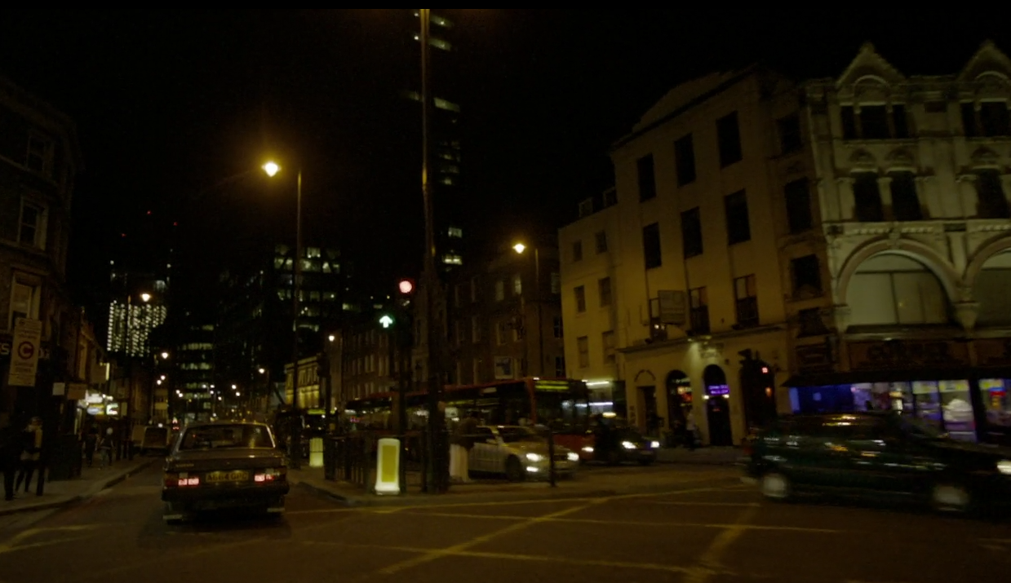
Task 1: Inner-city Crime
Luther
The Sweeney
Credit: The Sweeney: ITV, UK
Credit: Luther: BBC, UK
The Sweeney S01E01: Vimeo timings (18:00–20:25)
Luther S01E01: Netflix timings (23:00–27:50)

Slide 8
Task 1: Inner-city Crime
The Sweeney | Luther
London by day | London by night
Recognisable from Underground | Recognisable from buses and city street
Pursuit of a suspect in an investigation | Domestic ‘violence’ (exhibited by the hero)
Police plant evidence in broad daylight | Cyberstalking (exhibited by the ‘victim’)
Shows that crime happens anywhere, at any time, in a city like London | Shows that there are different levels of crime, that can happen behind closed doors
Luther S01E01: Netflix timings (23:00–27:50)
The Sweeney S01E01: Vimeo timings (18:00–20:25)

Slide 9
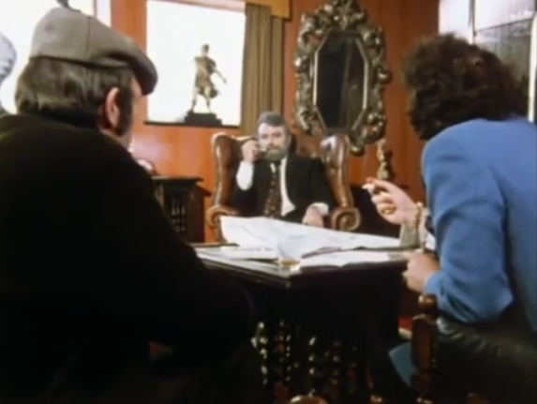
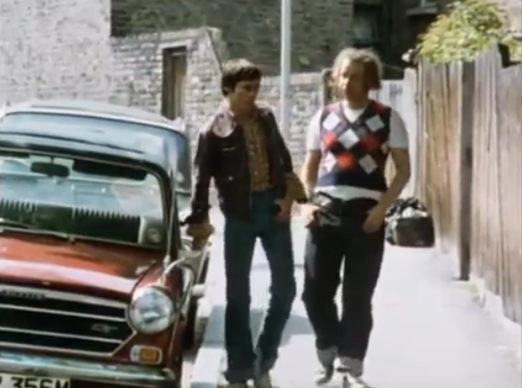
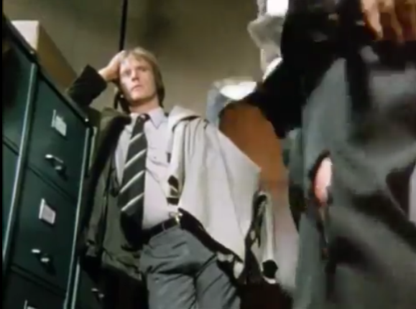
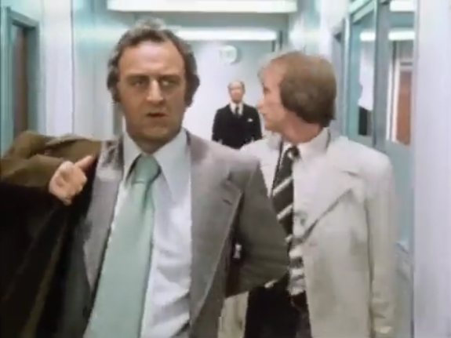
Plenary: The first impression
Based on this extract (times provided below), explore, by means of a class discussion, how partnerships are represented and portrayed in The Sweeney.
Credit: The Sweeney: ITV, UK
Crime boss and lackeys
Car theft (vs murder)
Helping in unideal situation
Partners vs boss
Organised crime
Petty crime
Relying on each other
Allies against authority
The Sweeney S01E01 (Vimeo extract: 06:30–10:04)

Slide 10
Plenary: The first impression
The Sweeney holds partnerships in high esteem, and represents their importance; not only from the police’s side, but also from the criminals’.
Credit: The Sweeney: ITV, UK
Crime boss and lackeys
Car theft (vs murder)
Helping in unideal situation
Partners vs boss
Organised crime
Petty crime
Relying on each other
Allies against authority
The Sweeney S01E01 (Vimeo extract: 06:30–10:04)

