Slide 1
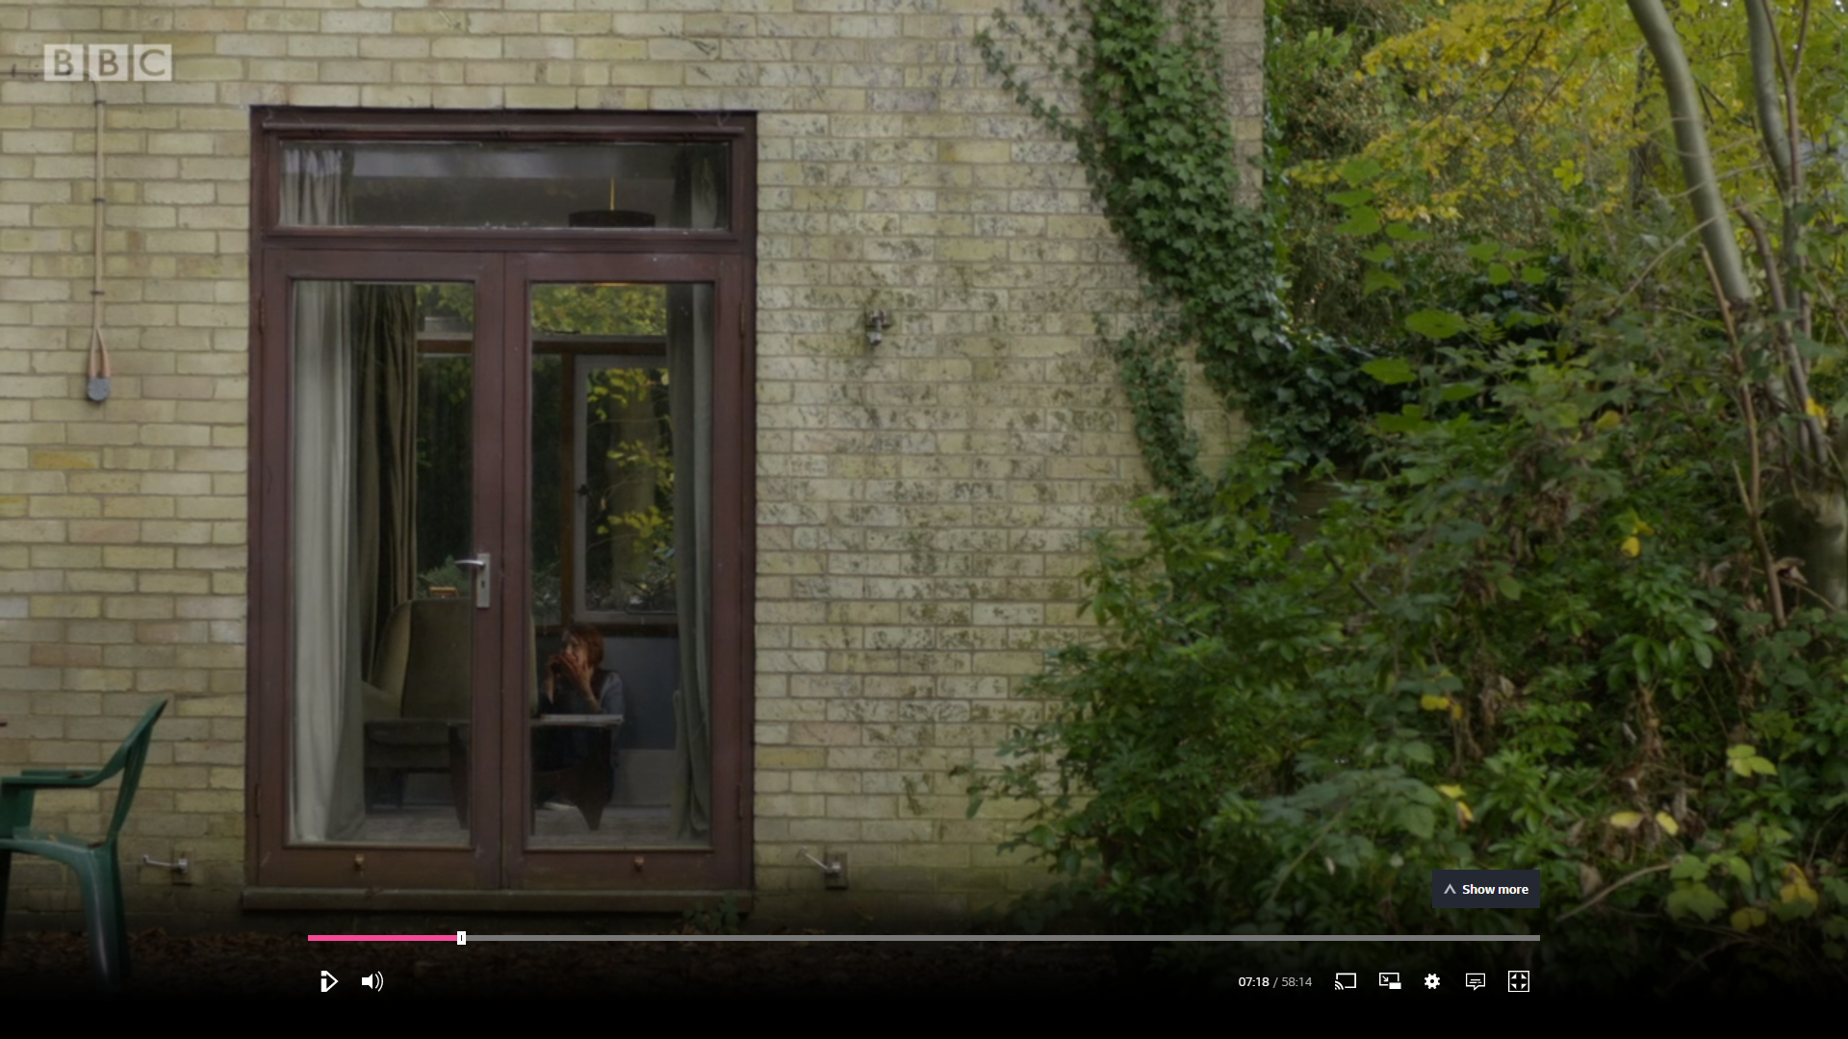
Representation: Gender
-Identify and write down the shot type.
-Discuss: How is Alice Morgan presented in the frame?
-Write a single word to describe Alice when we are introduced to her.
-Write down: Why might Alice be presented like this?
IMAGE 1

Slide 2
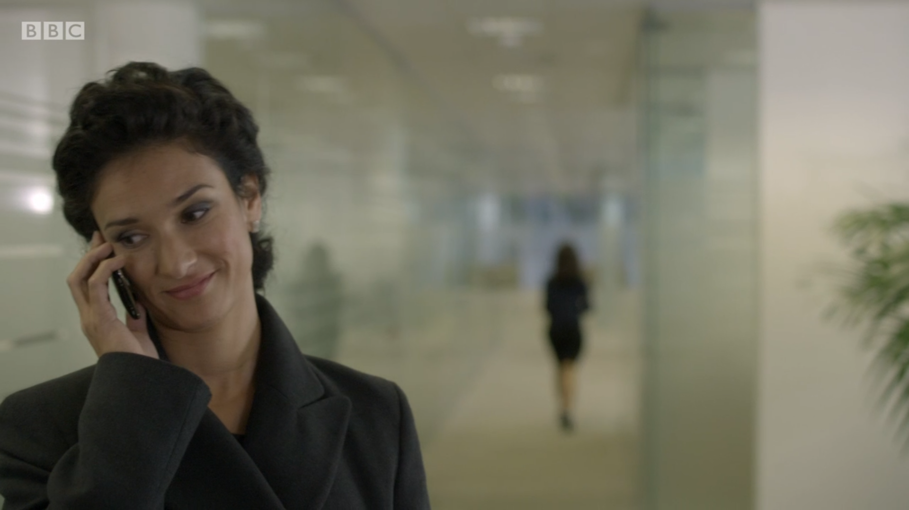
Introduction to Zoe Luther
-Identify and write down the shot type.
-Write: Why is it used here?
-Look at the mise-en-scene. Write a short sentence to describe it.
-Write down: What impression do we first get of Zoe Luther, based on the mise-en-scene?
-Discuss: What are the differences between how we are introduced to Zoe and Alice?
-Write a short paragraph considering the different representations of these when we are first introduced to them.
IMAGE 2

Slide 3
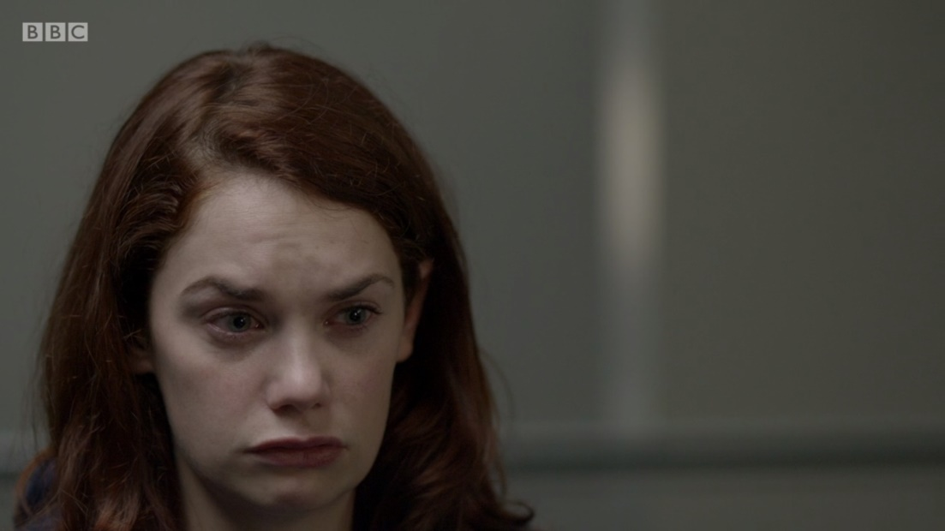
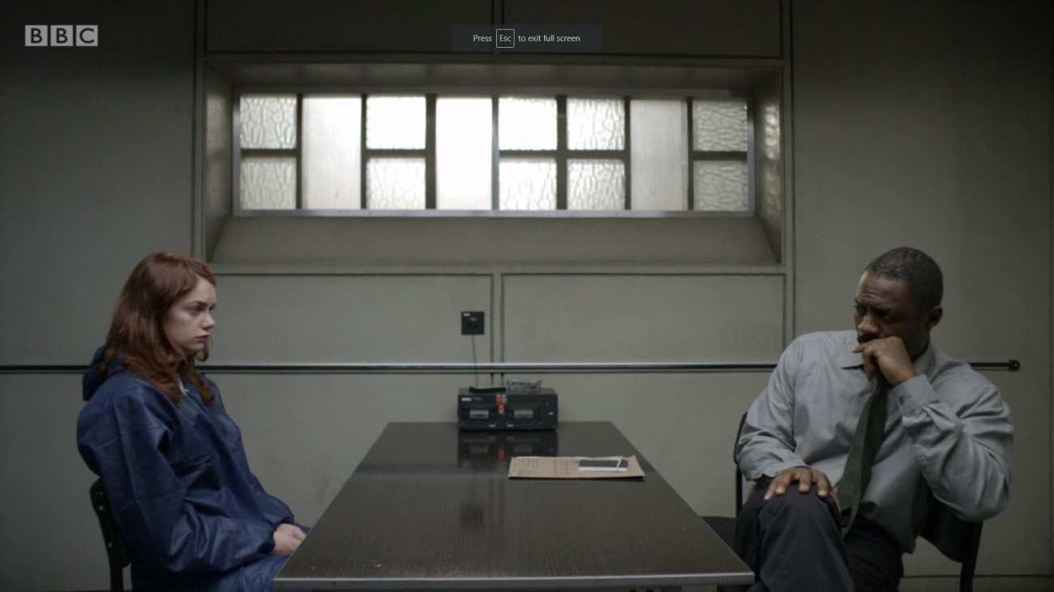
-Look at these two shots of Alice. Discuss: what impression do we now get of her?
-Look at the wide two-shot. Discuss: Who has the power here? How do we know?
-Answer: Are Alice and Luther represented as similar here, or opposite?
IMAGE 3

Slide 4
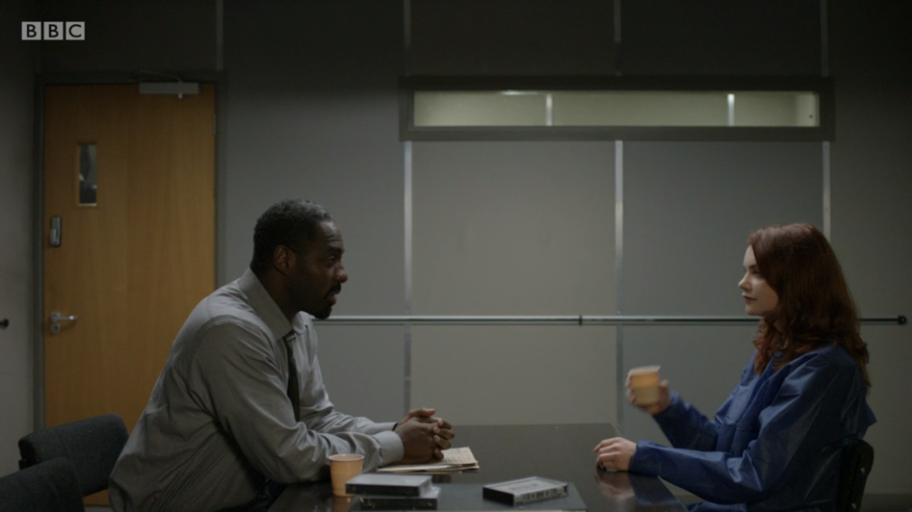
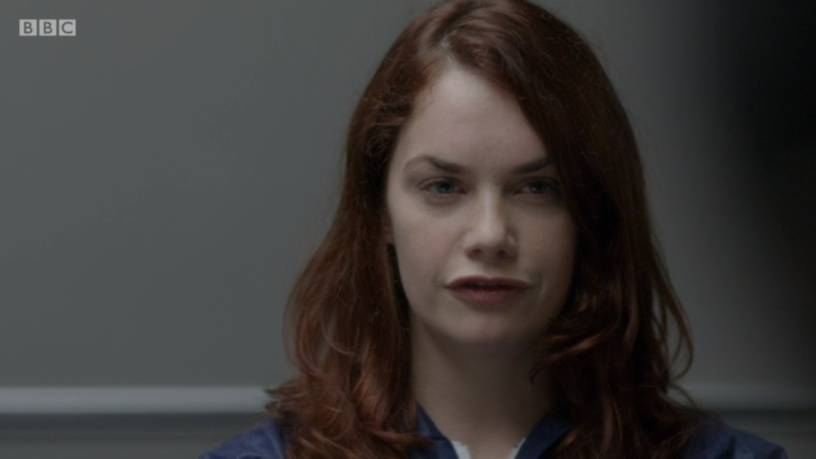
-Look at these two shots of Alice. Discuss: what impression do we now get of her?
-Discuss: What side of the frame is she positioned on in the close-up? How does it differ from the previous sequence?
-Discuss: Who has the power here? How do we know?
-Write a short paragraph answering: How is Alice Morgan represented in the whole interview sequence? (use Image 3 & Image 4 to help)
-Remember to include: What stock character type does Alice Morgan follow?
Image 4

Slide 5
How is Alice Morgan represented in the interview sequence?
Model paragraph
At the start of the interview sequence (image 3), a close-up shot is used with the camera slightly tilted almost creating a high-angle shot showing Alice as vulnerable. The close-up uses the mise-en-scene of Alice’s facial codes to represent her as upset and timid. In the wide two-shot her body position is hunched reinforcing the idea she is in some way troubled. During the opening she is the binary opposite of Luther who is relaxed, in charge and with his body tilted so as to take up more of the frame than her. As the sequence progresses we see a shift in power however.
In image 4 we can see Alice’s body position is much more upright and confident, representing her as strong and potentially in charge of the situation. The close-up used here show her facial codes as focused and poised, representing her as someone who is intelligent and potentially manipulative when compared to the sequence before. Additionally she is shown on the opposite side of the frame to the previous sequence, perhaps showing a duality to her personality; representing her as the crime drama stock character type of the Femme Fatale.

Slide 6
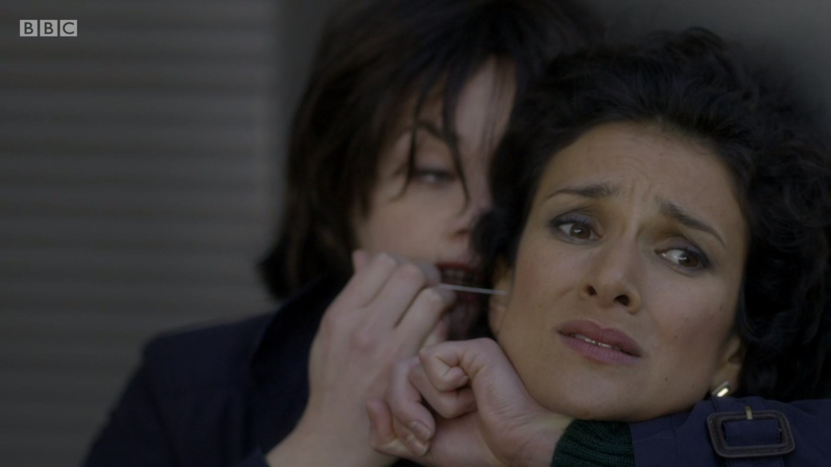
-Who has the power here?
-Compare this scene to how we are first introduced to Alice and Zoe, has anything changed?
IMAGE 4

Slide 7
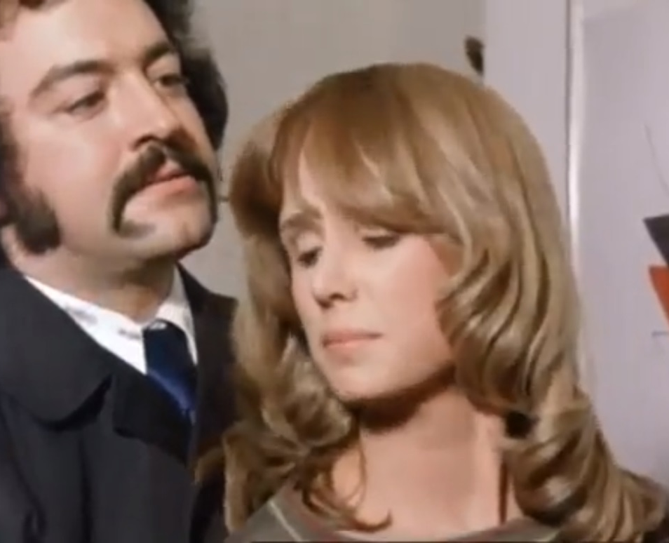
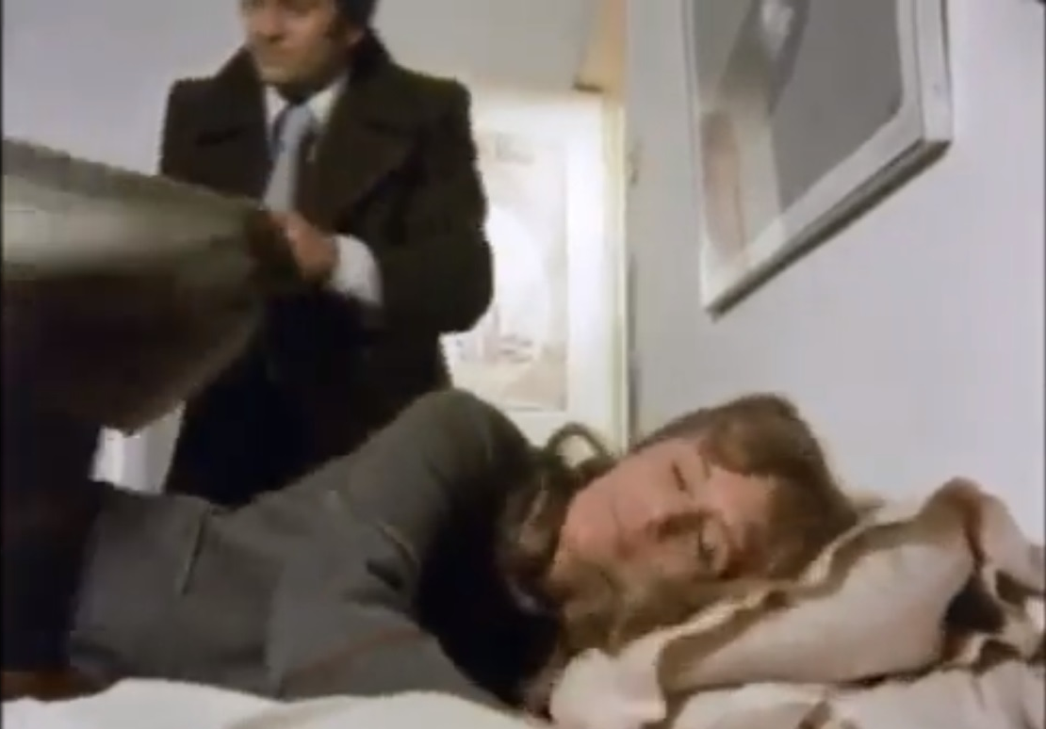
Comparing the women in Luther to Jenny Townsend (Regan’s girlfriend)
in The Sweeney, what are the differences when representing:
-Ethnicity?
-Character?
Discuss: Does Jenny fit any stock character in crime drama or any other genre?
Discuss: What is her role in this episode?

Slide 8
Any differences/similarities between Jenny and the female police officer at the door?
Take a look at the IMDB cast for this episode: https://www.imdb.com/title/tt0714456/?ref_=ttep_ep2
What does this tell us about women’s roles and representation on television during the 1970s?

