Slide 1
Representation, Part 2 Representing People
Lesson 9

Slide 2
Learning Outcomes
Understand the difference between social groups and stereotypes
Understand how stereotypes can be used as a narrative tool
Understand how stereotypes and social groups resonate with audiences, depending on viewers’ own personal identities and beliefs

Slide 3
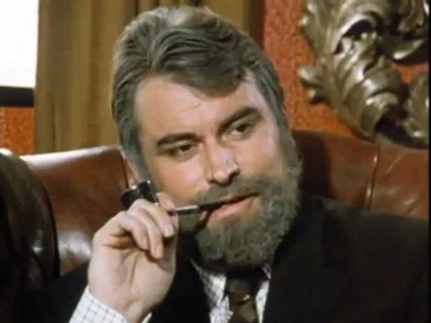
Starter: Crime Drama Stereotypes
All crime dramas feature a criminal that needs apprehending.
Based on the image, what kind of criminal is Haskins in The Sweeney?
Relaxed
Smoking: pipe vs cigarette
Leather chair
Mob boss
Well-groomed
Compared to petty criminals Billy and Stupid, Haskins is clearly a man in charge; a mafia boss of sorts – organised and superior. His work is known to the police, especially considering his men were under surveillance in the previous scene.
Credit: The Sweeney: ITV, UK

Slide 4
Intro: Crime Dramas’ Ethnicity
How is ethnicity represented in The Sweeney and in Luther?
The Sweeney
Luther
John Merrick
Caucasian
Black
Diverse
ethnicity
Henry
Luther
Zoe
Kemble’s goon
Alice
The Sweeney has only one minority in the set episode – the character of a lower-level goon, Kemble.
Luther‘s two antagonists are white, the crime drama’s hero is black, and Zoe is the only ethnically diverse character.

Slide 5
Intro: Crime Dramas’ Ethnicity
The Sweeney: the lack of ethnic diversity in a crime drama from the 1970s is unsurprising, as this was lacking significantly during the decade. If black actors did appear, they would stereotypically be delegated criminal roles, as they were seen as social deviants (or, in the case of the USA, black people were still seen by many as a white person’s commodity, even though by then slavery had been made illegal in the country).

Slide 6
Intro: Crime Dramas’ Ethnicity
Luther: It is interesting to see how ethnicity in crime dramas has changed over time.
Luther himself is black. Instead of being the criminal of the story, he is the hero.
Alice/Henry: the two main antagonists of the episode are white, showing how the story is not automatically assuming that villains have to be people of colour.
Zoe: representative of women with diverse ethnic backgrounds. However, her character is written and portrayed in a way that doesn’t rely on stereotypes, yet her character is still compelling.
Zoe in particular shows us that human characteristics and flaws can be just as effective in creating an interesting character as the use of stereotypes can be.

Slide 7
Task 1: Gender in Crime Dramas
Remind yourself of the main characters presented in Luther’s first episode.
The six key characters in Luther are connected through respect, fear, love, obsession, power or obedience.
Create a mind map of character relations showing how each character is connected, and whether the feeling is one-sided or mutual.

Slide 8
Plenary: Character Relations
DCI JOHN LUTHER
Fear
ZOE LUTHER
Love
MARK NORTH
Love
Power
Fear
Obsession
ALICE MORGAN
Respect
Power
Power
Respect
DSU ROSE TELLER
DSU JUSTIN RIPLEY
Obedience
Power

