Slide 1
Film Techniques Recap!
Today we are going to look at representation in the opening sequence in Luther. Please load up the first quiz ready to go in order to recap film techniques!
Quiz 1: https://quizizz.com/admin/quiz/5ccff31b440eb8001a8df9cd/film-techniques-for-year-11
Quiz 2: https://quizizz.com/admin/quiz/5c6f07318383f5001a2a0c56/film-techniques

Slide 2
Crime Drama Conventions
Typical Genre Conventions:
White, male lead detective:
Remember – typical DCI conventions:
-Middle-aged, white
-’Hard cops’
-Break the rules/mavericks/on the edge of the law
-Somewhat aggressive – by any means necessary
-Intelligent
-Troubled – issues with: alcohol, relationships, addicted to the job etc.

Slide 3
Crime Drama Conventions
Typical Genre Conventions:
Minority characters
-Traditionally on the wrong side of the law.
-Black, inner city males often dressed in hoodies/dark clothes and aggressive
-Generally lack of representation – in the Sweeney episode 1 a solely white cast

Slide 4
Crime Drama Conventions
Typical Genre Conventions:
Boss/Superior
Remember – typical DSU/superior conventions
-White, male
-Usually older or a lot younger than the DCI
-Plays by the rules – has to answer to their superiors
-Usually at odds/angry at the DCI for playing by their own rules
-Will have the DCI’s back begrudgingly

Slide 5
Crime Drama Conventions
Typical Genre Conventions:
Female characters
Traditionally in crime dramas women have two roles:
Femme Fatale – the alluring, sexualised, super intelligent ‘love interest’ who will double cross the lead detective
The victim – the princess that needs to be constantly saved from danger by the male, ‘hero’ detective.

Slide 6
Crime Drama Conventions
Luther’s Genre Conventions:
White, male lead detective:
-Black, middle-aged
-’Hard cop’
-Break the rules/mavericks/on the edge of the law
-Somewhat aggressive – by any means necessary (does this present Luther is a more negative light because of his race?)
-Intelligent
-Troubled – issues with: alcohol, relationships, addicted to the job etc.

Slide 7
Crime Drama Conventions
Luther Genre Conventions:
Boss/Superior
Remember – typical DSU/superior conventions
-White, female
-Usually older or a lot younger than the DCI
-Plays by the rules (sort of?)– has to answer to their superiors
-Not really ‘at odds’ with Luther
-Has Luther’s back as she vouches for him to return

Slide 8
Crime Drama Conventions
Luther Genre Conventions:
Female characters
DSU Rose Teller adheres to very few traditional genre conventions of the female
character(s). Teller subverts the typical crime drama conventions by being the head of
Luther’s unit and being a strong, independent member of the police force. She is neither a victim nor femme fatale stereotype.
One minor way she conforms to traditional gender roles in crime drama is when she becomes the first to tend to the victim trapped in the wall. Here she, arguably, conforms to the ‘mother’ stereotype by helping the young victim. Similarly the fact that the victim is female is a typical convention of the crime drama genre, where the young girl appears helpless and needs saving.

Slide 9
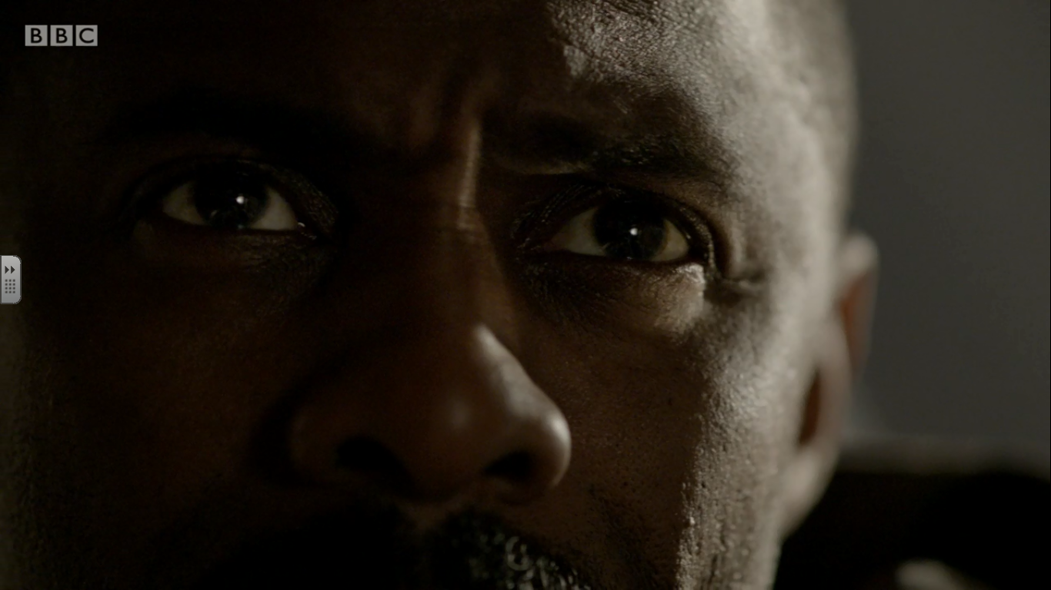
-Identify and write down the shot type.
-Identify and write the type of lighting used.
-Write a single word on how the use of lighting presents John Luther.
-Write a sentence on how the use of lighting presents John Luther.
IMAGE 1

Slide 10
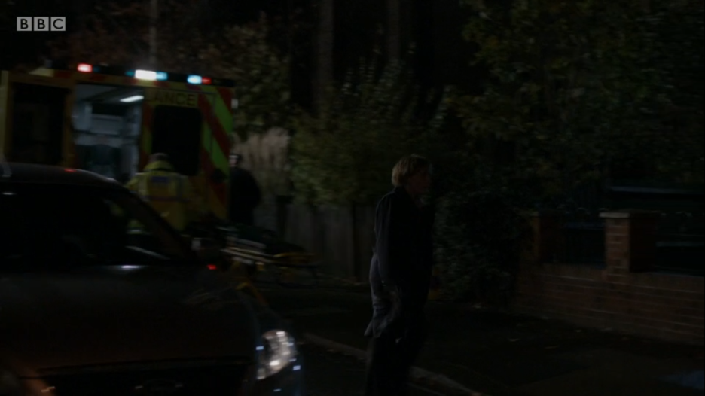
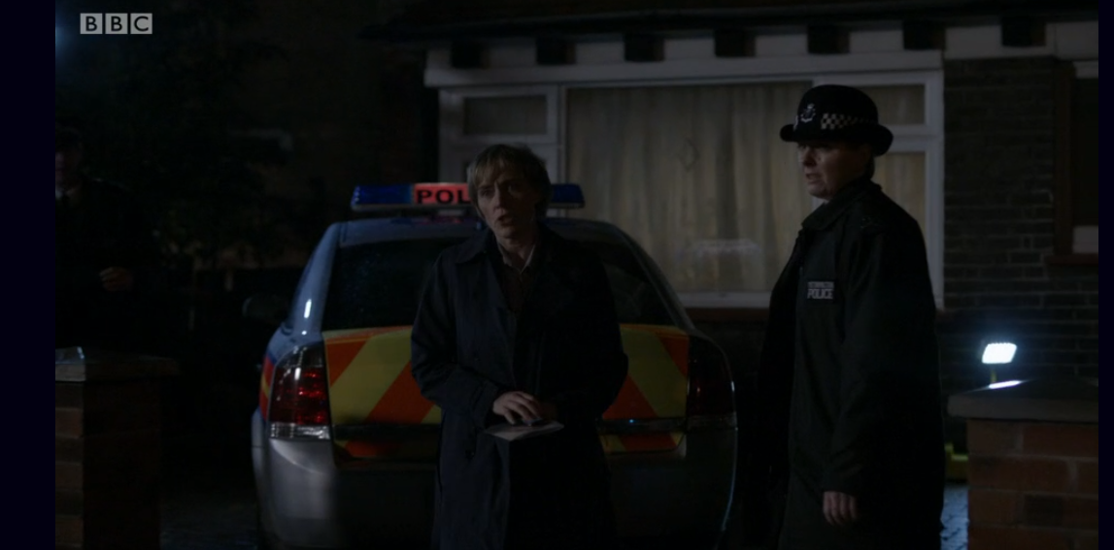
-Identify and write down the camera movement for the left image.
-Where is DCU Rose Teller positioned in the frame?
-How is she dressed?
-How does her dress style juxtapose the other female officer? What
is this showing?
IMAGE 2

Slide 11
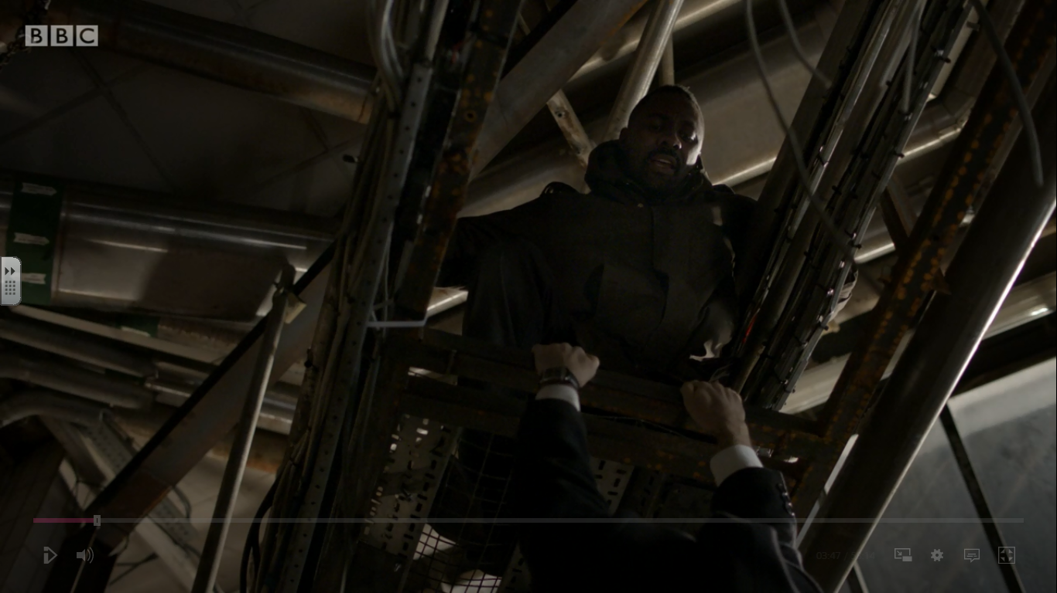
-Identify and write down the shot type.
-Write a short sentence - what does this shot type show?
-Write down who you think has the power in this scene.
-Write a single word to describe John Luther here.
IMAGE 3

Slide 12
-Identify and write down the shot type.
-Use a short sentence to describe John Luther’s mental state here.
-Write another short sentence explaining why you think this.
-Considering all 3 images so far does Luther follow the conventions of a typical detective?
IMAGE 3

Slide 13
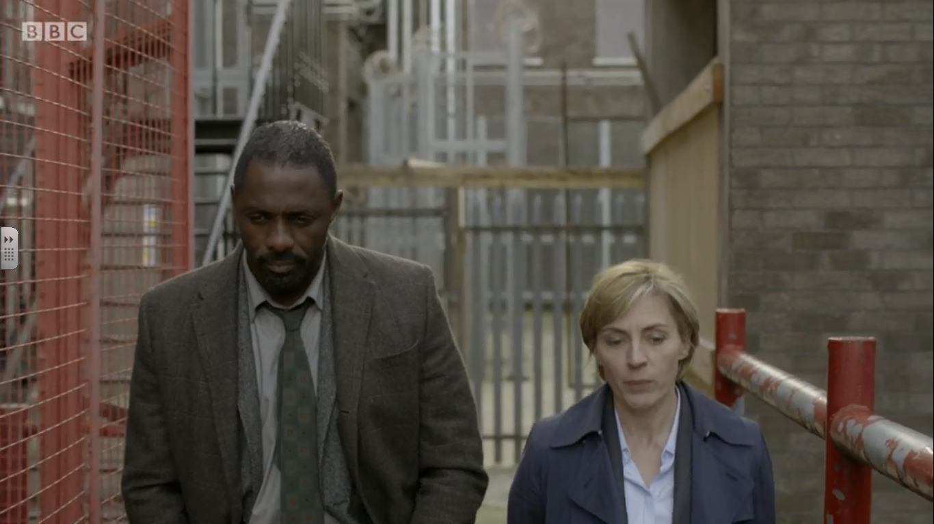
-Identify and write down the shot type.
-Write down a 3 words to describe how the police and presented here.
IMAGE 4

Slide 14
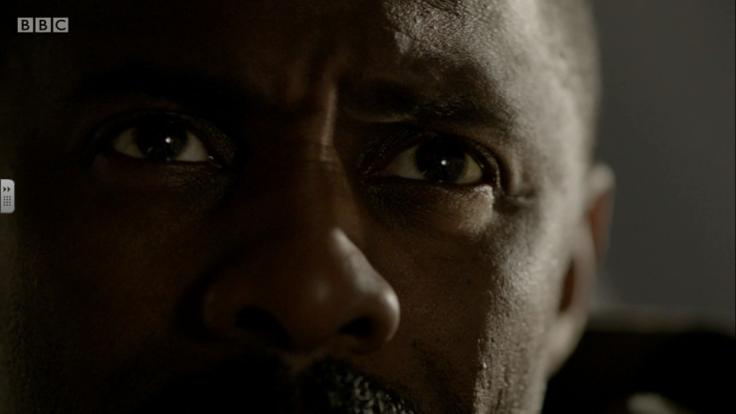
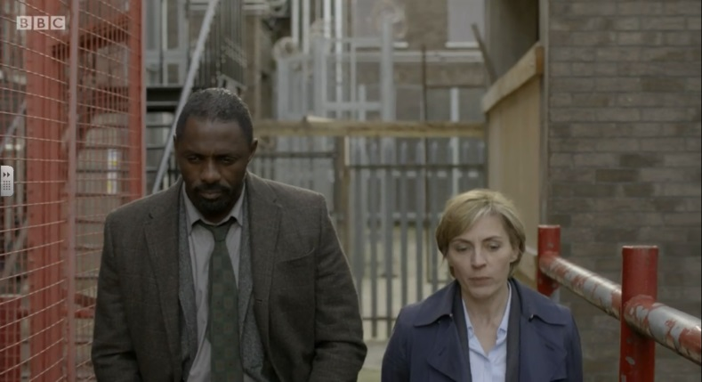
Considering the opening sequence and the stills we have just looked at answer the following question: Does DCI John Luther follow traditional crime drama conventions?
Remember – typical DCI conventions:
-’Hard cops’ -Middle-aged, white
-Break the rules -Troubled
-Somewhat aggressive
-Intelligent

Slide 15
Considering the opening sequence and the stills we have just looked at answer the following question: Does DCI John Luther follow traditional crime drama conventions?
Model PEA
In ‘image 4’ of the opening sequence we see a wide two-shot of DCI John Luther and DSU Rose Teller walking side by side. Contrasting the representation earlier in the sequence which shows Luther as aggressive and someone who plays by his own rules, here Luther wears professional dress and appears calm and focused. The high-key lighting portrays somewhat of an upbeat mood and may reflect the idea Luther is in a better place. The professional dress of both of the detectives could represent the police as reliable and in control, following certain typical crime drama conventions. The positioning of John Luther next to his superior officer Rose Teller goes against typical crime drama conventions however, as it implies they have a good working relationship. In comparison to The Sweeney, Regan and his commanding officer have a poor relationship and often argue, which is historically more typical of the genre.

Slide 16
Considering the opening sequence and the stills we have just looked at answer the following question: Does DCI John Luther follow traditional crime drama conventions?
Model PEA
In ‘image 1’ of the opening sequence a close-up shot of DCI John Luther is used, combined with low-key lighting. The close-up shot focuses on Luther’s eyes which appear focused and determined. Arguably it could also be said he appears aggressive due to his somewhat furrowed brow combined with his piercing stare. The low-key lighting also adds menace the scene as Luther is partly bathed in shadow. In this instance Luther could be said to conform to traditional crime drama conventions of black males appearing aggressive and linked to criminal activity. However, this is ultimately subverted since Luther is a high ranking police officer on the side of the law. The low-key lighting in this scene also works to create chiaroscuro on Luther’s face. Here the opposition of extreme dark and extreme light could potentially indicate Luther is wrestling with his ‘dark’ and ‘light’ side, showing he is mentally conflicted; he wants to catch the criminal he is chasing but knows he may have to step outside the bounds of the law to do it. In this instance Luther adheres to the traditional crime drama convention of the troubled lead detective, dealing with mental and emotional conflict within himself. This notion is furthered in the following scene where a series of rapid smash cuts are used to show the frantic state of Luther’s mind as he decides what to do with the criminal hanging beneath his feet.

Slide 17
Considering the opening sequence and the stills we have just looked at answer the following question : Does DSU Rose Teller follow traditional crime drama conventions?
Model PEA
When we are first introduced to DSU Rose Teller a tracking shot is used to follow her out of the police car. The follow-shot remains fixed on Teller positioning her male colleague off-screen. The use of the camera work here immediately shows that DSU Rose Teller is the most important officer in the scene. This initially goes against traditional crime drama conventions whereby female characters are often victims or femme fatale characters. As the sequence progresses Teller is positioned centre frame implying she is the most important character in shot. Considering mise-en-scene, her costume of formal office wear indicates that she is not a traditional police officer and implies she is possibly in a high position of authority. Her costume is juxtaposed with the more traditional ‘beat’ uniform of the female officer to her right to reinforce Rose Teller’s status within the police force. Again, this goes against the typical conventions of a crime drama since it shows a woman in a position of power within a traditionally male environment. Additionally having another female officer in shot reinforces the gender diversity of the current police force and subverts traditional crime drama conventions that largely failed to effectively show female police officers on-screen. Despite subverting gender traditions here the use of low-key lighting and a dark, sombre colour palette reinforces the traditional aesthetics of a crime drama, in that it works to create a gritty, urban landscape to mirror the dark nature of crime.

Slide 18
Considering the opening sequence and the stills we have just looked at answer the following question: Does DCI John Luther follow traditional crime drama conventions?
Model PEA
In ‘image 3’ a low-angle shot of DCI John Luther is used. This shot could connote the power that John Luther has in this scene as it makes Luther look like he is dominating the frame. Combined with his costume of dark urban clothing and the low-key-lighting, Luther is shown as a dangerous force who is playing by his own rules to solve the current case. Presenting the lead detective as a powerful maverick is a classic convention of crime drama.

Slide 19
Other shots and scenes in the opening sequence:
*Establishing shot of the abandoned factory + high key lighting + shot at night time– conventional setting for a crime drama: urban, dangerous, abandoned
*Over the shoulder shot of Luther as he walks aggressively at pace – does this establish him like a criminal in the opening?
*Luther’s fellow officers are all in more formal dress than him

