Slide 1
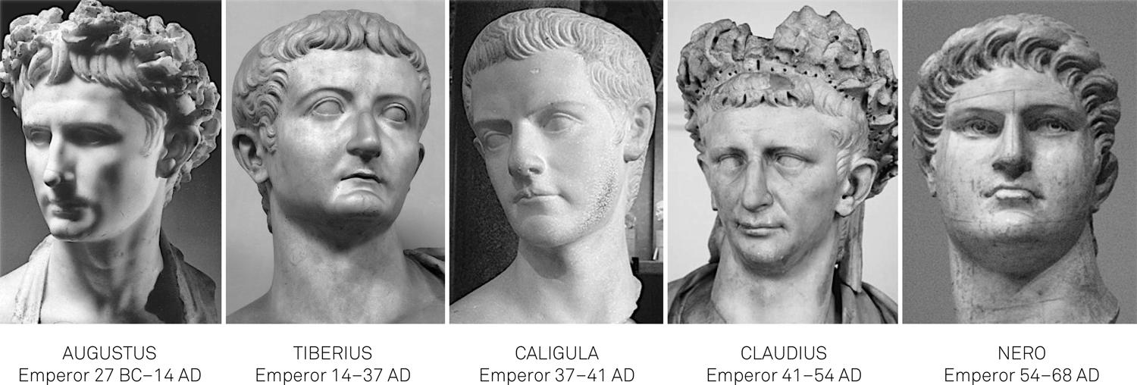
Roman Period Study
The Julio Claudians,
31 BC – 68 AD
Key Debate 2:
The Characters of Tiberius, Gaius, Claudius and Nero?

Slide 2
Key Debate 2 – The Characters of Tiberius, Gaius, Claudius and Nero
TIBERIUS
Character | Support | Challenge
Introvert and distant Cold and paranoid Brutal | Role in the treason trials - “Under Tiberius Caesar treason charges became so commonplace that they amounted to a form of national madness and cost the lives of more Roman citizens than any civil war” (Younger Seneca) Leaving Rome for Capri – AD 26. Tiberius “let all of the affairs of state slide” (Suetonius) Possible murder of relatives/rivals – Suetonius accuses Tiberius of ‘every sort of cruelty’ and that his savagery increased after the death of Sejanus Poor relationship with the plebs – Romans shouted “to the Tiber with Tiberius” (Seutonius) Failed to create as positive a relationship with he Senate as Augustus – Tacitus describes how the Senate became frustrated with Tiberius’ apparent reluctance to take power after Augustus and asked him what bit of the empire he wanted | Treason trials may have been led by others – Tacitus suggests that Sejanus manipulated Tiberius to leave Rome for Capri in AD 26 so that he could have sole power in Rome Acted decisively when necessary – German mutinies: dispatched Germanicus and Drusus to deal with revolts in the army (Tacitus). Subdued the Tacfarinas revolt in North Africa, AD 15-24 Showed awareness and decisiveness with the removal of Sejanus – Dio explains how Sejanus’ power became too great (“off-shore monarch”) forcing Tiberius to act Hostility of the sources – worth remembering that we have a number of critical sources e.g. Tacitus is critical of Tiberius for abusing absolute power, as is Dio

Slide 3
Key Debate 2 – The Characters of Tiberius, Gaius, Claudius and Nero
GAIUS
Character | Support | Challenge
Extrovert Excessive Impulsive and brutal Sinister | Imperial cult – expanded its worship as a way to enhance his autoritas (Josephus: “he was now claiming…honours no longer appropriate for mortal men”) (Supported by Dio and Suetonius) Lavish public games (Suetonius – on a scale not seen before). Dio suggest he had to introduce harsh new taxes to cover the costs. Enjoyment of execution/torture – (Dio: “he not only rivalled, but even surpasses Tiberius’ licentiousness and bloodthirstiness”). (Suetonius: Gaius fed prisoners to animals as butcher’s meat was too expensive) Treatment of the Senate – initially stopped the treason trials and allowed free speech only to reinstate the trials and threaten the Senate (Dio) Alleged incest with sisters | Strong relationship with the plebs – (Suetonius says that Gaius was “like the answer to their prayers” and that the people showed “extravagant joy that he was now emperor”) Sensible administrative reforms at the start of his rule – these do not appear to be the actions of a mad man e.g. published an imperial budget (Dio), revised the list of equites, gave magistrates full authority over court cases, began work on the Anio Novus (Pliny the Elder) Attitude towards the imperial cult may have been a clever political move Evidence of brutality and incest largely anecdotal Hostility of the sources

Slide 4
Key Debate 2 – The Characters of Tiberius, Gaius, Claudius and Nero
CLAUDIUS
Character | Support | Challenge
Old bumbling man Not up to the job Gullible and easily manipulated | Background – Claudius was kept away from power and was ridiculed by his family Portrayal in the take-over of power i.e. “trembling” behind a curtain (Suetonius). Josephus also suggests that the Praetorian Guard were the real source of power and ‘kidnapped’ Claudius to control the new emperor. Also shown in Aureus of Claudius AD 41-5 Control of wives and freedmen – Suetonius: “One might say everything that Claudius did…were dictated by his wives and freedmen”. (Pallas, Narcissus, Callistus) – meant to have sold citizenship, military commands, and civilian positions. Bronze statue of Pallas authorised in AD 52. Messalina accused by Dio of a debauched sex-life and using her power to remove opponents e.g. head of the Praetorian Guard Agrippina the Younger – presented by Tacitus as having raised Nero above Britannicus and then murdering Claudius in AD 54 when he became an obstacle | Very successful building projects – e.g. the harbour at Ostia, Aqua Claudius. Also returned stability to the grain supply Invasion of Britain – could be argued as the product of his weakness at home but strikingly successful – Claudius voted a triumph by the Senate and the pomerium of Rome was expanded Maintained obedience of the Senate and support of the plebs – Warm an popular relationship through the games, referring to the crowd as “my lords” (Seutonius). Considering the opposition of the Senate at the start of his reign he did well to maintain support. Also introduced reforms to reinvigorate the Senate e.g. introduction of Gauls Role of freedmen was traditional – Augustus relied on freemen too Hostility of the sources

Slide 5
Key Debate 2 – The Characters of Tiberius, Gaius, Claudius and Nero
NERO
Character | Support | Challenge
Philhellenism Artistic Impulsive and violent Immature and gullible | Participation in musical and theatrical performances – Tacitus is particularly critical of this and the impact it had: “Roman morals had long become impure, but never was there so favourable an environment for debauchery”. Suetonius says that Nero formed his own groups of professional applauders and staged the ‘Neronia’ Domination by his mother – Aureus of Nero AD 54 shows Nero and Agrippina face to face. Tacitus suggests that ‘according to another author’ Agrippina used sex to control her son Manipulated by Poppaea and advisers – influence of Seneca and Burrus. Poppaea, according to Tacitus, is meant to have pressurised Nero to remove his mother so they could marry Portrayal during the Great Fire in AD 64 – suggestion from the sources that he caused or certainly took advantage of the fire (Suetonius claims he sang ‘The fall of Troy’ as watching). He did go on to build the domus aureus on the ashes (Pliny) Portrayal in AD 68 – weak and indecisive: Dio’s account shows him distracted as Vindex’s revolt grew “I have discovered how to make the water organ make both a louder and a more musical sound.” | Quinquennium Aureum – modelled his first actions on Augutus (Seutonius) Acted decisively against his mother to rule more independently after 59 – evidence that Agrippina was losing control over Nero (e.g. she threatened to support Britannicus’ claim to power in AD 55) Suetonius’ account of the murder of Agrippina Reforms after the Fire of Rome – Tacitus describes the building regulations introduced. Also showed leadership during the fire by opening up his private gardens and organising relief Moderate attitude towards the imperial cult – copied Augustus’ image as the defender of traditional religion Accounts of him fleeing Rome and committing suicide heavily fictionalised

Slide 6
Example Question
Sometime before Sejanus’ fall, but when Tiberius already suspected him, Agrippina’s eldest son had been put to death. Not until 33 was is elder brother Drusus killed. Their mother committed suicide. The next years saw more trials and executions with Macro proving as ruthless in eliminating opposition as Sejanus had been. Attempts have been made to exonerate Tiberius, or at least to suggest that Tacitus exaggerates. Perhaps he does. And it is easy to forget when reading him that the circle affected by the executions and suicides was relatively limited. But two things are clear and indisputable: the demoralisation of the senatorial class, collectively and for the most part individually: and the fact that whenever Tiberius made his wishes clear, for leniency or the reverse, he was obeyed. In theory he could have stopped the denunciations and the useless deaths; in practice, of course, isolated, scared, increasingly cynical, he lacked the will to do so….His personality continues to puzzle historians, because Tacitus made it into an enigma.
C. Wells, The Roman Empire
How convincing do you find Wells’ interpretation of Tiberius’ character and actions?

