Slide 1
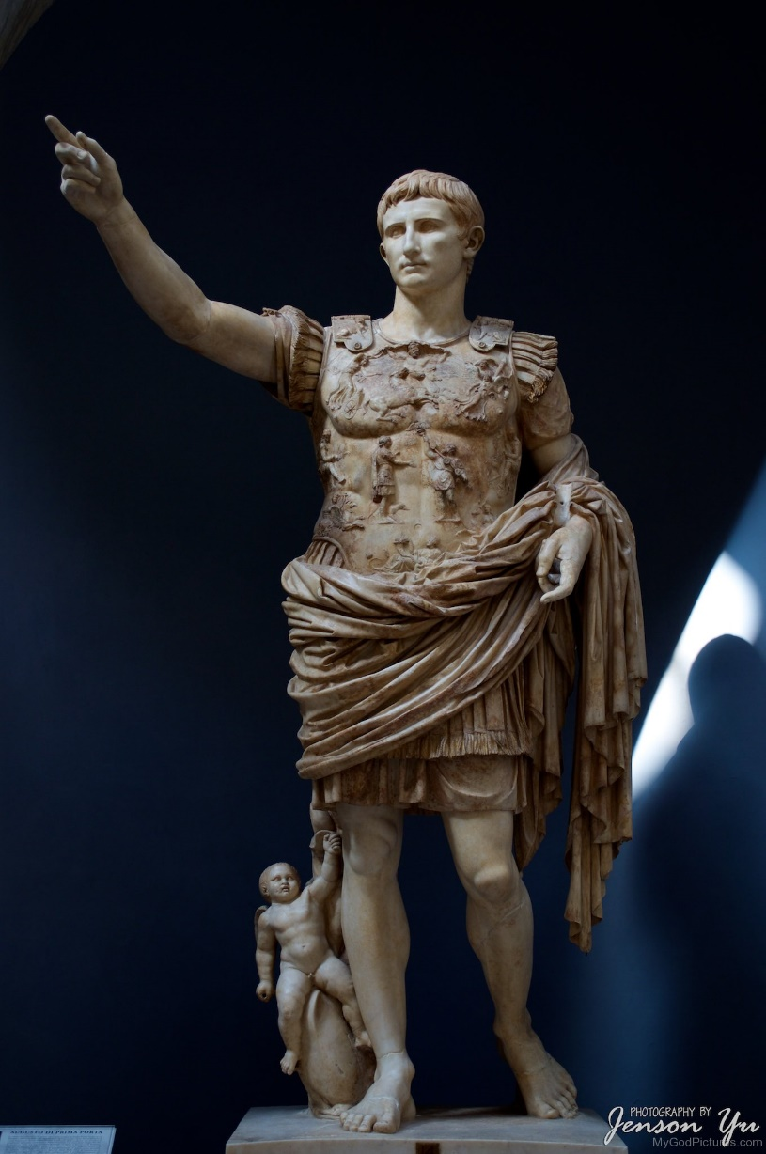
Roman Period Study – The Julio Claudians, 31 BC – 68 AD
Key Debate 1:
Did Augustus actually restore the republic?

Slide 2
Some BAsics
There are three key debate topics for the Roman Period study and three for the Greek
These are areas where there is considerable historical discussion and argument
You will be given an unseen 20 mark interpretation question that comes from one of these key debates
All of the content is also valid in a 30 mark essay
In the interpretation question you are being assessed on your ability to use your knowledge of the topic and the sources to analyse the argument of a modern historian (A01=5 marks, A04=15 marks)
The big question for this key debate is whether Octavian/Augustus, following his defeat of Mark Antony and victory in the civil war, restored the traditional form of government, based around the Senate and magistrates, or if he went on to take absolute power in Rome.

Slide 3
Did Augustus actually restore the republic? – yes (OK)
Augustus styled his regime as the restoration of the Roman Republic and this is supported to an extent by the terms of the First Constitutional Settlement in 27 BC. Here Augustus assumed existing, traditional titles to confirm his position as Princeps e.g.
Laurels on his doorposts
Award of the civic crown
A Shield of Virtue in the Senate building
Augustus would occupy one of the two consulships for a period of ten years. This was a traditional position, as was the practice of time-limiting power
The Senate asked Octavian to take these powers. Augustus then retained the Senate even after his position was secure and carried out reforms to improve its standards
Even after the Second Constitutional Settlement, the traditional ‘tribunician’ power given to Augustus was the basis of his power

Slide 4
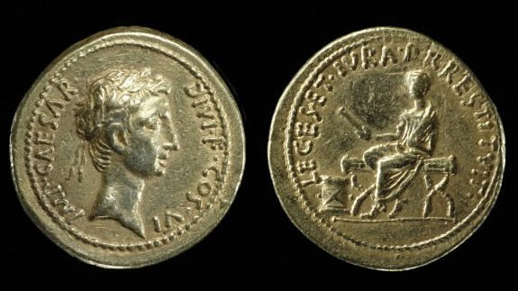
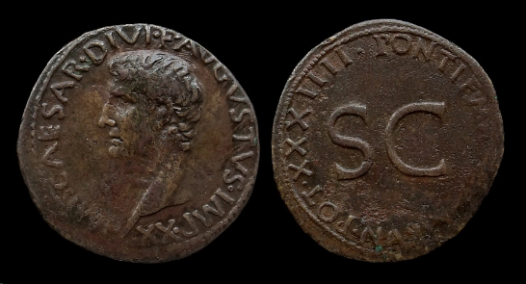
Did Augustus actually restore the republic? – yes (Sources)
Res Gestae Divi Augusti
“…even though the senate and people of Rome were in agreement that I should be appointed on my own as guardian of laws and customs with supreme power. I accepted no magistracy conferred upon me that contravened ancestral custom.”
“In my sixth and seventh consulships [28-27 BC], after I had put an end to civil wars, although by everyone’s agreement I had power over everything, I transferred the state from my power into the control of the Roman senate and people.”
Velleius Paterculus
“Force was restored to the laws, authority to the courts, majesty to the senate; the power of the magistrates was reduced to its former limits, except that two praetors were added to the eight; the ancient, traditional form of the republic was brought back”
Prescribed Source – New aureus 28 BC
Obv.: Head of Octavian, wearing laurel wreath “Commander Caesar, Son of the Deified, consul for the sixth time”
Rev.: Octavian seated on magistrate’s chair wearing toga, holding out scroll in right hand “He has restored to the Roman People their laws and rights”
Prescribed Source – Coin portrait of Augustus, aged 73 AD 11-12
Obv.: Augustus, “Imperator Caesar Augustus, Son of the Deifie, hailed victorious general twenty times”
Rev.: SC (by decree of the Senate), “Pontifex Maximus, Tribunician power for the thity-fourth time’

Slide 5
Did Augustus actually restore the republic? – NO (OK)
The appearance of the traditional republic was a façade designed to hide Augustus’ absolute power and prevent him suffering the same fate as Julius Caesar
Augustus’ power at the First Constitutional Settlement was absolute but informal. In the Second Constitutional Settlement (23 BC) this power was made formal through the award of tribunicia potestas and the creation of the title Imperium Proconsulare Maius. Augustus made his power explicit as he potentially now felt strong enough to do and also because it would make succession easier. This was made more important with the death in 23 BC of his heir apparent Claudius Marcellus
Augustus ensured that he retained full control of the army. The FCS gave him control of the provinces on the edge of the empire (Strabo), where most legions were. The SCS ensured he could overrule any provincial governor and control the legions
The Senate was kept to ‘rubber-stamp’ Augustus’ decisions and Augustus’ reforms ensured that its members were loyal to him. He reduced the size of the Senate and then, according to Macrobius, paid off 4 million sesterces worth of senators’ debts
Augustus encouraged the development of the imperial cult as it arrived from the east of the empire – this is at odds with the impression of restoring the republic (Tacitus, “There were no honours left for the gods…”)
Succession was of paramount importance to Augustus which contradicted the idea of a republic
The sources which argue most clearly that Augustus restored the republic are either sympathetic to him or direct propaganda

Slide 6
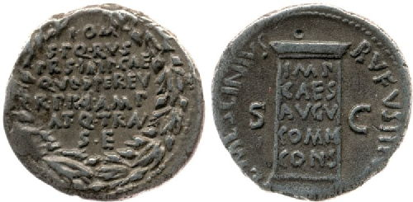
Did Augustus actually restore the republic? – NO (Sources)
Dio
“Through this process the power both of the people and of the Senate was wholly transferred into the hands of Augustus, and it was from this time that a monarchy, strictly speaking, was established. It would certainly be most truthful to describe it as a monarchy”
Tacitus Annals
Thereafter, once he had seduced the soldiery with gifts, the people with corn, and everyone with the delights of peace, he gradually increased his power, arrogating to himself the functions of the senate, the magistrates and the law.
Suetonius
“Twice Augustus seriously thought of restoring the republic: immediately after the fall of Antony, when he remembered that Antony had often accused him of being the one obstacle to such a change, and again when he could not shake off an exhausting illness”
Prescribed Source – Public vows for Augustus’ safety, denarius, 16 BC
Obv.: Inscription within oak-wreath “To Jupiter Greatest and Best the Senate and People of Rome took vows for the safety of Imperator Caesar because through him the state is in a more expansive and peaceful condition”
Rev.: Pillar inscribed “to Imperator Caesar Augustus by common consensus” (By decree of the Senate)

Slide 7
Other Arguments
Augustus did not originally intend to end the republic and replace it with the Principate but this evolved during his reign as his power adapted to different situations. For example, he formalised his power in 23 BC not because of a master plan to destroy the republic but because his health had suddenly declined and he needed clearer powers to be able to pass on to a successor (Dio challenges this by claiming he had a masterplan)
Augustus created a hybrid form of government that kept some elements of the Republic and combined these with new powers under the Principate. It is too simplistic to think of him restoring the Republic or abandoning it
Augustus did end the Republic but because it was no longer possible for this form of government to control Rome after the civil wars (Tacitus and Suetonius both suggest this – Tacitus: “The younger generation had been born after the victory at Actium, and most of their elders during the civil wars. How many remained who had seen the republic?”)
The sources most certain that he did end the Republic (Tacitus and Dio) were written at least a century later when the power of emperors had grown and become clear. Hindsight possibly leads them to exaggerate the extent to which Augustus caused this change. Writers at the time were much less aware of a significant change

Slide 8
Example question
Whether people liked (Augustus) or loathed him, he was in many ways a puzzling contradictory revolutionary. He was one of the most radical innovators Rome ever saw. …
Yet Augustus appears to have abolished nothing. The governing class remained the same (this was no revolution in the strict sense of the word), the privileges of the senate were in many ways enhanced, not removed, and the old offices of state, consulships and praetorships and so on, continued to be coveted and filled. Much of the legislation that is usually ascribed to Augustus was formally introduced, or at least fronted, by those regular officials…Most of his formal powers were officially voted to him by the senate and cast almost entirely in traditional Republican format, his continued use of the title ‘son of a god’ being the only important exception. And he lived in no grand palace, but in the sort of house on the Palatine Hill where you would expect to find a senator, and where his wife Livia could occasionally be spotted working her wool. The word that Romans most often used to describe his position was princeps, meaning ‘first citizen’ rather than ‘emperor’ as we choose to call him, and one of his most famous watchwords was civilitas – ‘we’re all citizens together’.
M. Beard, SPQR A History of Ancient Rome
How convincing do you find Beard’s interpretation that ‘Augustus appears to have abolished nothing’?

