Slide 1
AQA
    A Level
      Computer Science
      Paper 2
Defining and updating tables using SQL
  Unit 11
  Databases and software development

Slide 2
Objectives
Be able to use SQL to define a database table
Be able to use SQL to update, insert and delete data from multiple tables of a relational database
Know that a client server database system provides simultaneous access to the database for multiple clients
Know how concurrent access can be controlled to preserve the integrity of the database

Slide 3
Creating a new table using SQL
SQL may be used to define and create a new table
Here is an example:
  CREATE TABLE tblProduct
  (
  ProductID CHAR(4) NOT NULL PRIMARY KEY,
  Description VARCHAR(20) NOT NULL,
  Price CURRENCY
  )
Notice how the primary key is defined
  Two of the fields in this example cannot be left blank when data is added to the table

Slide 4
Common data types
Data type | Description | Example
CHAR(n) | Char string of fixed length n | ProductCode CHAR(6)
VARCHAR(n) | Character string variable length, max. n | Surname VARCHAR(25)
BOOLEAN | TRUE or FALSE | ReviewComplete BOOLEAN
INTEGER, INT | Integer | Quantity INTEGER
FLOAT | Number with a floating decimal point | Length FLOAT (10,2) (maximum number of digits is 10 with max. 2 after decimal point)
DATE | Stores Day, Month, Year values | HireDate DATE
TIME | Stores Hour, Minute, Second | RaceTime TIME
CURRENCY | Formats numbers in the currency used in your region | EntryFee CURRENCY

Slide 5
Altering a table structure
The ALTER TABLE statement is used to add, delete or modify columns in an existing table
To add a new column:
  ALTER TABLE tblProduct
  ADD QtyInStock INTEGER

Slide 6
Delete or alter a table structure:
To delete a column:
  ALTER TABLE tblProduct
  DROP QtyInStock
To change the data type of a column:
  ALTER TABLE tblProduct
  MODIFY COLUMN Description VARCHAR (30) NOT NULL

Slide 7

Defining linked tables
In this example we will create three linked tables:
  Product (ProductID, Description, Price)
  ProductComponent (ProductID, CompID, Quantity)
  Component (CompID, CompDesc, Cost)
The ProductComponent table is defined as shown:
  CREATE TABLE ProductComponent
  ( ProductID CHAR(4) NOT NULL,
  CompID CHAR(6) NOT NULL,
  Quantity INTEGER,
  FOREIGN KEY ProductID REFERENCES Product(ProductID),
  FOREIGN KEY CompID REFERENCES Component(CompID),
  PRIMARY KEY (ProductID, CompID) )

Slide 8
Worksheet 4
Do Tasks 1 and 2 on the worksheet

Slide 9
Inserting data using SQL
The INSERT INTO statement is used to insert a new record into a table, for example the Product table, which is defined as shown below:
  ProductID CHAR(4) NOT NULL PRIMARY KEY
  Description VARCHAR(20) NOT NULL
  Price CURRENCY
Insert a new record for ID A345, “Pink rabbit”, £7.50:
  INSERT INTO Product (ProductID, Description, Price)
  VALUES (“A345”, “Pink Rabbit”, 7.50)
Note that you do not need to specify the field names in the top line if data is being added to all fields

Slide 10
Updating data using SQL
The UPDATE statement is used to update a record in a table, for example the Product table:
  ProductID CHAR(4) NOT NULL PRIMARY KEY
  Description VARCHAR(20) NOT NULL
  Price CURRENCY
To update record for product ID A345, changing the description to “Blue Rabbit” and the price to £8.25:
  UPDATE Product
  SET Description = “Blue Rabbit”, Price = 8.25
  WHERE ProductID = “A345”

Slide 11
Deleting a record using SQL
The DELETE statement is used to delete a record in a table, for example the Product table:
  ProductID CHAR(4) NOT NULL PRIMARY KEY
  Description VARCHAR(20) NOT NULL
  Price CURRENCY
To delete record for product ID A345:
  DELETE FROM Product
  WHERE ProductID = “A345”

Slide 12
Worksheet 4
Do Task 3 on the worksheet

Slide 13





Client-server database
A client-server database provides simultaneous access to a database for several clients
Database server

Slide 14
Client-Server database
Database Management System (DBMS) software on the server processes requests for clients, which are individual workstations
For example:
  when you make an online transfer from your bank account to a company you have bought goods from, a client program in your computer forwards the request to a server program at the bank
  When your account has been retrieved from the database, the amount is deducted and the new balance displayed to you by the client program in your computer

Slide 15
Advantages of a client-server system
Consistency of the database is maintained because only one copy is held
The resources of a powerful computer are made available to a large number of users
Access rights and security are managed centrally
Backup and recovery are managed centrally

Slide 16
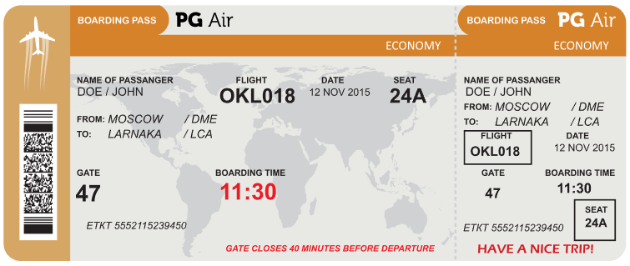
Potential problems with
client-server databases
What are the potential problems?
  Suppose several people are simultaneously trying to reserve the last few seats on an aeroplane … what could happen?

Slide 17
Record locking
Record locking prevents simultaneous access to objects in a database in order to prevent updates being lost or inconsistencies in the data arising
  The diagram shows what can happen without record locking,
With record locking, a record is locked when a user retrieves it for editing or updating
  Anyone else attempting to retrieve it is denied access until the transaction is completed or cancelled
User A copies record to memory, changes X’s address
A saves update
B’s changes lost!
User B copies record, changes X’s balance
B saves update

Slide 18
Serialisation and timestamp ordering
Serialisation is an alternative technique used to ensure that transactions do not overlap in time
It can be implemented using timestamp ordering
Every object in the database has a read timestamp and a write timestamp
These are updated whenever an object is read or written

Slide 19
Timestamp ordering
When a user tries to save an update, if the read timestamp is not the same as it was when they started the transaction, the DBMS knows another user has accessed the same object
  The transaction will be cancelled and a message
  “Update unsuccessful” sent to the user
Object timestamp
0905
Object
timestamp
0910… A cannot save update
User A copies record to memory, changes X’s balance
Object timestamp
0906
Object
timestamp
0910… B saves update
User B copies record, changes X’s balance

Slide 20
Commitment ordering
This is another serialisation technique to ensure that no transactions are lost if two clients are simultaneously trying to update a record
Transactions are ordered in terms of their dependencies on one another as well as the time they were initiated
  It can be used to prevent deadlock by blocking one request until another is completed

Slide 21
Plenary
You need to be able to :
write SQL statements to CREATE, ALTER, INSERT INTO, UPDATE, DELETE database tables and records
Describe what is meant by a client-server database management system
Describe methods of preserving the integrity of a multi-user client-server database

