Slide 1
AQA
    A Level
      Computer Science
      Paper 2
Systematic approach to problem solving
  Unit 11
  Databases and software development

Slide 2
Objectives
Describe aspects of software development
Explain the prototyping/agile approach that may be used in the analysis, design and implementation of a system
Understand what is meant by data modelling
Know the criteria for evaluating a computer system

Slide 3
Software development
Before a problem can be solved, it must be defined
An analyst will ask questions about:
  the data – origin, uses, volume, characteristics
  the procedures – what is done, where, when and how
  the future – development or expansion plans
  any problems with the existing systems

Slide 4
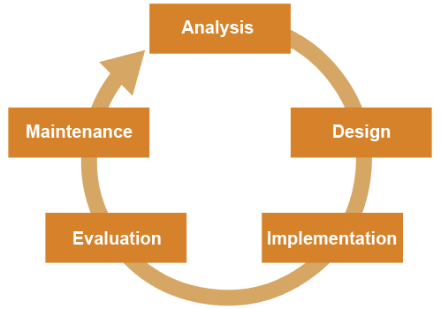
Traditional approach
In the “System Life Cycle” approach, each stage had to be completed before the next one could begin
  Often after a few years, the whole cycle started again as the system became out-of-date and technology developed

Slide 5
Agile approach
A more modern and flexible approach is to get constant feedback from the user throughout the development of a new system
Adjustments can be made at every stage
  Why might this be a better approach?

Slide 6
Advantages of the Agile approach
Often the user is not sure what is possible, so cannot clearly define requirements
Sometimes the analyst may misunderstand the user’s requirements or wishes
It is much easier to say what is wrong with a prototype version than to express in advance exactly what you are expecting
It is expensive and time-consuming to make changes to a finished product

Slide 7

Establishing requirements
The analyst must try to find out exactly what the user or users want in a new system
  This may involve interviewing users, observing the current system, and examining documentation
  Using an “agile” approach, the process of clarifying requirements may involve building a prototype

Slide 8
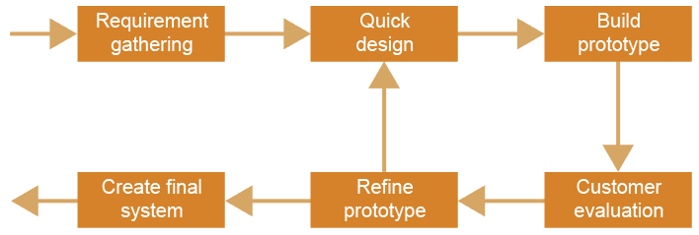
Prototyping – an iterative approach
At each stage, a prototype is built or developed,
with user participation

Slide 9
Success depends on…
keeping the model simple, and not trying to build in everything that might come in useful later on
regular feedback from the user
understanding that requirements may change during development as the user forms a clearer picture of what the final system will look like
being prepared to make incremental changes as development progresses

Slide 10

Application of iterative design
How might the choreography for backing dancers in a music video apply an iterative design approach?

Slide 11
Modelling data requirements
The data required of a new system needs to be organised and related in such a way that it represents the real world as closely as possible
This is often done through entity relationship modelling, OOP inheritances or by using graphs
  How might the relationships between colleagues in a school be represented?
  Is it strictly hierarchical?

Slide 12
Design
A modular structure is designed
Data structures are decided upon
The user interface is designed
Algorithms are designed
  How would prototyping be useful at this stage?
  What form might a prototype take?
  What functionality, if any, might it have?

Slide 13
Prototyping the design
Prototyping is very useful at the design stage
The user may be able to see, for example, what a proposed website will look like, and discuss with the designer what improvements could be made
  An iterative, incremental approach works well!

Slide 14

Getting it right…
Is this what the user had in mind?
Or is it back to the
drawing board?

Slide 15
Implementation
This stage involves coding the programs
User feedback will probably necessitate changes at this stage, so the systems developer and programmers have to be responsive and flexible

Slide 16
Testing
Different types of testing include:
  module testing
  system testing
  acceptance testing
Testing takes place using normal, boundary, and erroneous data
Acceptance testing is undertaken with or by the user of the system in the environment in which the system will be used, with realistic volumes of data

Slide 17
Evaluation
This may take place over a period of months
It allows users to evaluate the system on the basis of effectiveness, usability and maintainability
  Actual performance is compared with expected performance
  Unexpected benefits and problems may come to light
  Errors or omissions in the system may be discovered and corrected

Slide 18
Worksheet 5
Try the tasks on the worksheet

Slide 19
Plenary
The traditional “Systems Life Cycle” approach is no longer considered the best approach to systems development
Prototyping and the “Agile” approach is more flexible and better suited to modern computer systems
User involvement is considered key to success
Be sure you can describe these approaches and their advantages and disadvantages!

