Slide 1
3.1.2 Carbohydrates

Slide 2
Learning Objectives
Understand that monosaccharides are the monomers from which larger carbohydrates can be made.
Understand that glucose, galactose and fructose are common monosaccharides
Know that glucose has two isomers, alpha glucose and beta glucose and recall their structures.
Understand that condensation reactions produce disaccharides through the formation of glycosidic bonds to produce maltose, sucrose and lactose.

Slide 3
Learning Objectives
Understand that glycogen and starch are polysaccharides formed by the condensation of alpha glucose and that cellulose is formed by the condensation of beta glucose.
Understand the structures of glycogen, starch and cellulose are how they are well suited to their functions.
Recall the biochemical tests for reducing and non-reducing sugars and starch.
Understand how to use calibration curves to provide quantitative data on the concentration of unknown solutions.

Slide 4
What you should know from GCSE
Starch can be broken down into sugars

Slide 5
Preparatory Work
Sweet spot: Carbohydrates by Penguin Prof
https://www.youtube.com/watch?v=M6ZLDJluj6I

Slide 6
Questions
1. a) Short term energy storage (converted to ATP before cells actually use it as fuel), b) long term energy storage (glycogen in animals, starch in plants), c) structural.
2. Hydrated carbon atoms
3. C, H and O (in a ratio 1:2:1)
4. – ose
5. Mono = one, saccharide = sugar
6. Disaccharide
7. Table sugar

Slide 7
Questions
8. Malt sugar (beer!), Milk sugar
9. Polysaccharides
10. Glycogen
11.
 | Nutritional Sources
Monosaccharides | Fruits, berries, vegetables, honey
Disaccharides | Table sugar, sugar beets, sugar cane, fruits, milk
Starchy Polysaccharides | Cereals, whole grains, rice, pasta, potatoes, peas, corn, legumes
Non starchy polysaccharides | Dietary fibre such as cellulose, found in leafy greens

Slide 8
Question
12. The glycemic index measures how blood glucose levels change following the ingestion of carbohydrate. The number typically ranges between 50 and 100, where 100 represents the standard, an equivalent amount of pure glucose (exam question available on GI)
13. High
14. Low

Slide 9
Structure of Carbohydrates

Slide 10
Carbohydrates
There are 3 main classes:
Monosaccharides (single sugars)
Disaccharides (double sugars)
Polysaccharides (many sugars)

Slide 11
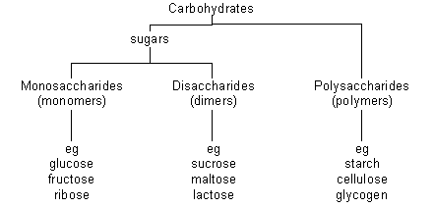
soluble and sweet
insoluble

Slide 12
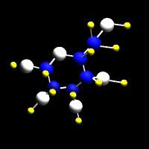
Monosaccharides
General formula: (CH2O)n
Named according to the number of carbon atoms
If n=3 - triose e.g. glyceraldehyde
If n=5 - pentose e.g. deoxyribose, ribose
If n=6 - hexose e.g. fructose, glucose, galactose
Generally monosaccharides are used for
Energy
As building blocks (monomers) for polysaccharides

Slide 13
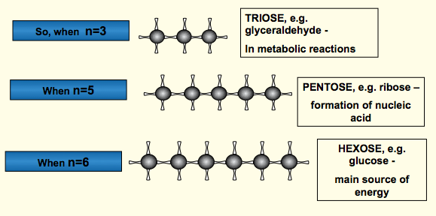
Functions Monosaccharides

Slide 14
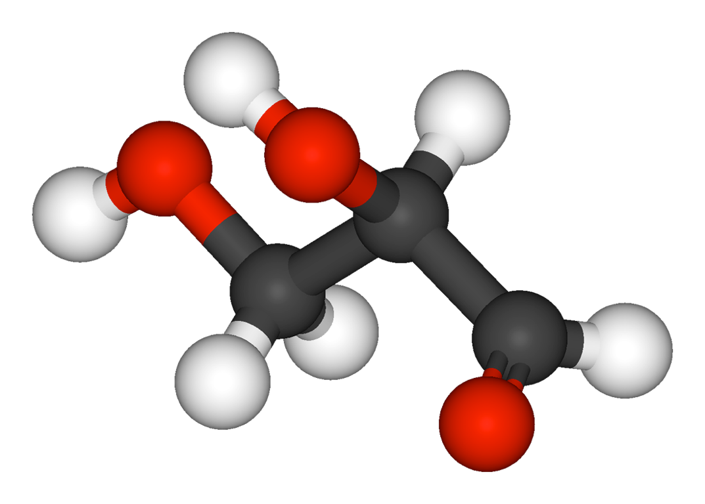
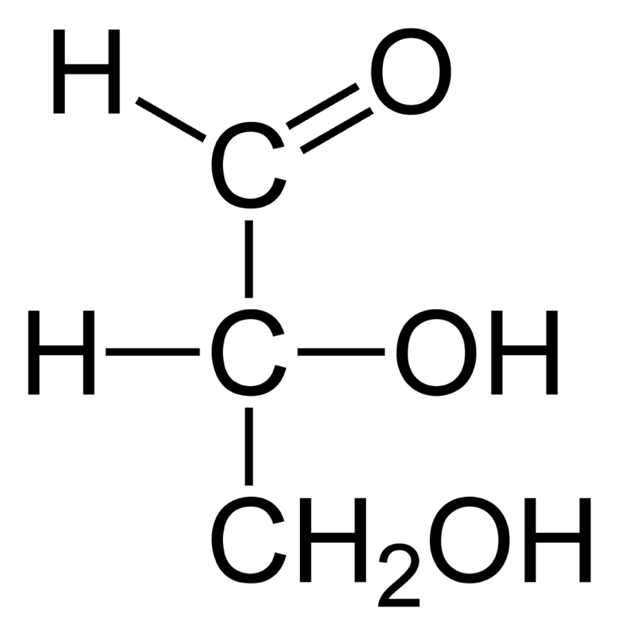
What type of monosaccharide is this molecule? What is its name?
Plays a role in respiration (glycolysis)

Slide 15
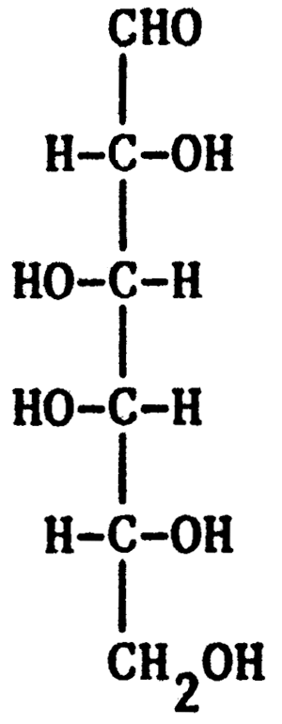
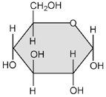
What type of monosaccharide is this?
Important as an energy source for cells
and to form important structural and storage polymers.

Slide 16
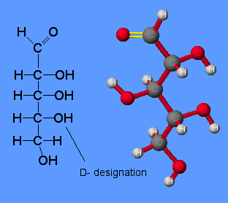
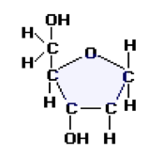
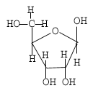
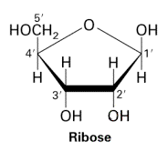
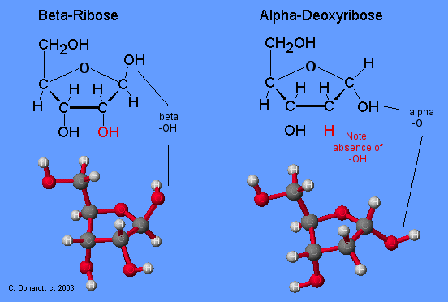
What types of monosaccharide are these?

Slide 17
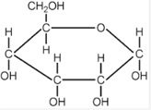
What type of monosaccharide is this?

Slide 18
Numbering of Carbons in Glucose
Perhaps the most important hexose is glucose
Students need to learn to draw
6
CH₂OH
The carbons in a glucose ring are numbered clockwise from the oxygen atom.
5
H
C
O
H
H
C
C
1
4
OH
H
HO
C
C
OH
3
2
H
OH

Slide 19
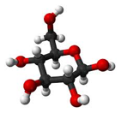
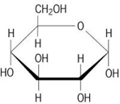
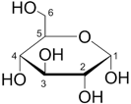
Glucose can be represented in many different ways
You should be able to recognise any representation!

Slide 20
Alpha and Beta Glucose
Glucose itself can exist as isomers, α & β glucose
OH
An Isomer = Same chemical formula, Different structural formula
B
a
hydroxyl
group up
or down
OH

Slide 21
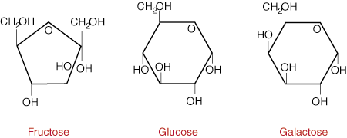
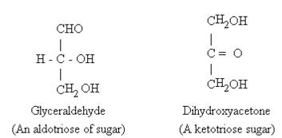
Two further isomers of glucose
What are the differences?

Slide 23
Disaccharides
Formed from two monosaccharide units (monomers)
Joined by a glycosidic bond (A type of covalent bond)
Through a condensation reaction
http://www.biotopics.co.uk/as/disaccharideformation.html
Formula: Cn(H2O)n-1 for disaccharides where n = the number of carbon atoms

Slide 24
Forming Disaccharides
Glucose
CH₂OH
CH₂OH
CH₂OH
C
O
H
C
O
H
H
H
H
C
H
C
C
C
OH
H
OH
H
OH
C
C
OH
OH
C
C
OH
H
OH
H
OH
Maltose
CH₂OH
CH₂OH
H
C
O
H
H
C
O
H
C
H
C
C
H
C
OH
H
OH
H
OH
C
C
OH
O
OH
C
C
OH
O
H
H
H
OH
Glycosidic
Bond
OH
H
This is a CONDENSATION reaction, where a water molecule is lost.

Slide 25
Forming a disaccharide
C
C
C
O
C
O
C
C
C
C
C
C
OH
OH
C
C
two alpha glucose molecules (monomers)

Slide 26
Forming a disaccharide
C
C
C
O
C
O
C
C
C
C
C
C
OH
OH
C
C
The hydroxyl groups on C1 of one molecule and C4 of the other molecule react

Slide 27
Forming a disaccharide
C
C
C
O
C
O
C
C
C
C
C
C
O
C
C
H₂O

Slide 28
Forming a disaccharide
C
C
C
O
C
O
C
C
1
4
C
C
C
C
O
C
C
producing a disaccharide
with a 1,4 glycosidic bond

Slide 29
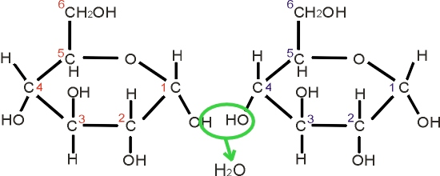
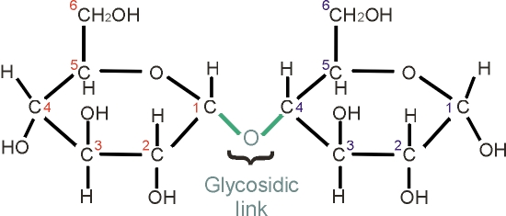
alpha glucose
reacts with
alpha glucose
Have a go
at drawing the
reaction on a white
board.
Then try
Glucose + fructose
(in your work
booklet)
and write
the word equation
for the formation of
Lactose.
forming the disaccharide called
or bond
maltose (what’s the formula of maltose?)

Slide 30
Summary: 3 Disaccharides you should know
A disaccharide can be made from two of the same monosaccharide molecule or from two different ones.
The combination of monosaccharides determines which disaccharide is formed.
MONOSACCHARIDES
DISACCHARIDE
GLUCOSE
GLUCOSE
GLUCOSE
WATER
WATER
WATER
MALTOSE
SUCROSE
FRUCTOSE
LACTOSE
GALACTOSE
GLUCOSE

Slide 31
Disaccharides: Word Equations
glucose + glucose → maltose + H2O
glucose + galactose→ lactose + H2O
glucose + fructose→ sucrose + H2O

Slide 32
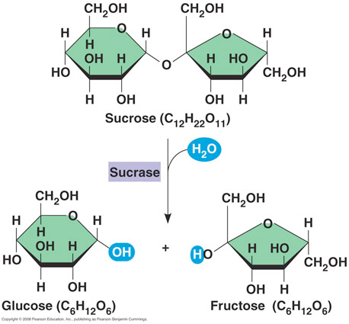
Condensation reactions can be reversed.
The chemical insertion of a molecule of water can result
in a disaccharide being split into its constituent monosaccharides
Enzymes involved in hydrolysis are
Amylase, maltase
Sucrase and lactase.
Hydrolysis

Slide 33
Food Tests: Reducing Sugars
All monosaccharides and two disaccharides (maltose and lactose) are also referred to as reducing sugars
With heat, they can reduce the blue copper sulphate in Benedict’s solution to red copper oxide
How? Cu2+ ion gives Benedict’s solution its blue colour.
The colour change is caused by the sugar donating an electron to the Cu2+ ion reducing it to Cu+
Cu+ is a red colour
Remember OIL RIG?: Reduction = gain of electrons - so the sugar is a reducing sugar.

Slide 34
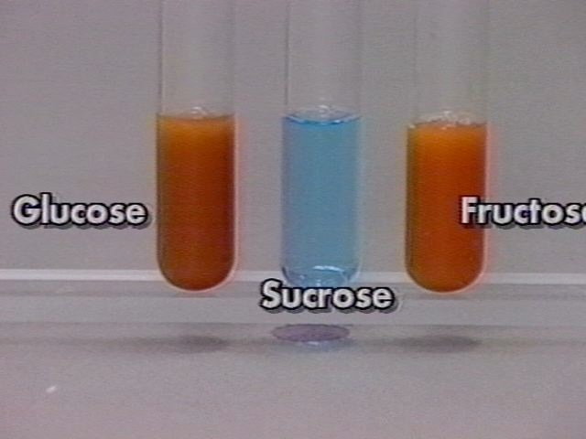
Method: Add an equal volume of Benedict’s reagent (blue) to the solution being tested and heat in a water bath (95-100 degrees C). If a reducing sugar is present then it will gradually turn through green, yellow and orange until a brick red precipitate forms.
A qualitative or quantitative test?
Results from Benedict’s Test

Slide 35
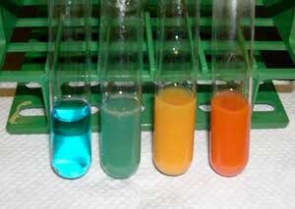
The colour of the precipitate depends on the concentration of reducing sugar
Zero reducing sugar = blue
(sucrose for example)
0.5% reducing sugar = green
1.0% reducing sugar = yellow
2% reducing sugar = brick red
Why is it not possible to distinguish between very concentrated
samples, even when their concentration is different?

Slide 36
Calibration Curves
Student Activity
Page 9 and 10 in booklet
Read information and answer questions
Need graph paper to plot calibration curve for data in table.

Slide 37
Test for Non Reducing Sugars
All disaccharides, except for maltose and lactose, are also referred to as non-reducing sugars. (Therefore in this spec, sucrose is the only disaccharide that is a non reducing sugar).
They cannot reduce the blue copper sulphate in Benedict’s solution

Slide 38
Method for Non reducing sugars
Add Benedict’s solution to sample and heat - negative result, no reducing sugar present
Heat with hydrochloric acid
Acid hydrolyses the disaccharide
Add an alkali (sodium hydrogen carbonate) to neutralise the acid (Benedict’s solution will not work in acidic conditions)
Retest sample with Benedict’s solution
Red precipitate shows non reducing sugar was present in sample

Slide 39
Polysaccharides
Polymers are formed from three or more monosaccharides (monomers) joined with glycosidic bonds
Two main types: Storage (starch and glycogen) and structural (cellulose)

Slide 40
Forming polysaccharides
Glucose
CH₂OH
CH₂OH
CH₂OH
CH₂OH
H
C
O
H
H
C
O
H
H
C
O
H
H
C
O
H
C
H
C
C
H
C
C
H
C
C
H
C
OH
H
OH
H
OH
H
OH
H
OH
C
C
OH
O
OH
C
C
OH
O
OH
C
C
OH
O
OH
C
C
OH
O
O
O
H
OH
H
H
H
OH
H
H
H
OH
H
H
H
OH
In this example, 3 condensation reactions have produced 3 water molecules to produce the polysaccharide.
A HYDROLYSIS reaction (addition of water) reverses the reaction and splits the polysaccharide releasing 3 monosaccharide molecules.

Slide 41
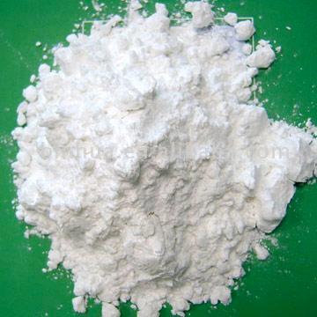
Starch
Role: Insoluble store of glucose in plants
A mixture of two glucose polymers: amylose & amylopectin

Slide 42
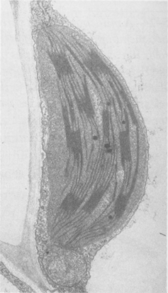
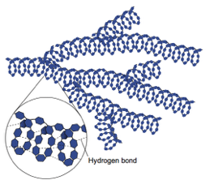
Starch
Amylose Structure
(a linear molecule with no branches)
Around 1000 or more
α glucose monomers
with 1,4 glycosidic bonds
Forms a spiral structure
because of the angle of the glycosidic bond.
H bonds hold the structure
in place

Slide 43
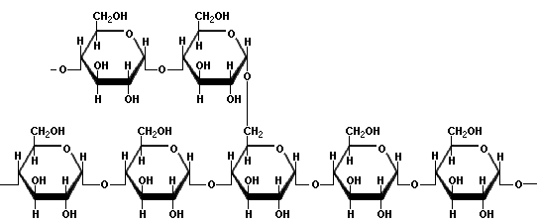
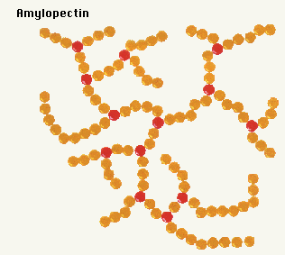
Amylopectin
α glucose monomer
with 1,4 and some 1,6
glycosidic bonds (every 25
Units)
Giving a Branched,
open structure

Slide 44
Relating Structure to Function
Compact shape takes up little space, but large and insoluble and so does not diffuse out of cells.
Insoluble – therefore does not affect water potential, so water is not drawn into the cells by osmosis.
Easily hydrolysed to glucose for respiration (by amylase)

Slide 45
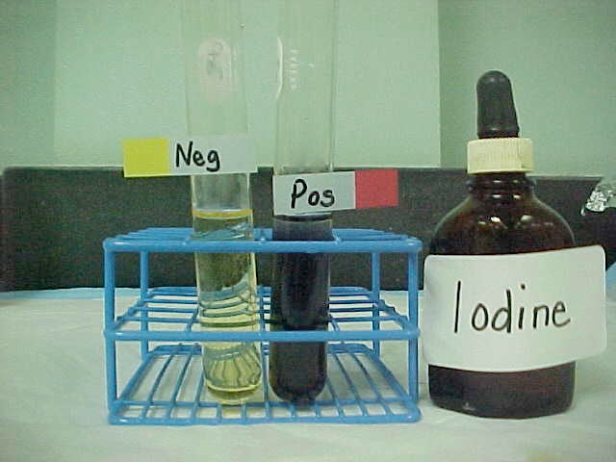
Test for starch - 2/3 drops
Iodine

Slide 46
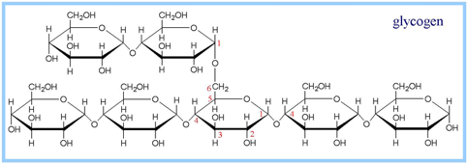
Glycogen
Role: an insoluble, compact store of glucose in animals, found mainly in muscle and liver
Alpha glucose units
1,4 and 1,6 glycosidic bonds

Slide 47
Structure and Function
Compact shape takes up little space
Insoluble - therefore osmotically inert and does not diffuse outside of cells
Easily hydrolysed to glucose for respiration (by amylase) because more branches than starch and so more of the ends can be worked on simultaneously by enzymes.
Speed of hydrolysis important because animals have a higher metabolic rate than plants.

Slide 48
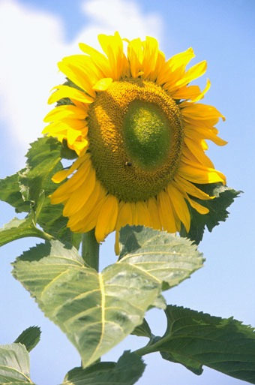
Cellulose
O
O
O
O
O
Role: Structural polysaccharide in plants
Made from Beta glucose
1,4 glycosidic bonds
long parallel chains
H-bonds link adjacent chains

Slide 49
White Boards
Draw two Beta glucose units side by side
Try and react them
What’s the problem?

Slide 50
Linking of β-Glucose Molecules
When Beta glucose molecules link together by condensation reactions one has to rotate by 180 degrees
H
O
OH
H
O
OH
+
HO
H
HO
H
H
O
OH
HO
H
HO
H
H
O
OH

Slide 51
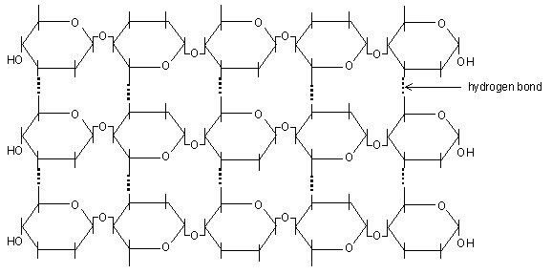
Cellulose -poly 1- 4 glucose but with beta glucose
This difference leads to parallel, straight chains that bundle together because of the formation of H bonds between hydroxyl groups in adjacent chains. These bonds cannot form between alpha glucose units because they are not rotated

Slide 52
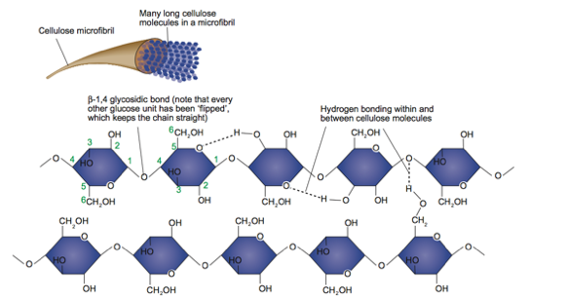

Slide 53
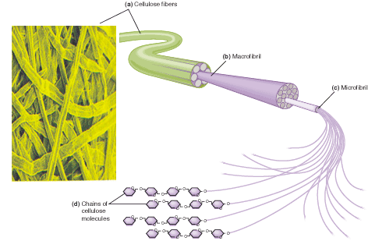
60 -70 cellulose molecules become tightly cross linked to form bundles called Microfibrils. These join together with other microfibrils to form a macrofibril which bundle together to form cellulose fibres. The cell wall has multiple layers of fibres running in different directions to increase strength. Microfibrils are very strong and rigid and give huge structural stability to the plant

Slide 54
Cut and paste activity
The sheet gives you all of the elements to make starch, glycogen and cellulose
Cut and paste with arrows and labels

Slide 55
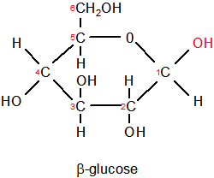
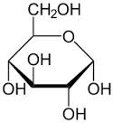
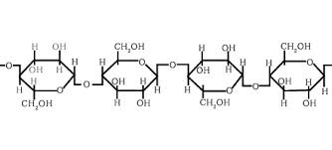
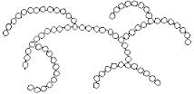
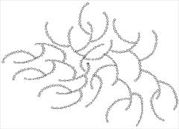
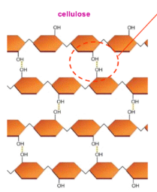
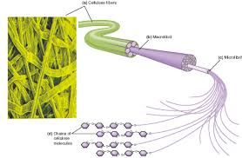
Cut and Paste Activity Solution
α glucose
+
Hydrogen bond
Amylopectin
Amylose
glycogen
Starch
PLANTS
ANIMALS
Cellulose

